Slide 1
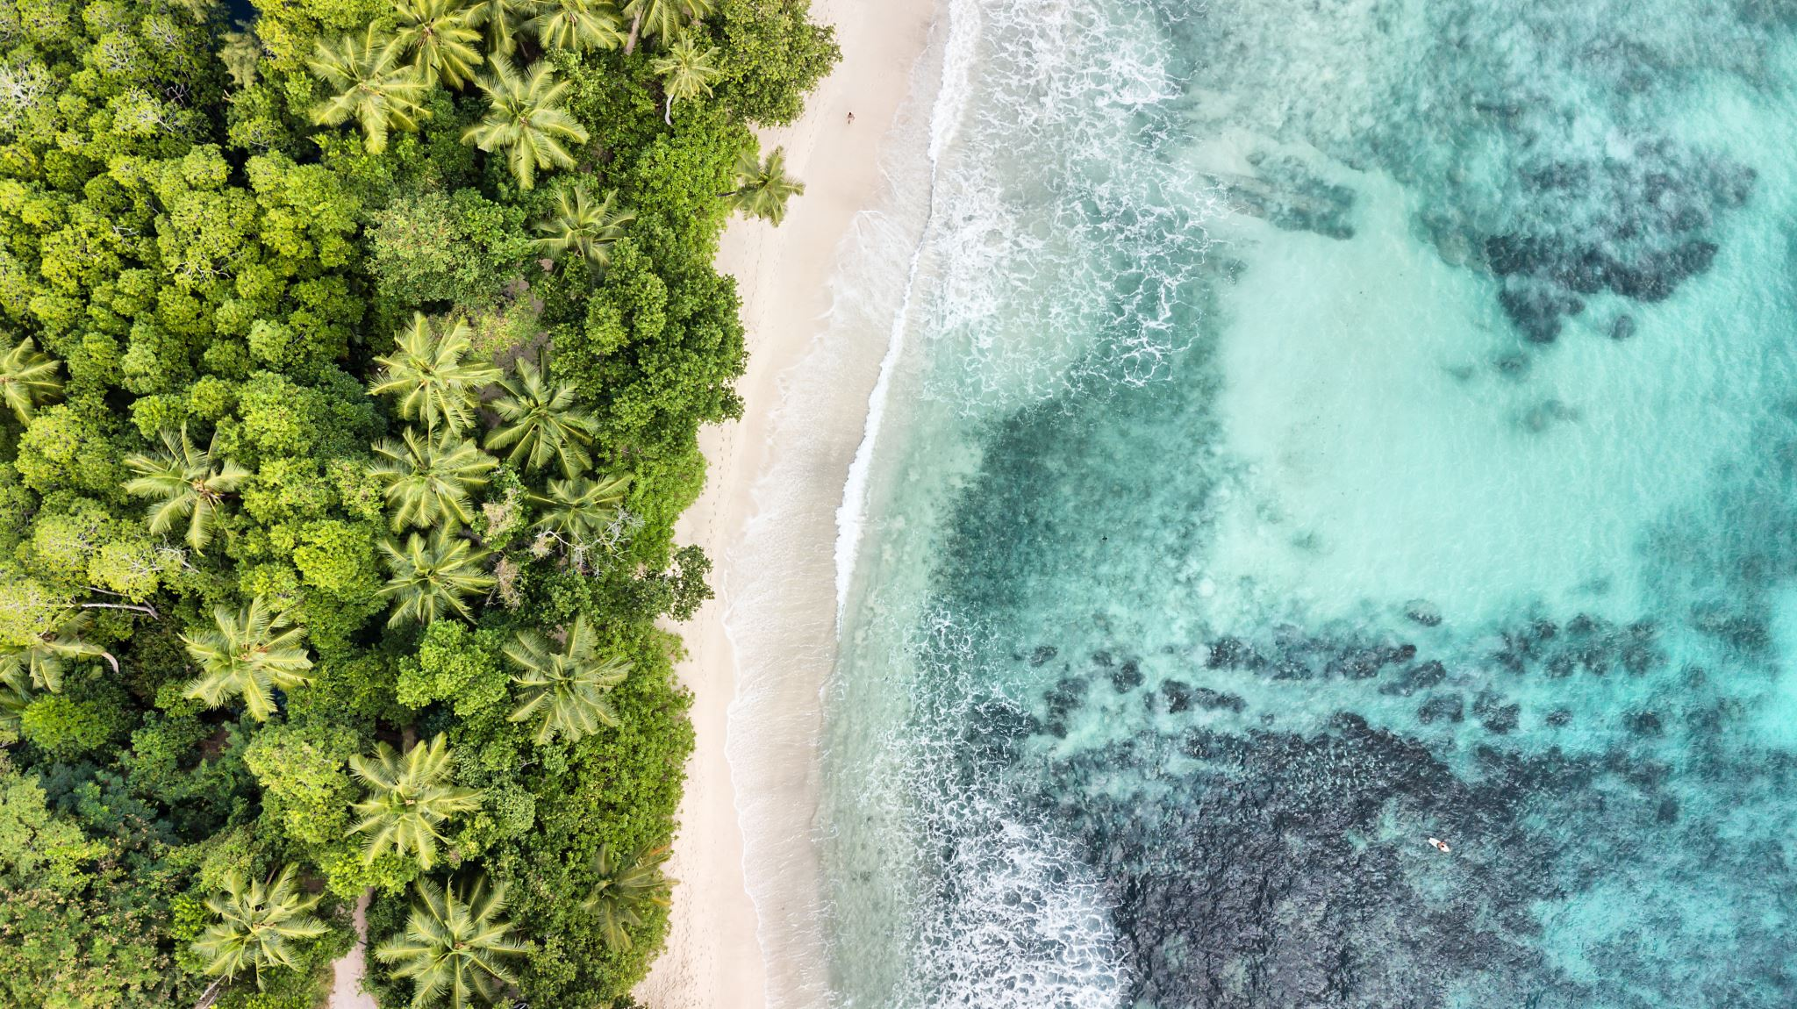
On the beach

Slide 2
On the beach you will see the sea! Listen – can you hear the waves? You might even splash in the sea!
https://www.youtube.com/watch?v=f77SKdyn-1Y&t=272s
Feel water with hands / feet

Slide 3
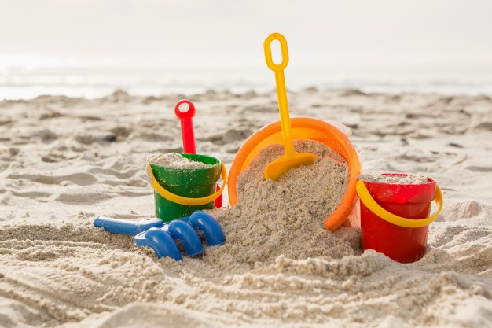
On the beach you might walk on sand – can you feel the sand on your hands a feet? You might build a sandcastle!
Explore the feel of sand or sand like materials

Slide 4
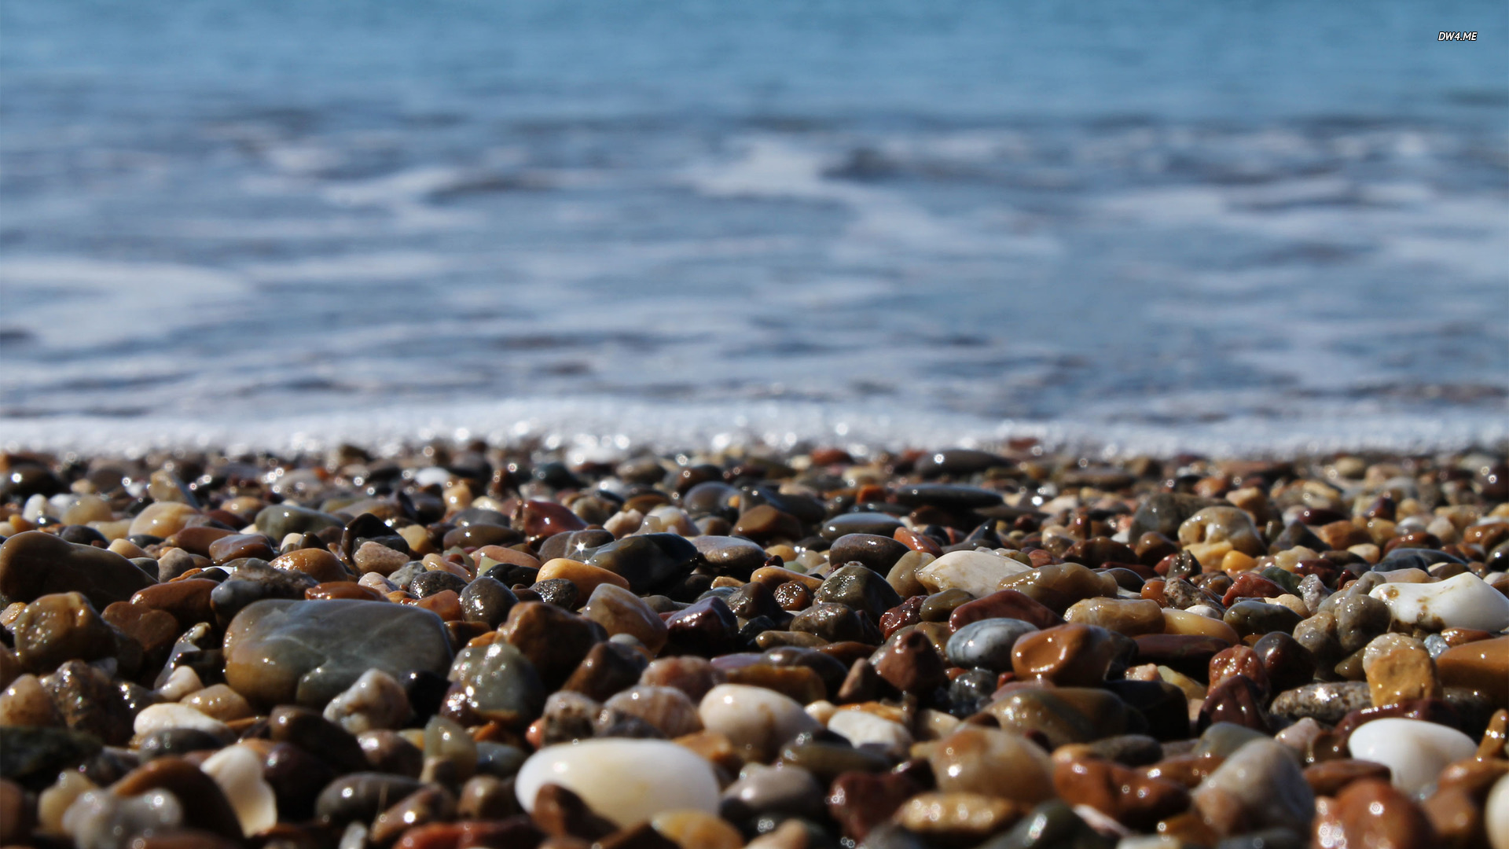
Or you might walk on pebbles – can you feel how smooth they are? Listen to the sound when you tap them together.
Explore the feel of pebbles / stones. Tap them together to make a sound.

Slide 5
Listen! Can you hear the seagulls?
https://www.youtube.com/watch?v=lP7K8tf6kT8
Explore the feel feathers or feathery materials.

Slide 6
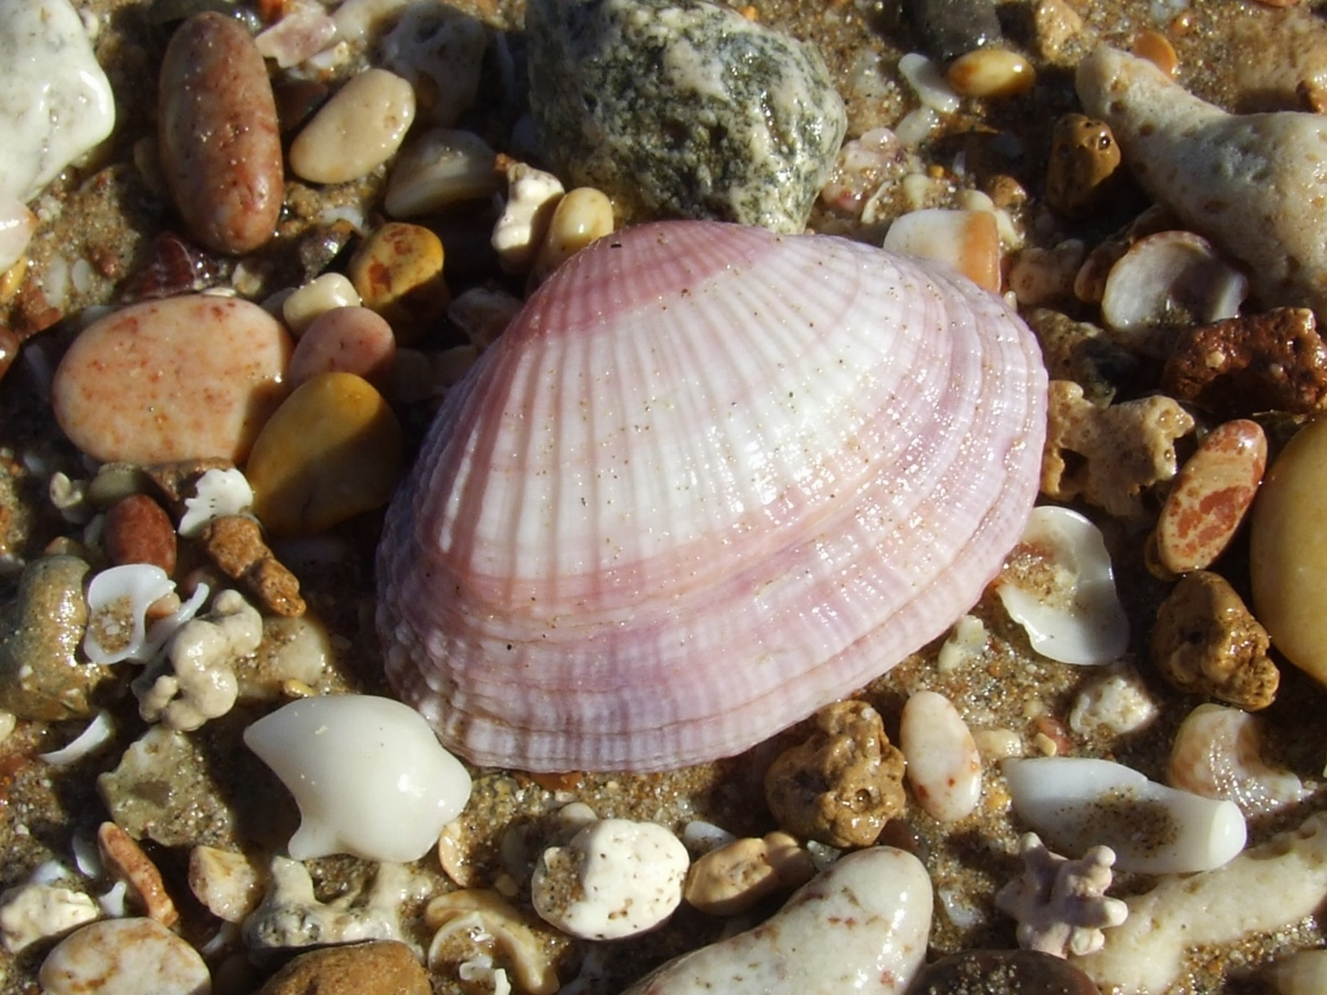
Look in the sand, what can you find? It’s a shell!
Explore the feel of shells.

Slide 7
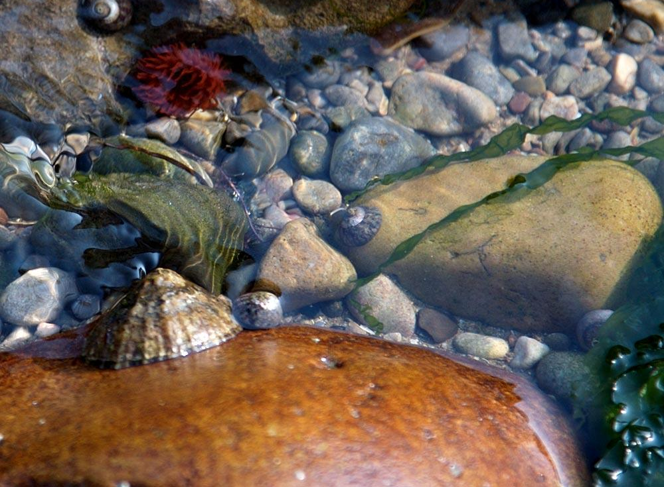
Look in the rock pool – what animals can you see?
https://www.youtube.com/watch?v=lWCQoCurPOY
Put water in a bowl with pebbles and plastic sea creatures – look on the next slides to watch the youtube videos

Slide 8
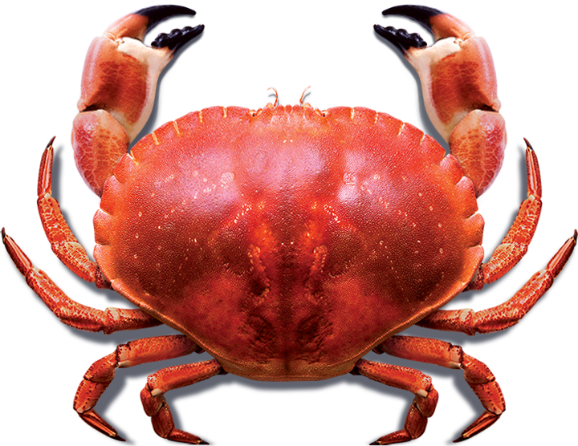
A Crab!
https://www.youtube.com/watch?v=xB74swq2LlI
Shell, plastic crab or make bounce hand movements on your child’s body.

Slide 9
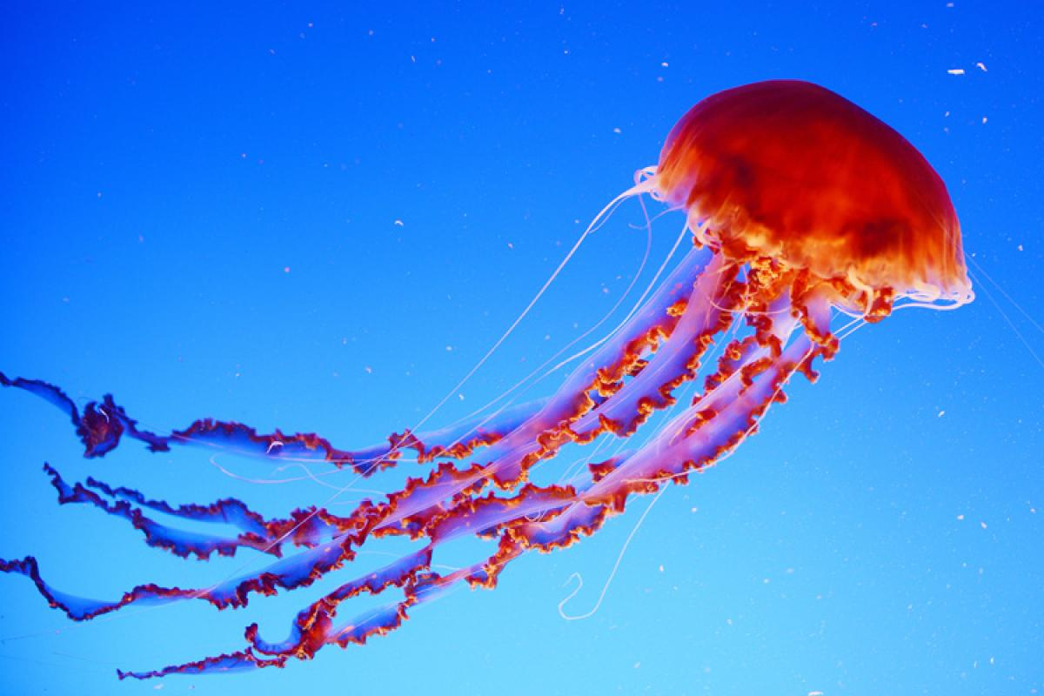
A jellyfish!
https://www.youtube.com/watch?v=gdJjc6l6iII
Drape coloured strands of material on your child.

Slide 10
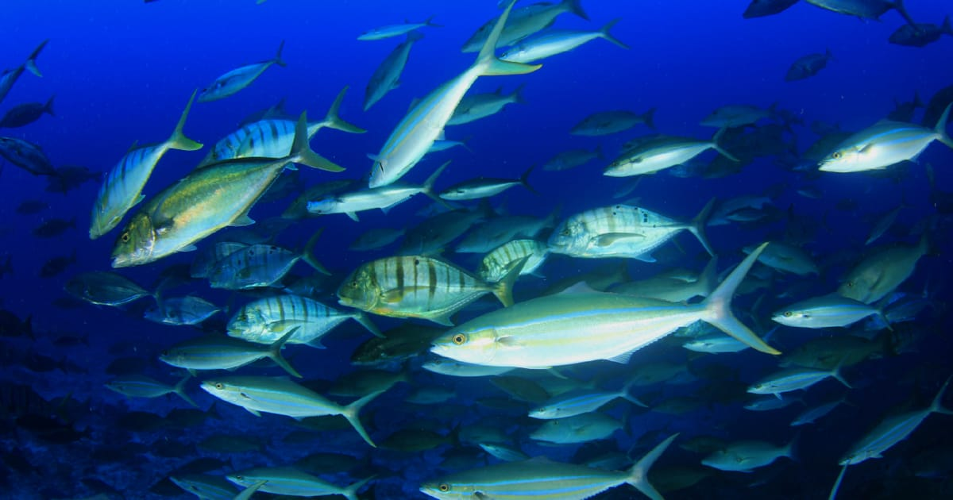
Fish!
https://www.youtube.com/watch?v=g_G6hVvOaGU&t=648s
Plastic toy fish, or ‘wave’ hand movements on your child.

Slide 11
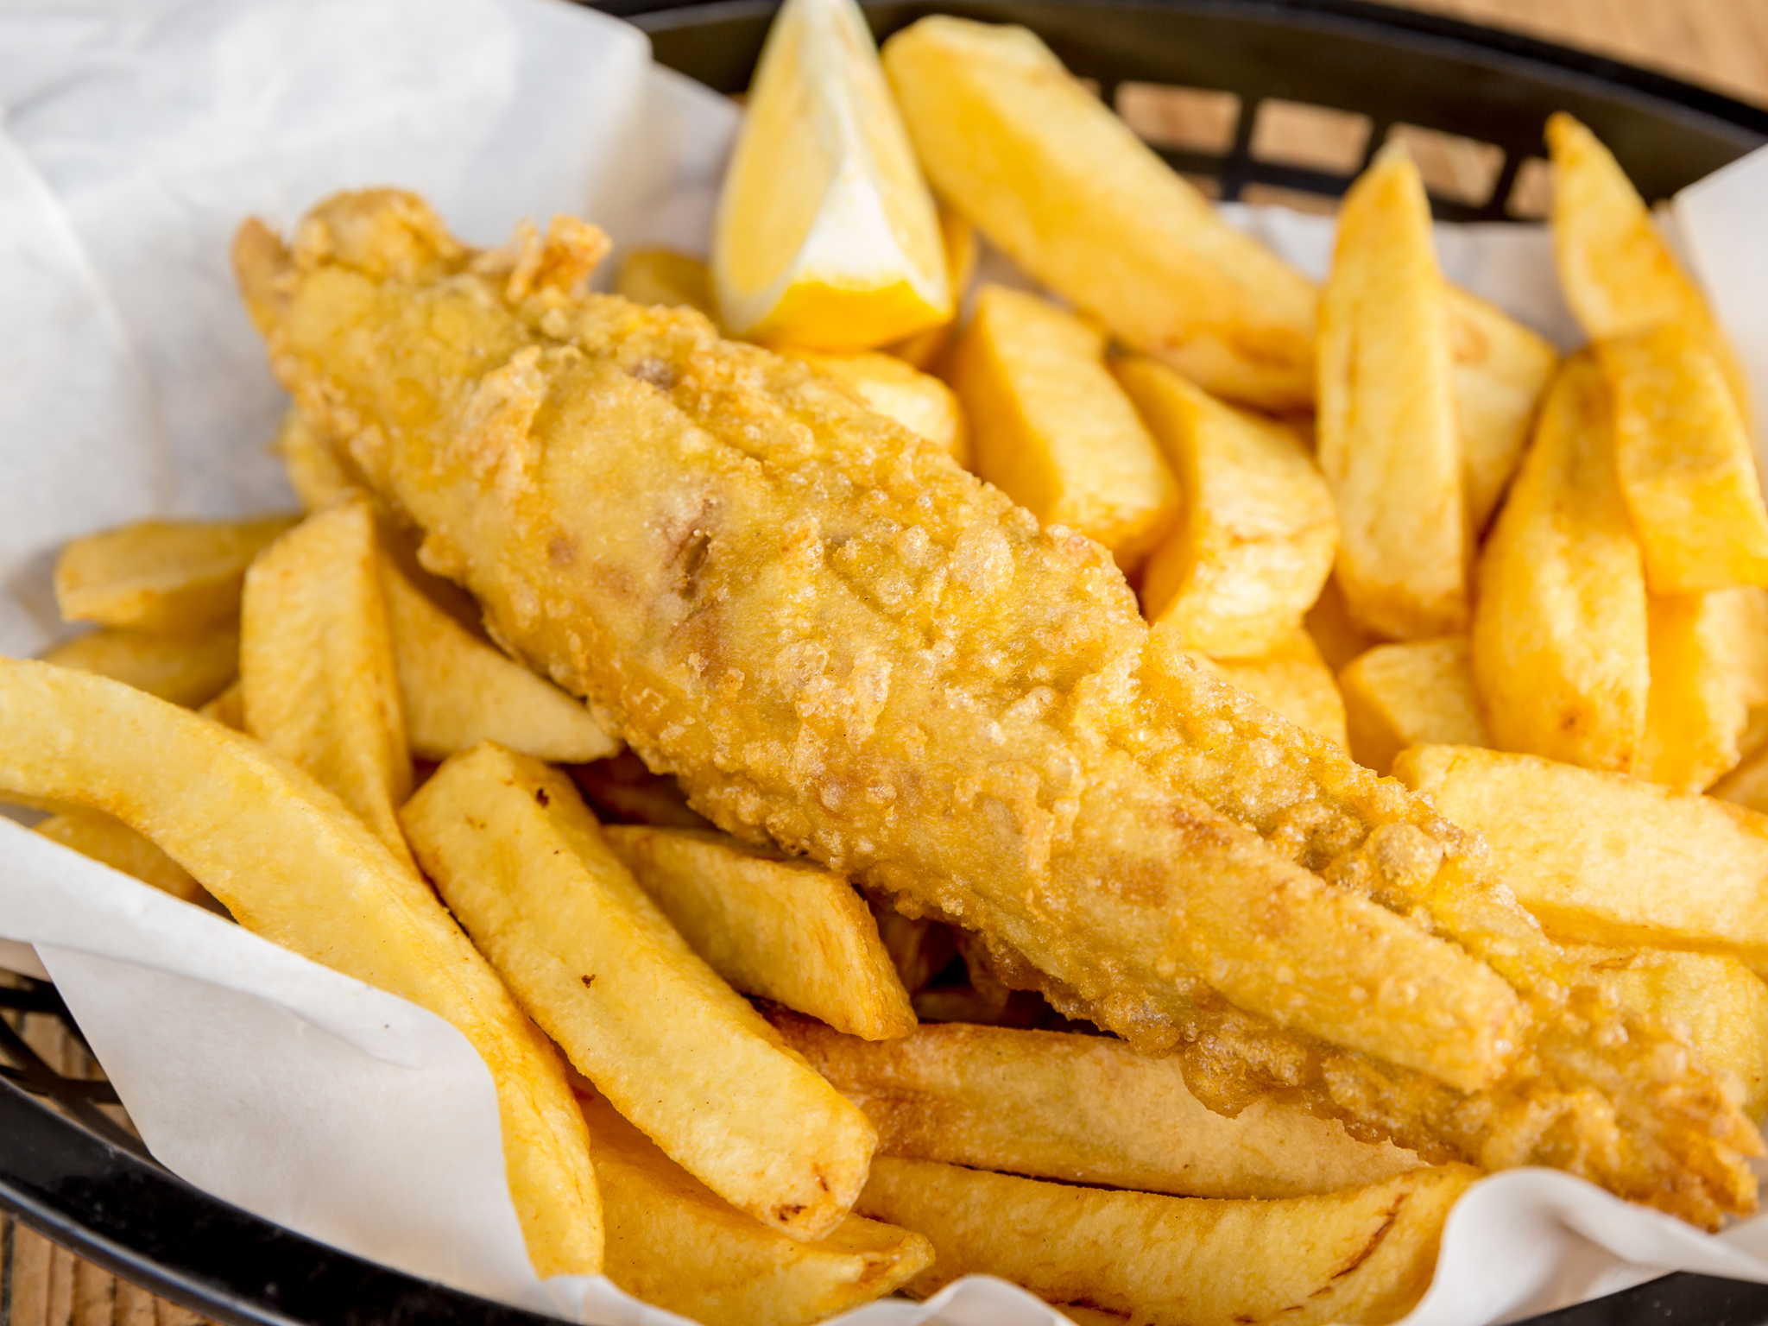
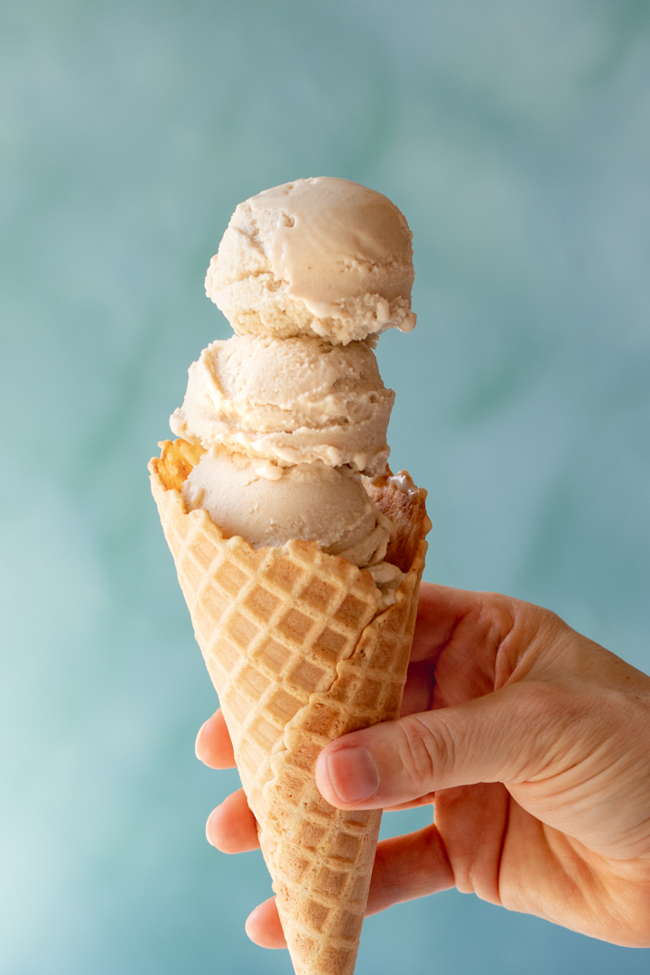
It’s time for dinner – can you smell the fish and chips? Yum! Maybe we could have an ice cream for pudding!
Children to smell vinegar or tomato ketchup. Smell/feel/taste icecream

