Slide 3
Resource: Plastic duck or a feather
She’d spent a long time making everything neat
For a special young duck she was longing to meet…
Down by the bulrushes, tucked in a nest,
Lay Brenda the duck, who was having a rest.

Slide 4
Resource: Shredded paper / sticks
She’d cared for her egg since the day it was laid
She looked at her friends who had nested nearby
And she gazed at their eggs with a sorrowful sigh.
And she loved it, despite its uninteresting shade.
Resource: Egg

Slide 5
For all of the others had eggs that were bright,
With colourful patterns; not boring and white.
She listened as other ducks gloated with glee,
As they dreamed of how special their ducklings would be.

Slide 6
Resource: Blue material
“My egg is so blue,” Brenda heard Betty boast,
“My baby will turn out much wiser than most.
With feathers azure like the sparkling sea,
What a dazzling creature my duckling will be!”

Slide 7
Resource: Gold material
Then Gretchen went by with a satisfied grin,
“My glistening egg holds a starlet within.
Brimming with confidence, charming and bold,
Its feathers will twinkle with shimmering gold.”

Slide 8
Resource: Pink material
“My egg is so frilly, it’s pink and it’s white,”
Said Penny one day, as she gleamed with delight.
“My duckling is sure to be talk of the lake;
Creative and talented, make no mistake.”

Slide 9
Brenda felt sad that her egg was so plain,
As the other ducks stared at her nest with disdain.
She worried her duckling could never compete
When its friends were so gifted, the world at their feet.

Slide 10
Resource: Plastic egg (slowly open it up to show small chick inside)
At sunrise, while Brenda lay snuggling her egg,
It started to crack…
She said, “Well it might not be shiny or blue
But I know that my duckling is loved through and through.
I’ll teach it to share and to always be kind,
For a kind duck’s the best duck you ever will find.”
and then out popped a leg!

Slide 11
Resource: Quacking sound
And then, sure enough, came a series of cracks
As the ducklings were born in a flurry of quacks.
A duckling emerged with the softest of down,
Which was coloured a beautiful yellowy brown.
Resource: Feather / soft material

Slide 12
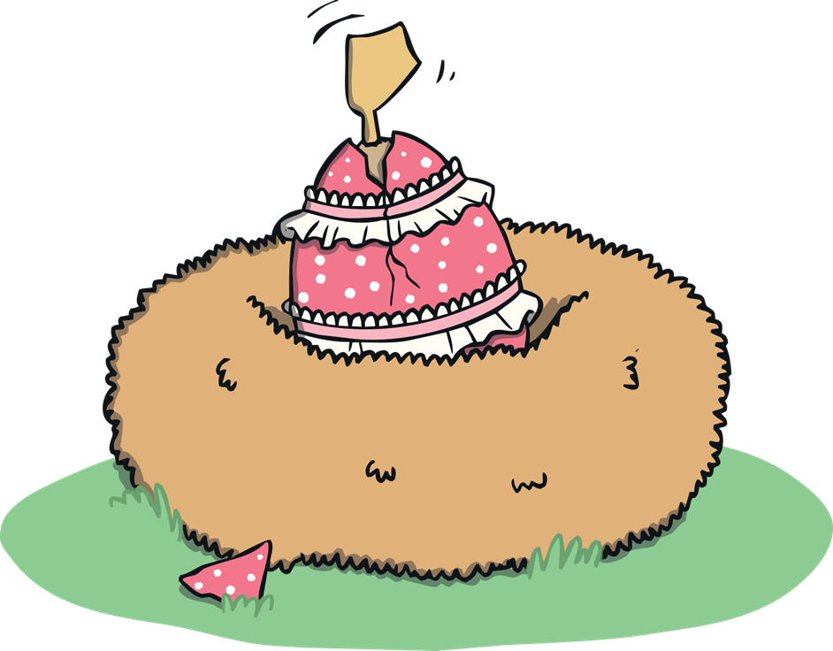
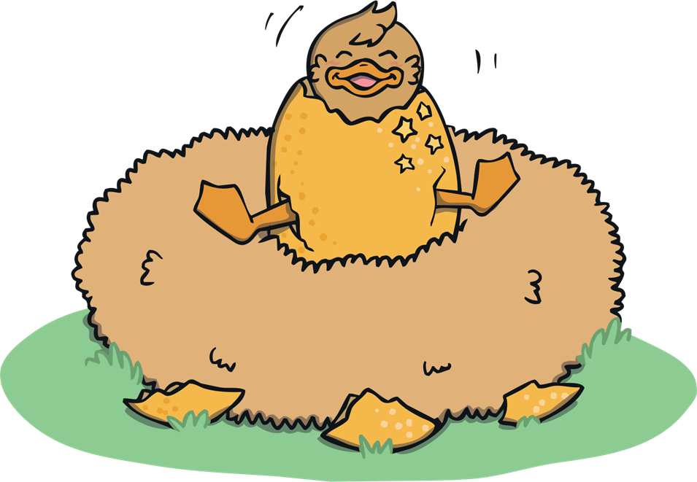
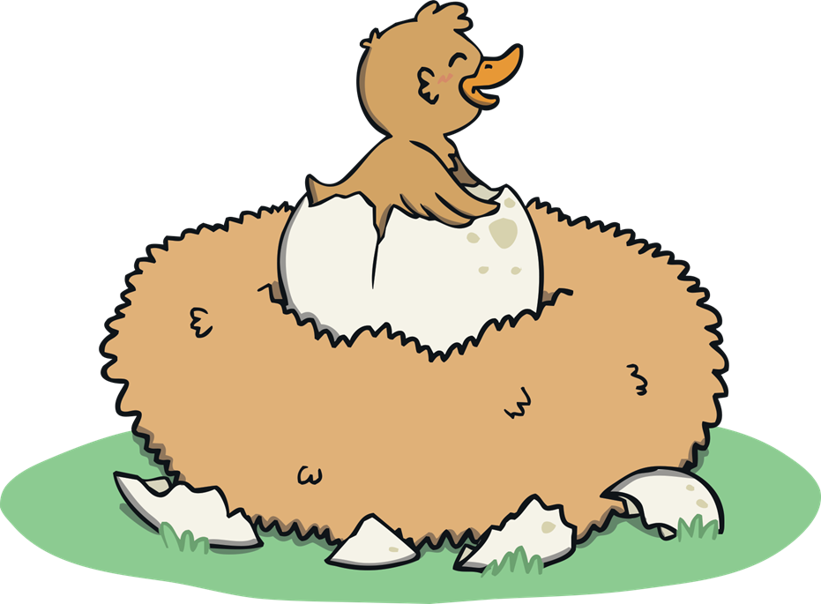
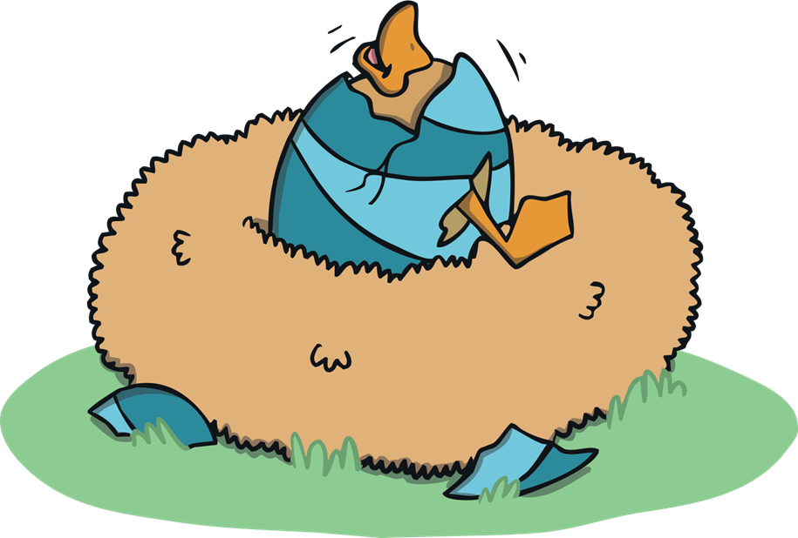
The pink one…
the shimmering gold…
But the ducklings were not as their mummies had told!
the blue one…
No feathers of rainbow, no silvery trims,
Just four fluffy ducklings...
Resource: Blue, pink, gold materials and/or 4 plastic ducks

Slide 13
Resource: 4 plastic ducks
…two hers and two hims!
The mummy ducks gasped as the ducklings all hatched.
Their beaks looked the same and their feathers were matched.
None of them glittering, none of them chic,
But each of them special and each one unique.

Slide 14
The ducks were now sorry and felt very bad
That their boasting and gloating had made Brenda sad.
All thoughts of the eggshells were now cast aside
As their hearts started bursting with love and with pride.
The eggs they had nurtured were lovely, for sure,
But the ducklings inside mattered very much more.
They waddled and played as the mummies looked down
At their cute little ducklings of yellowy brown.

