Slide 1
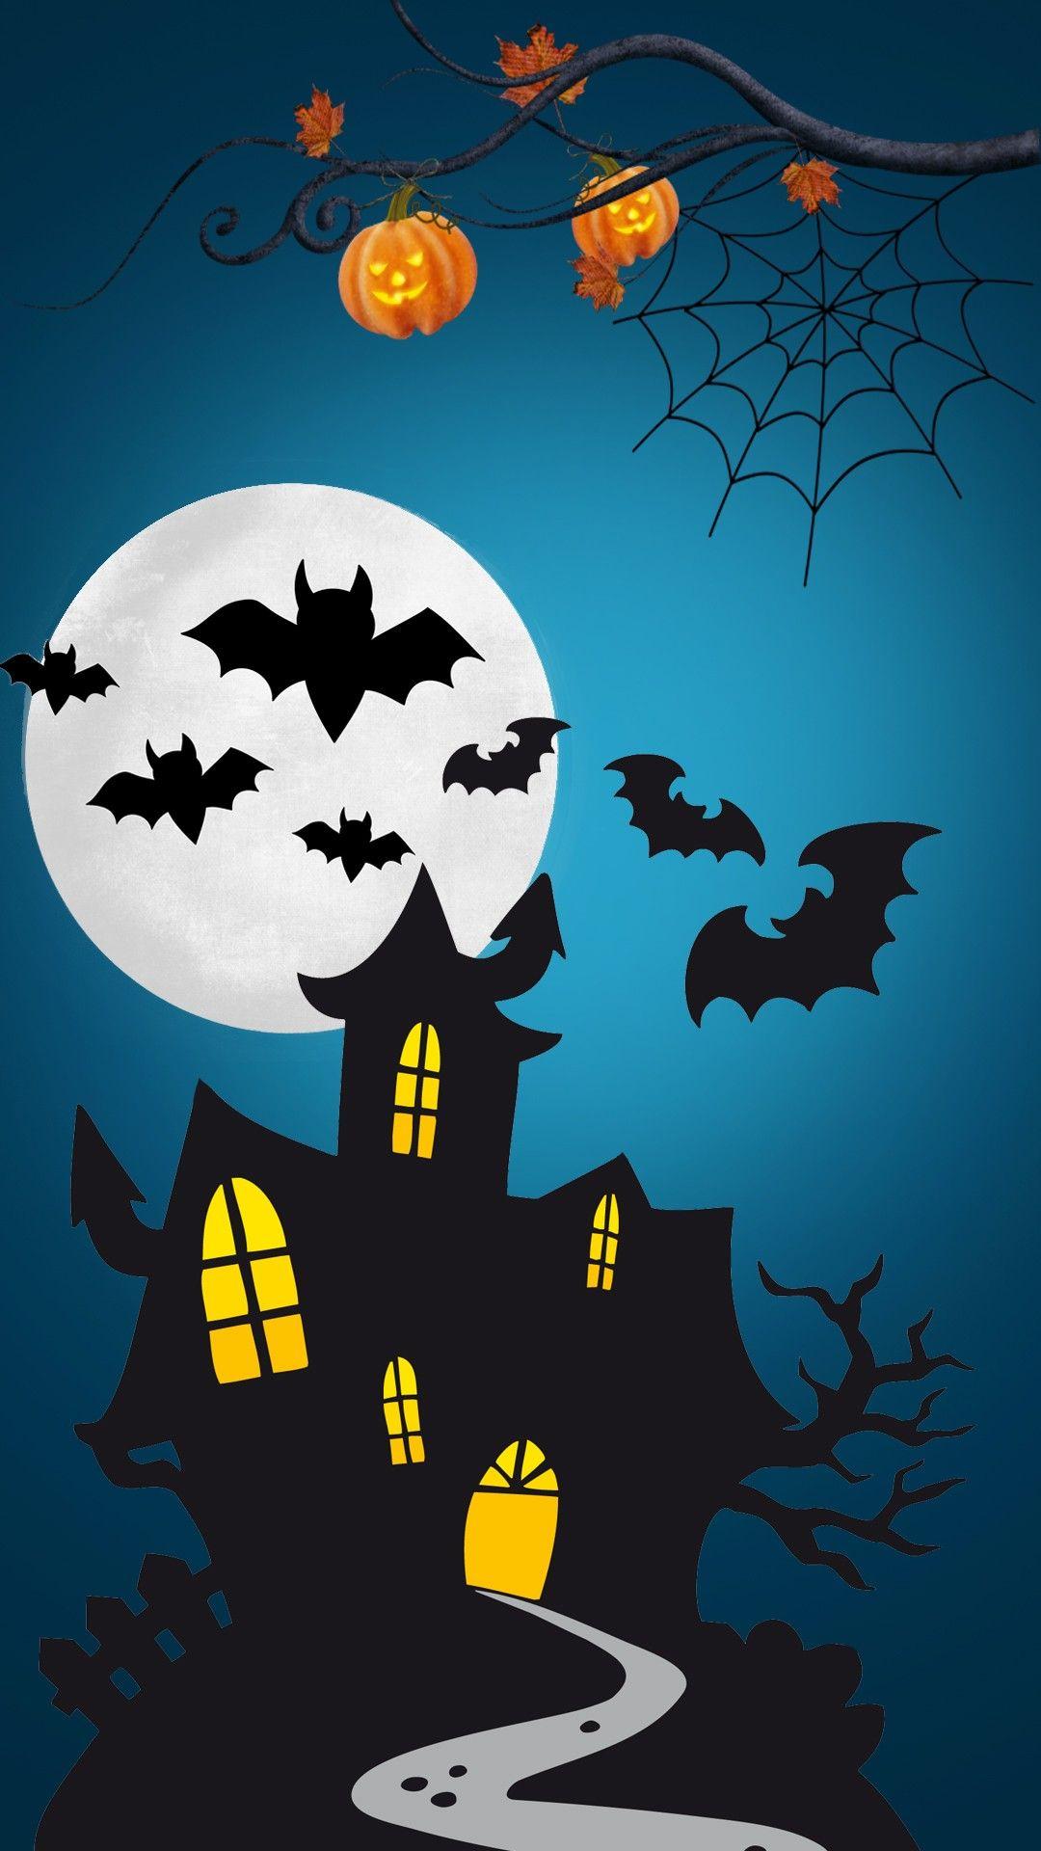
Halloween Sensology

Slide 2
Resources
Say hello: Mirror
Touch: cobwebs and spiders
Smell: mixed spice
Taste: biscoff spread
See: ghost light toy, skeleton, bat and ghosts
Sound: laughing and whistling

Slide 3
Say hello….
Encourage each child to look at themselves in the mirror. Begin by talking to them about the parts of the body they can see in the mirror (head, eyes, nose, ears etc) and then move on to point/tap to other parts of their body such as their arms, legs, hands, feet etc.
Sing the song ‘This is me’ – support each child to pat each part of their body
https://www.youtube.com/watch?v=QkHQ0CYwjaI

Slide 4
Story Massage:
In the Haunted Woods it was deep and dark (The Fan)
The trees were rustling in the howling wind (The Sideways Wave)
The ghosts were floating through the trees (The Sprinkle)
And the moonlight flickered between their leaves (The Bounce)
The bats were flapping in the moonlit sky (The Circle)
While spiders scurried in their glistening webs (The Walk)
Rats were squeaking around their feet (The Claw)
And the raindrops dripped upon our clothes (The Sprinkle)
We hug each other to keep us safe (The Squeeze)
Lucky we are together so we’re NOT SCARED (The Drum)
It’s not so haunted in the night time woods! (The Calm)

Slide 5
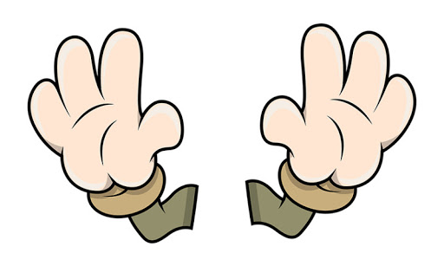
Touch
Briefly introduce that we use our bodies and our hands to touch. Encourage each child to explore the feel, one at a time, the cobweb material and spiders.
Feel: cobwebs and spiders

Slide 6
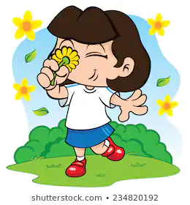
Smell
Introduce that we use our nose to smell, indicating to each child where their nose is (or asking them to show you themselves). Encourage each child to smell the mixed spice scent.
Smell:mixed spice

Slide 7
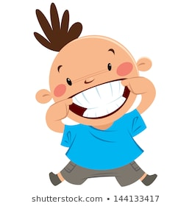
Taste - may not be applicable to all pupils. Pupils unable to taste can smell the resources or feel.
Introduce that we use our mouth to taste, indicating to each child where their mouth is (or asking them to show you themselves). Offer a taste of the biscoff biscuit spread.
Taste: biscoff biscuit spread

Slide 8
See
Introduce that we use our eyes to see, indicating to your child where their eyes are (or asking them to show you themselves). Show each child the ghost light toy, bats, skeletons and ghosts.
See: ghost light toy, ghosts, skeletons and bats

Slide 9
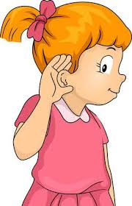
Hear
Introduce that we use our ears to hear, indicating to each child where their ears are (or asking them to show you themselves). Listen to the sound of creaking door, scary laugh and thunder. Use the thunder instrument if available.
Creaking door: https://www.youtube.com/watch?v=9BXEbdUrsDQ
Scary laughing: https://www.youtube.com/watch?v=90I7_Ak-j34&list=PLlKkIChXEU9pS4cBsbFNeDPGiAJJUMsZ3
Thunder: https://www.youtube.com/watch?v=2KqVvereuaE&list=PLlKkIChXEU9pS4cBsbFNeDPGiAJJUMsZ3&index=13

Slide 10
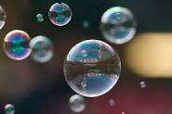
Relaxation
Relax with each child, listening to the music and giving them a massage. Blow bubbles or move parachute over the children’s heads.
https://www.youtube.com/watch?v=MfwOJWDj18k

