Slide 1
Resources (if turning into a sensory story)
Doll
Penguin teddy or picture
Feather or toy bird
Plastic duck
Black material
Horn sound effect
Toy boat
Blue material
Water spray
Bowl of water
Ice cube
Binoculars / toilet roll tube (as a pretend telescope)

Slide 2
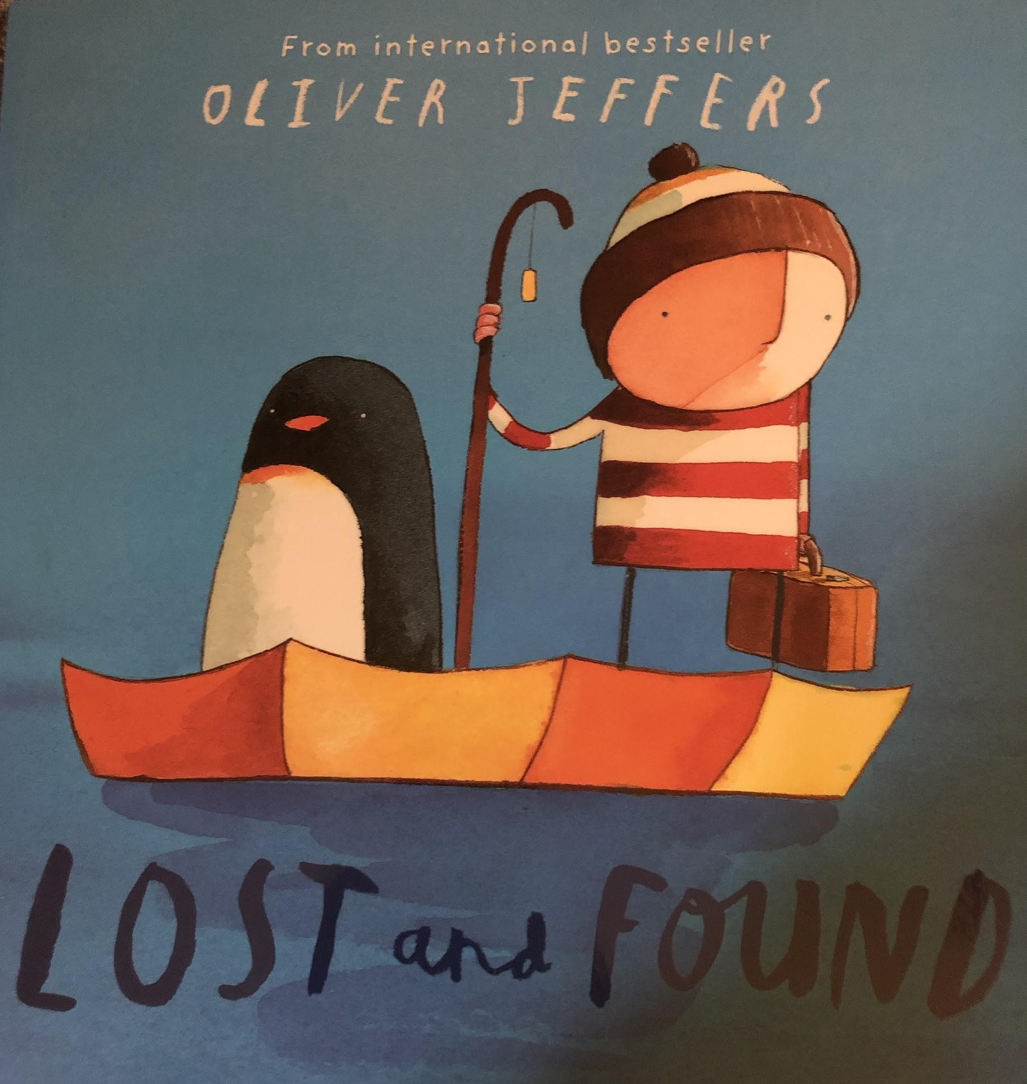

Slide 3
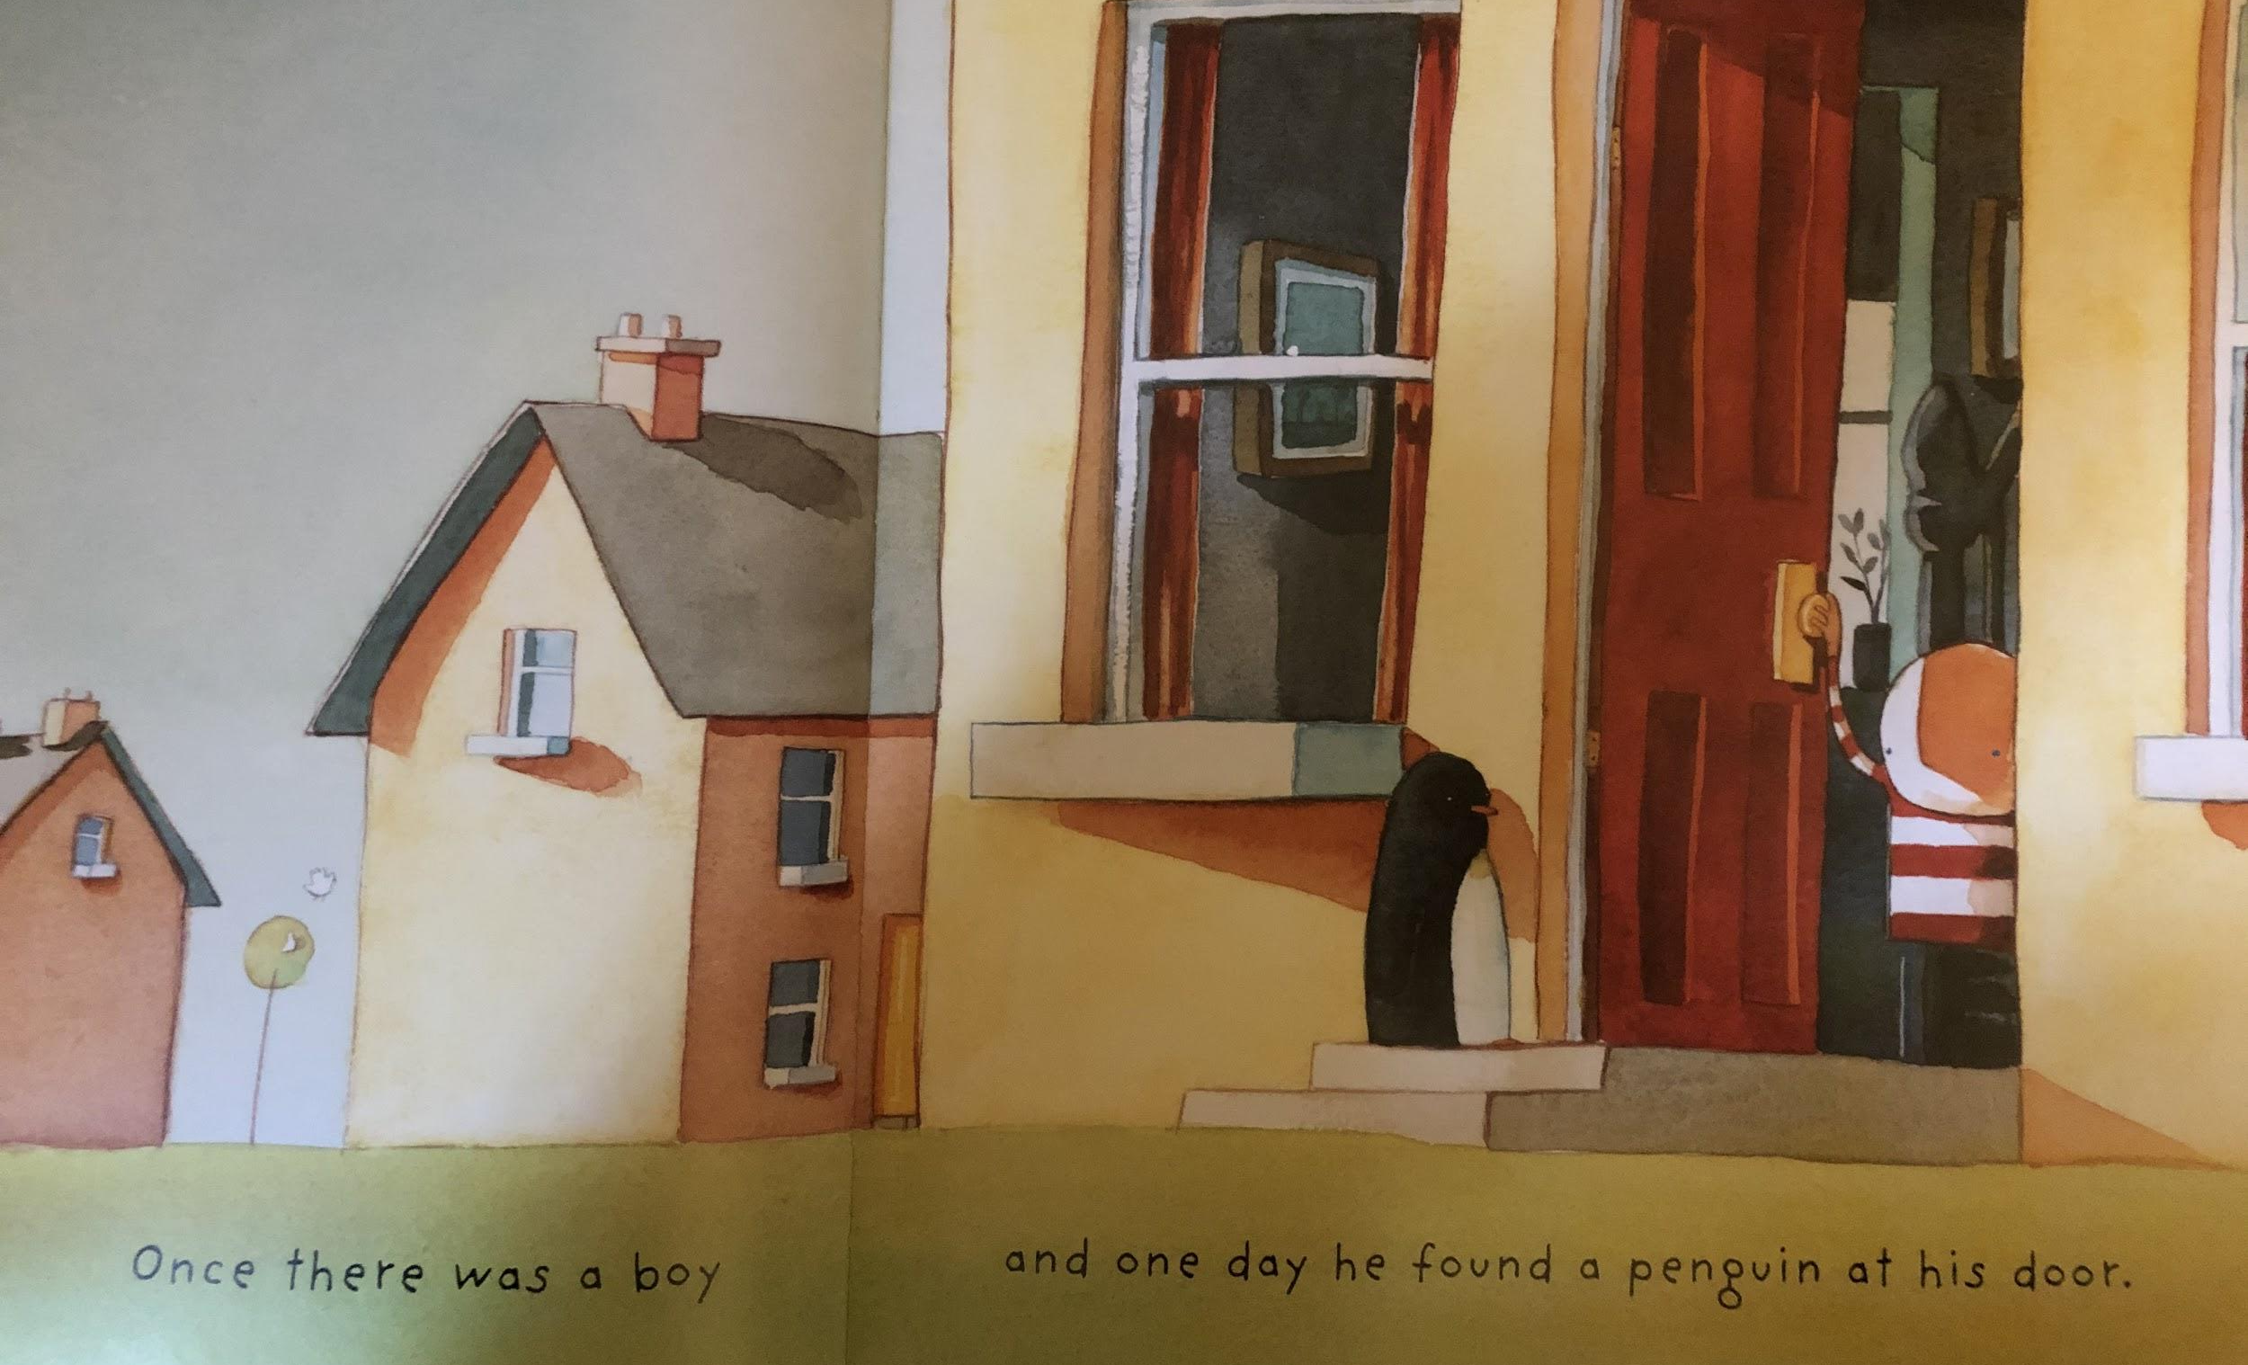
Resource: doll / penguin teddy or picture

Slide 4
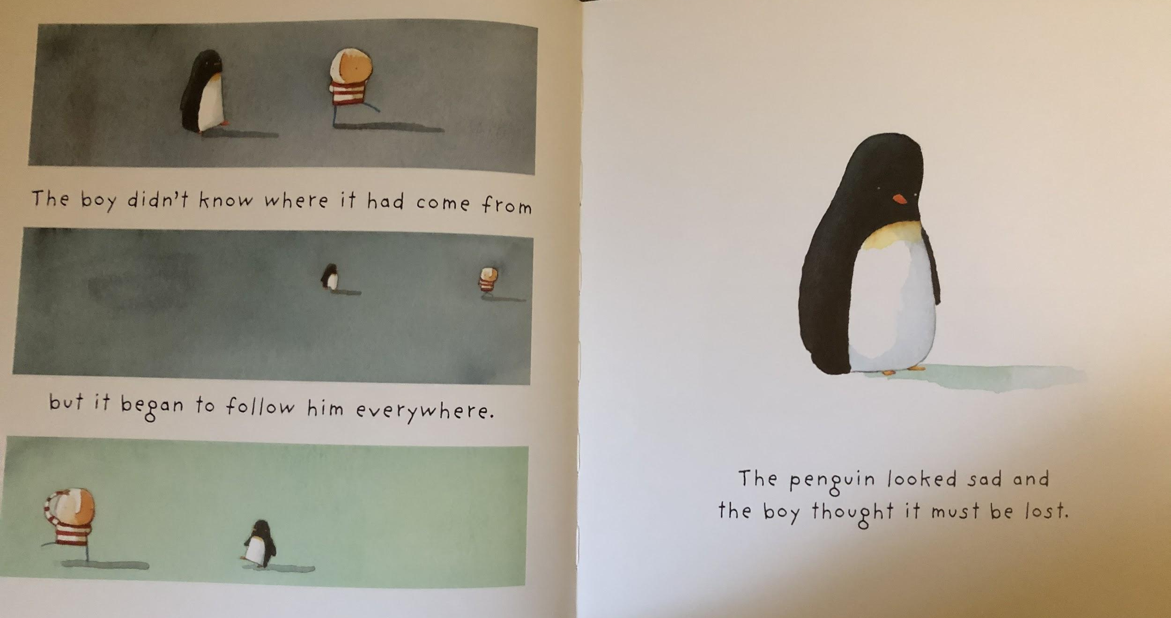
Resource: doll / penguin teddy or picture

Slide 5
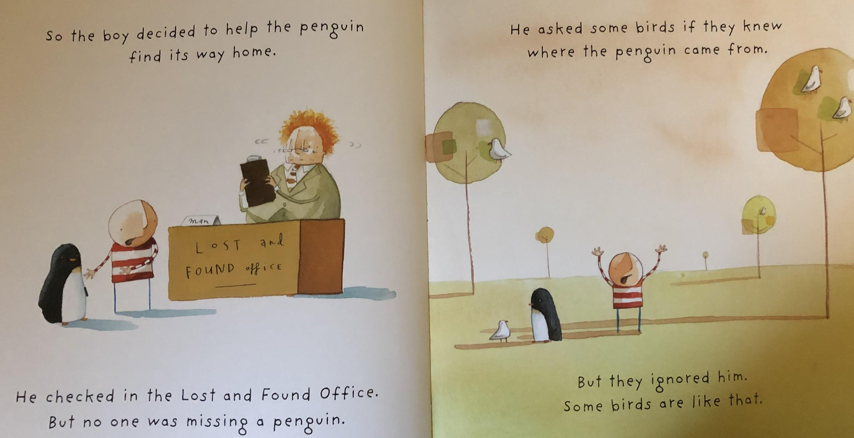
Resource: feather or toy bird

Slide 6
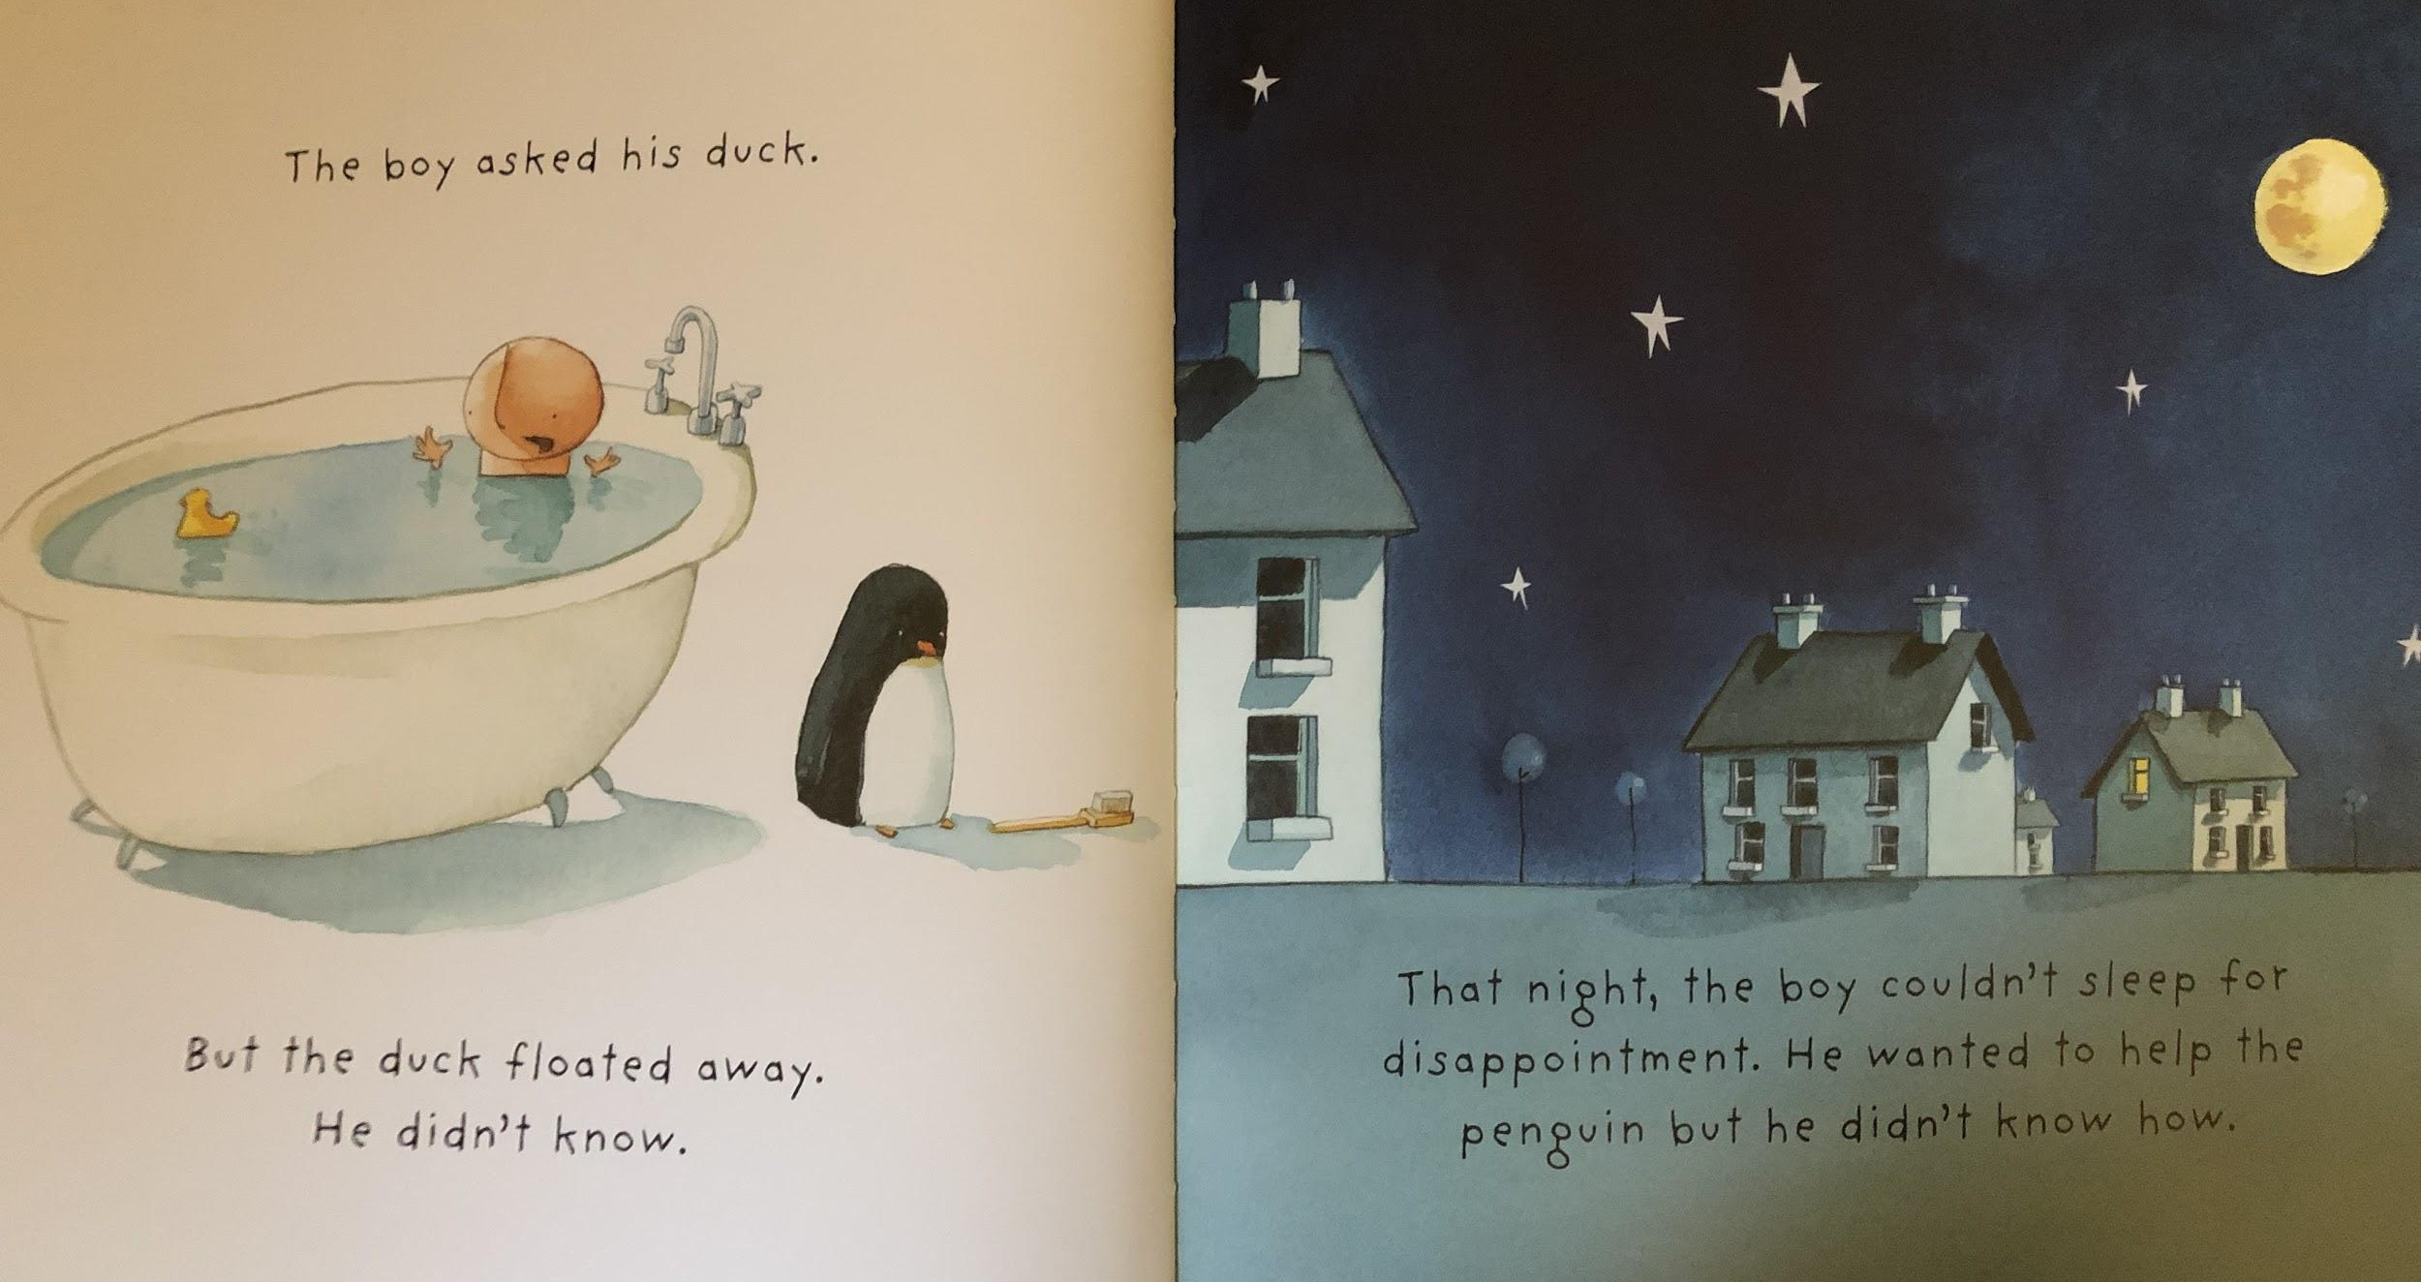
Resource: plastic duck
Resource: black material

Slide 7
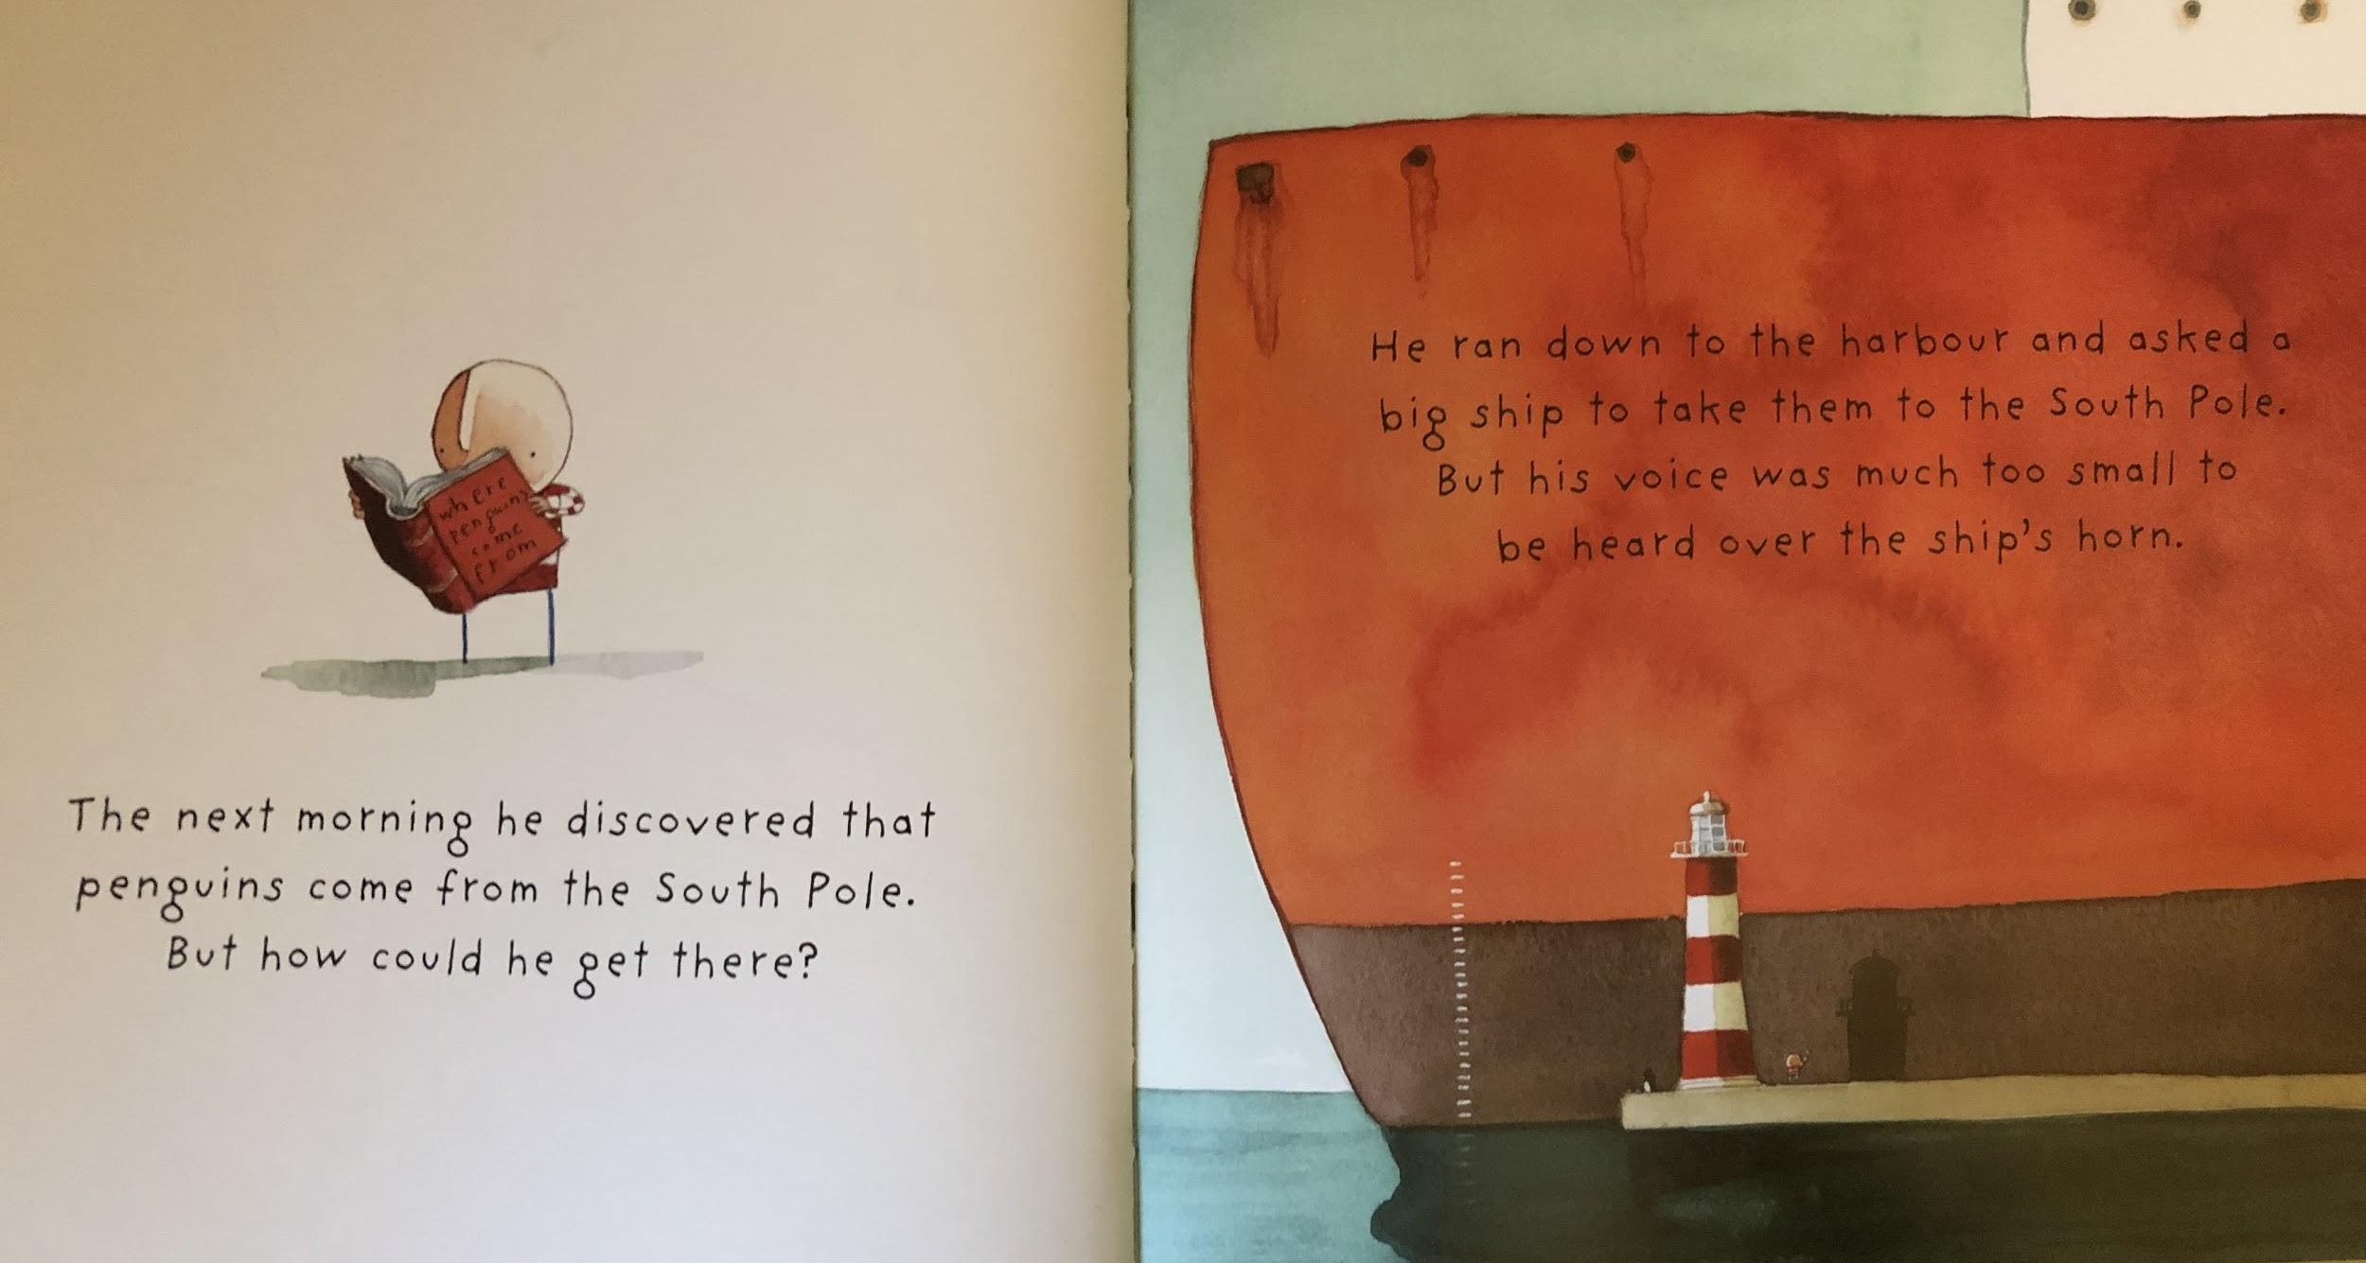
Resource: horn sound effect (you could use youtube for sound effect.

Slide 8
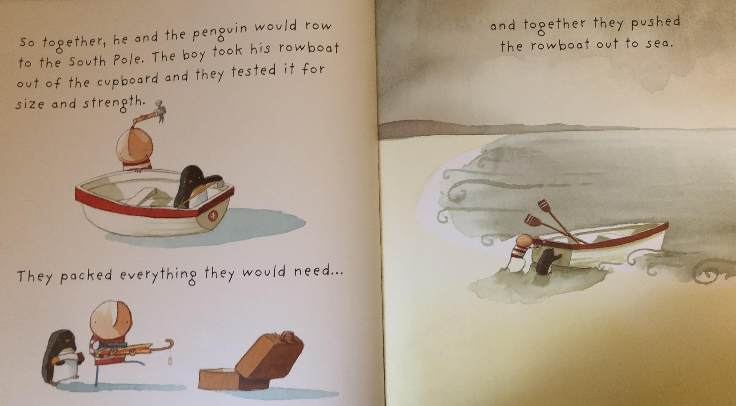
Resource: toy boat

Slide 9
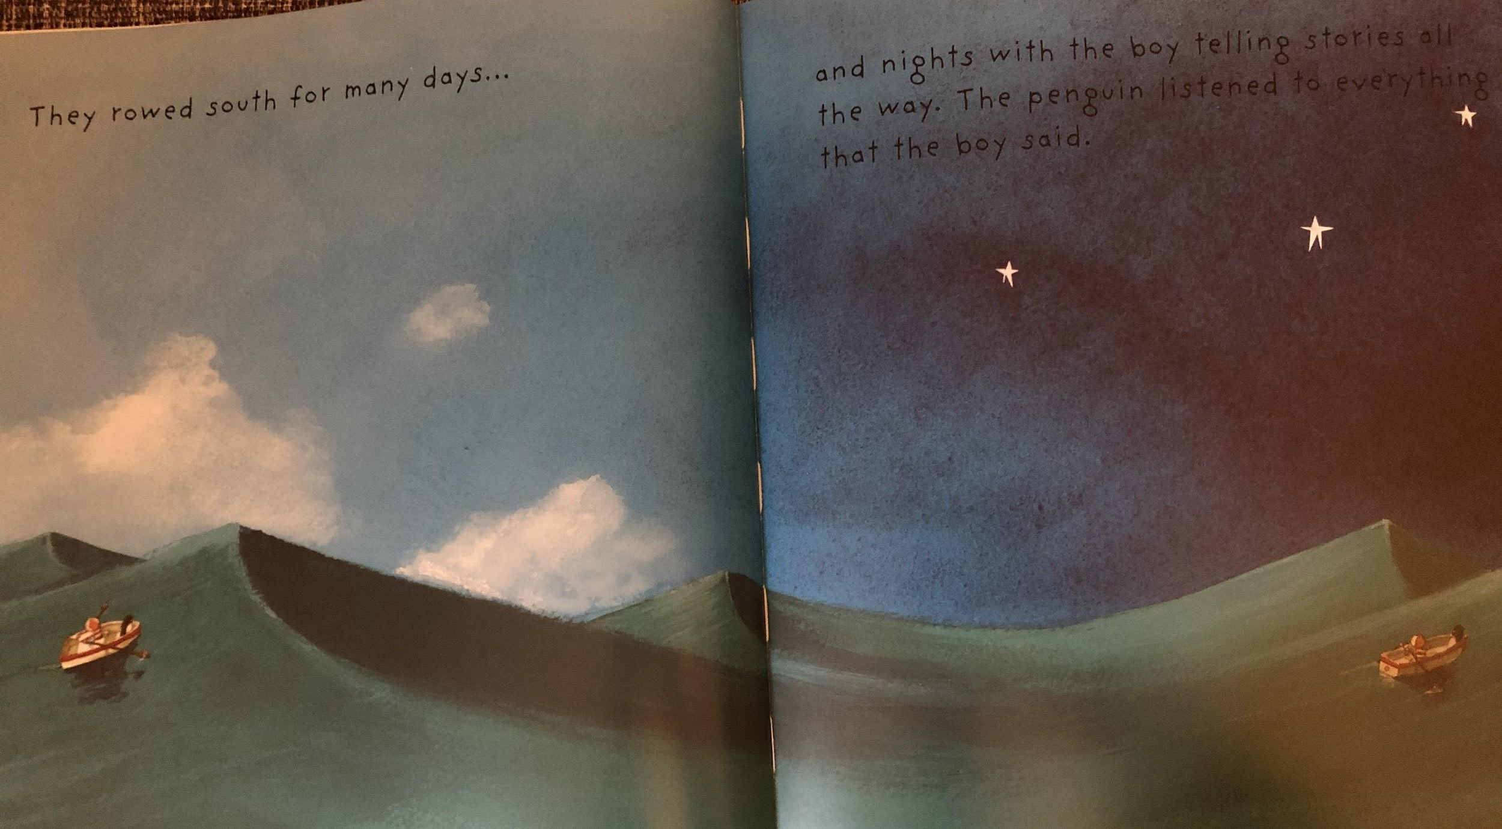
Resource: toy boat / blue material

Slide 10
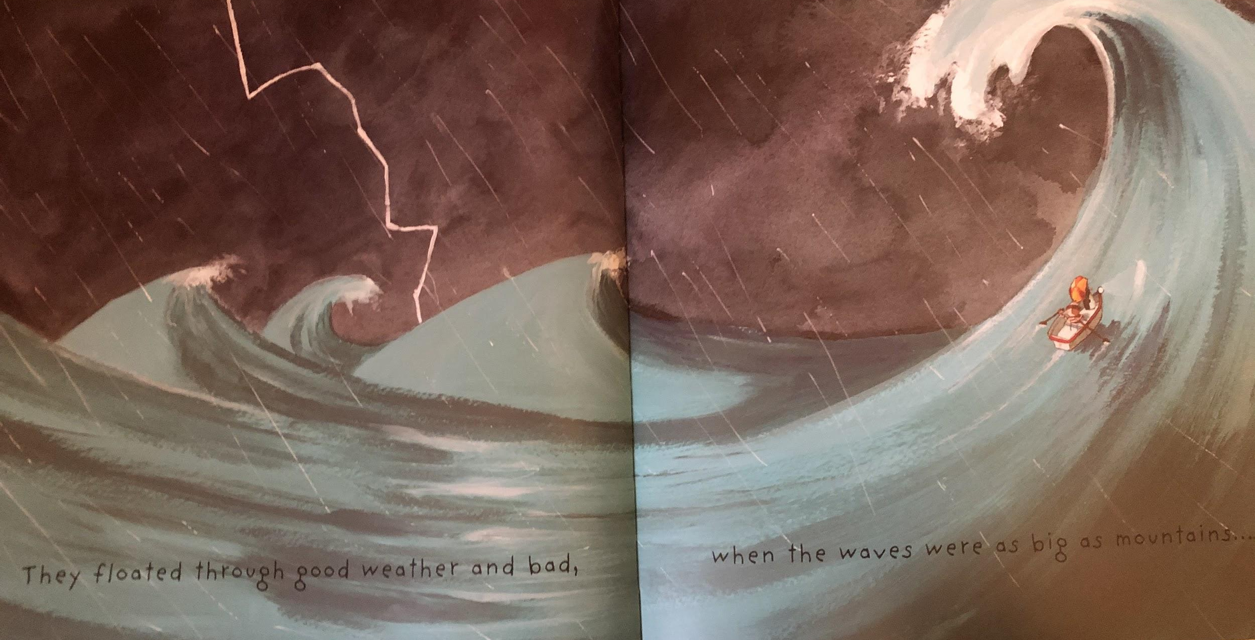
Resource: Water spray / water in a bowl

Slide 11
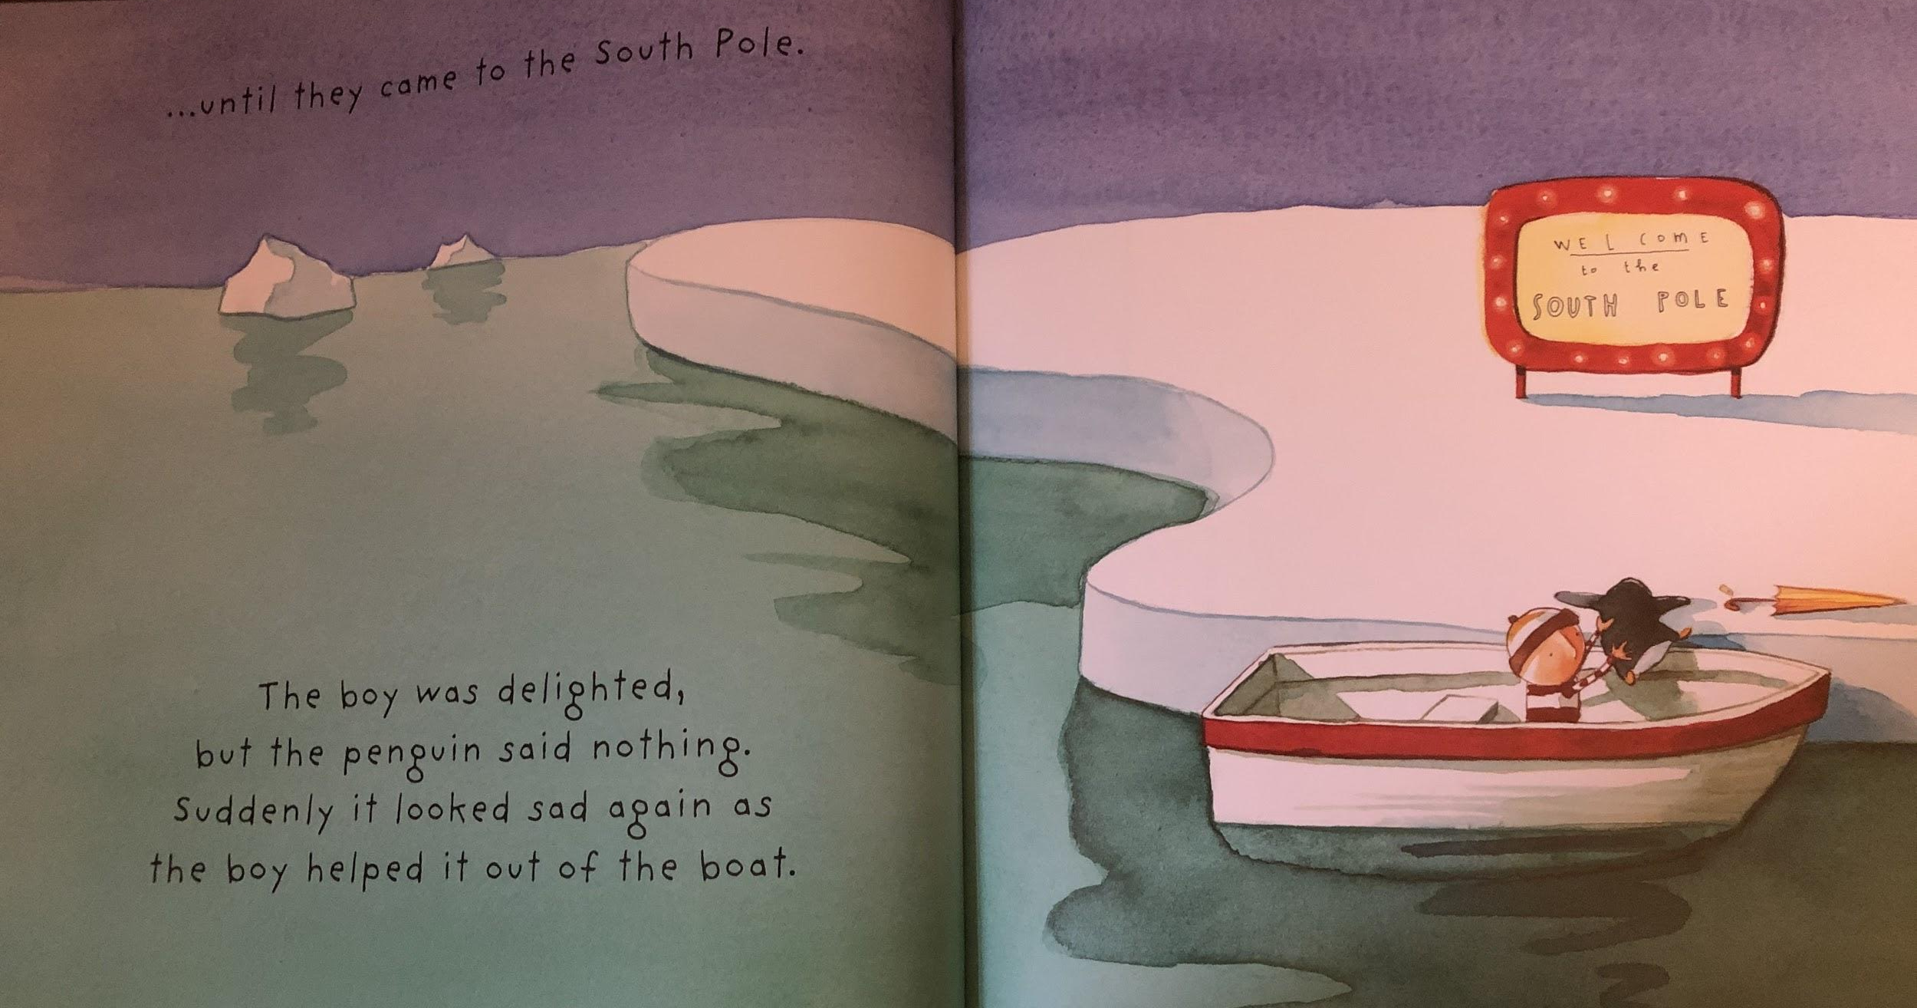

Slide 12
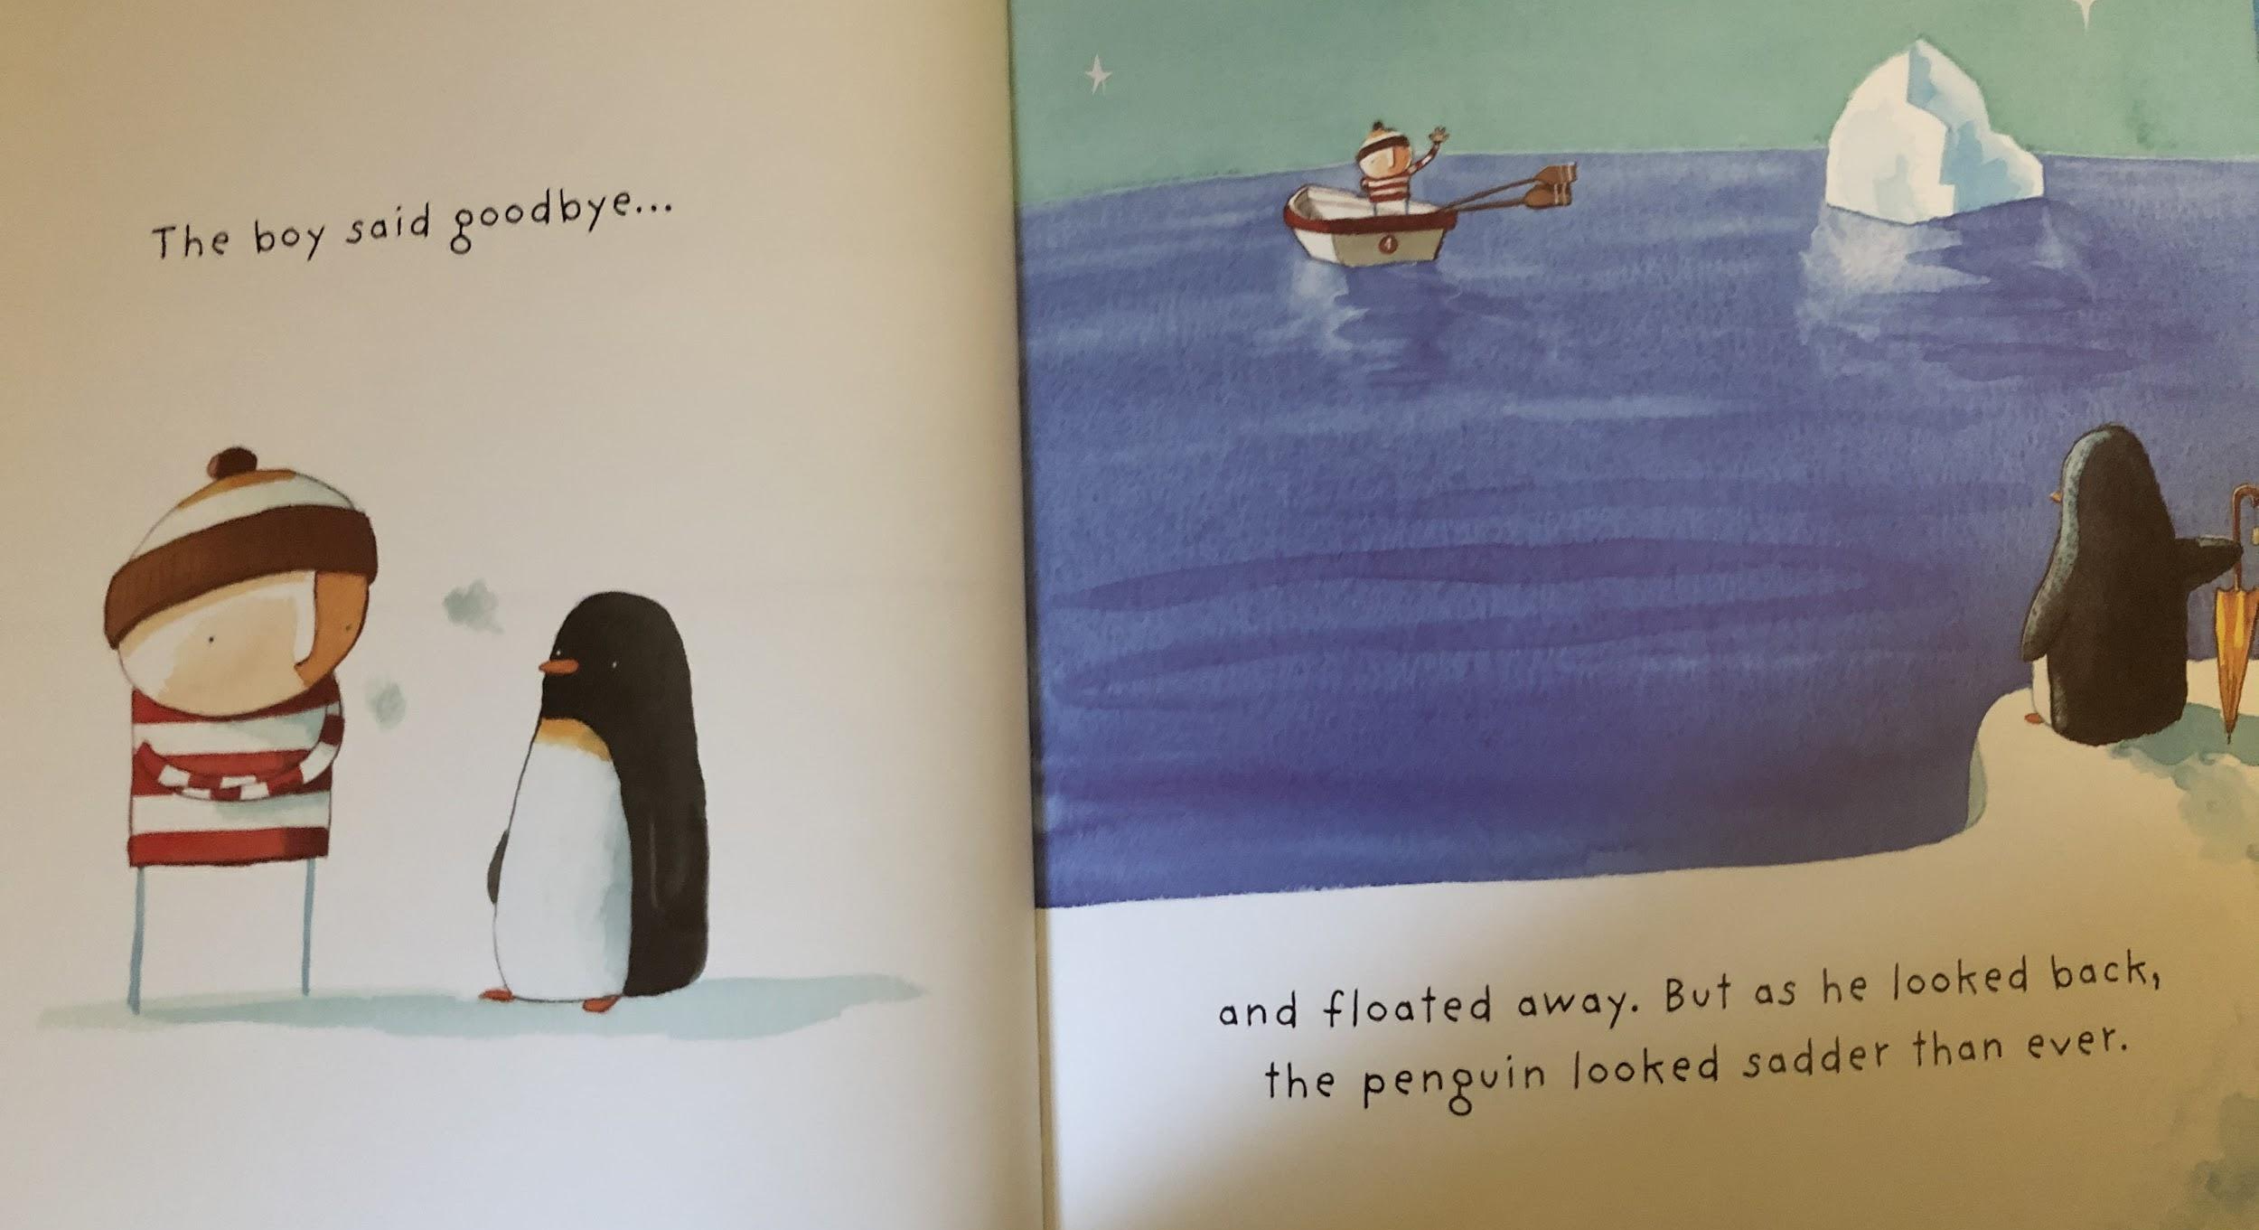
Resource: encourage child to wave ‘goodbye’

Slide 13
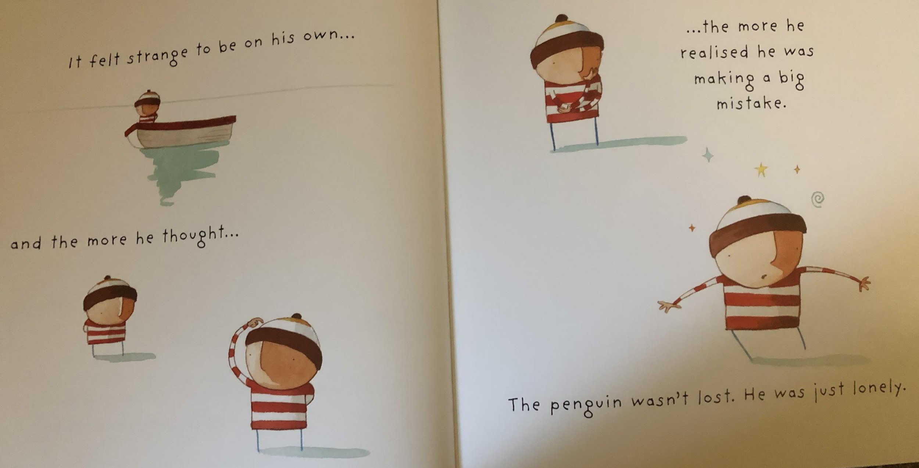

Slide 14
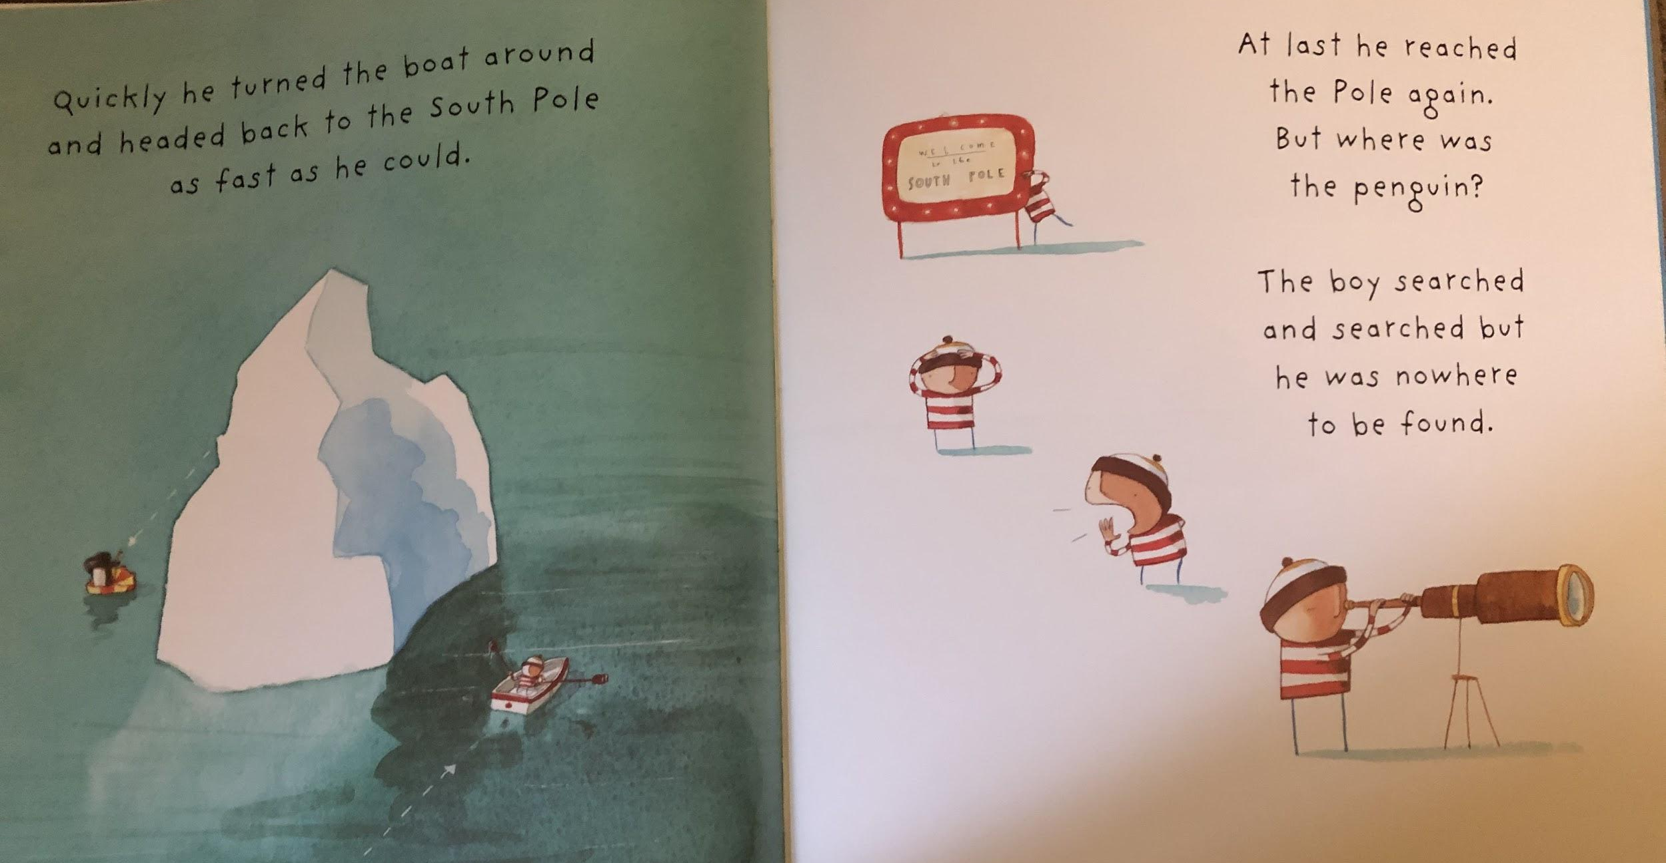
Resource: ice cube / binoculars

Slide 15
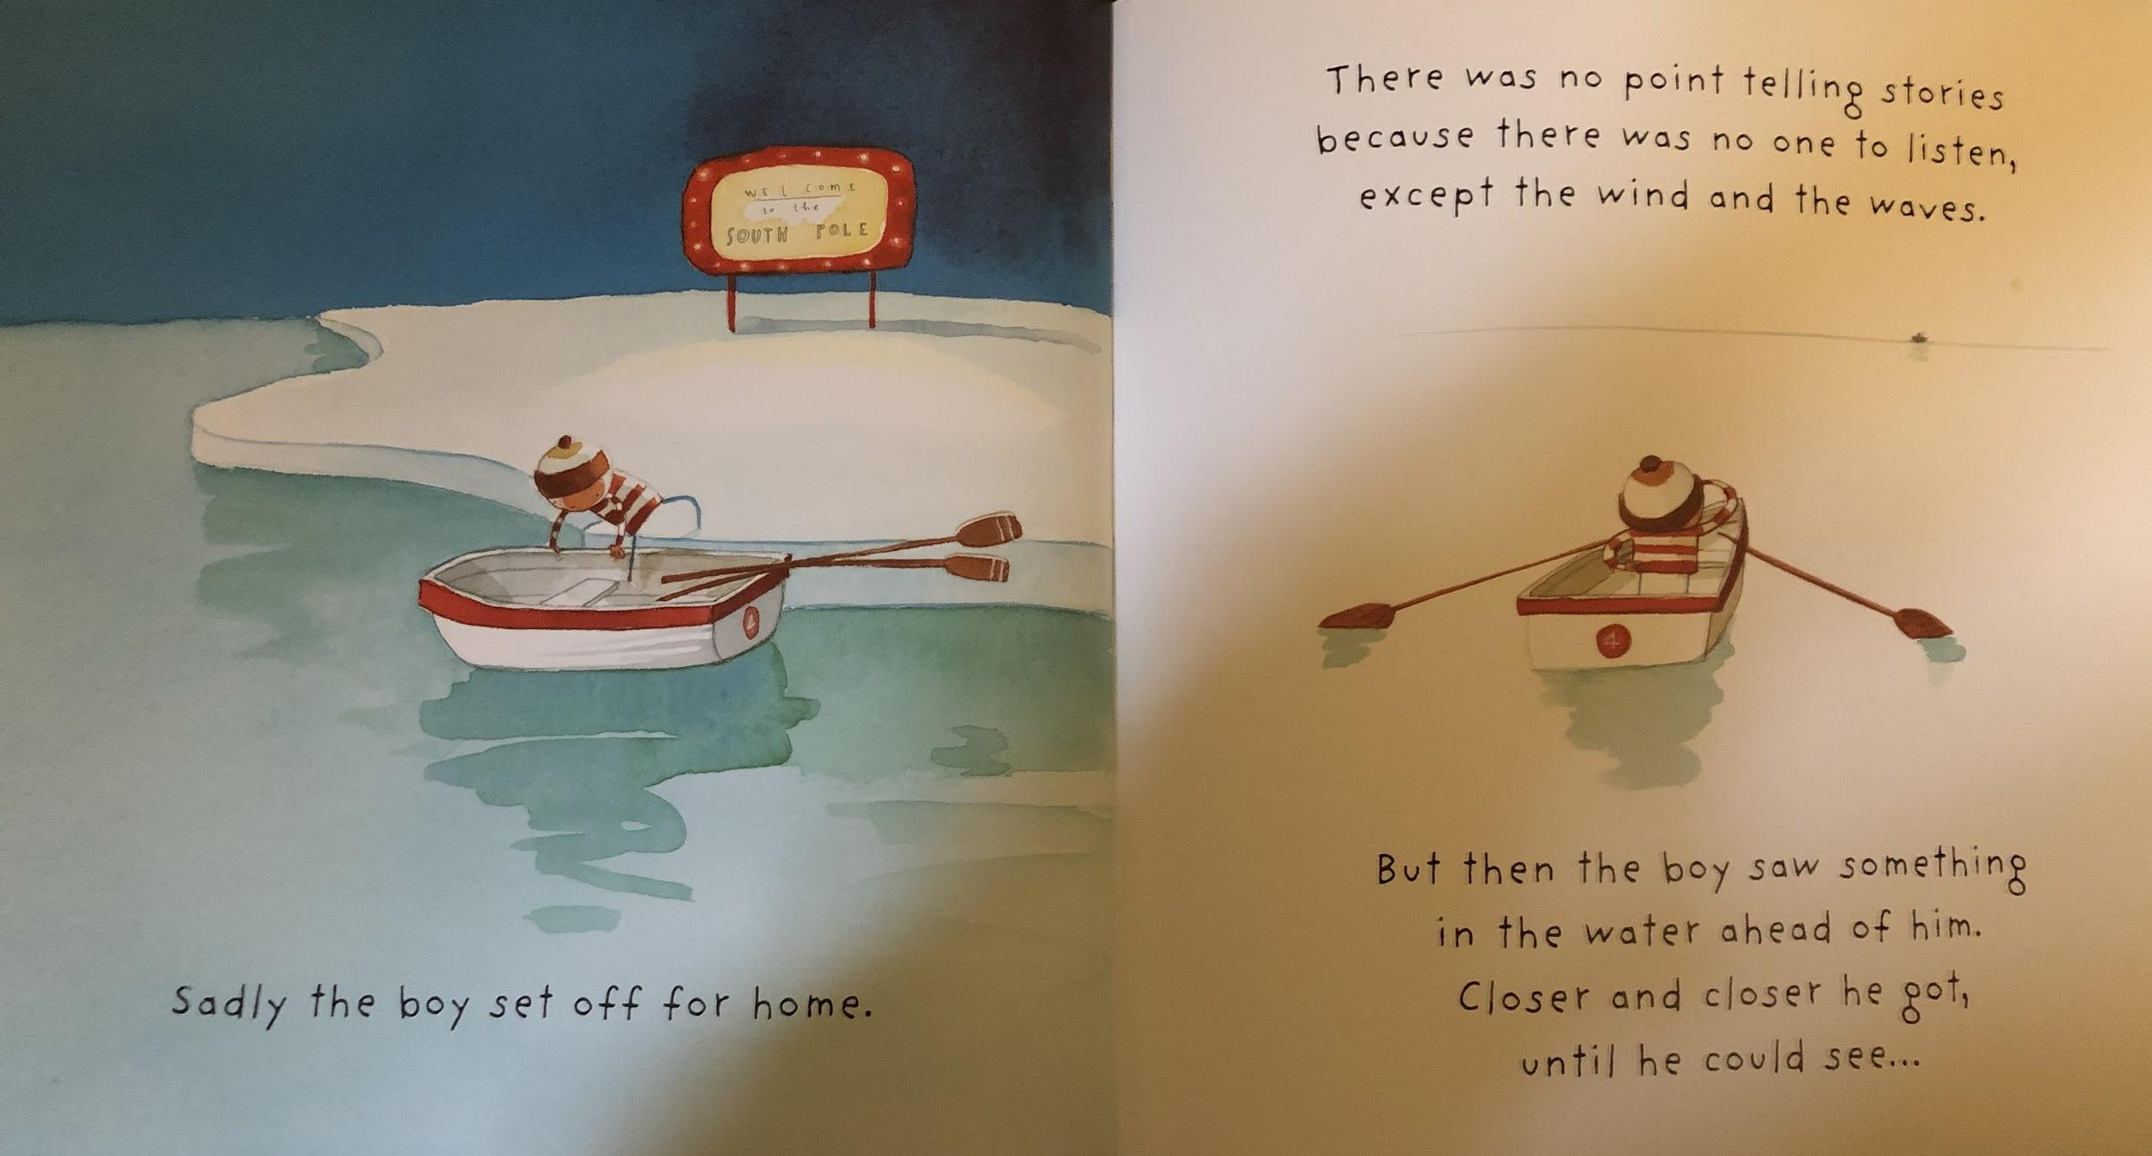
Resource: toy boat in a bowl of water

Slide 16
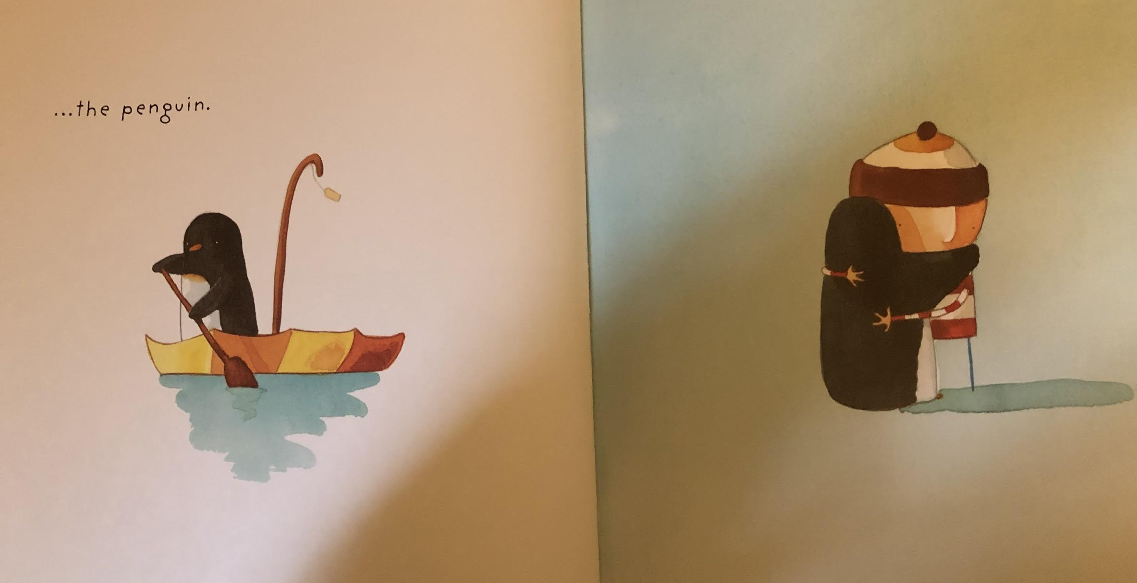
Resource: penguin teddy or picture

Slide 17
