Slide 1
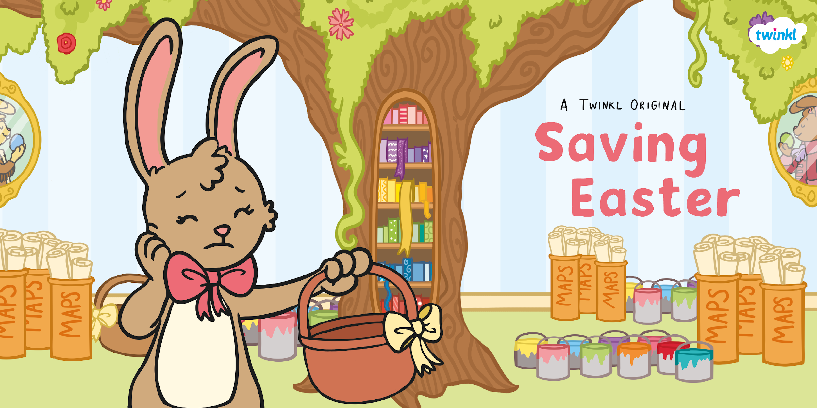

Slide 2


Slide 3
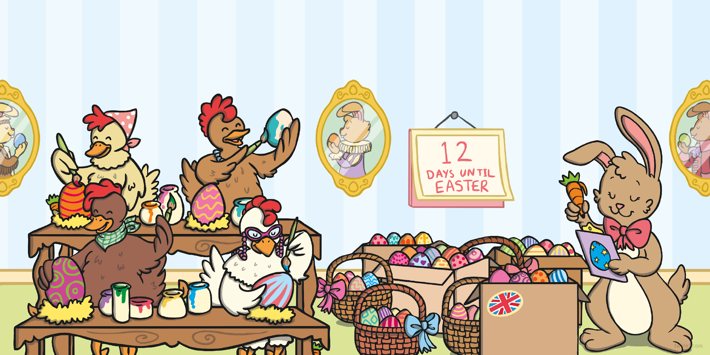
For as long as anyone can remember, children have been waking up to find eggs on Easter morning.
All the eggs were delivered by the Easter Bunny. She spends all year getting ready for this eggtastic morning. This is the story of how one year, the Easter Bunny had to learn to trust others to help her save Easter.
Resource: Plastic eggs/pictures, rabbit teddy

Slide 4
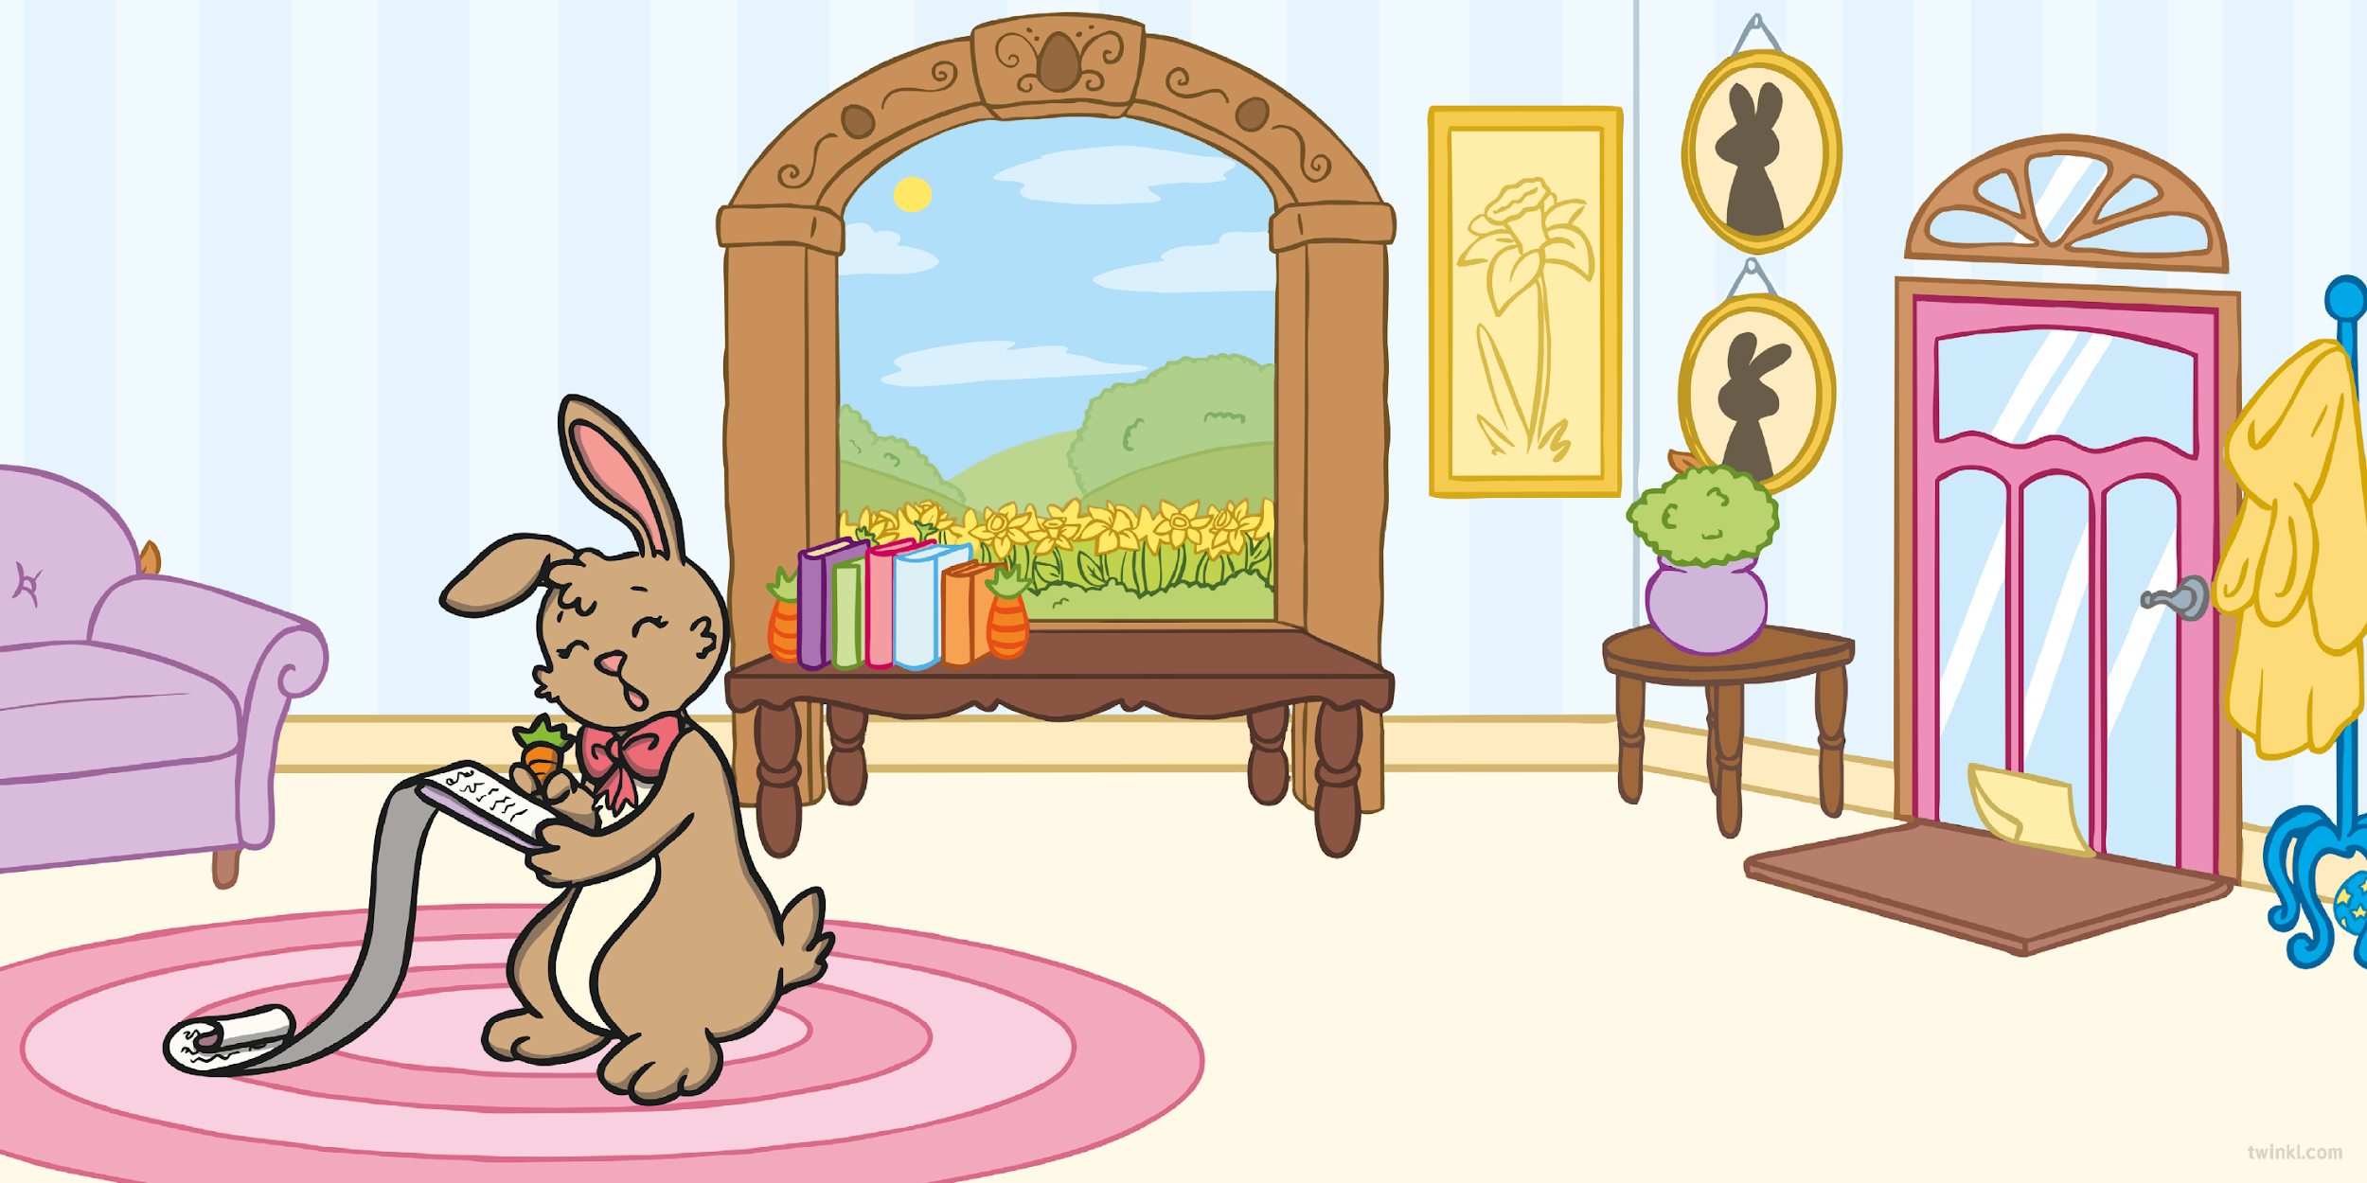
The first daffodils had just started to appear when the Easter Bunny started to get ready. She made her plan, working out just
how long they would take
to paint. She knew she
had to get started
straight away!
Just as she had finished writing her plans, an envelope was slipped under the door to her workshop. She opened it quickly and read the note inside.
Resource: Daffodil, rabbit toy/picture, envelope

Slide 5
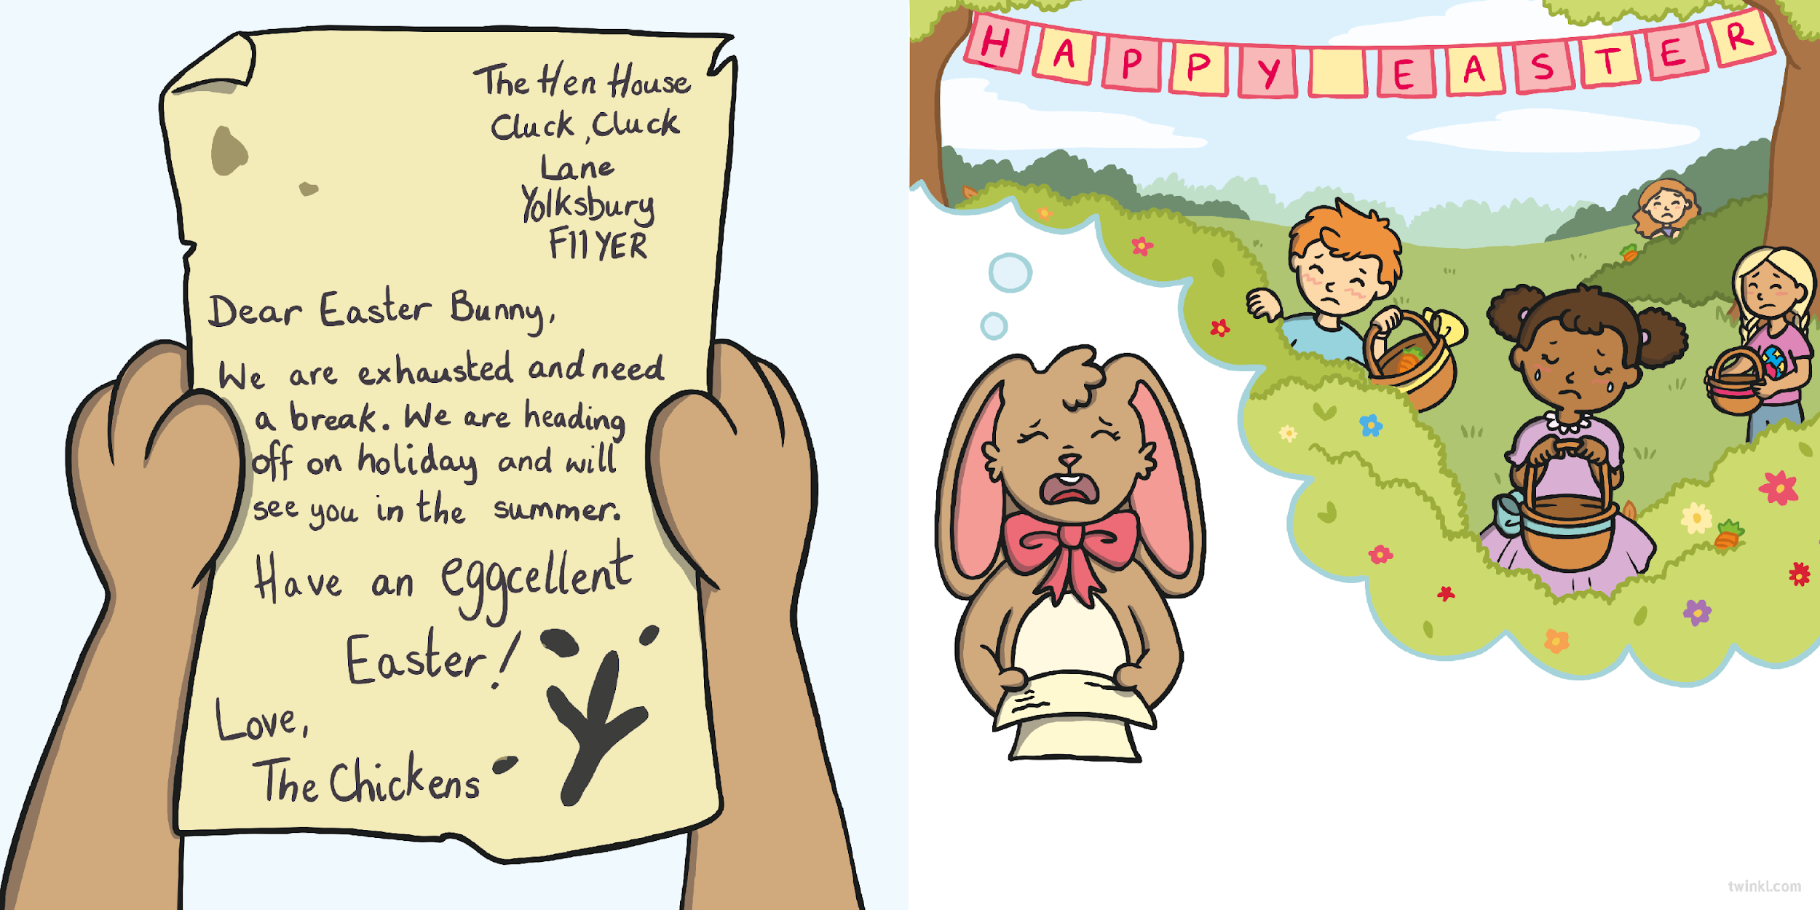
This was a disaster! Without the chickens,
there would be no eggs. No eggs meant no Easter egg hunts and no Easter egg hunts meant lots of unhappy children. The day would be ruined!

Slide 6
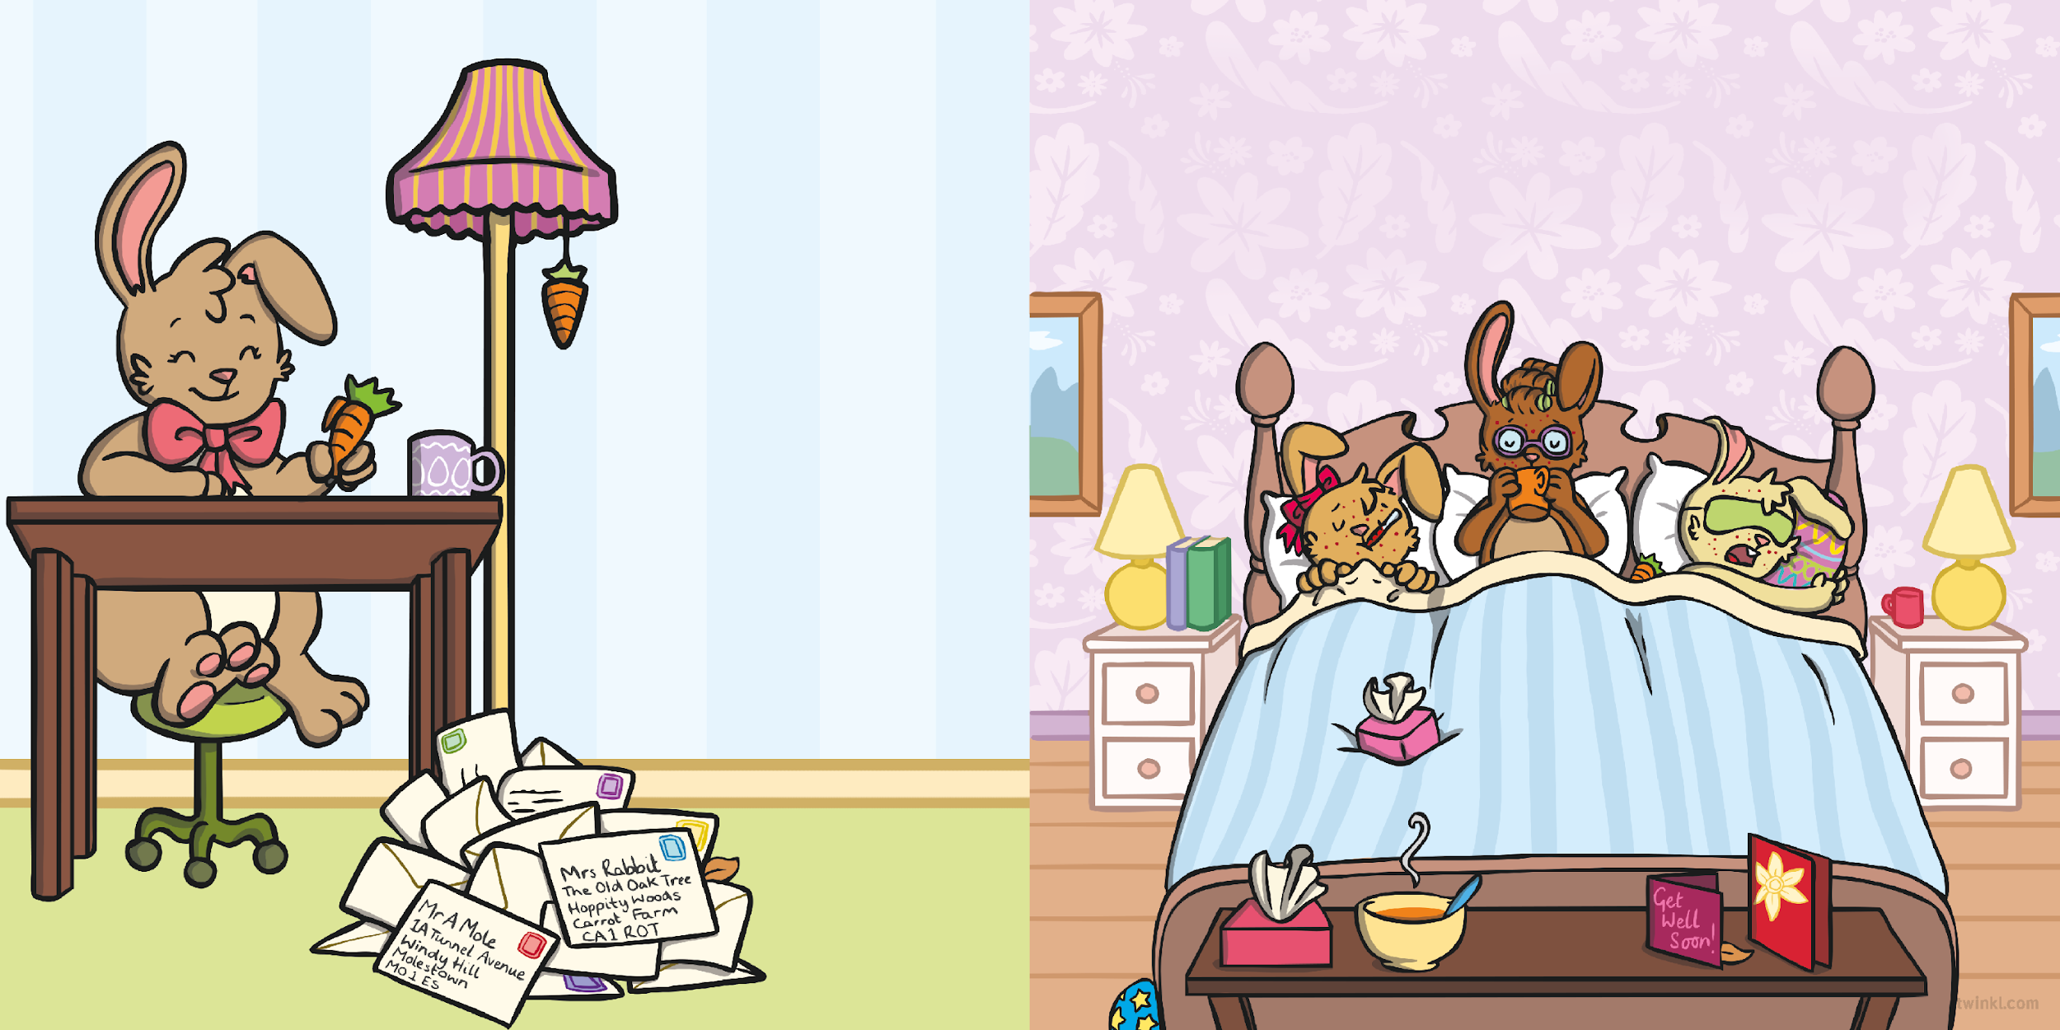
Resource: Rabbit teddy / picture
The next day, her luck still didn’t improve. The rabbits had a terrible case of bunny measles. They were all wrapped up tight in bed, drinking camomile tea and eating carrot soup.
Now the Easter Bunny wasn’t the kind of bunny to panic, so she sent letters to her friends, who she was sure would help.

Slide 7
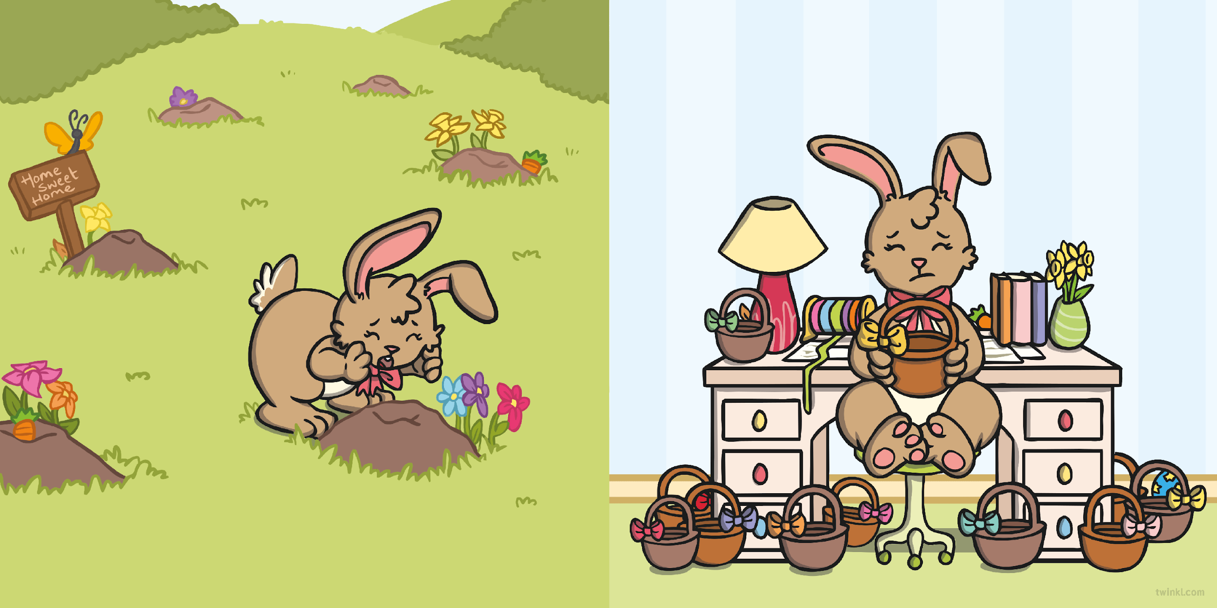
The Easter Bunny had no idea what she was going to do. She had no eggs, no brushes and no way to deliver any eggs even if she did manage to make them!
Even the moles, who dug the tunnels she used to deliver her eggs, were nowhere to be found.

Slide 8
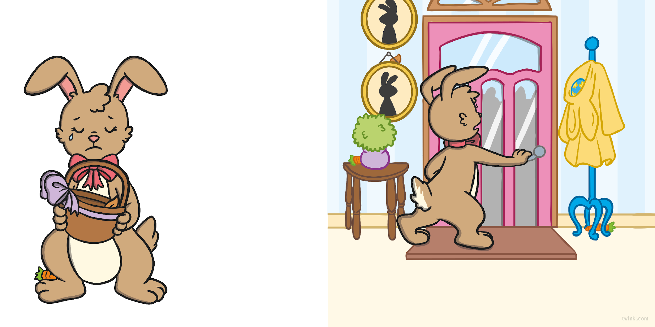
There would be no Easter this year, she thought to herself and a large tear ran slowly down her furry cheek.
A loud knock made her jump and she made her way to the door. When she opened it, she couldn’t believe her eyes!
Resource: knocking sound

Slide 9
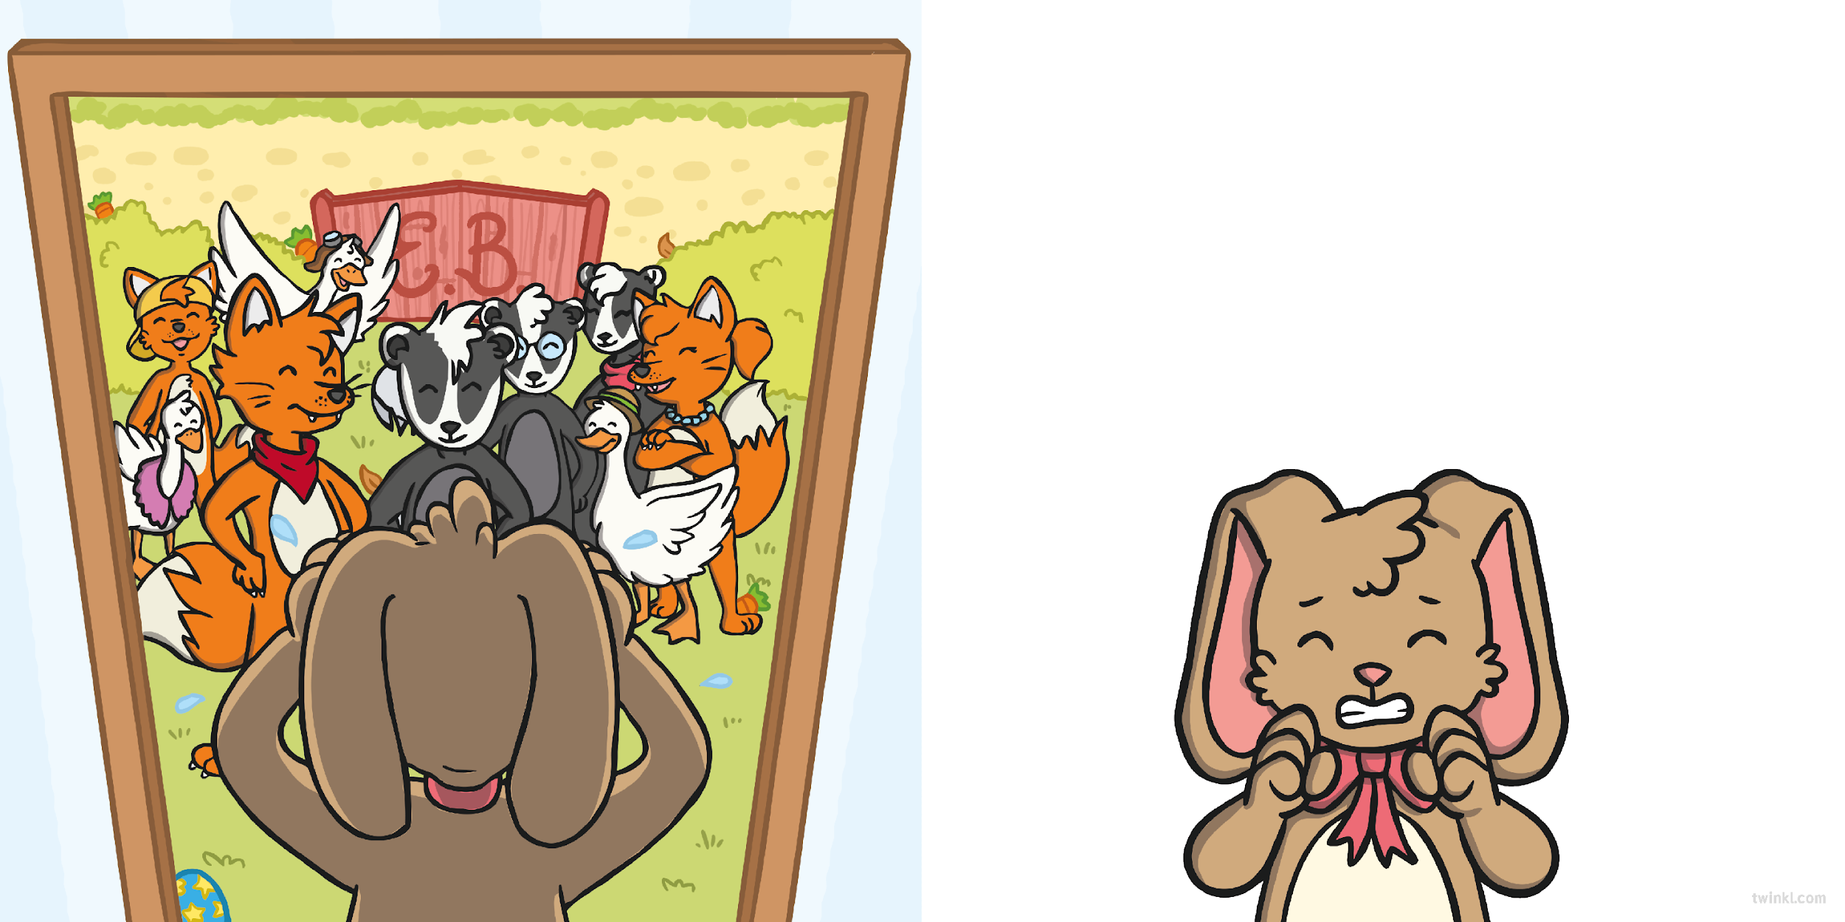
Outside, were all the animals she had been warned about
–sly foxes, thieving badgers and the gossiping geese!
“Can we come in?” said one of the foxes gently.
“No! Of course you can’t!” shouted the Easter Bunny, “Leave me alone!”
“But we heard you needed help,” honked one of the geese.
Resource: Stick puppets / toy animals

Slide 10
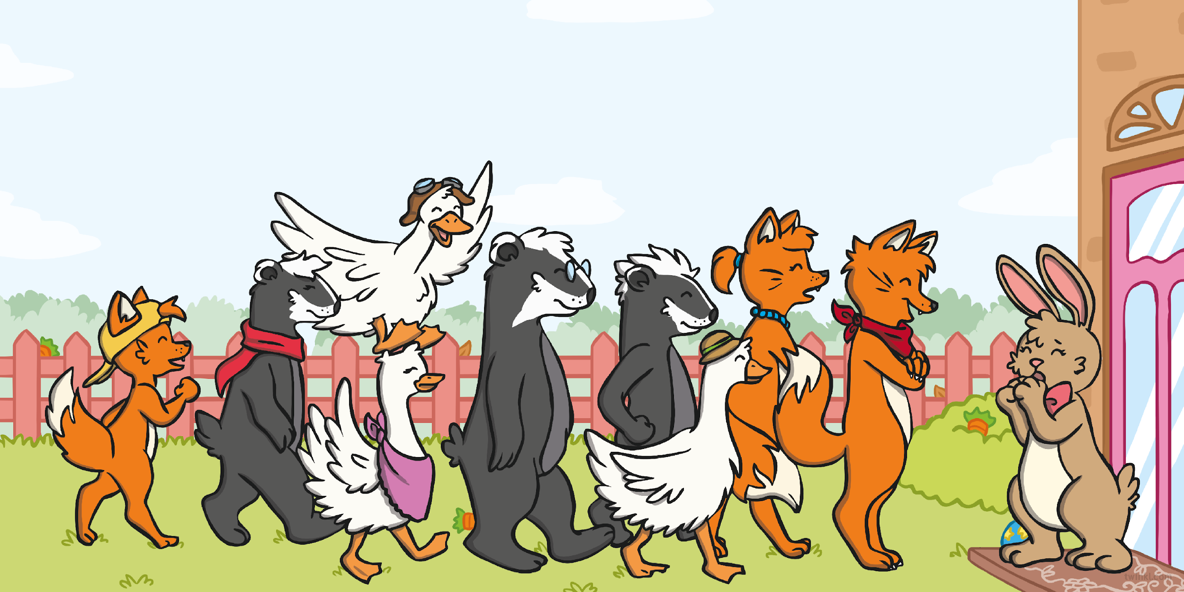
“You want to help me?” the Easter Bunny said, puzzled.
“Yes. We want to save Easter,” said the fox.
“Please don’t think that all foxes are sly and mean.
Trust me and I can help you.”
“We know that you need eggs because the chickens have gone away. Just give us a chance,” squawked the geese.
“Our paws are yours. We are ready to dig!” smiled the badgers.

Slide 11
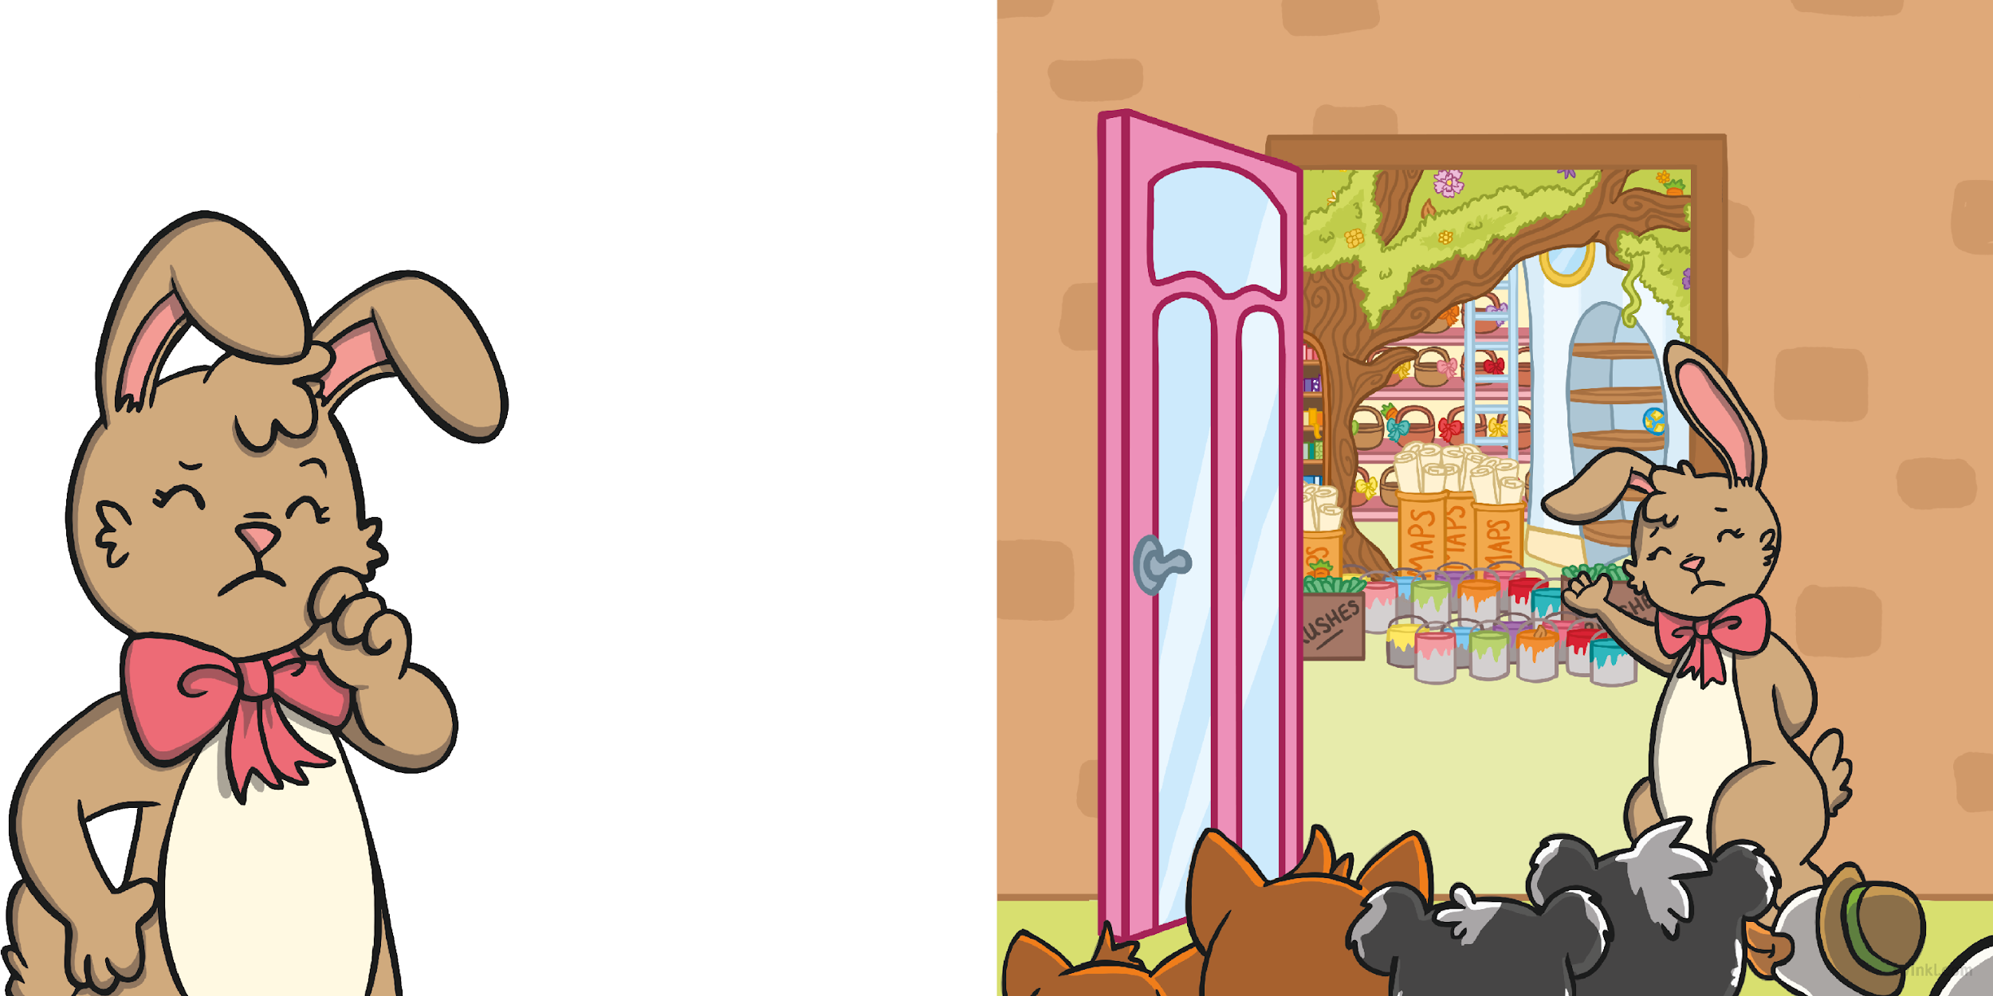
The Easter Bunny had heard stories about what these animals could be like and she didn’t believe that they were telling the truth.
She took a deep breath and invited them all in.
But she thought that perhaps she should give them a chance.
After all, she didn’t have a
chance of saving Easter
by herself.

Slide 12
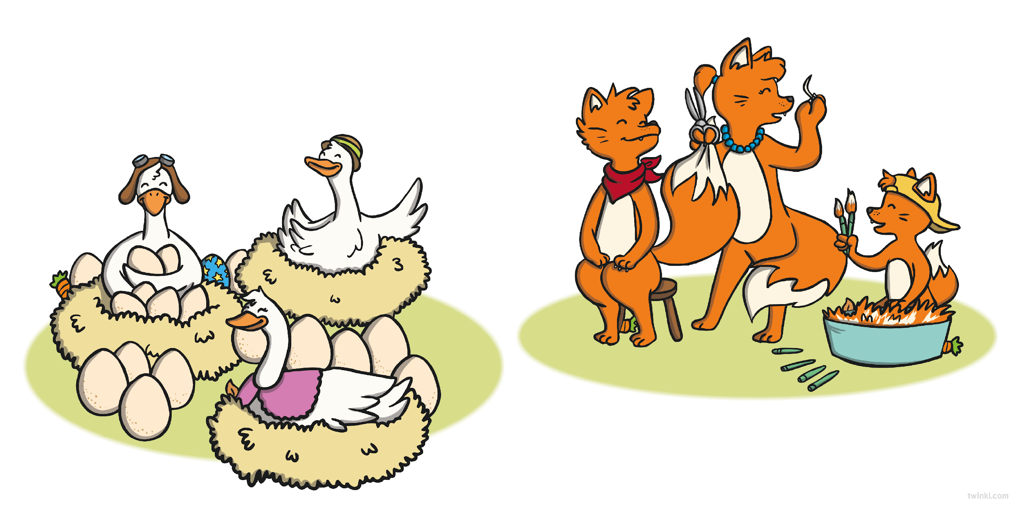
Much to the Easter Bunny’s surprise, the animals went straight to work. The geese laid eggs, morning, noon and night, until there were enough eggs for every child to have one.
Resource: Plastic eggs
The foxes used hairs from their bushy tails to make the finest brushes in the land for the Easter Bunny.
Resource: Fluffy materials / paint brush

Slide 13
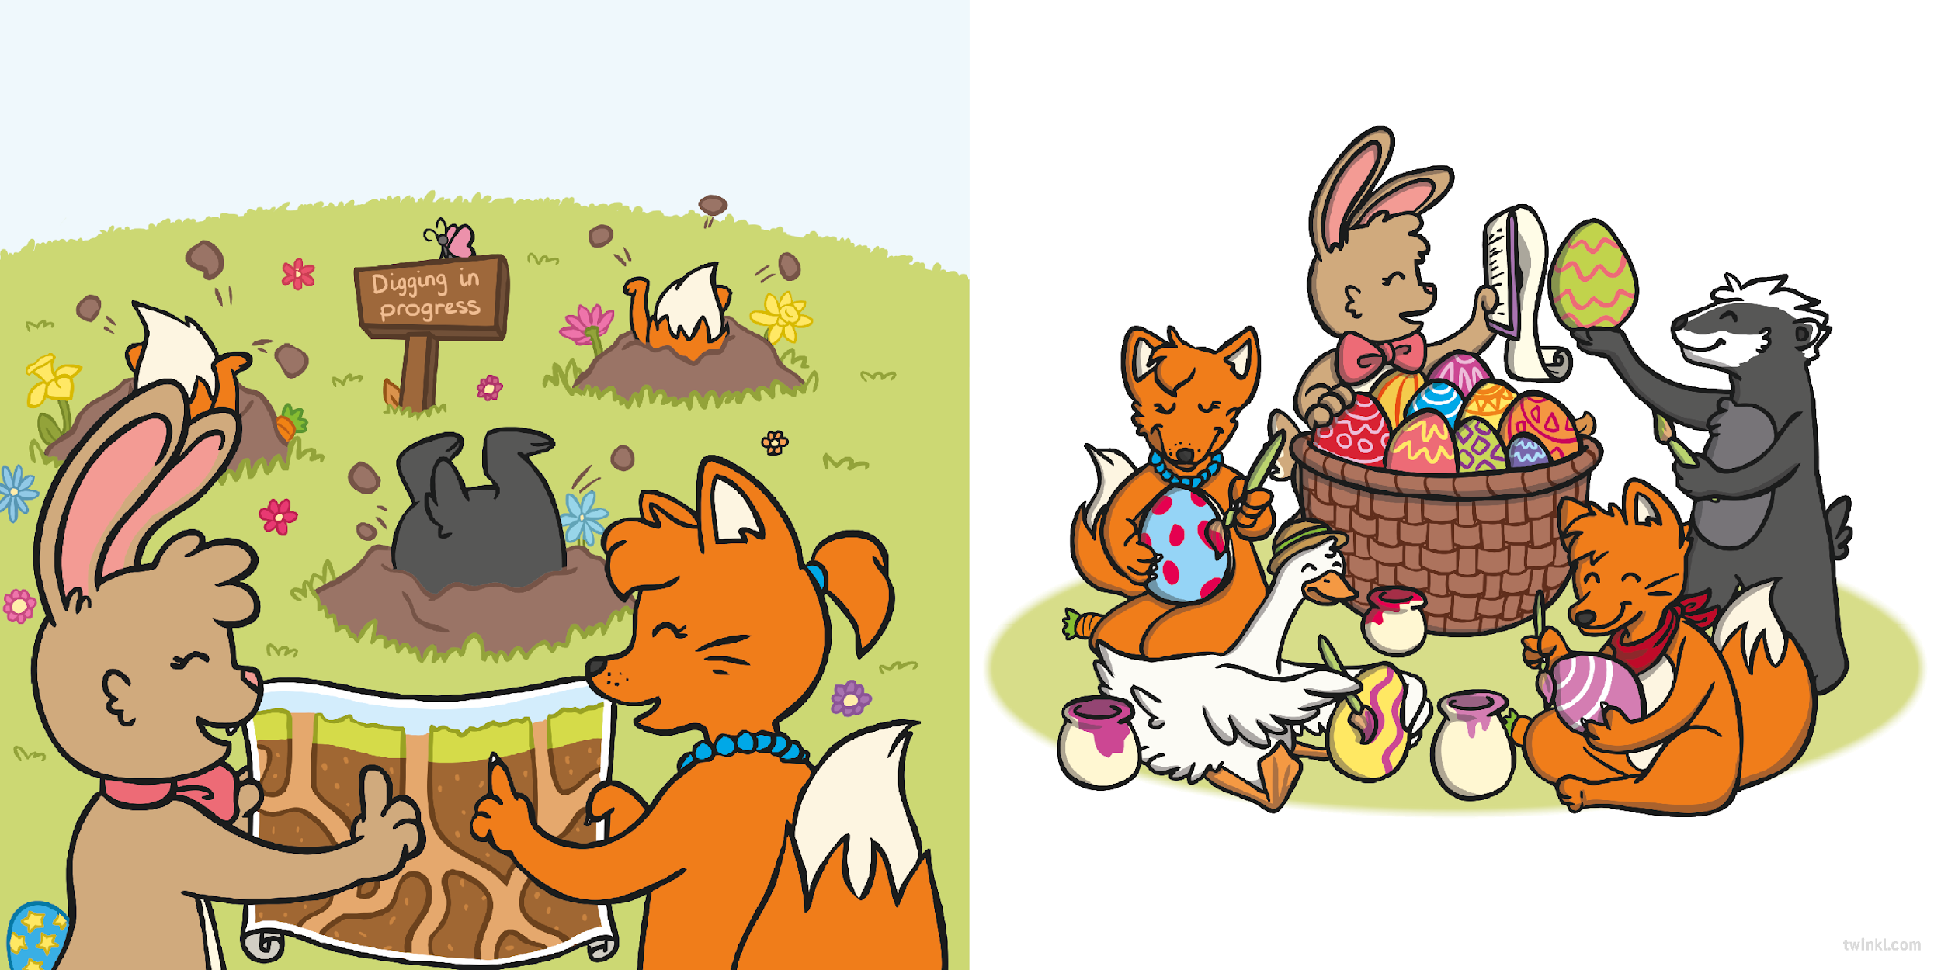
As soon as they had finished the brushes, they worked with the badgers to dig all of the tunnels the Easter Bunny needed.
With the eggs laid and the tunnels dug, everyone began to paint.
Together, they painted some of the most beautiful patterns the Easter Bunny had ever seen!
Resource: Paintbrush

Slide 14
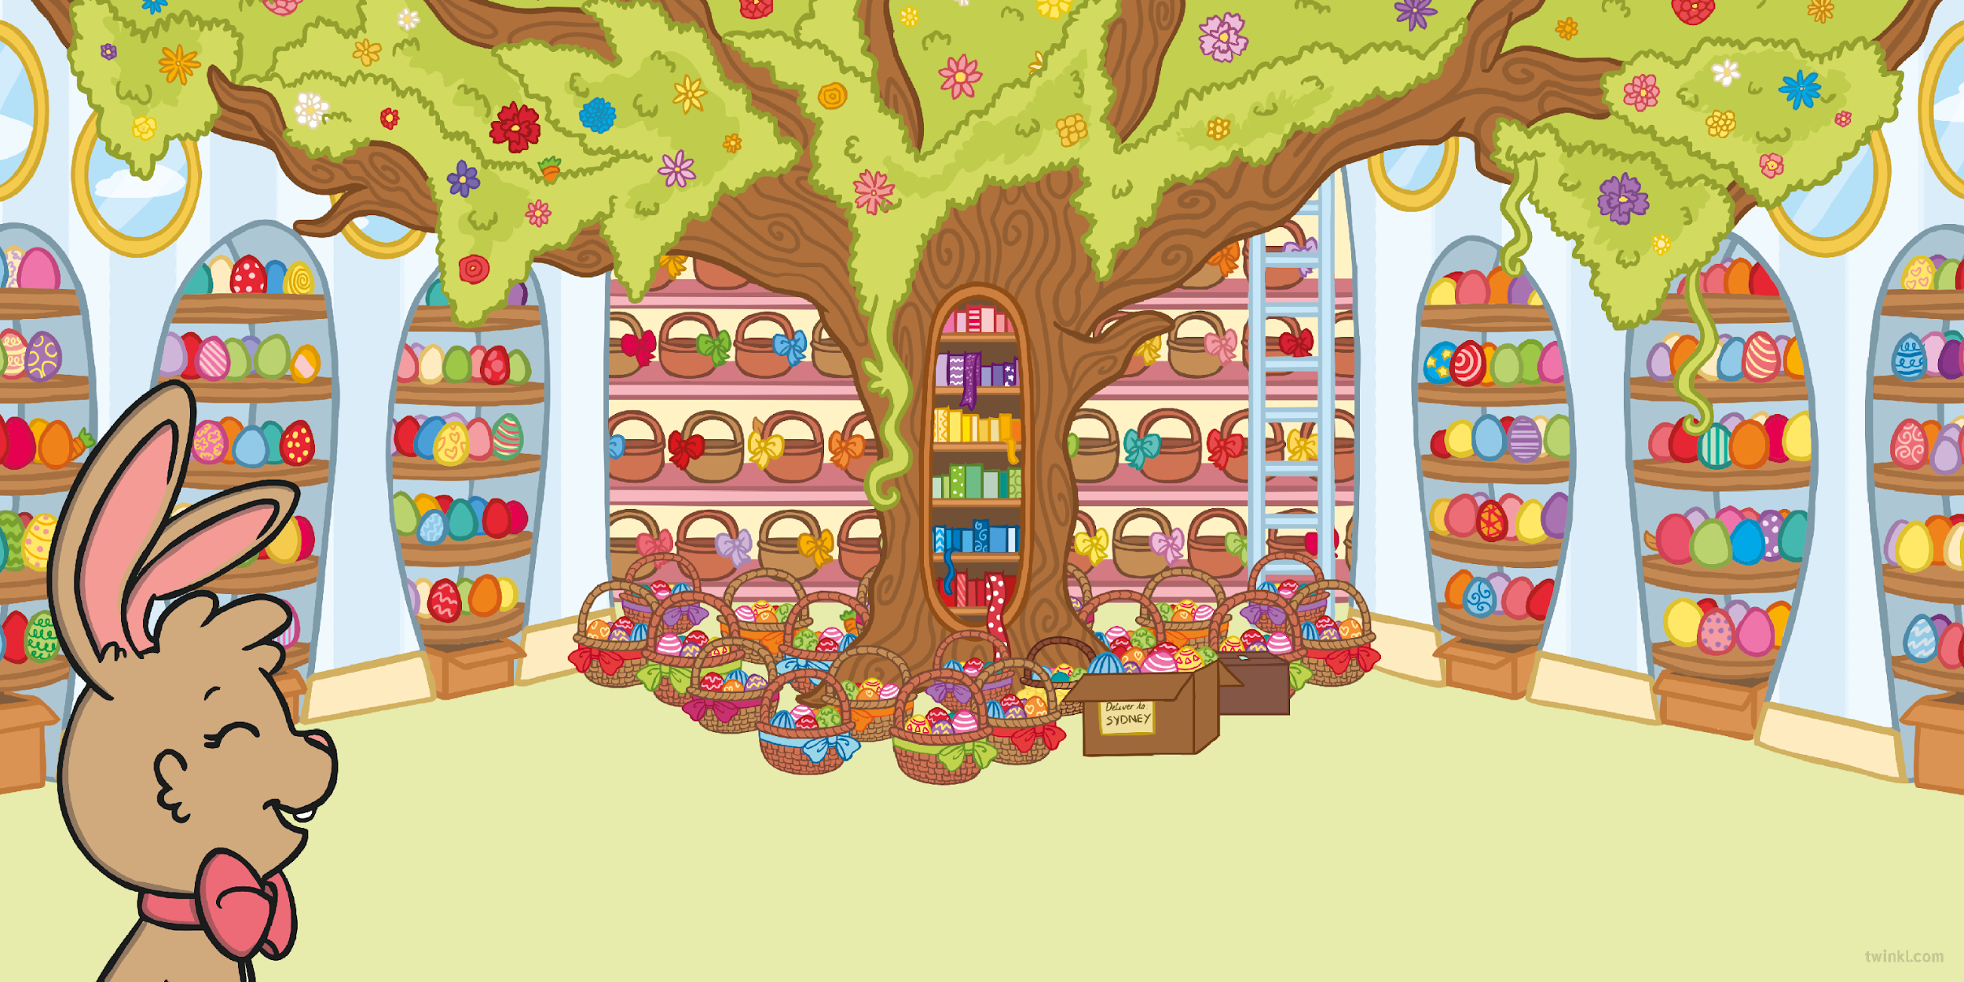
When they were finished, the Easter Bunny stood back to admire their work.
She let out a satisfied sigh. Her new friends had done it.
They had saved Easter!

Slide 15
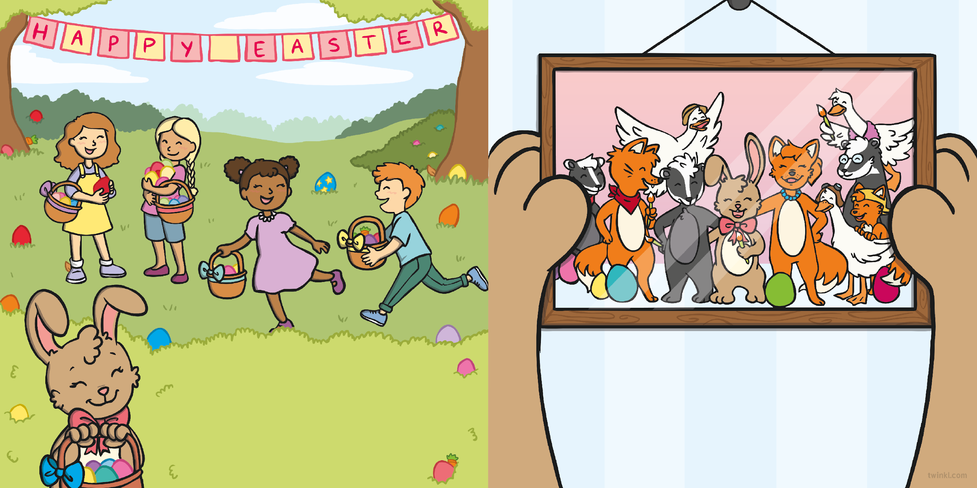
As Easter morning arrived, the eggs were collected together and the Easter Bunny delivered them to all the boys and girls, who were delighted.
The chickens returned, just like they said they would, but the Easter Bunny knew that if they ever needed a break again,
she had some new, unlikely friends
who she could rely on.
Resource: Easter egg / chocolate

Slide 17
