Slide 1
We’re going on a minibeast hunt!

Slide 2
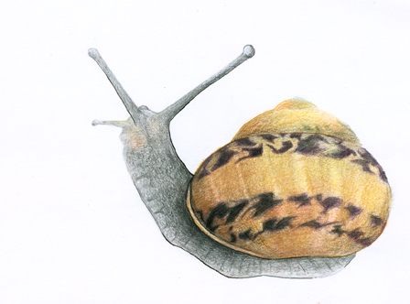
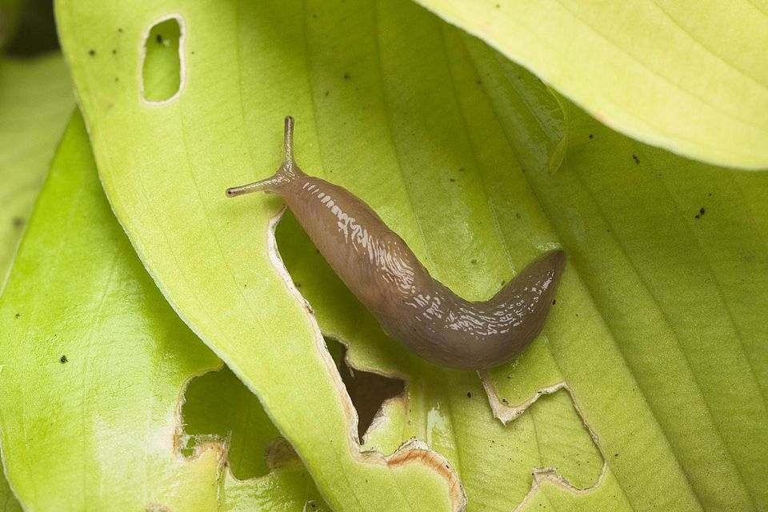
We’re going on a minibeast hunt, we’re going to catch some slimey ones! What a beautiful day, we’re not scared!

Slide 3
Oh no! Long grass!
We can’t go over it! We can’t go under it! We will have to go through it!
Swishy swashy, swishy swashy!

Slide 4
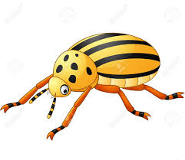
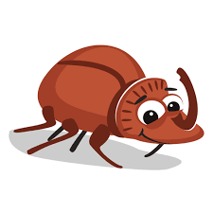
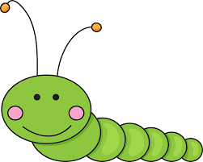
We’re going on a minibeast hunt, we’re going to catch some big ones! What a beautiful day, we’re not scared!

Slide 5
Oh no! A swamp!
We can’t go over it! We can’t go under it! We will have to go through it!
Squelch squerch, squelch, squerch!

Slide 6
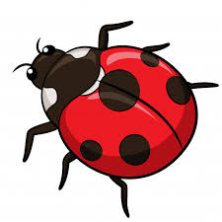
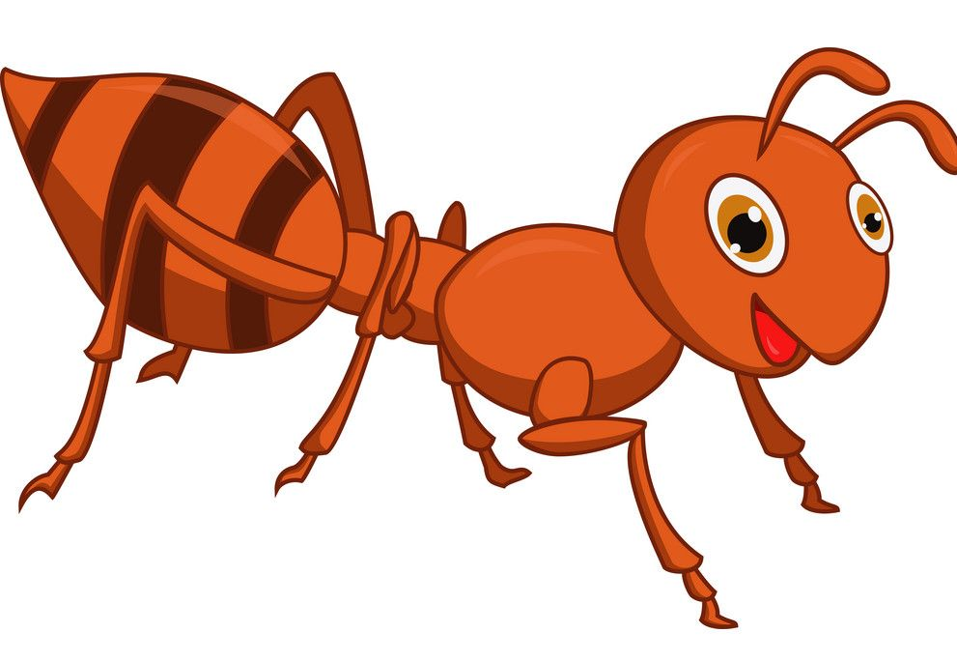
We’re going on a minibeast hunt, we’re going to catch some small ones! What a beautiful day, we’re not scared!

Slide 7
Oh no! A River!
We can’t go over it! We can’t go under it! We will have to go through it!
Splish splash, splish splash!

Slide 8
We’re going on a minibeast hunt, we’re going to catch some flying ones! What a beautiful day, we’re not scared!

Slide 9
Oh no! Mud!
We can’t go over it! We can’t go under it! We will have to go through it!
Squish squash, squish, squash!

Slide 10
We’re going on a minibeast hunt, we’re going to catch some creepy ones! What a beautiful day, we’re not scared!

Slide 11
Oh no! What’s that!
2 big eyes,
8 long hairy legs,
It’s a spider!!

Slide 12
Quick!
Back through the mud - squish squash, squish squash.
Back through the river - splish splash, splish splash.
Back through the swamp - squelch squerch, squelch squerch.
Back through the grass - swishy swashy, swishy swashy.
Into the house, shut the door, into bed, under the covers.
WE’RE NOT GOING ON A MINIBEAST HUNT AGAIN!!

