Slide 1
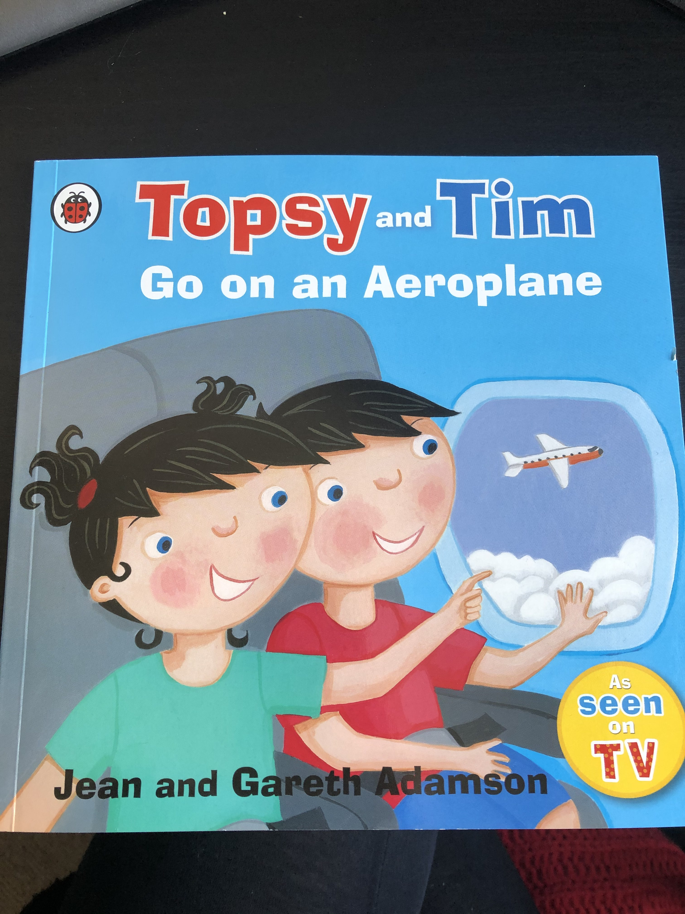

Slide 2
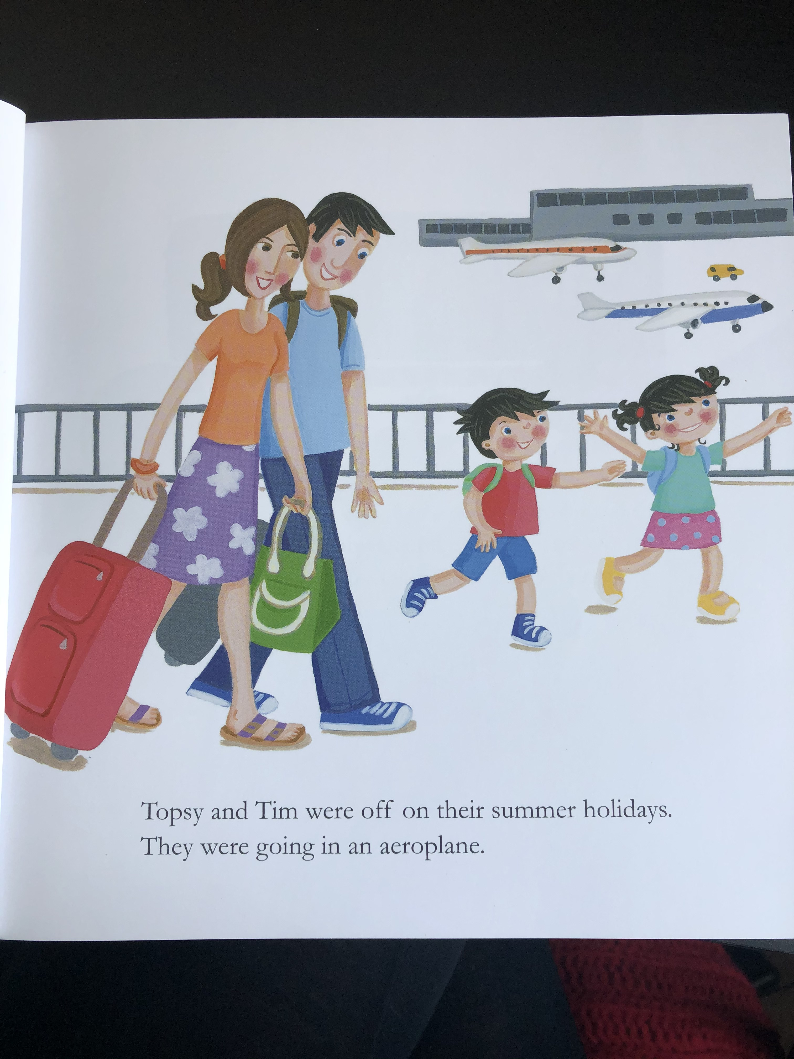
Resource:
Airplane sound / picture of an airplane

Slide 3
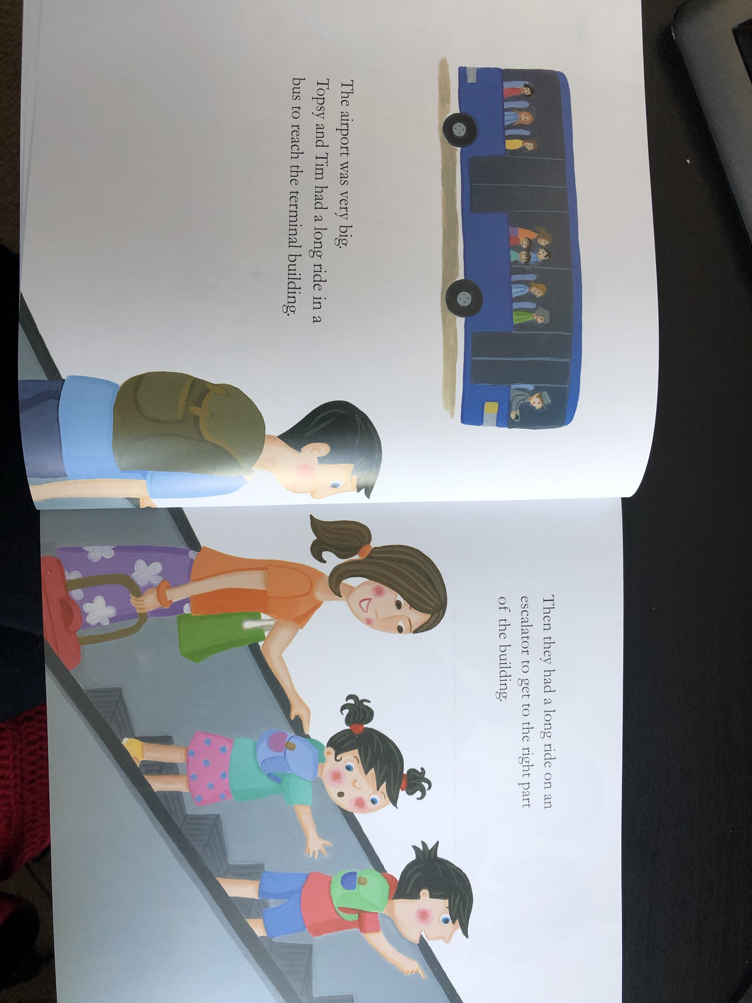
Resource:
Bus toy or the song ‘the wheels on the bus’

Slide 4
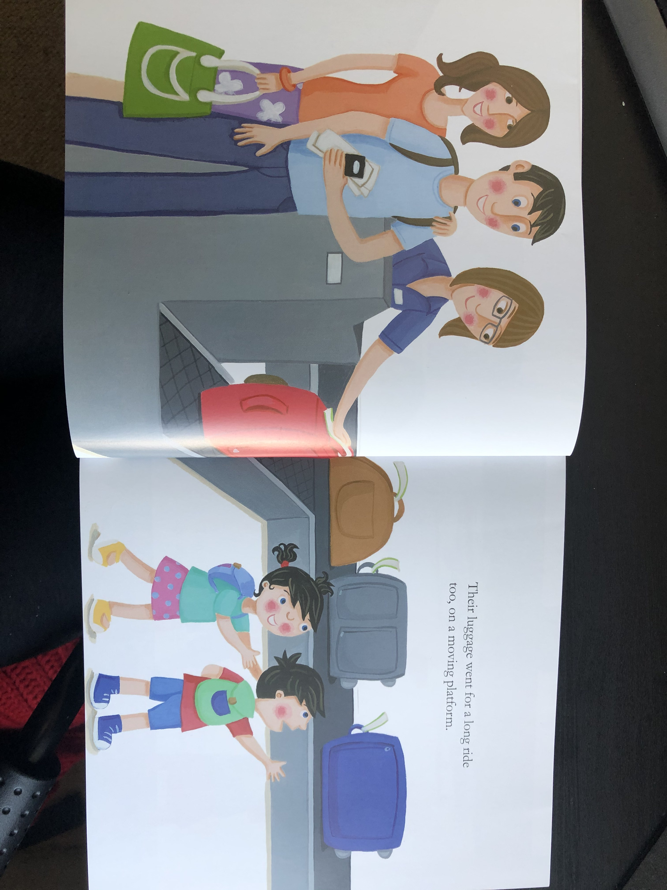
Resource:
Suitcase / bag for your child to feel

Slide 5
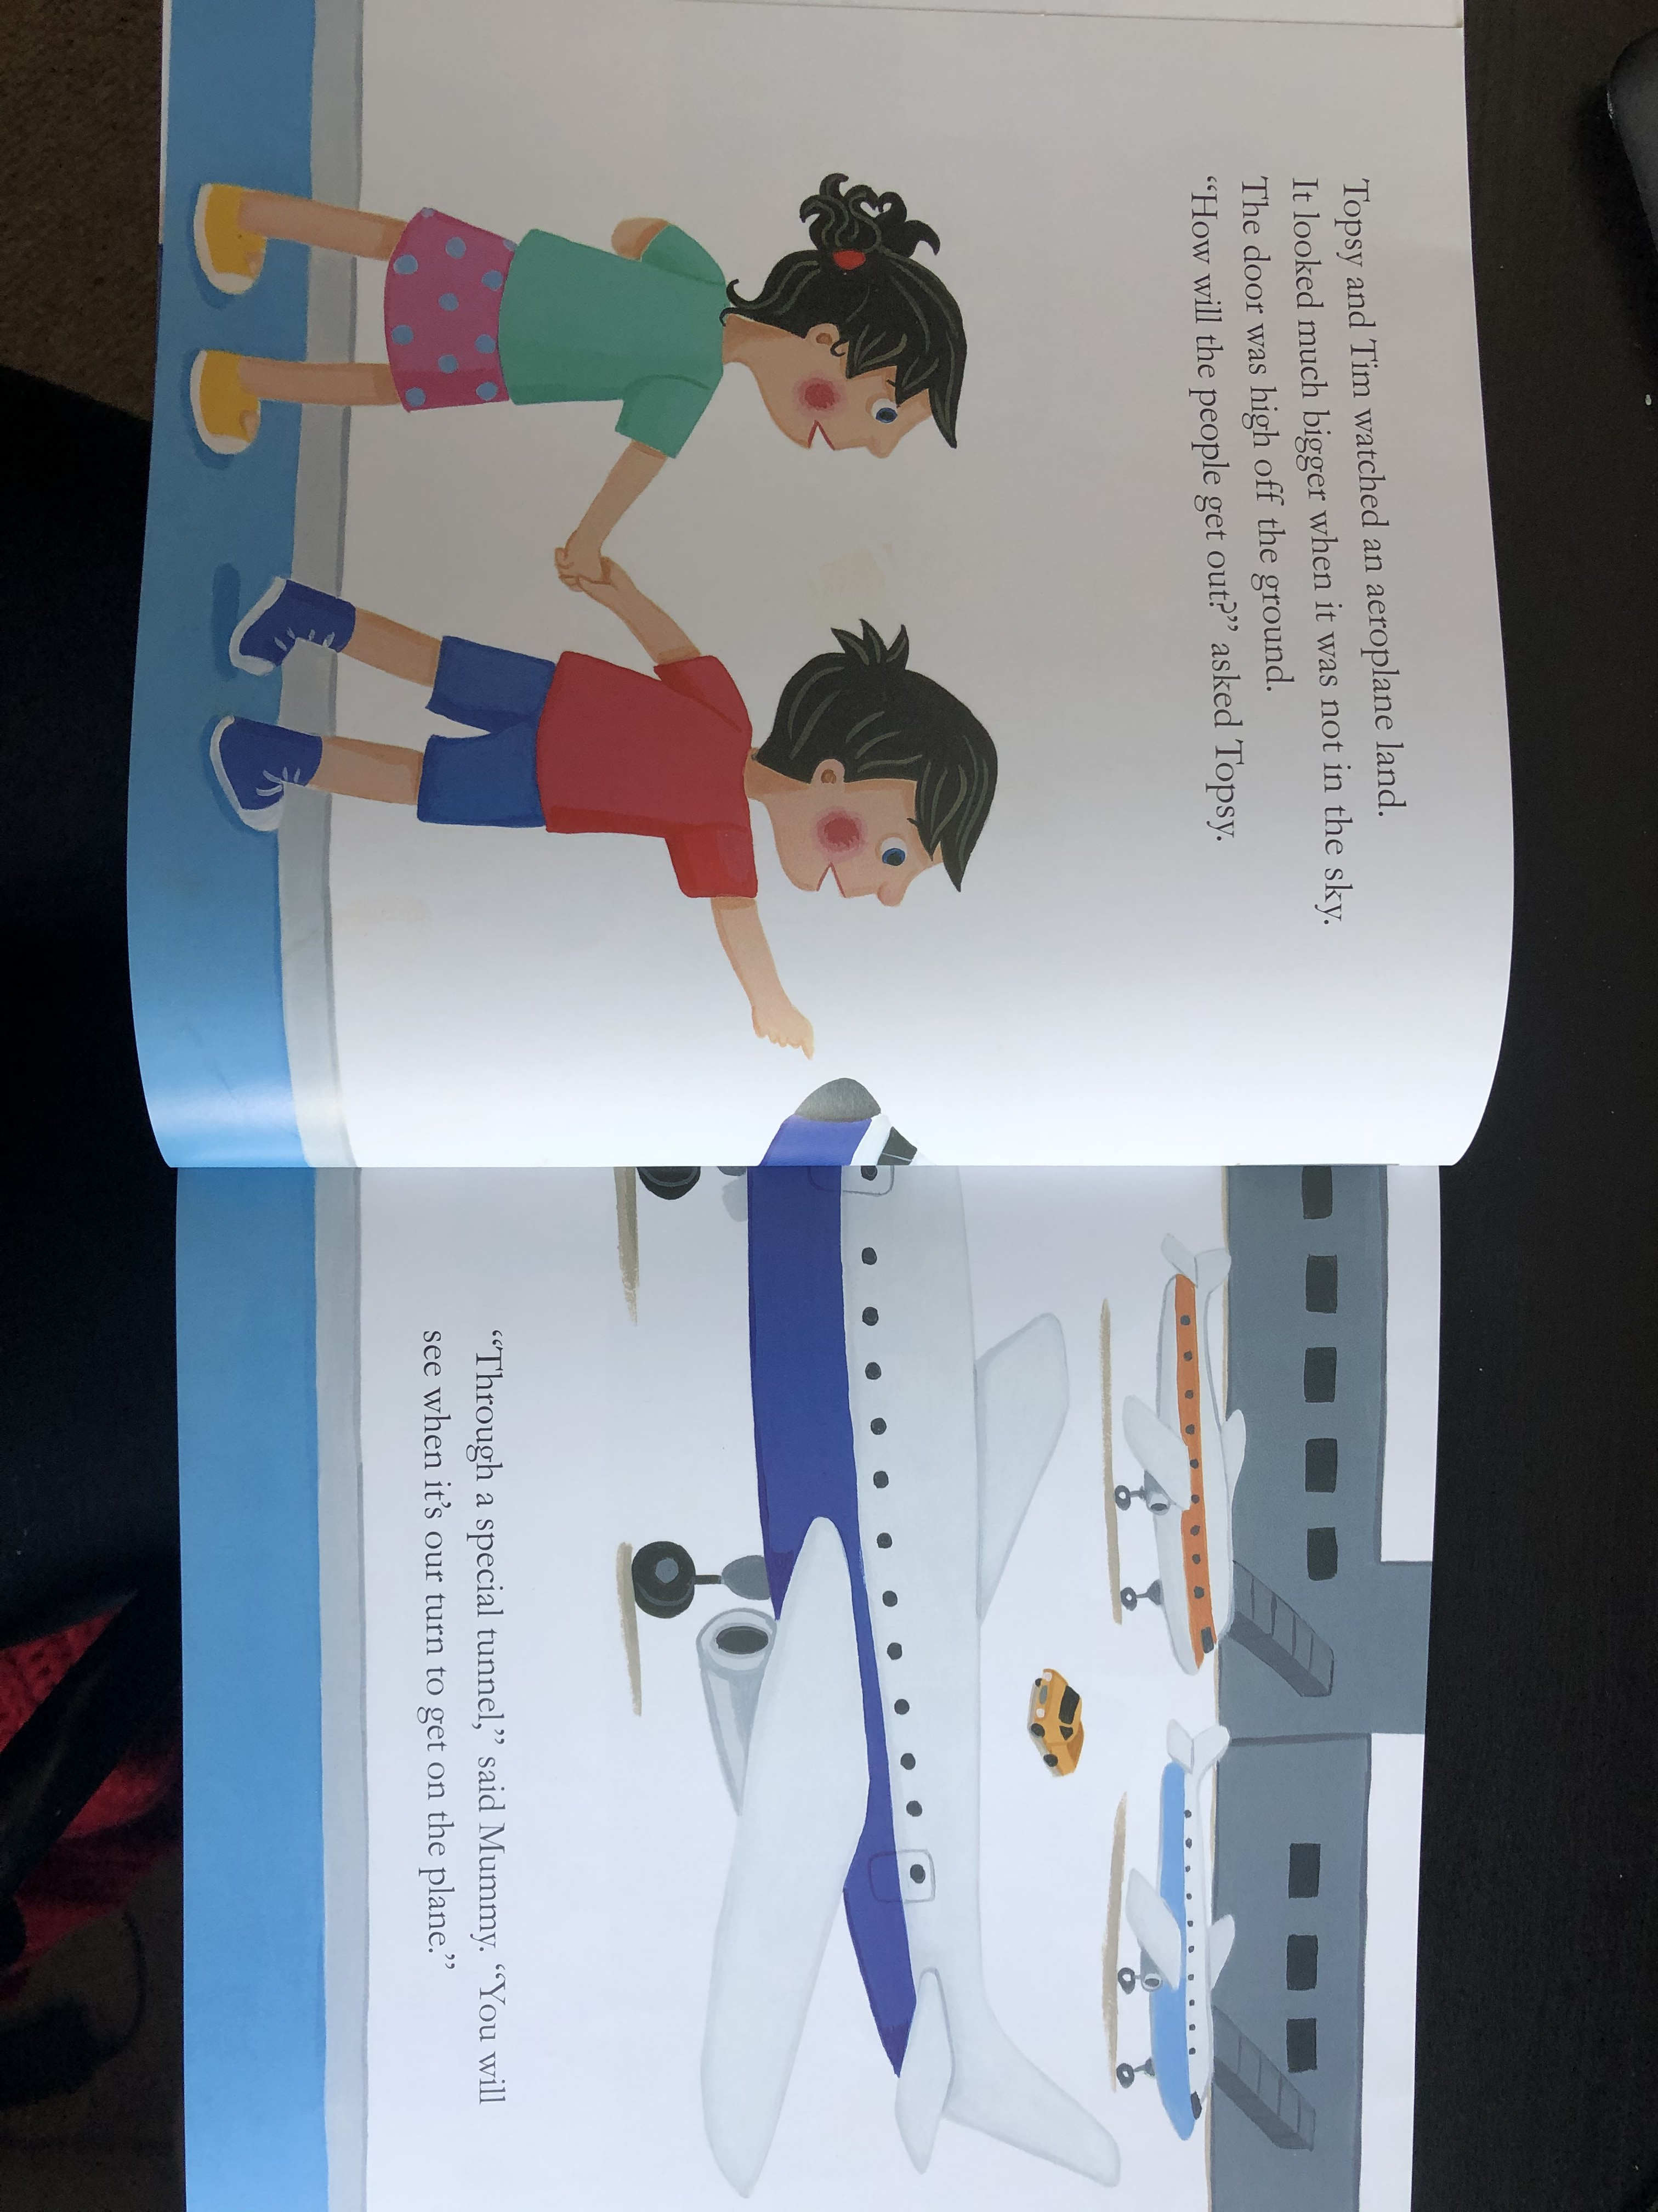
Resource:
Airplane sound / picture of an airplane

Slide 6
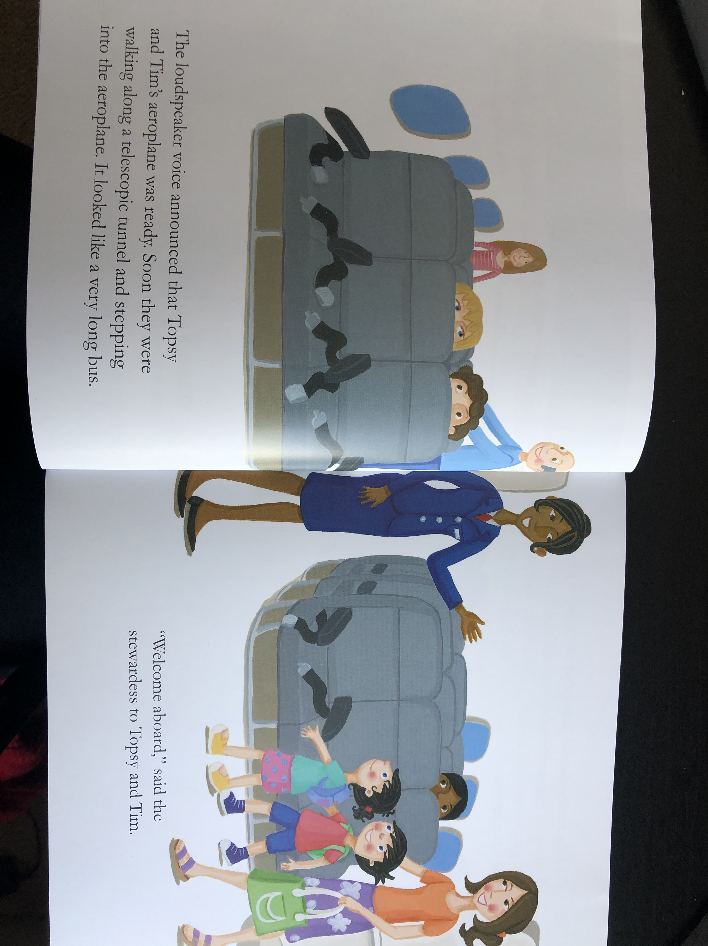

Slide 7
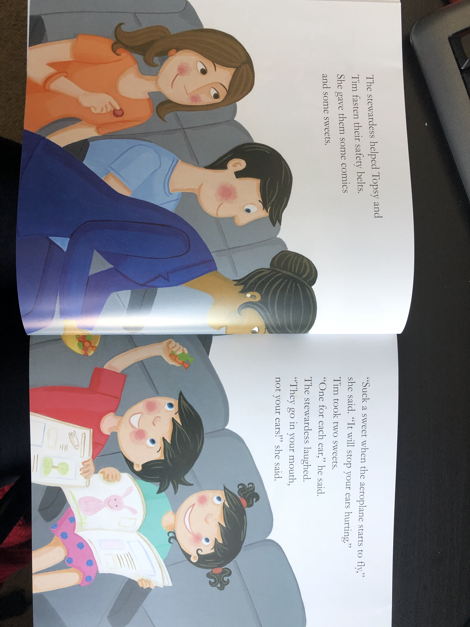
Resource:
Sweets / chocolate to smell, feel or taste

Slide 8
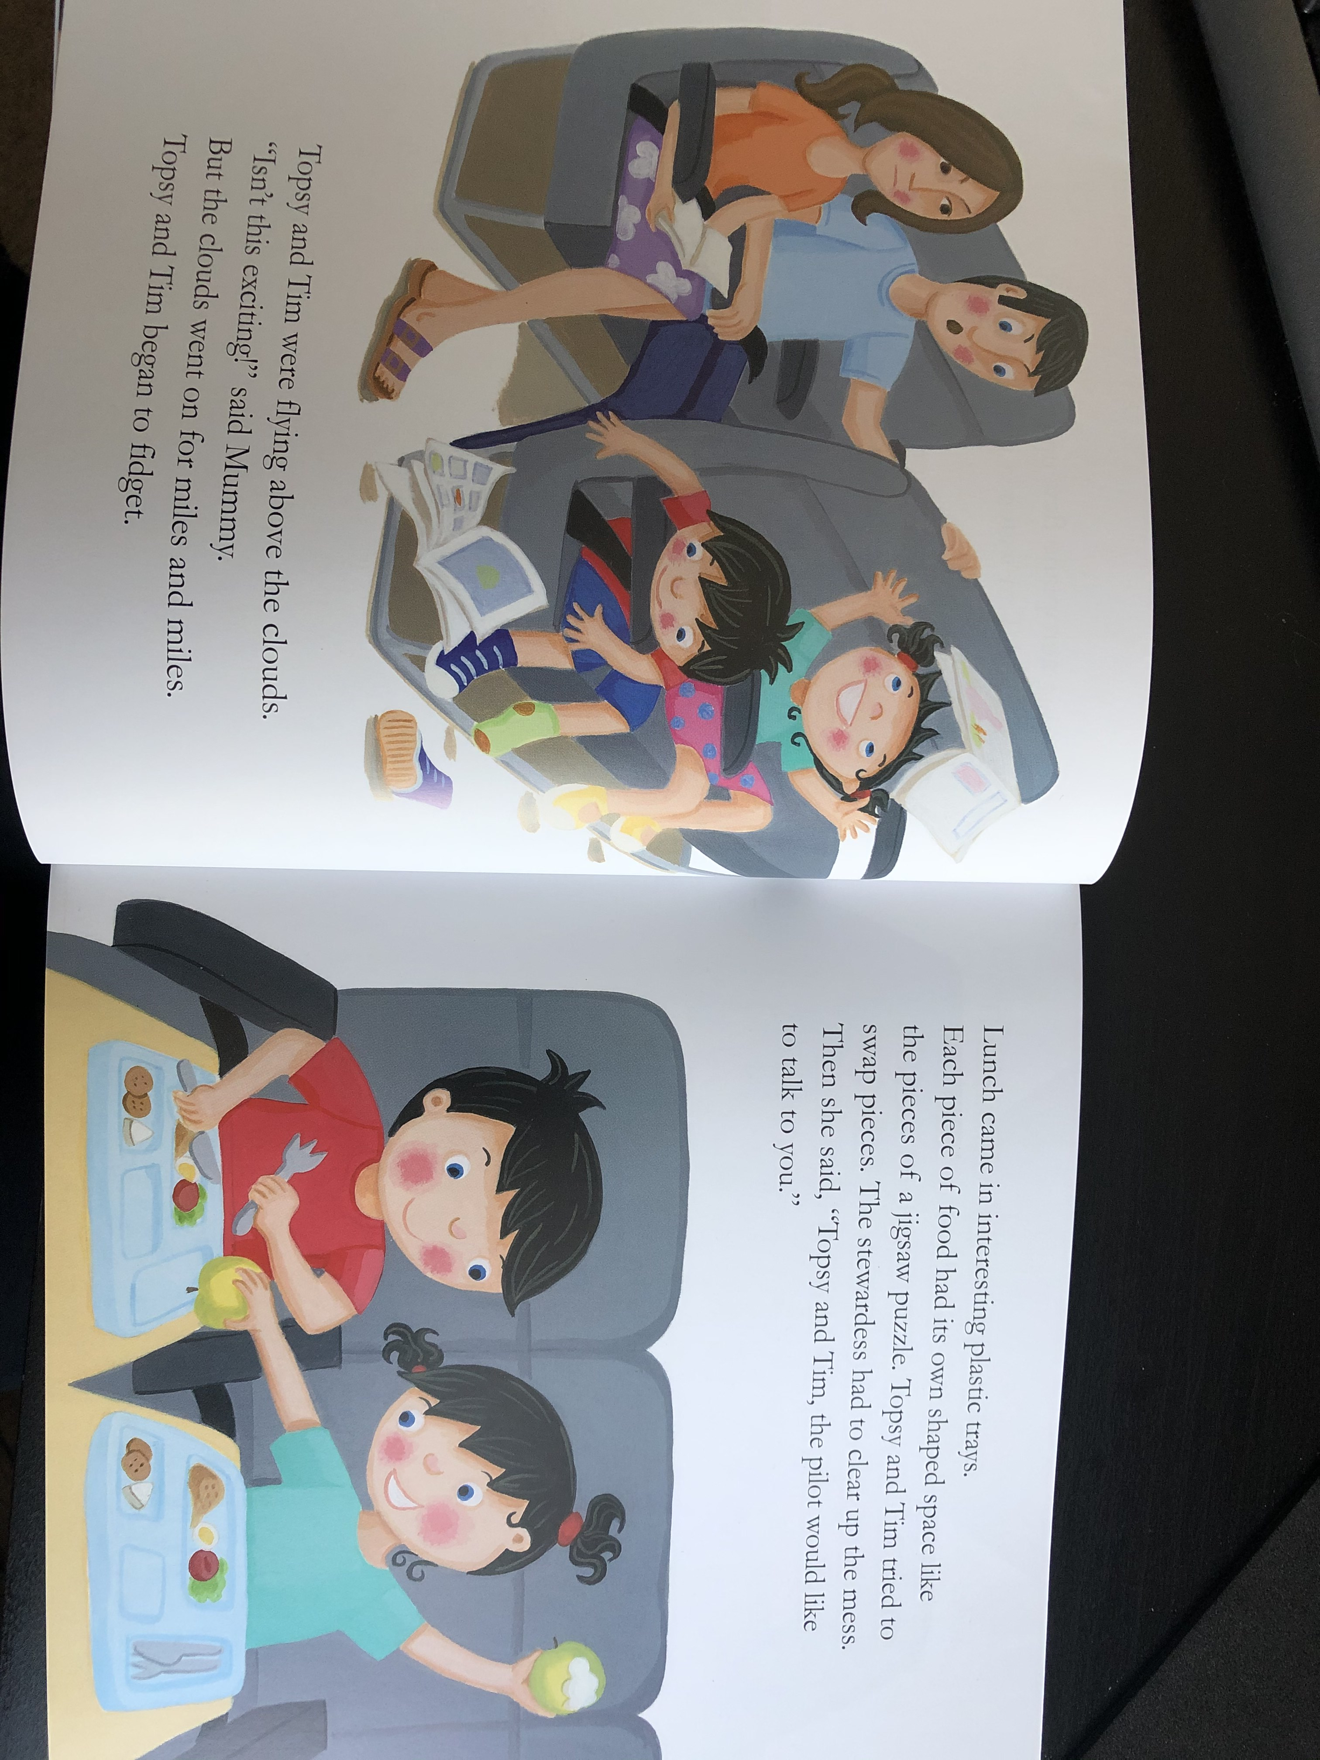
Resource:
Cotton wool (for clouds)

Slide 9
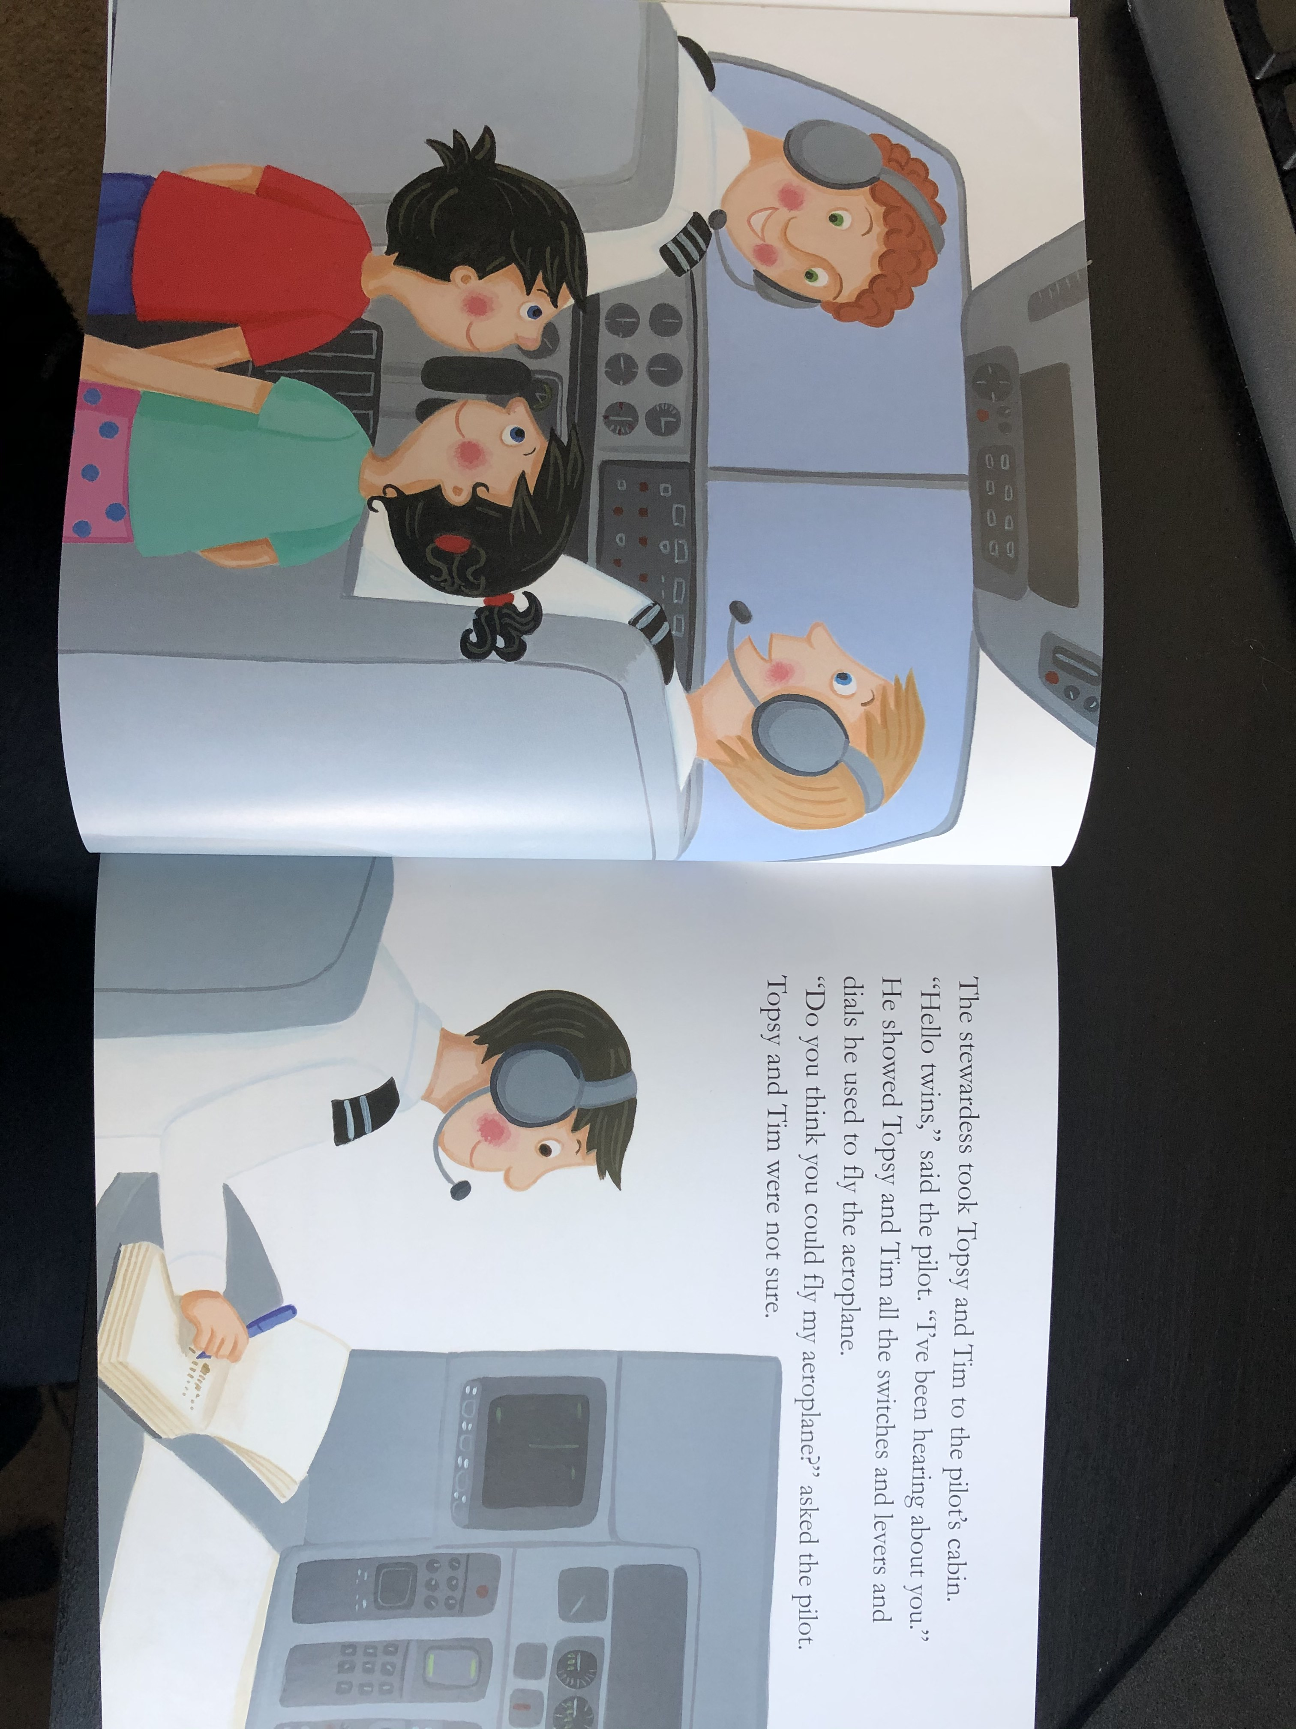
Resource:
Headphones, buttons for children to press (perhaps a remote?)

Slide 10
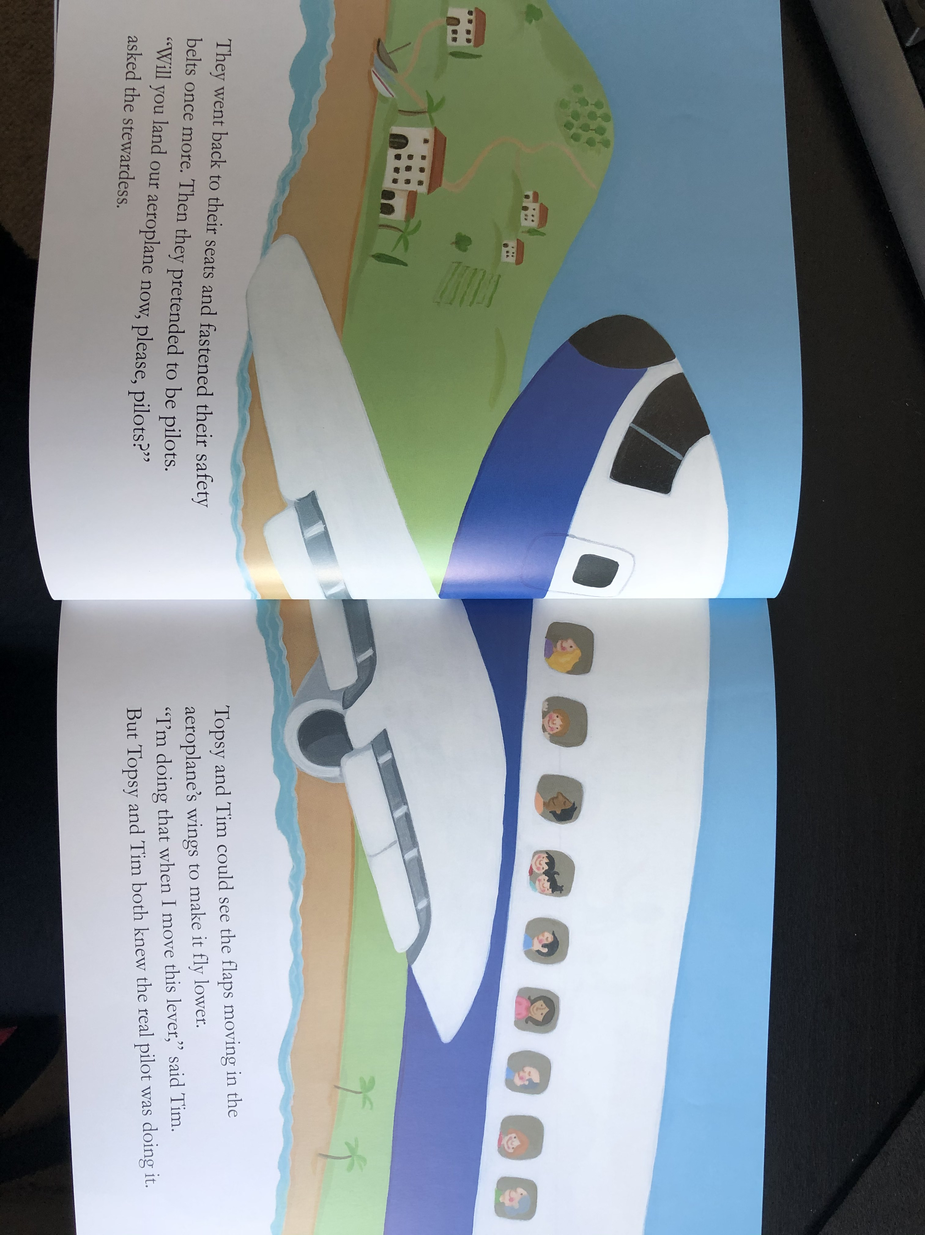

Slide 11
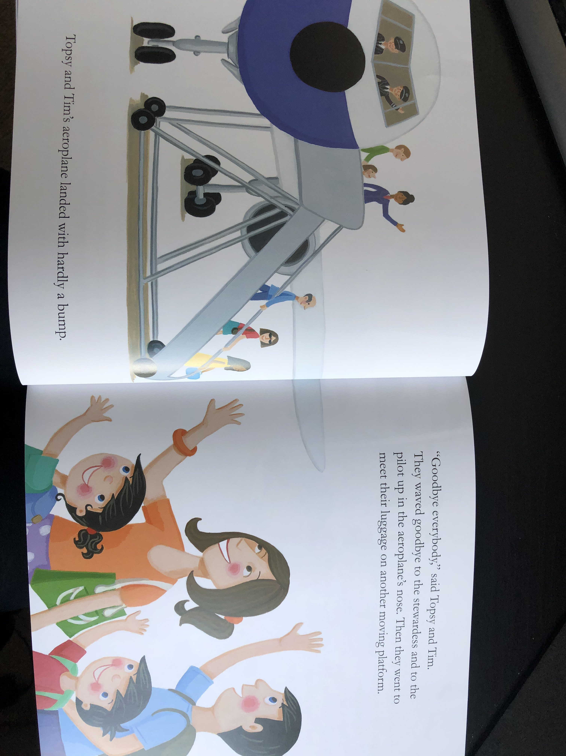
Resource:
Waving goodbye

Slide 12
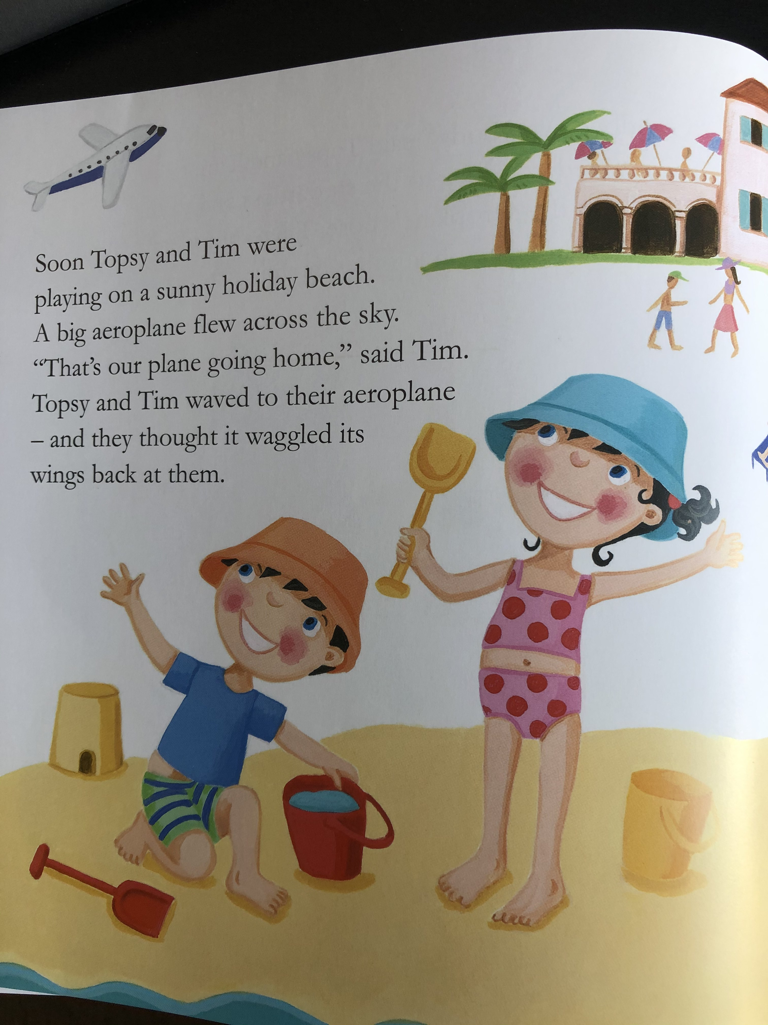
Resource:
Sand / water
Airplane sound

