Slide 1
Notes:
Drag the day of the week and the taste of the day into the box
Taste and smell the cherry if available.

Slide 2
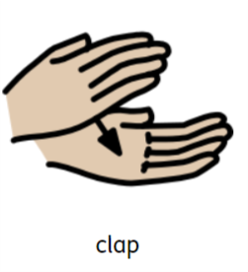
https://www.youtube.com/watch?v=MOWDb2TBYDg
Notes:
Turn the lights off and make a relaxing setting. Clap hands to different speeds. Clap hands on knees.

Slide 3
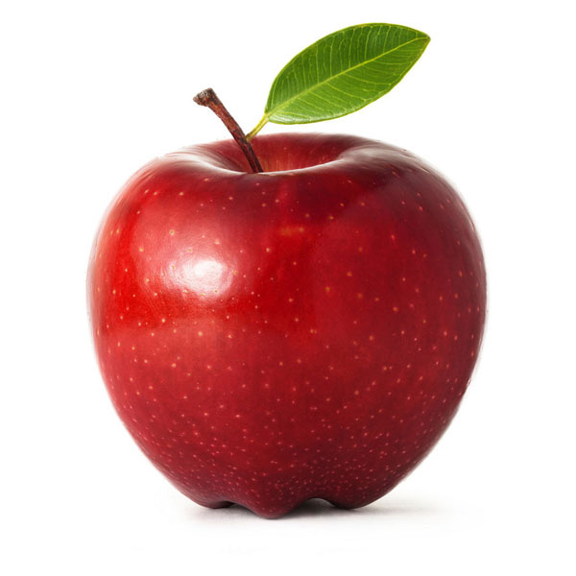
HP, TI, SO, BS and BG- Drag the red items into the box
Notes:
This slide is suitable for SO, TI, HP, BG and BS

Slide 4
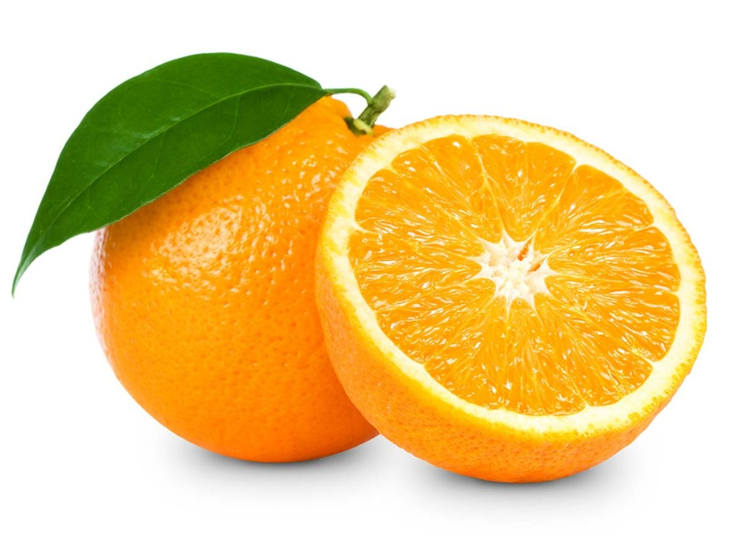
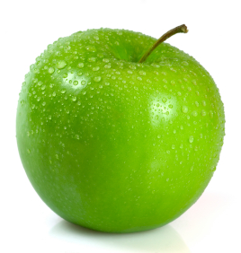
ML, JM and AM- Drag the red items into the box
Notes:
This slide is suitable for SO, TI, HP, BG and BS

Slide 5
Mathematics & Numeracy
Five Little Men
10 Fat Sausages
https://www.youtube.com/watch?v=2E3p_51tJx0
https://www.youtube.com/watch?v=pBjFM-Di7_M
Notes:
Counting songs- Mathematics and Numeracy

