Slide 1
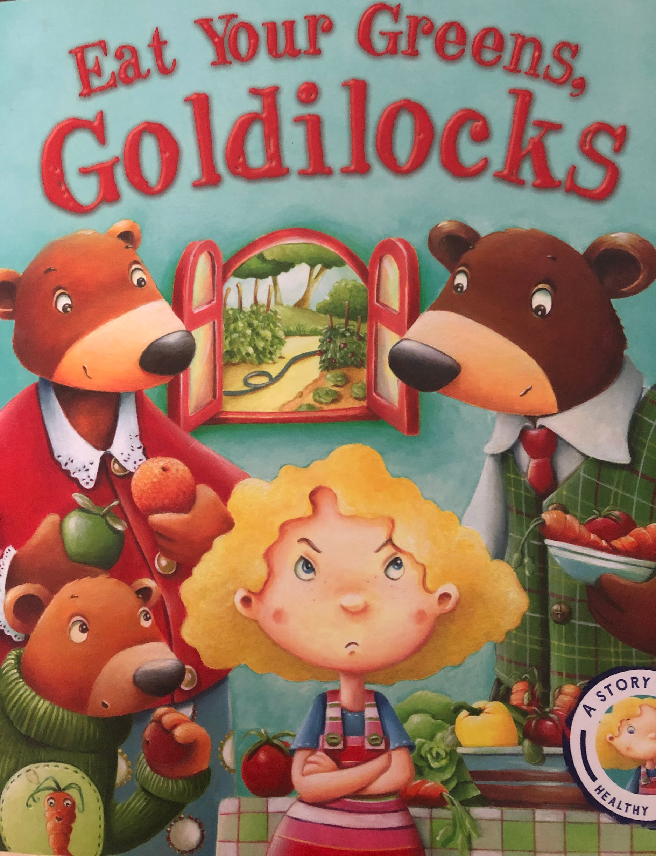

Slide 2
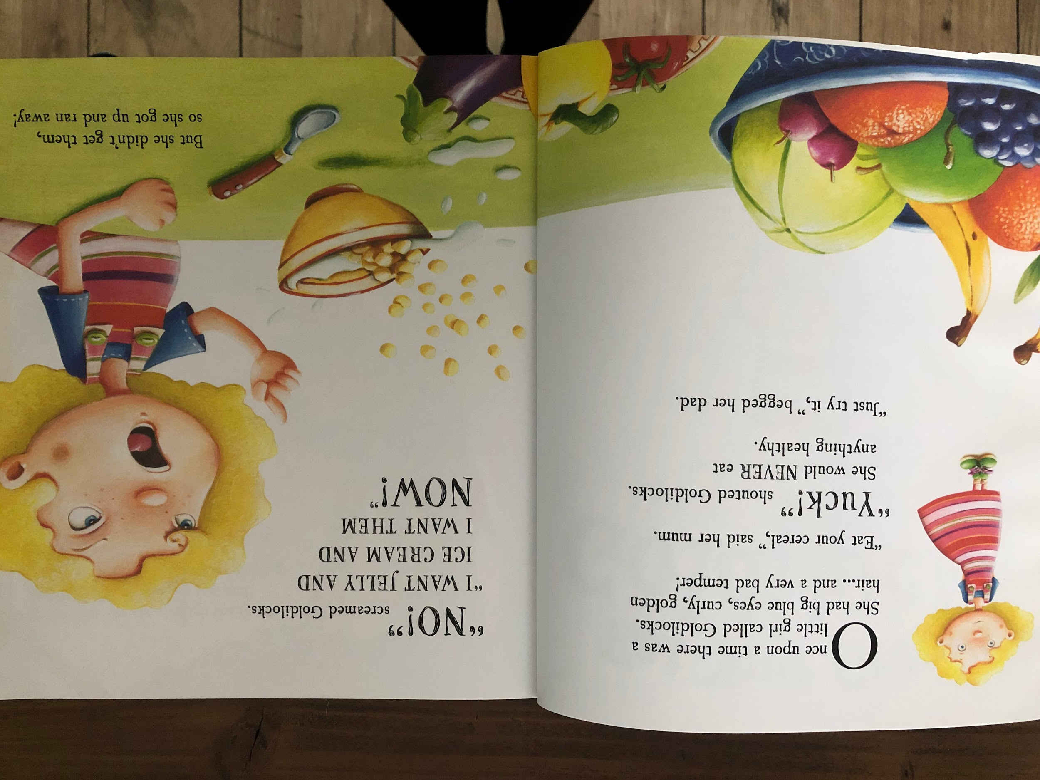
Resource: Puppet or doll

Slide 3
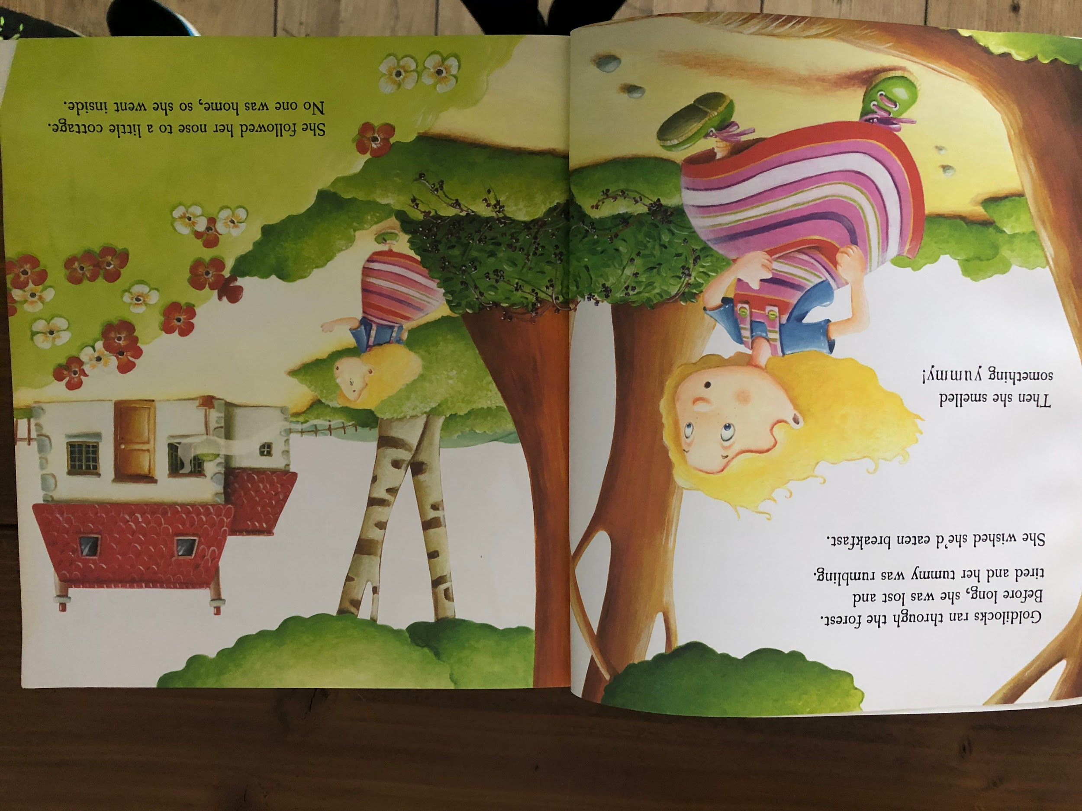
Resource: leaves, grass, sticks

Slide 4
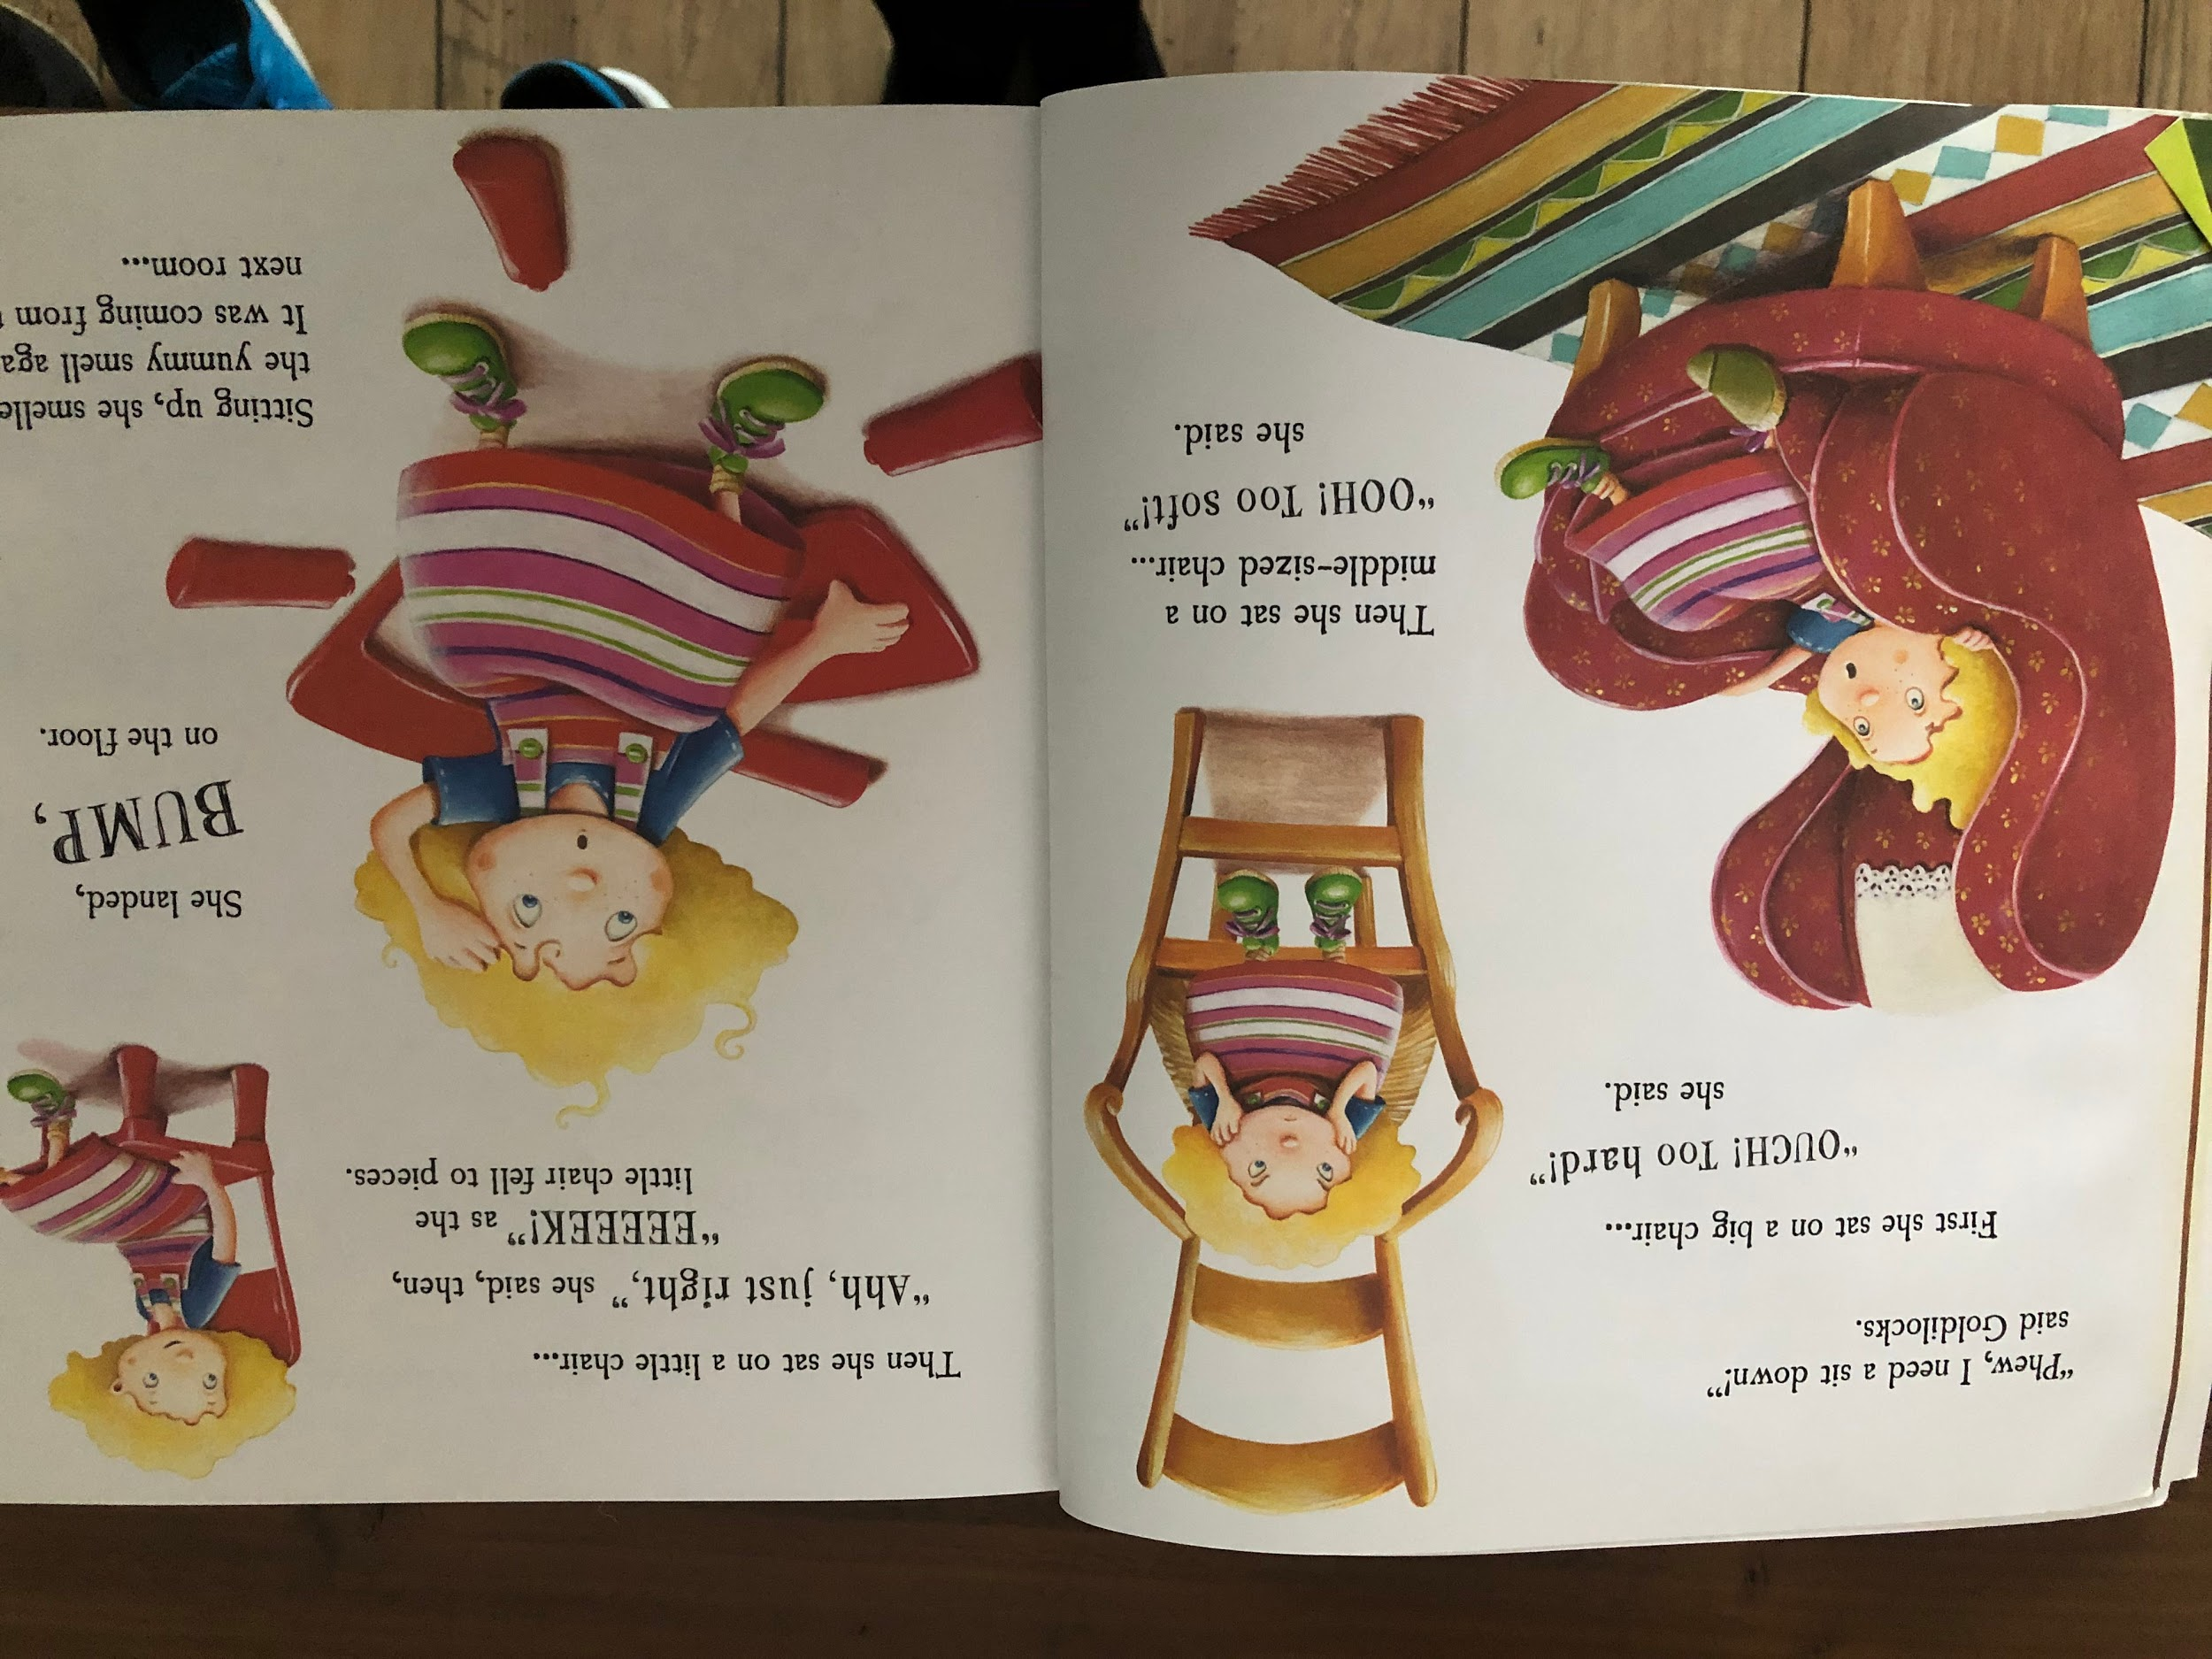
Resource: Something hard and something soft / big and small

Slide 5
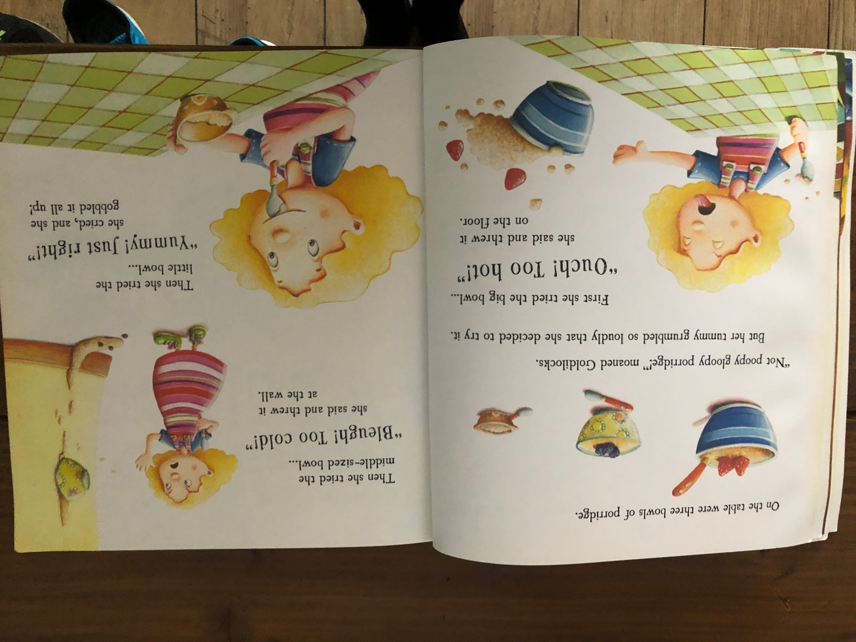
Resource: Oats, spoon and bowls (you could do something hot and something cold aswell)

Slide 6
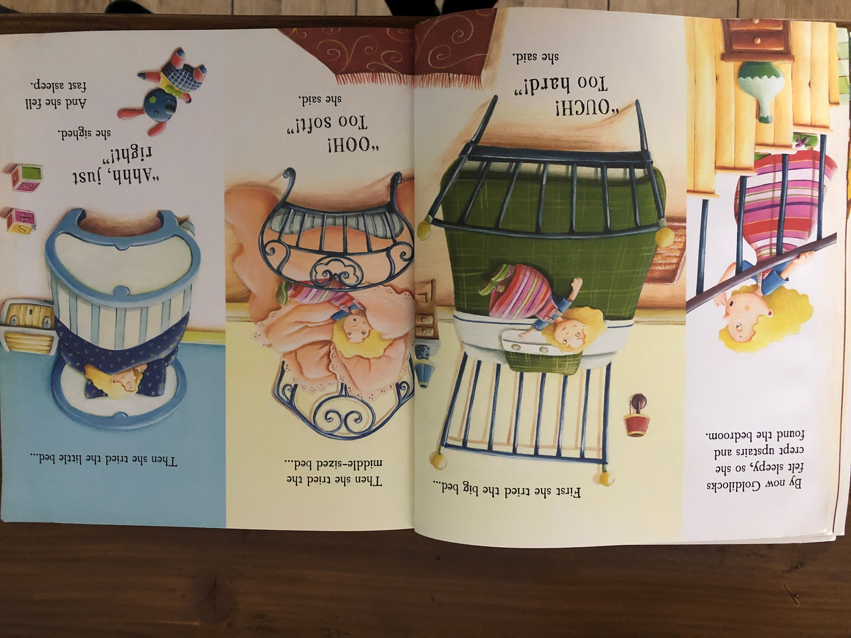
Resource: Something hard and soft (you could also do big and small)

Slide 7
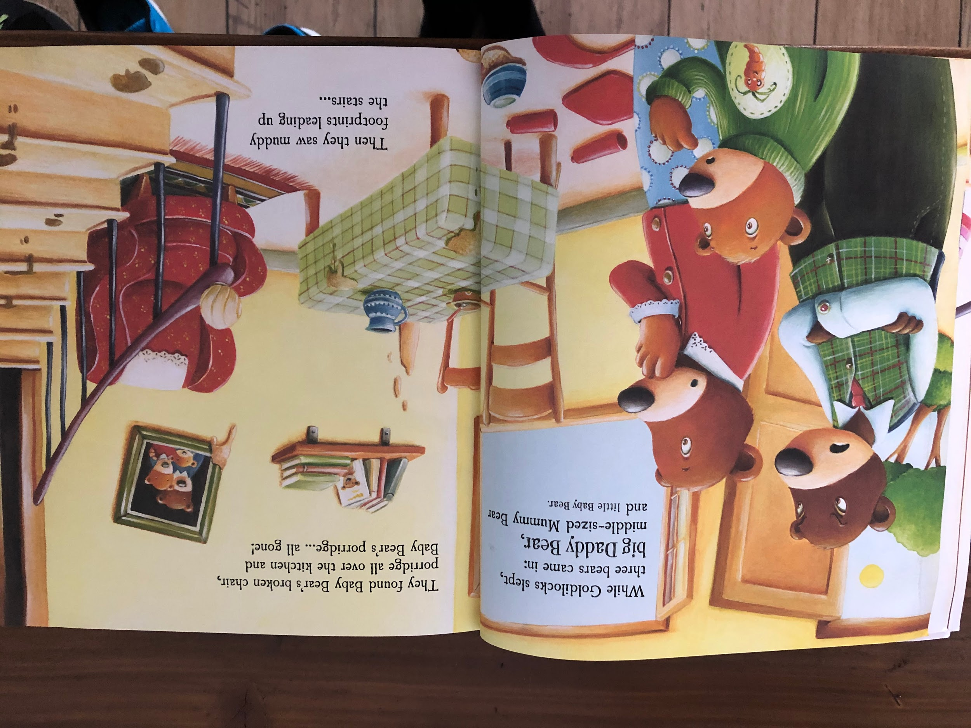
Resource: Teddy bear (3 if you have 3, and of different sizes if possible!

Slide 8
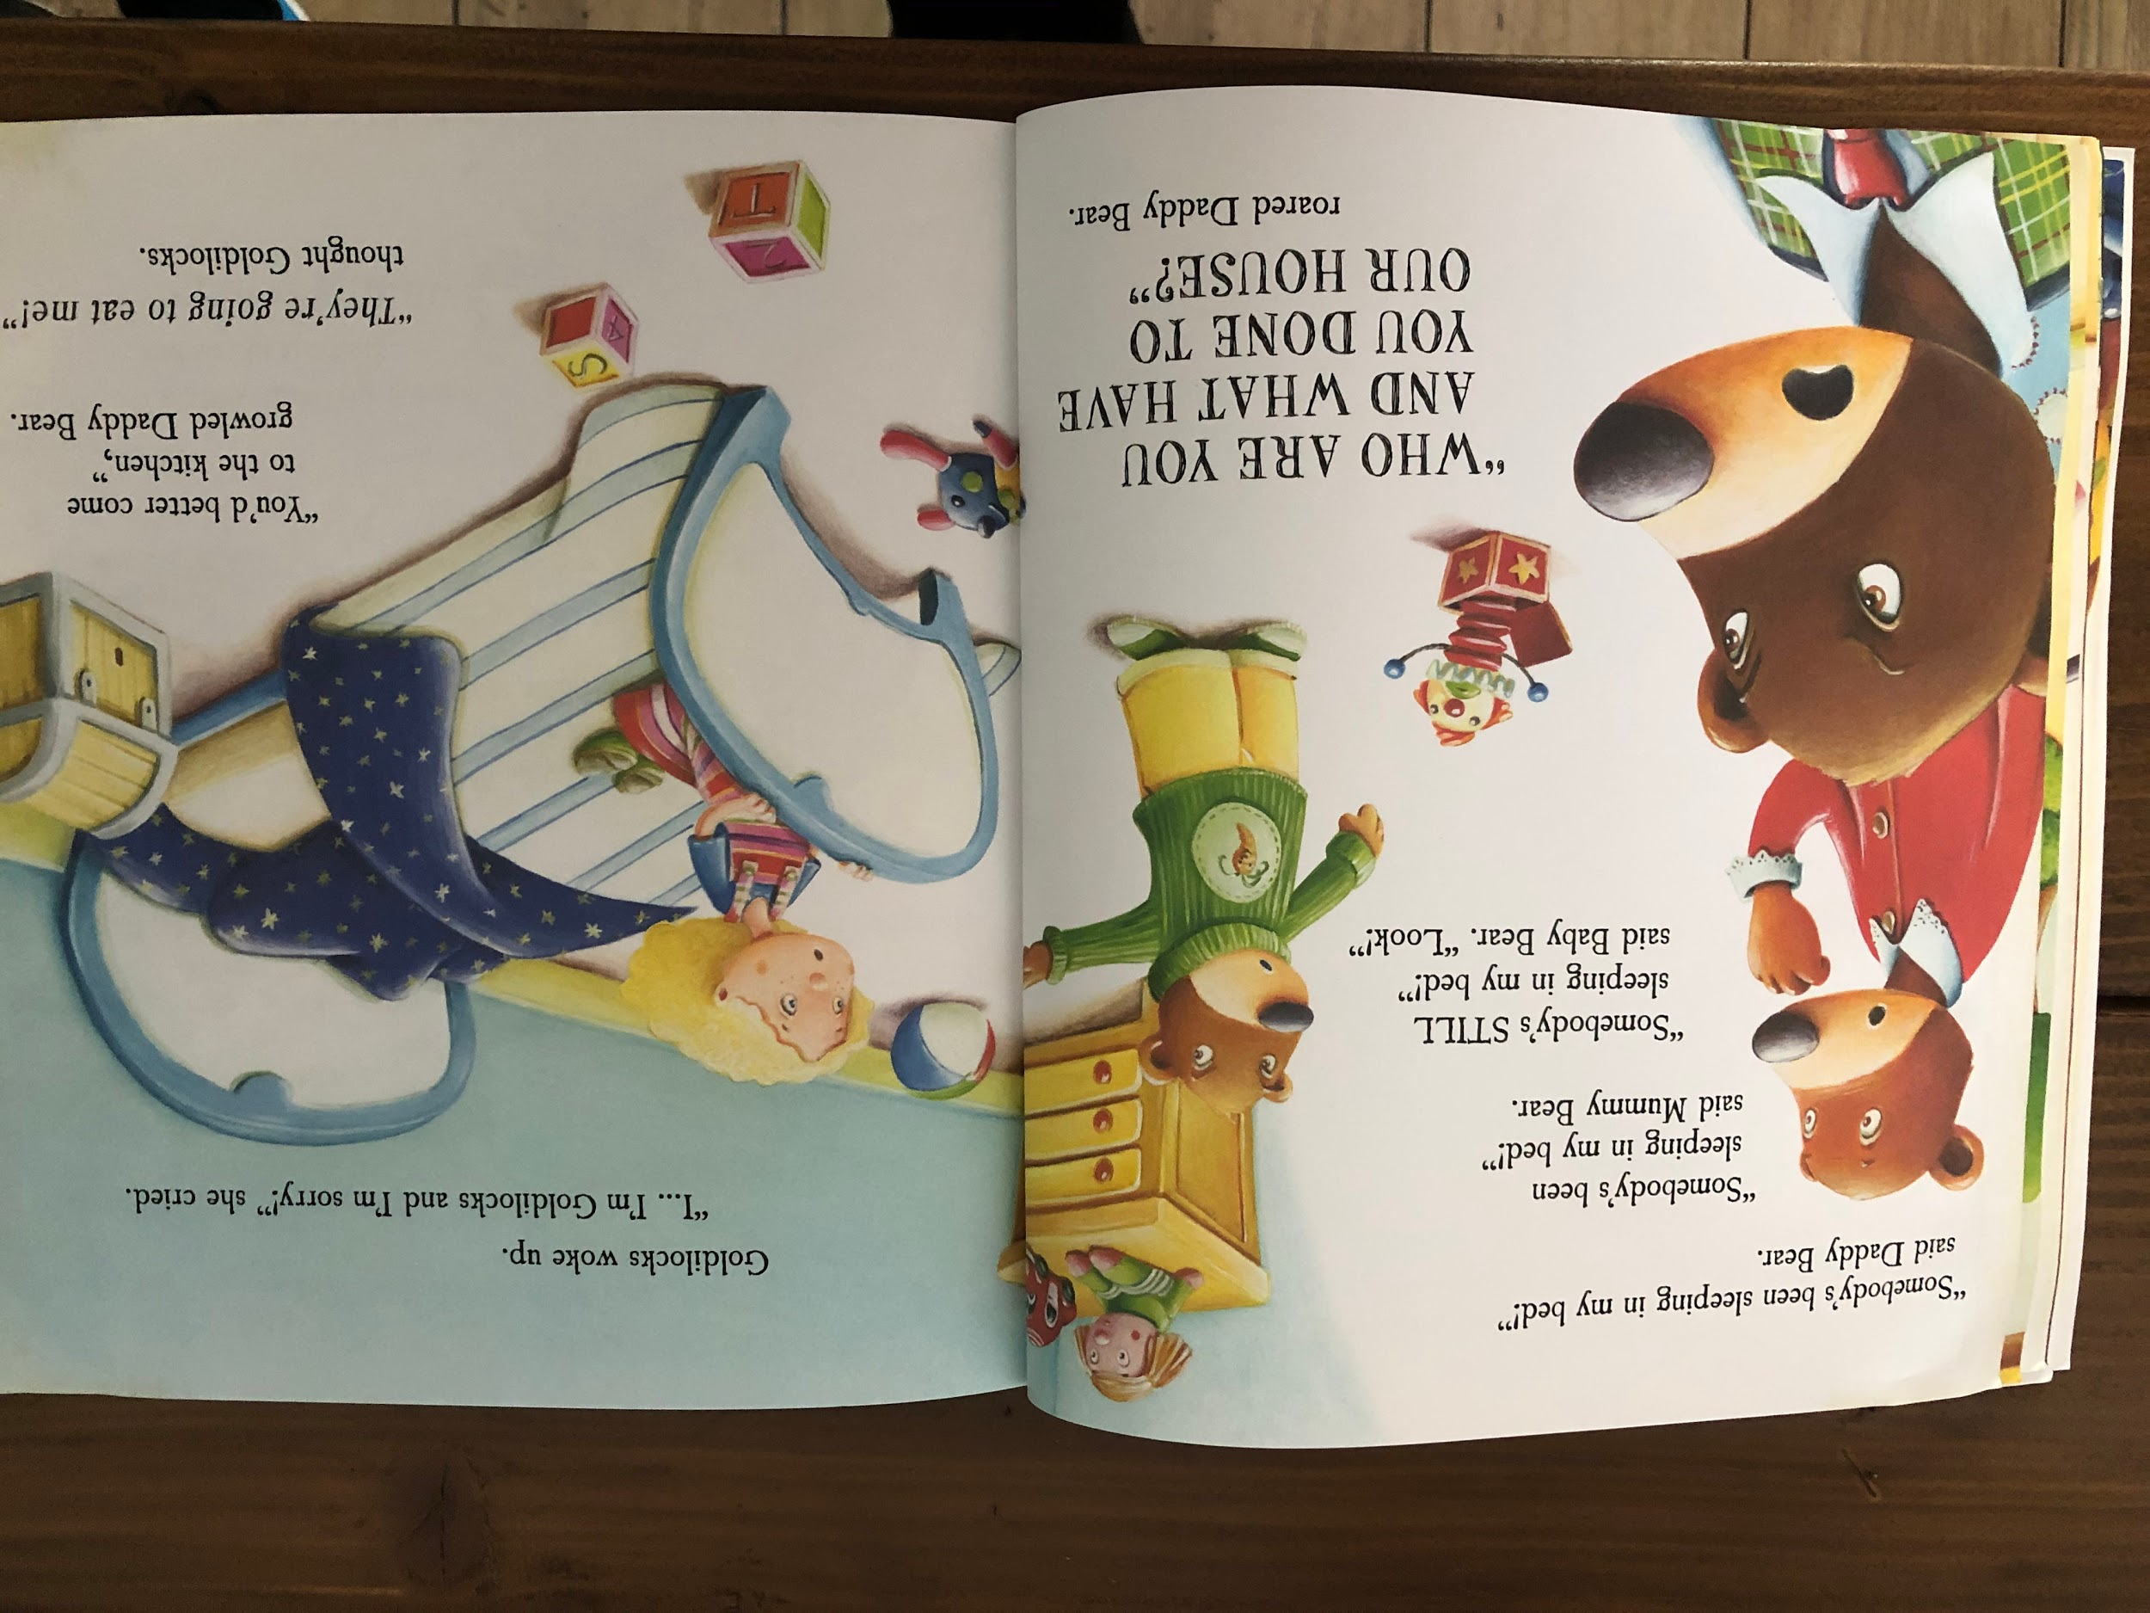

Slide 9
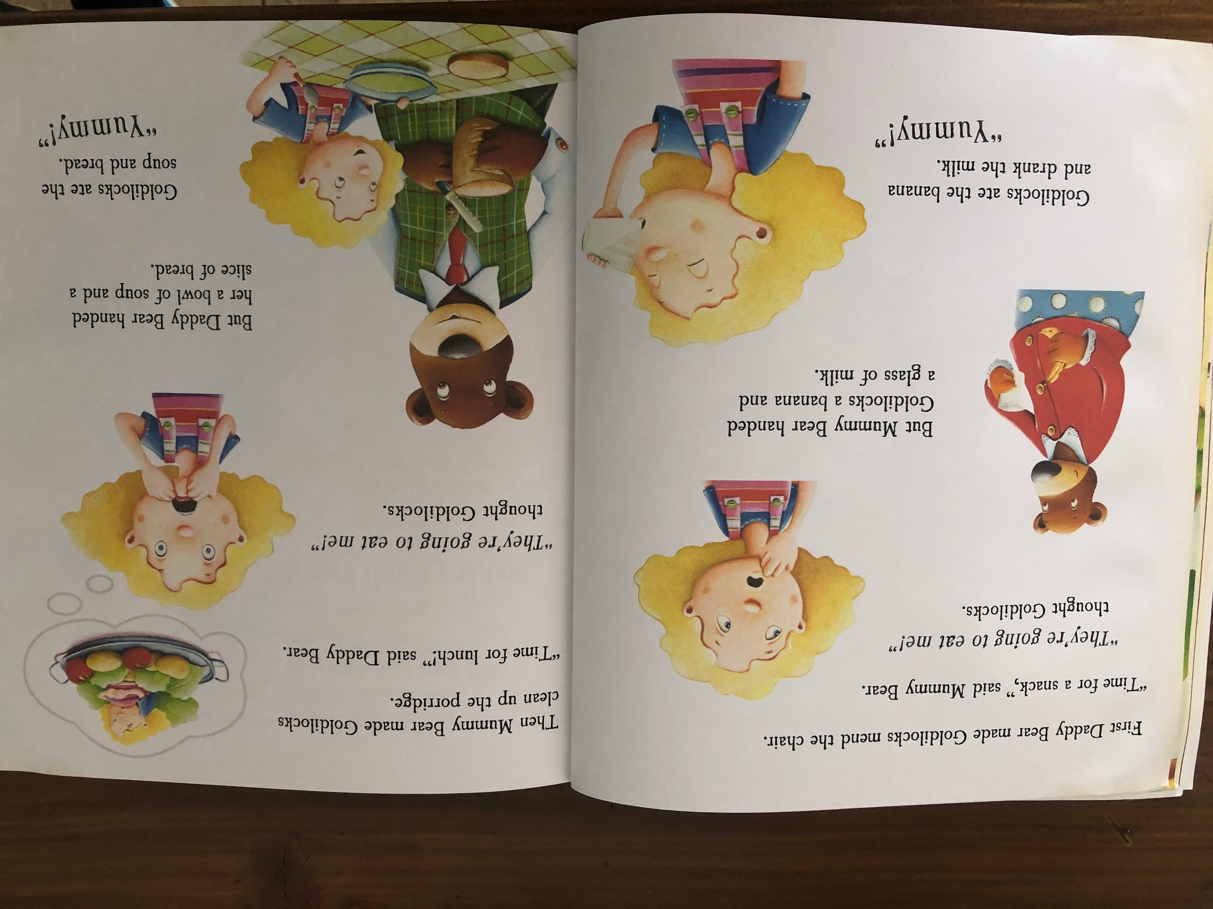
Resource: Foods to smell, feel and taste

Slide 10
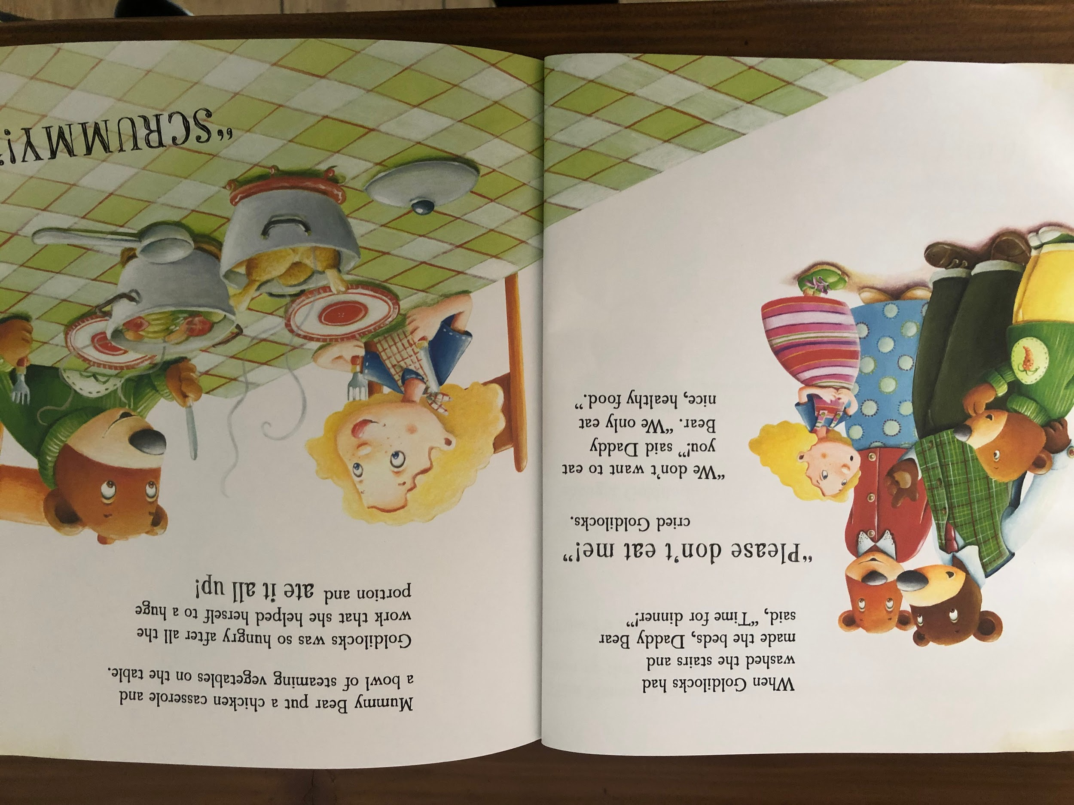
Resource: Vegetables to feel

Slide 11
