Slide 1
Sensory Play Activity suggestions
Skills to work on during sensory play activities:
During sensory play activities encourage your child to develop their fine motor skills through using their hands/fingers to make marks.
Sensory play can be a brilliant way of developing communication skills and encouraging social interaction through engaging in eye contact, playing alongside your child and by copying any sounds / actions that your child makes.
You could develop turn-taking skills with your child through these activities using a ‘your turn’, ‘my turn’ style of approach.
You can also develop numeracy skills by hiding objects / numbers in the sensory play and encourage your child to find and count. Number songs can also be used to reinforce this.
Develop body awareness and sensory exploration - encourage children to explore the messy play with parts of their body other than their hands.
Have fun! Use sensory play as a way to play with and interact with your child.

Slide 2
Dried Food Products
Cereals: e.g. cornflakes, rice crispies, weetabix, shredded wheat, oats
Pasta / spaghetti (if you can find some in the shops!)
Flour / icing sugar / cocoa powder
Rice
Dried pulses such as lentils and split peas

Slide 3
Examples of wet food products
Cereals: Dry cereals mixed with milk or water, e.g. porridge, weetabix
Angel delight
Mashed potatoes / smash / mashed vegetables
Cooked pasta, spaghetti, noodles, rice
Baby food jars
Jelly
Ice cream
Custard / gravy / jams / melted chocolate / icing
Tinned foods such as beans, mushy peas, spaghetti hoops
Cornflour and water

Slide 4
Other
Shaving foam
Soapy foam
Bubble bath / bath fizzers
Hair gel
Soap flakes
Sand
Water
Gellibaff / Gellislime (you can buy on Amazon)
Slime / conditioner slime
Playdough / saltdough
Natural resources: grass, sticks, mud etc
Cloud dough
Sensory bags
Paint - try painting with things other than brushes/hands. E.g. scouring brushes, sponges, toothbrushes
Ice cubes

Slide 5
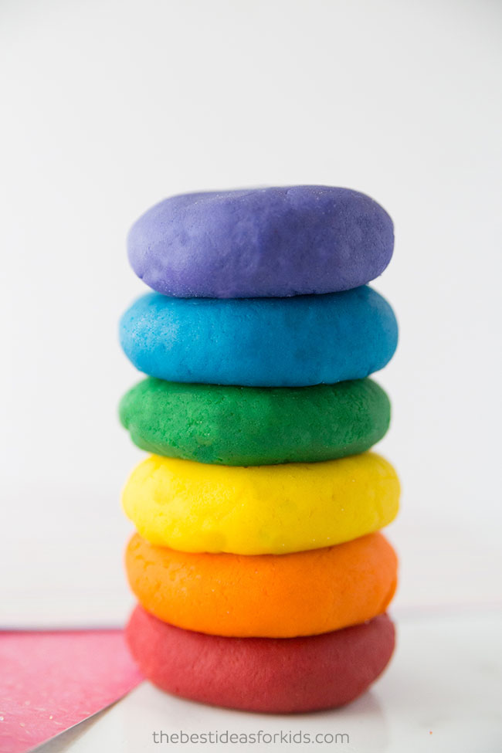
Playdough - website link: https://www.thebestideasforkids.com/playdough-recipe/
Ingredients
1 cup flour
2 tsp cream of tartar
1/2 cup salt
1 tbsp cooking oil Olive oil or vegetable oil
1 cup water
food coloring
Instructions
In a large bowl, combine all of your dry ingredients (flour, salt, cream of tartar) and mix well.
Mix food coloring with your water first. Then add the vegetable oil and water with food coloring to a large pot. Mix together.
Add the dry ingredients to your pot and mix well.
Cook over low to medium heat until the dough starts to form and becomes dry.
Once it starts to form a ball together and looks fully cooked, take off the heat. Let the dough cool first before touching.
Once cool, knead the dough for 5 minutes to make the dough soft

Slide 6
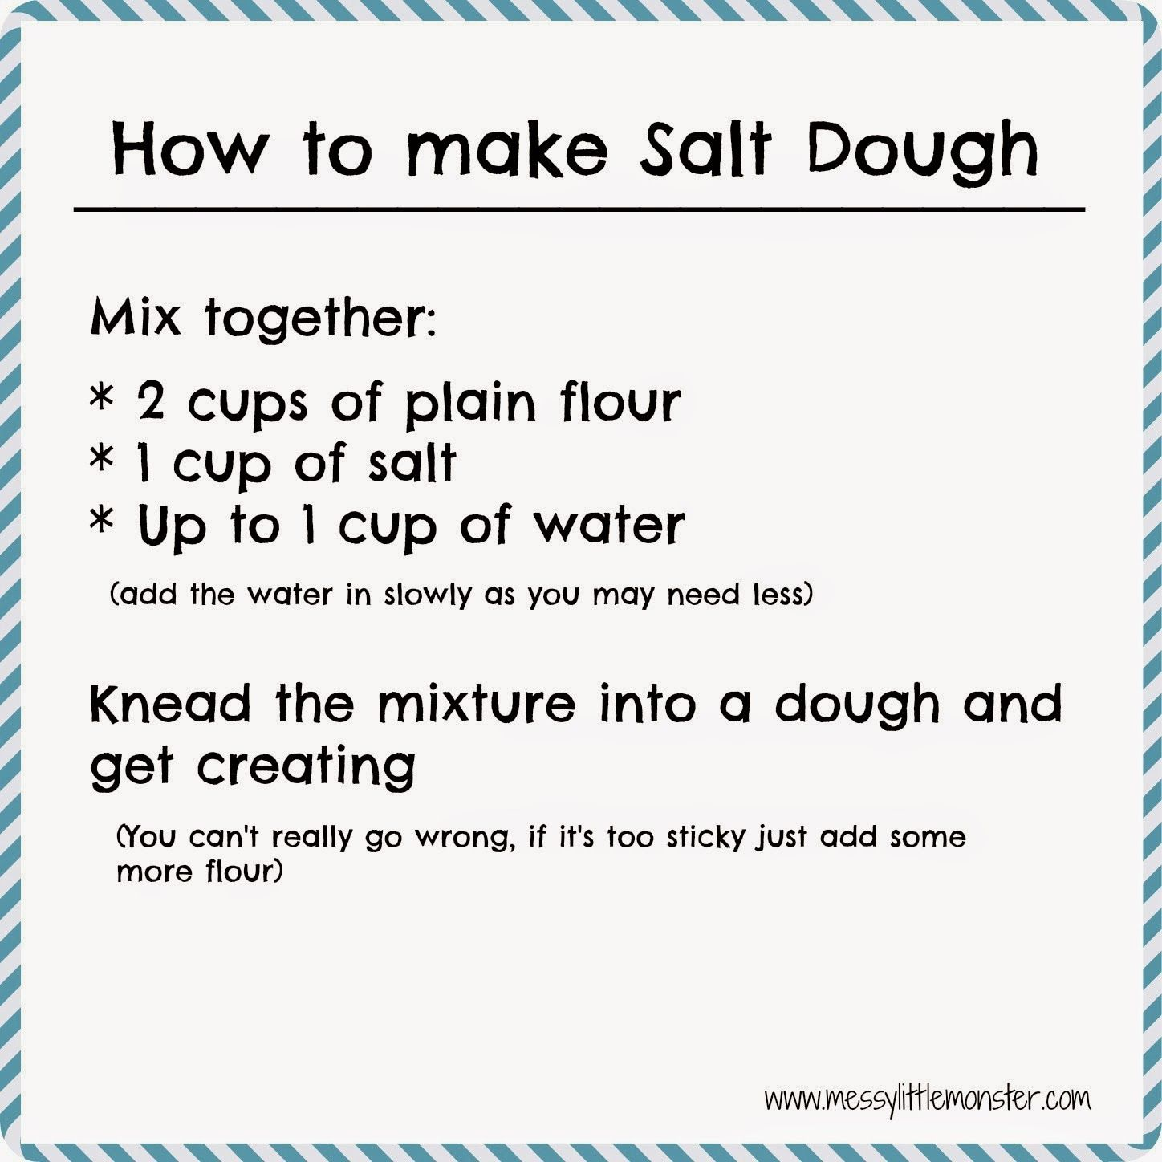
Saltdough

Slide 7
Slime https://www.bbcgoodfood.com/howto/guide/how-make-slime
Ingredients:
100ml PVA white glue (children’s craft glue or CE marked glue)
½ tsp bicarbonate of soda
gel food colouring
1 tsp contact lens solution (for alternatives visit: https://kitchenpantryscientist.com/borax-alternative-for-making-slime/)
glitter (optional)
1. Squeeze the glue into a mixing bowl (look for a bottle in a 100ml size if possible so you won’t have to measure it out). Add the bicarbonate of soda and mix well.
2. Add a drop or two of your chosen gel food colouring. Less colouring gives a pastel colour; the more you add, the brighter the colour. Mix until well incorporated.
3. Add the contact lens solution and mix. The slime will begin to form, going stringy before coming away clean from the bowl into a ball.
4. Once it has formed, take it out and knead it with your hands. It will be sticky at first but after about 30 seconds you’ll have a smooth and pliable ball. Add glitter at this point, if desired, and work in with your hands. Store in a pot with a lid.

Slide 8
Conditioner Slime
Ingredients:
one cup scented conditioner
two cups cornflour
a large bowl and a measuring cup
How to make:
Place all the ingredients into a bowl, mix them all together and have fun!

Slide 9
Sensory bags:
You can fill your sensory bag with whatever you fancy. Some ideas are:
Paint
Cornflour and water
Shaving foam and paint
Hair gel and glitter
Coloured water and glitter
Fill a zip lock plastic bag with one of the above options. Make sure it is well sealed and then give to your child to explore!

Slide 10
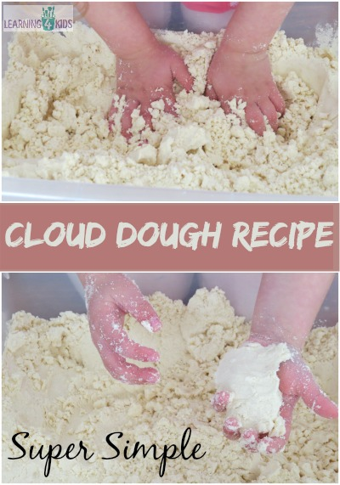
Cloud dough https://www.learning4kids.net/2014/08/13/make-cloud-dough-recipe/
Ingredients:
4 Cups of Plain Flour
½ Cup Baby Oil
Large tub and wooden spoon for mixing
Measure and pour the flour into the large tub.
Add baby oil.
Mix with a wooden spoon.
Using your fingers, squeeze and press the cloud dough to blend the oil throughout the flour.
Store in an airtight container.

Slide 11
Sand Foam
Ingredients:
Sand
Shaving foam
Place sand into a tray. Add shaving foam and mix until you achieve a desired consistency.

Slide 12
Coloured rice / pasta https://happyhooligans.ca/rainbow-rice/
Ingredients
1 cup of white rice / pasta
½ tsp vinegar
food colouring or icing gels
container with lids
Pour a cup of rice into your container. Then mix a generous drop of food colouring through the rice/pasta. Pour in half a teaspoon of vinegar and mix it all together! Pour onto a baking sheet or onto a plate to dry.

Slide 13
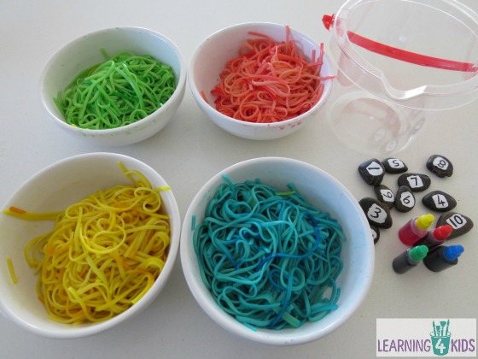
Painting with spaghetti
Ingredients:
Cooked spaghetti
Paint or food colouring
Paper
Mix together the cooked spaghetti and paint and then encourage your child to use their hands to get messy in the spaghetti and use it to make marks!

