Slide 1
Six Areas of Learning Experiences
Dosbarth Seren- how we explore each area weekly

Slide 2
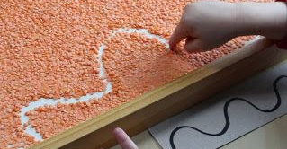
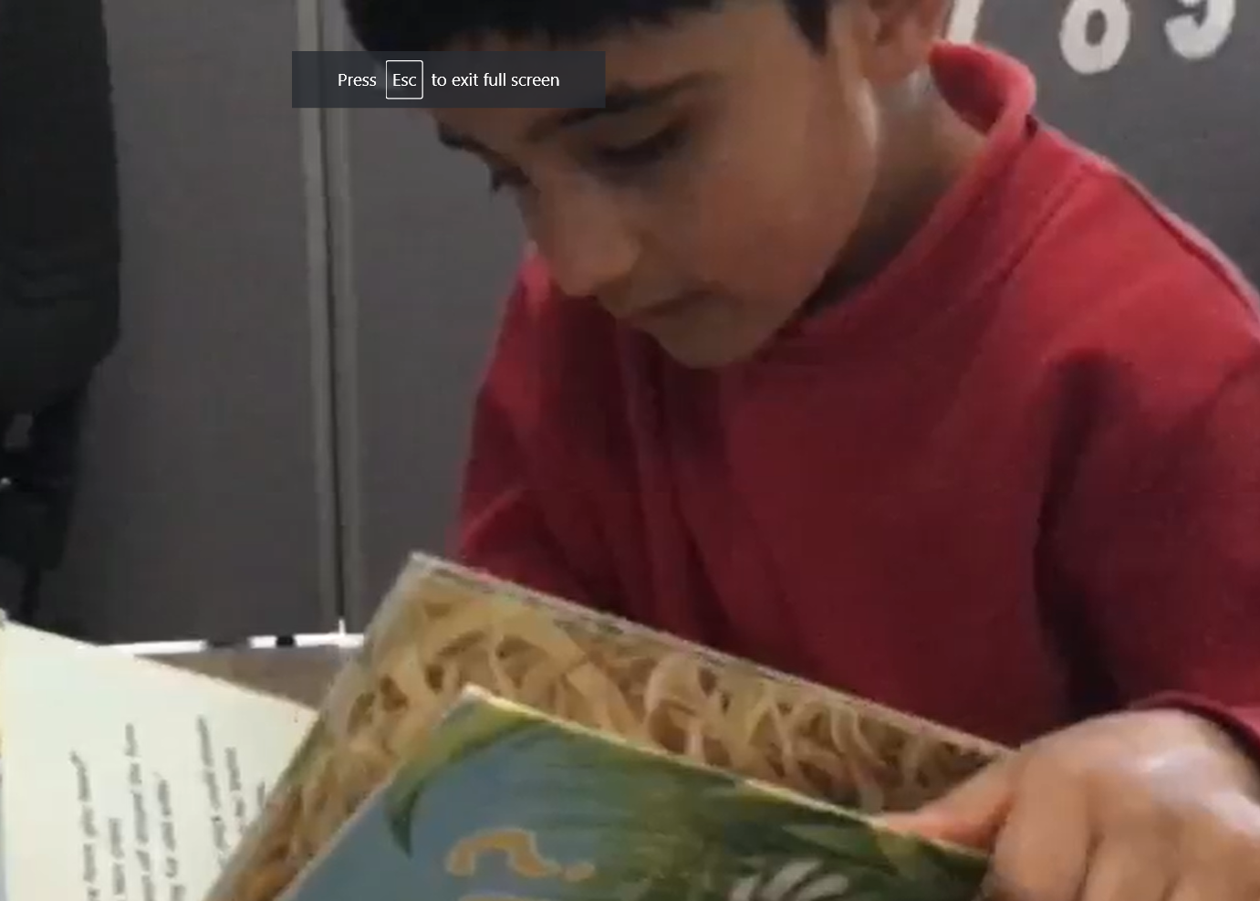
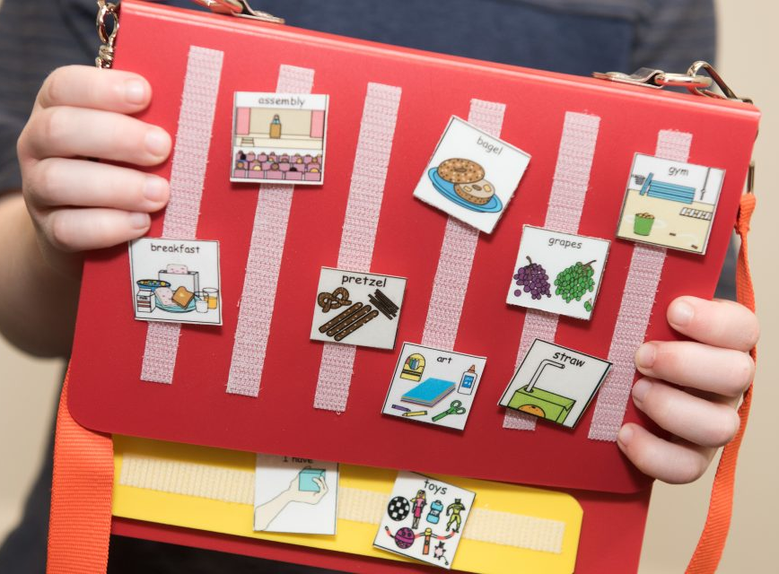
Languages, Literacy & Communication

Slide 3
Languages, Literacy & Communication All areas of learning are blended into one another during the school day, however Languages, Literacy and Communication is very important for our pupils to be encouraged to interact with peers, engage with reading and writing stimuli and to regularly communicate choices, interests, needs and wants. Some of the ways in which these skills are encouraged daily, weekly and termly are; 1. Communication support- PECs via structured 1:1 time, choice time and mealtimes 2. Mark making activities- exploring sensory play with dry and wet materials, making random marks in materials. For some pupils to extend this to overwriting and tracing. 3. Reading- whole class stories, structured reading 1:1, guided reading sessions and choice time stories 4. Welsh songs, games and stories- these are encouraged daily through discrete learning and Welsh focused activities, e.g. ‘Beth sydd yn y bocs?’

Slide 4
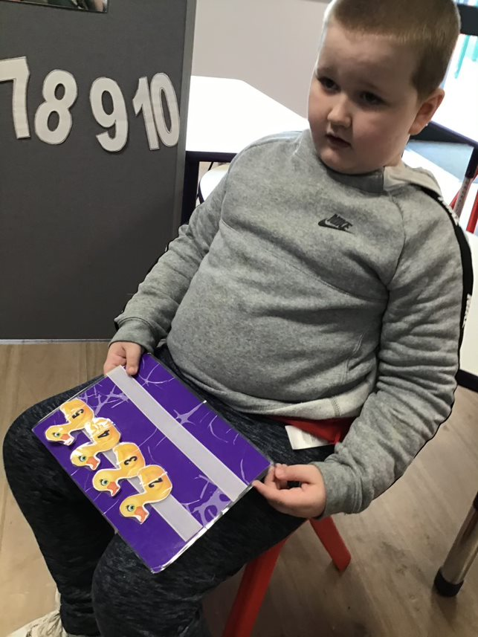
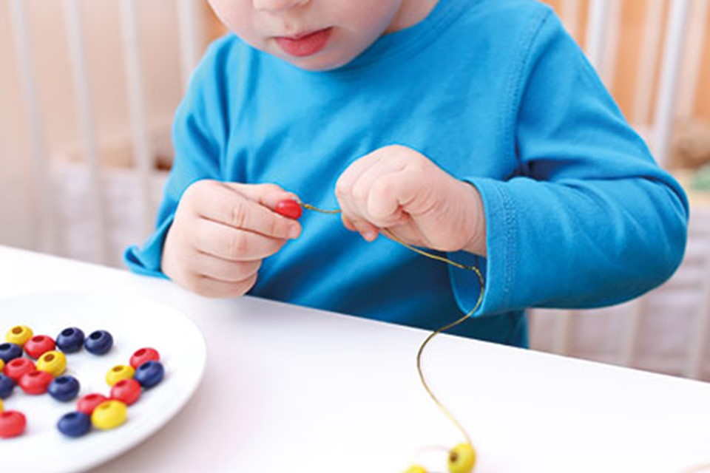
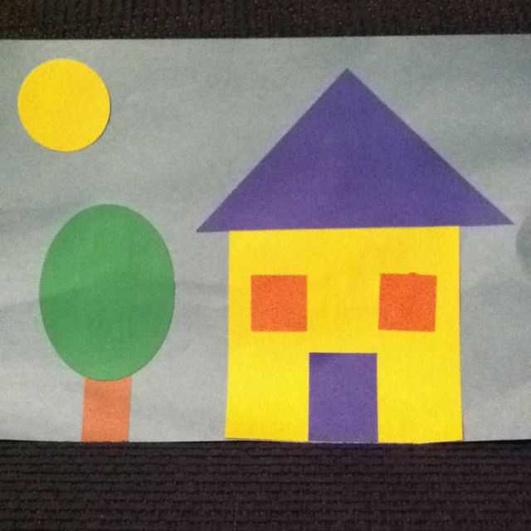
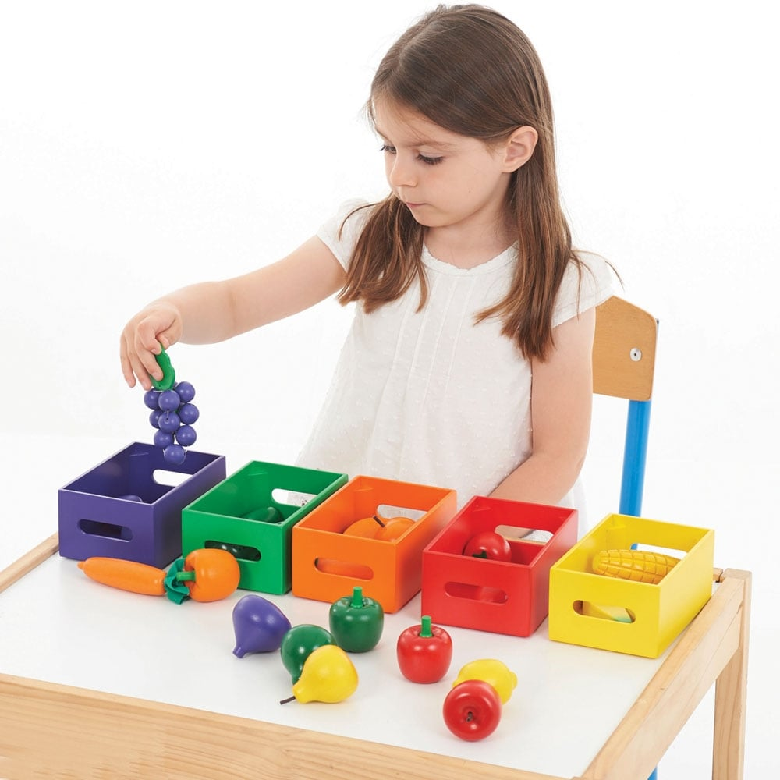
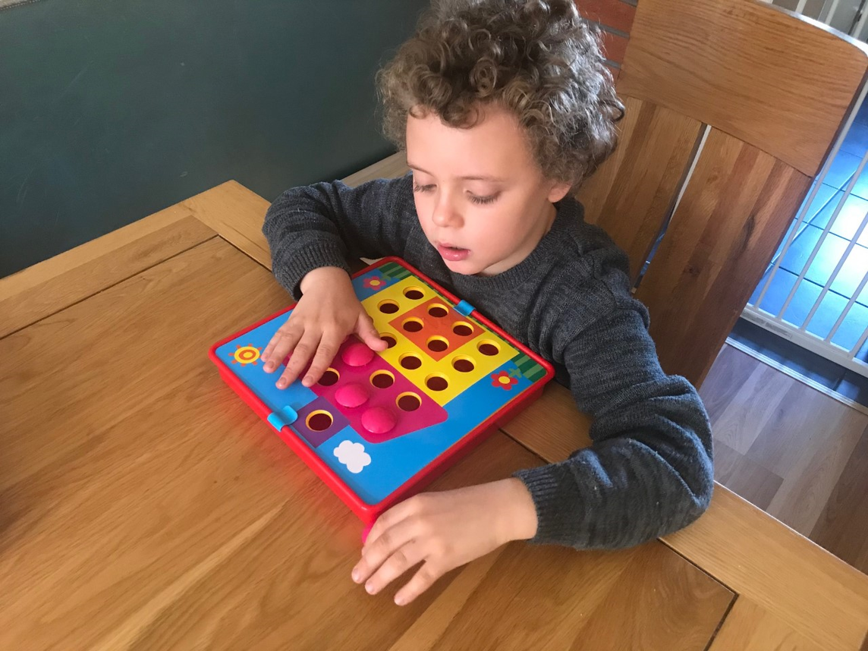
Mathematics & Numeracy

Slide 5
Mathematics & Numeracy Some of the ways in which Mathematics & Numeracy is delivered daily, weekly are termly are; 1. Puzzles- puzzles are important for recognising shapes, sizes and objects. We use puzzles of familiar faces to encourage recognising ourselves and peers. Puzzles are a great way to support learning via technology, e.g. prowise, and for turn-taking opportunities 2. Slotting and threading- a great activity to build on focus and concentration. This is a good activity to differentiate with colour sorting, sequencing sizes and ordering numbers. 3. Shapes- our pupils enjoy learning about shapes through blended learning, e.g. art activities making shape images such as a shape house. There are lots of songs that support learning shapes. Shapes can be supported through puzzle work and slotting shapes into the correct shape cut out. 4. Colour sorting- pupils are beginning to organise, group and match colours. A great way of doing this is using colour sorting bears/fruit/shapes and matching them to the correct bowl. To extend this, pupils can use tweezers to work on their grip. 5. Numbers- numbers are encouraged throughout the day via circle time, e.g. how many pupils are in school today? Pupils can identify the number on the number line. We learn our numbers by counting books, songs and counting various objects throughout the day.

Slide 6
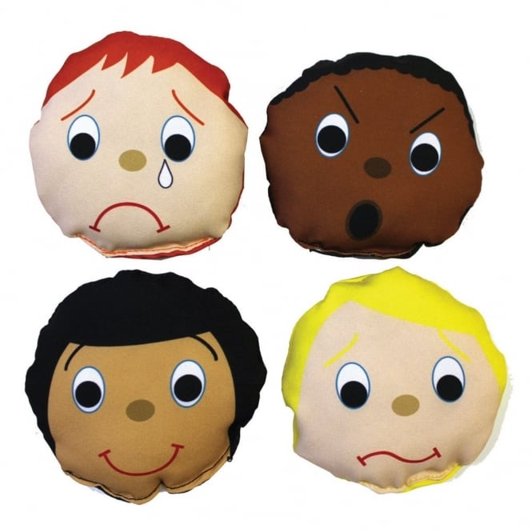
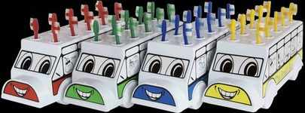
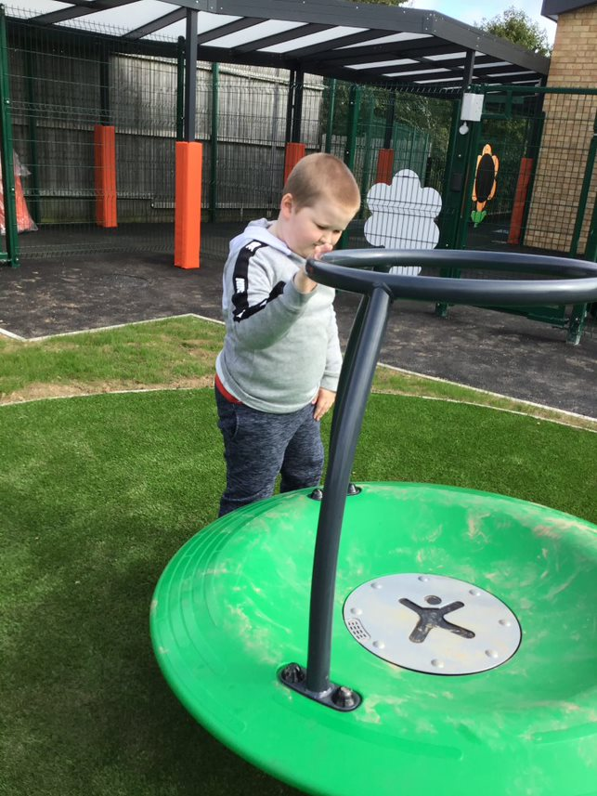
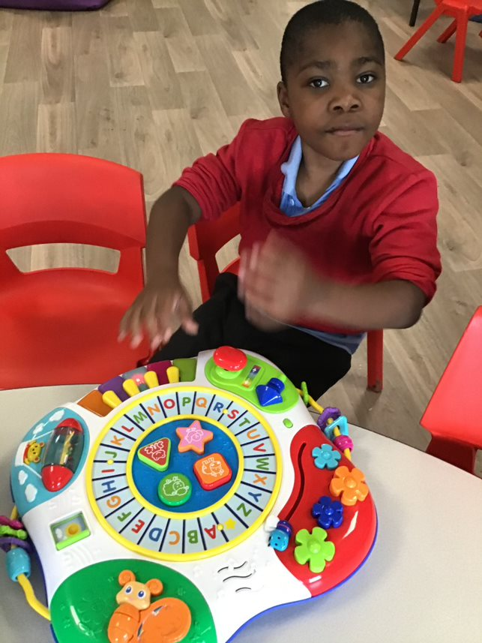
Health & Wellbeing

Slide 7
Health & Wellbeing The health and wellbeing is at the core of all learning. Ensuring our pupils are healthy, confident individuals is key to supporting them to becoming ambitious, capable learners. Health and wellbeing is encouraged daily throughout various sessions and is linked to all learning activities from hand washing, self help to learning about emotions. Here are some of the ways in which this is encouraged daily in school; 1. Emotions- pupils are learning to express if they are feeling happy or sad. Pupils can select a puppet to show the emotion. We listen to the song ‘if you’re happy and you know it’ to emphasise emotions. 2. Self-help- this includes toothbrushing, dressing, eating and toileting. Pupils are all working towards their own targets within this, however we always aim to increase pupils independence with these skills. 3. Circle time- these sessions are beneficial for emotions, introducing choice making and likes and dislikes. Visit our class page for circle time examples. 4. Outdoor learning- this is an important part of the school day to support independent play and exploration of new environments. 5. Sensology and TacPac- visit our class page for examples. These sessions are to enable pupils to engage with all five senses, to express likes and dislikes and to relax and respond to various stimuli. 6. Choice time- this is important for all learners to indicate preferences, to encourage independent exploration and to increase attention to some materials whilst discarding others.

Slide 8
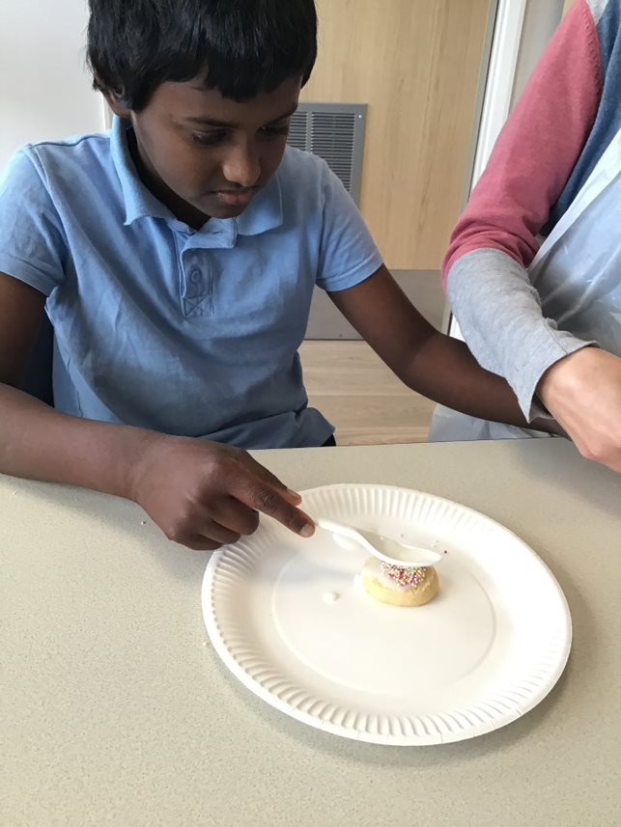
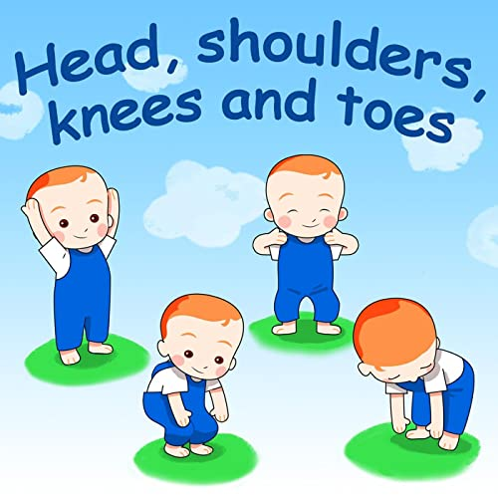
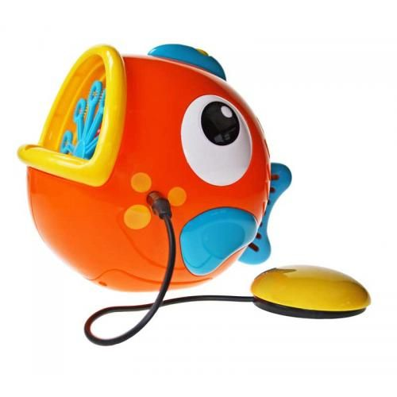
Science & Technology

Slide 9
Science & Technology Some of the ways in which Science & Technology is delivered daily, weekly are termly are; 1. Cookery sessions- these sessions support the development of all five senses. Pupils are encouraged to taste and smell new ingredients and to explore the textures of various wet and dry ingredients. 2. Switch work- pupils can be introduced to more complex technology via switches. Switches are great for visual learning, to access complex devices by touching the switch for cause and effect activities. 3. Big and small- our pupils are learning to respond to big and small during activities, e.g. playdough making- finding the big bowl and the small spoon. This is encouraged during circle time, e.g. big balls from small balls. 4. Action songs- during choice time, we have an action song Tap Tap Box. Pupils are encouraged to make body movements to different choice songs, e.g. ‘Head, Shoulders, Knees and Toes’ and ‘One Little Finger’. 5. PurpleMash- this can be accessed in school and at home. It covers all six areas of learning by offering different activities, e.g. paint pad, music, puzzles and more!

Slide 10
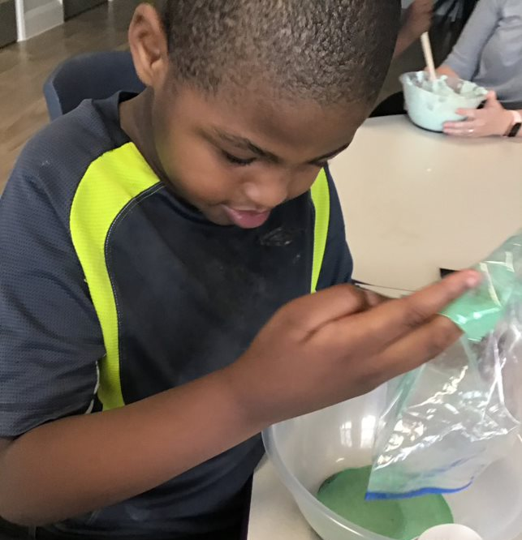
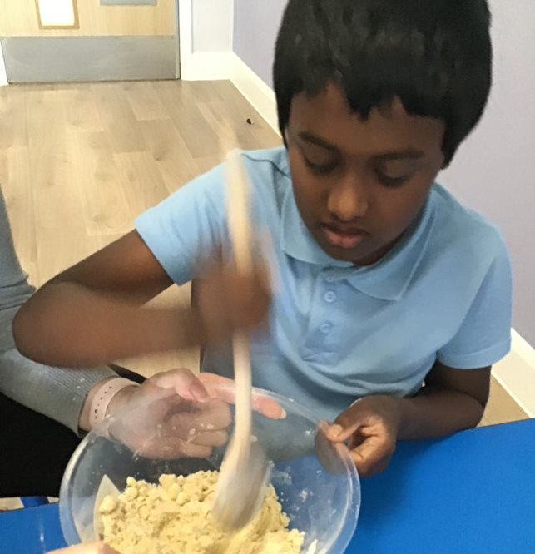
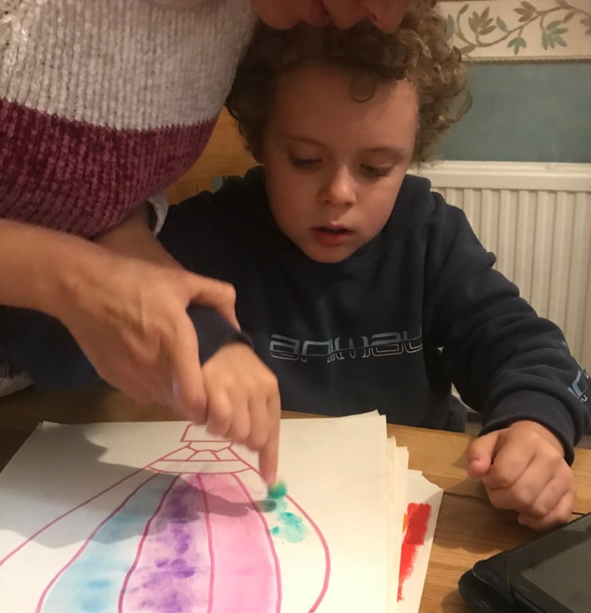
Humanities

Slide 11
Humanities Some of the ways in which Humanities is delivered daily, weekly are termly are; 1. Messy play- this is a great learning opportunity to encourage pupils to experience different textures, e.g. wet and dry (more ideas available on our class page) and to begin communicating likes and dislikes. Messy play is great for sensory learners, to help increase their independence and attention. 2. Learning about the world around us- this can be done through other subjects, e.g. art- designing transport by learning about various transport, creating shape houses, weekly walks exploring the local community and outdoor play. 3. Celebrations- learning about different events are important to support pupils becoming ethically, informed citizens. We do this via school assemblies (join in via ty gwyn- assemblies) and activities within class. 4. Reflection on learning- we keep photographs of our learning and place it in personalised stories. We look at these every Friday to see what we have been learning about. You could create collages of learning at home.

Slide 12
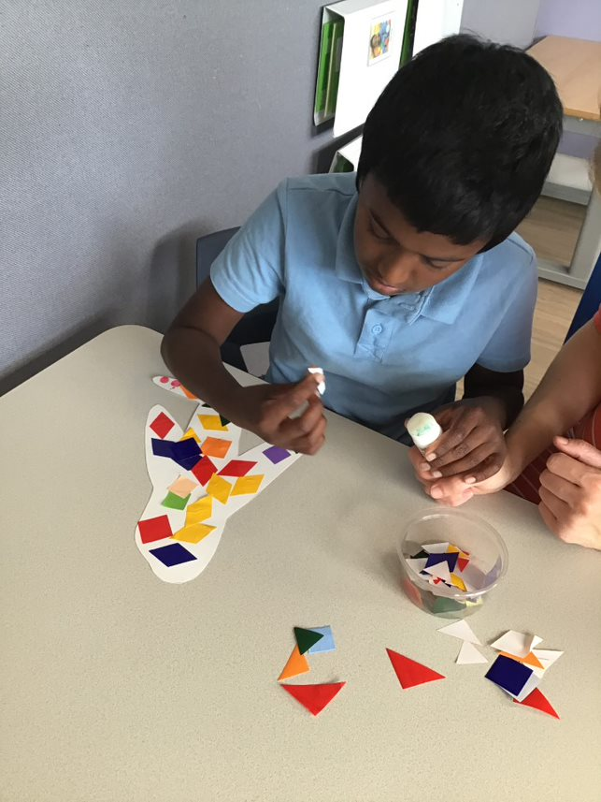
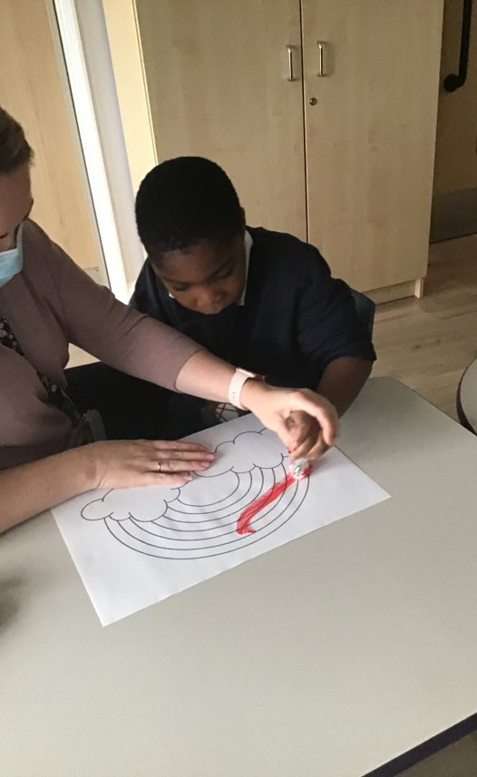
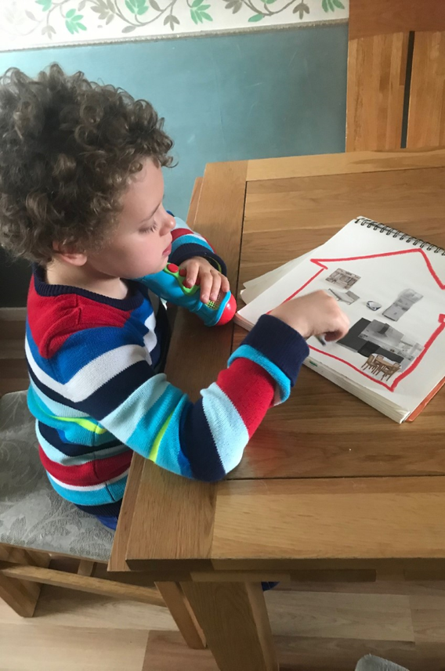
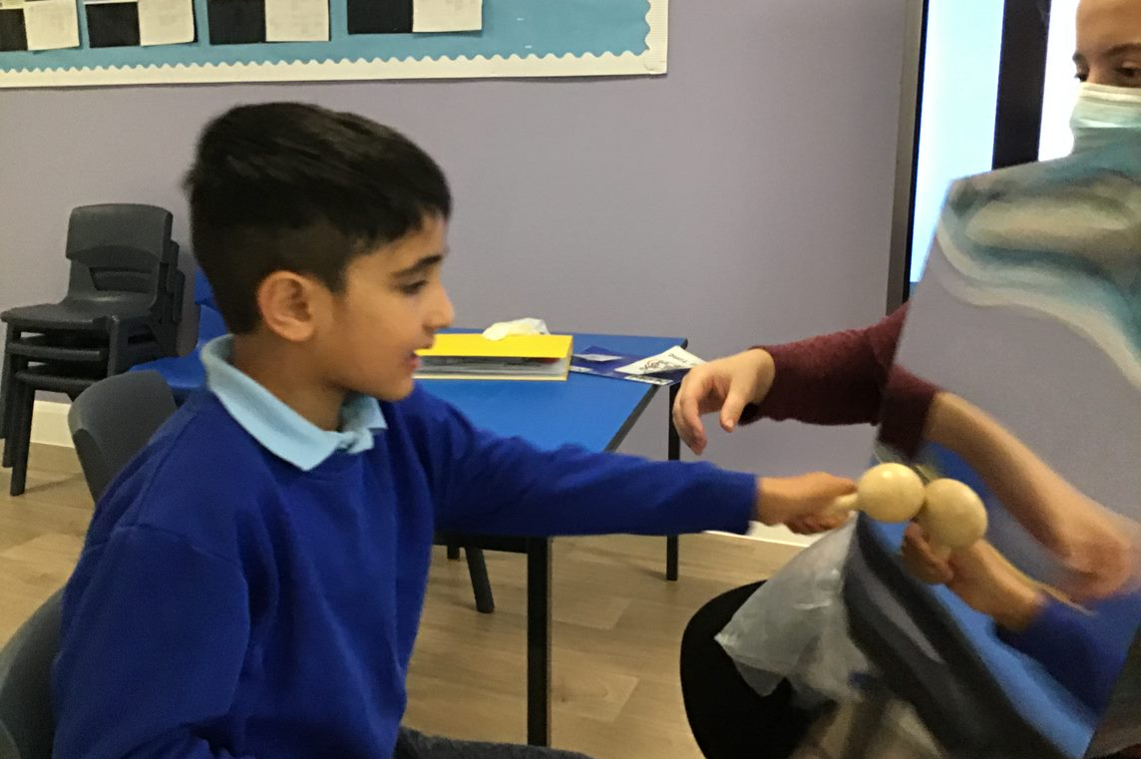
Expressive Arts

Slide 13
Expressive Arts Some of the ways in which Expressive Arts is delivered daily, weekly are termly are; 1. Music- whole class music sessions, music with Andy, Tap Tap Box and choice time, e.g. musical toys 2. Art- Daily art activities based around our topic- visit the learning activities section on the class page to see what we are learning about 3. DT- constructions, e.g. lego and duplo, creating collages, e.g. displays, threading and slotting activities- visit the learning activities area for more ideas Expressive Arts is important for pupils to create personalised work. Pupils can be encouraged to make choices around materials, e.g. colours and textures, musical instruments and begin to sequence methods to an activity. This area helps develop fine motor skills by cutting and gluing, focusing attention when threading and slotting and holding objects in each hand, e.g. colouring tools.

