Slide 1
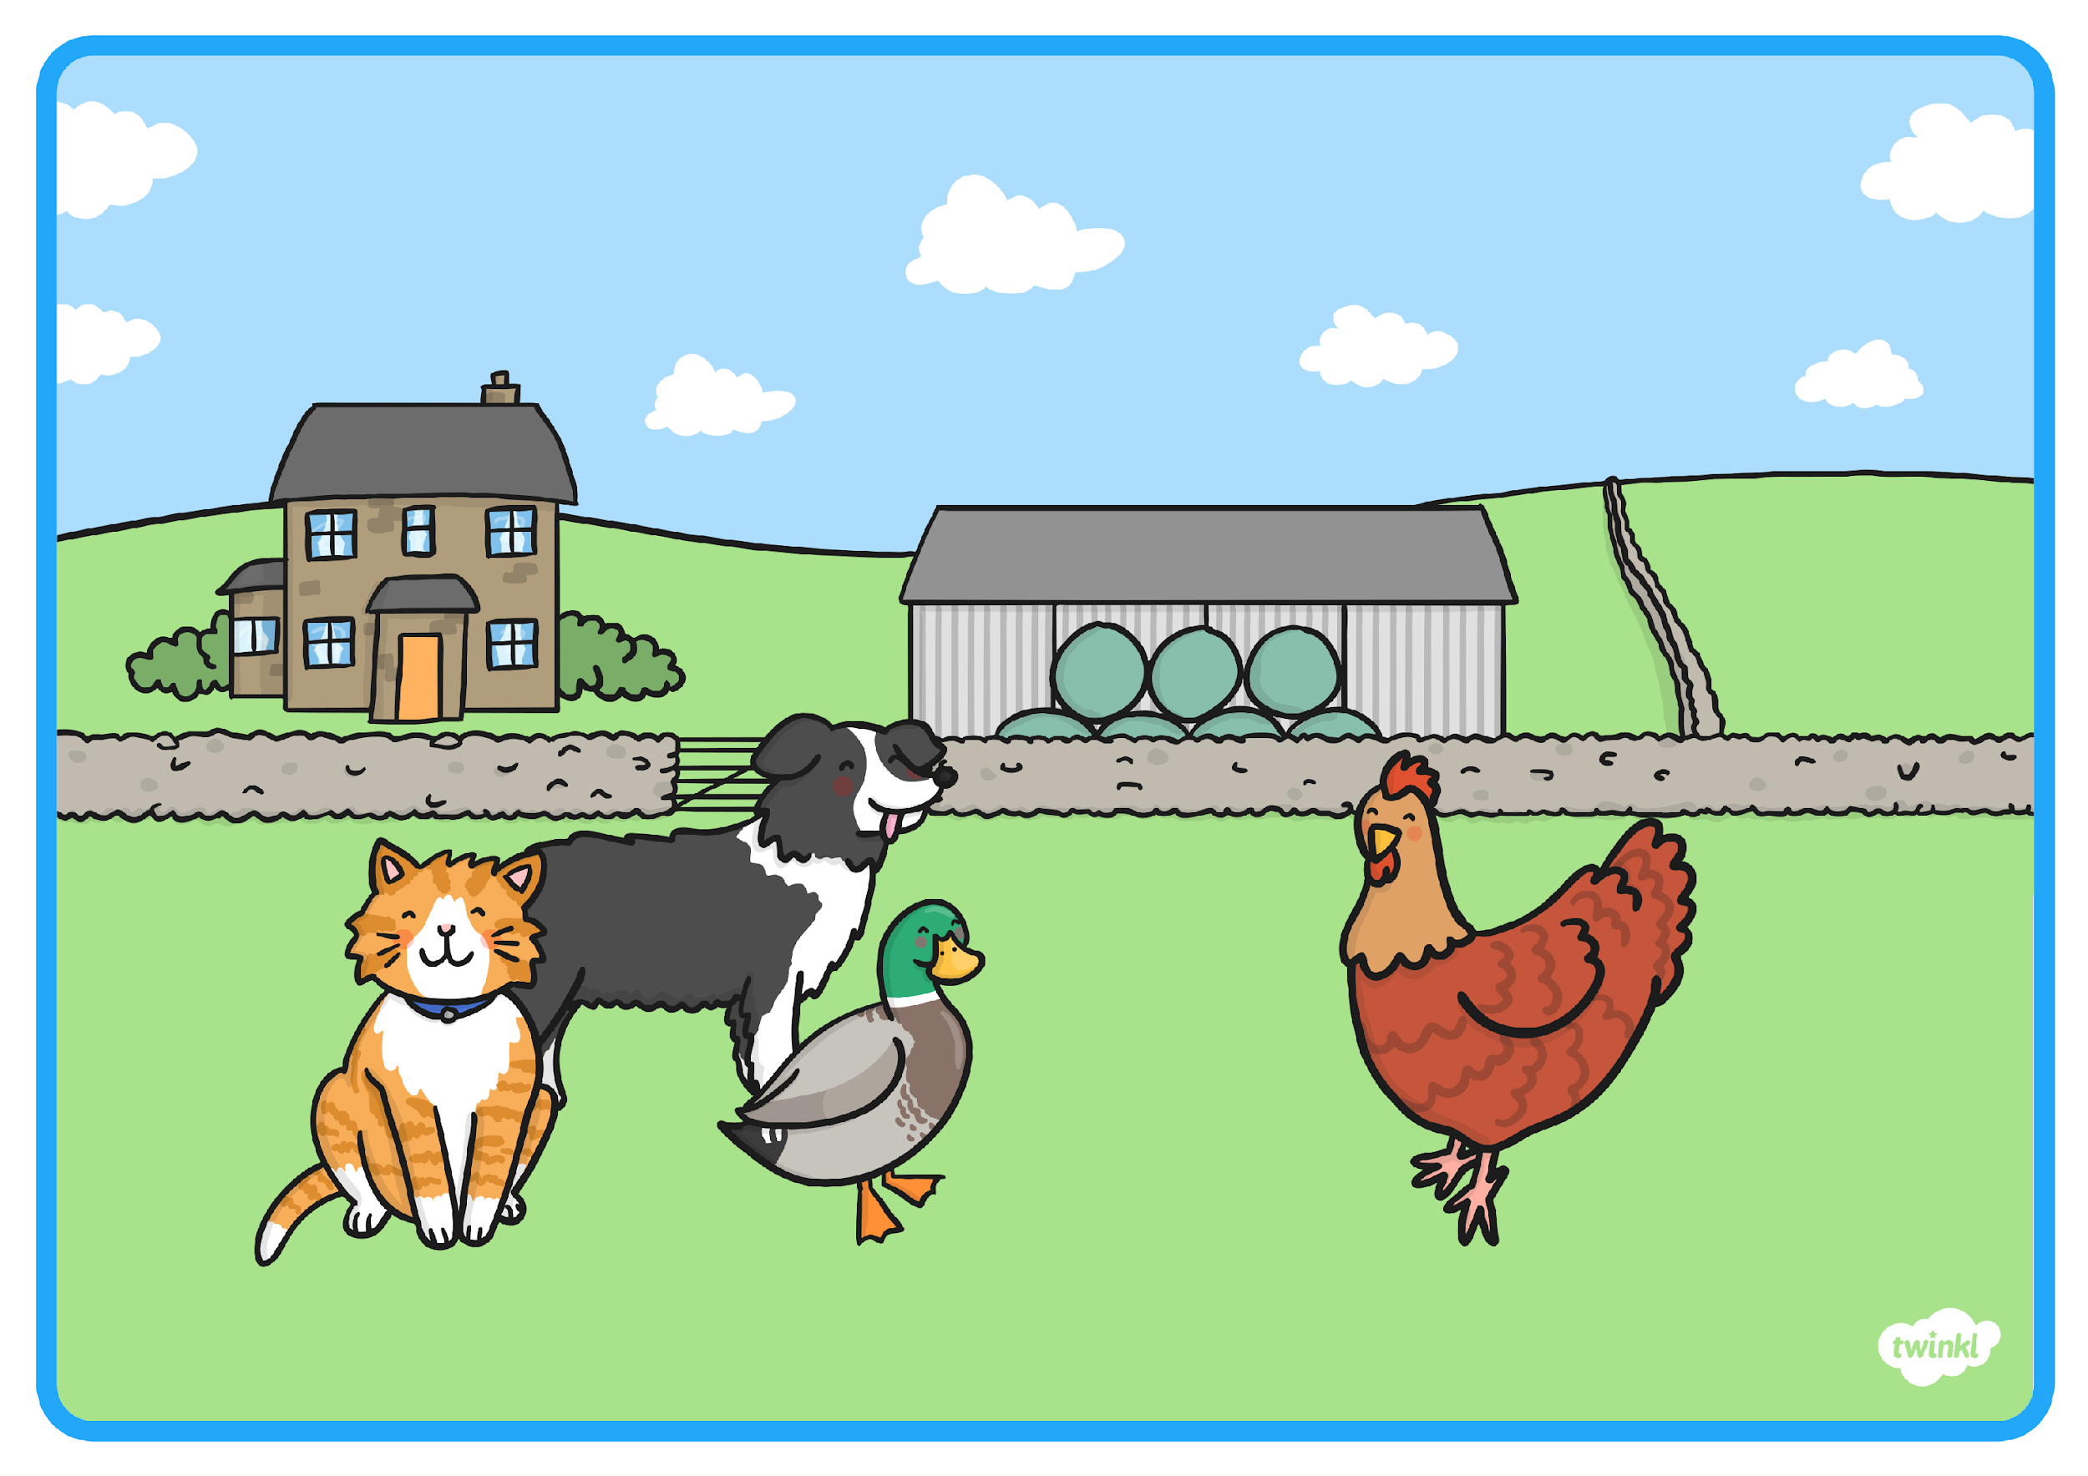
The Little Red Hen

Slide 2
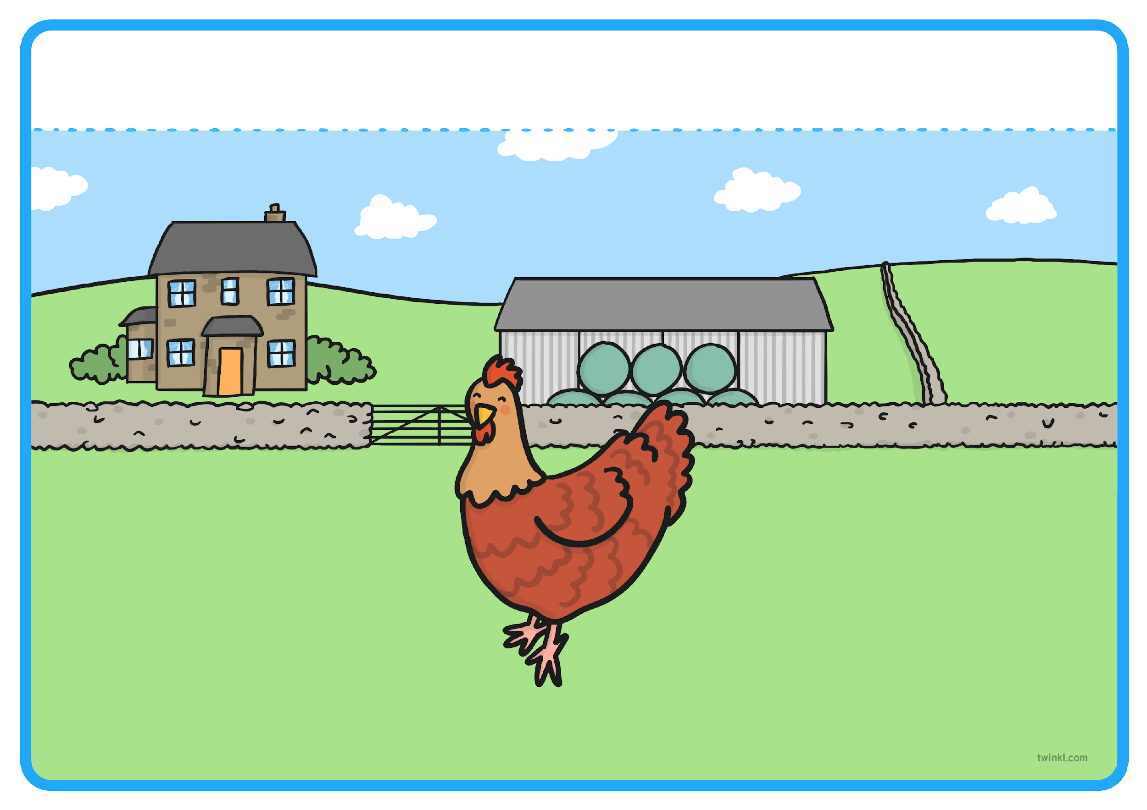
Once upon a time, there was a Little Red Hen. The Little Red Hen lived on a farm and was friends with...
Resource: hen teddy/prop or feather

Slide 3
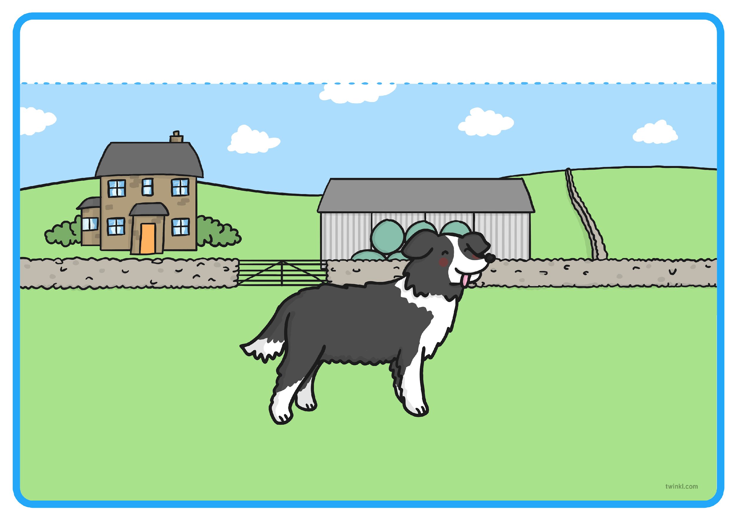
... a lazy dog,
Resource: dog teddy/prop or furry material

Slide 4
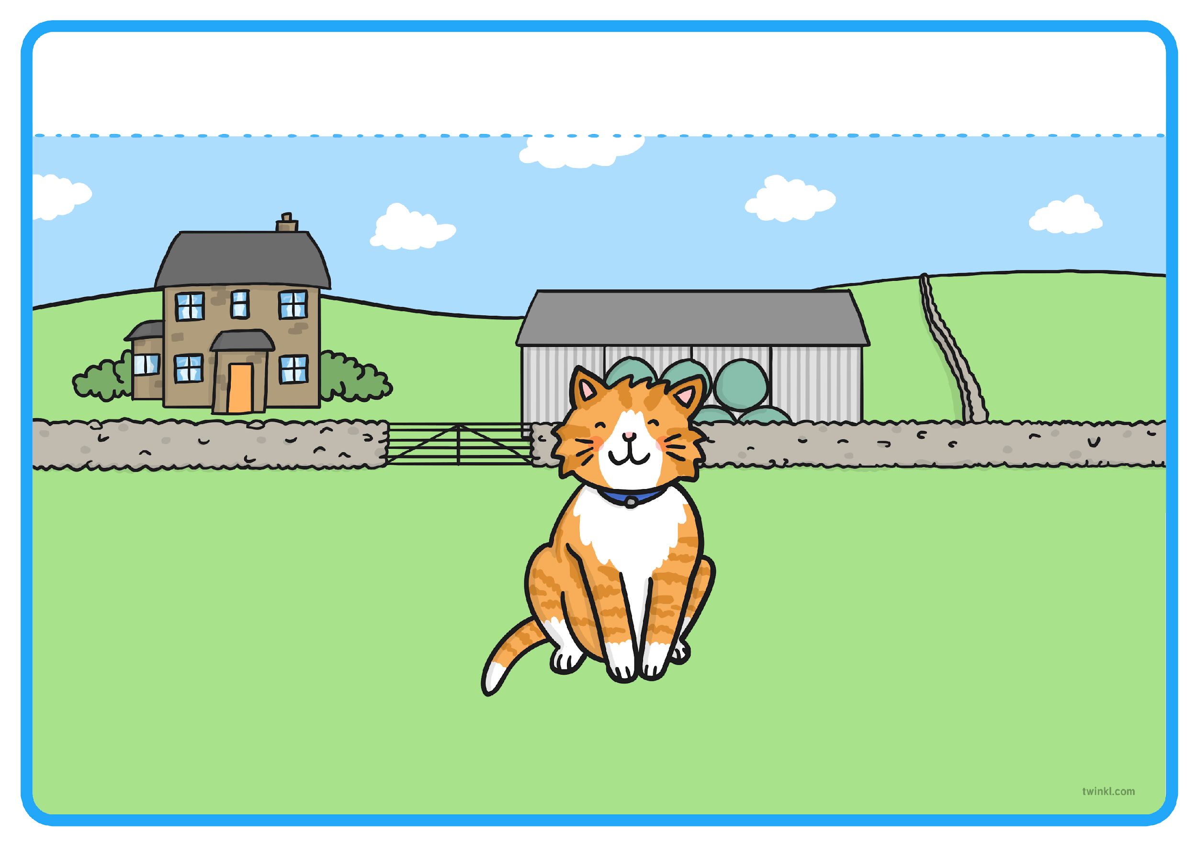
... a sleepy cat,
Resource: cat teddy/prop or bell

Slide 5
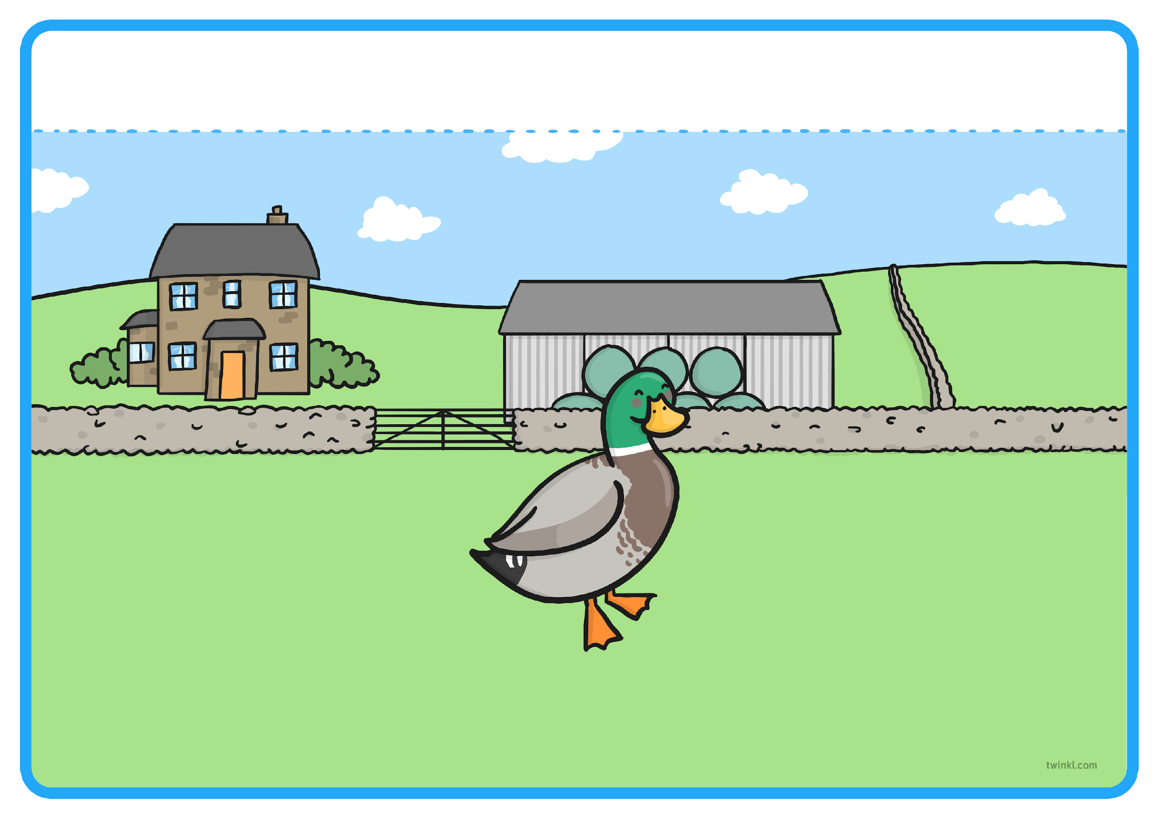
and a noisy duck.
Resource: duck teddy/prop or feather

Slide 6
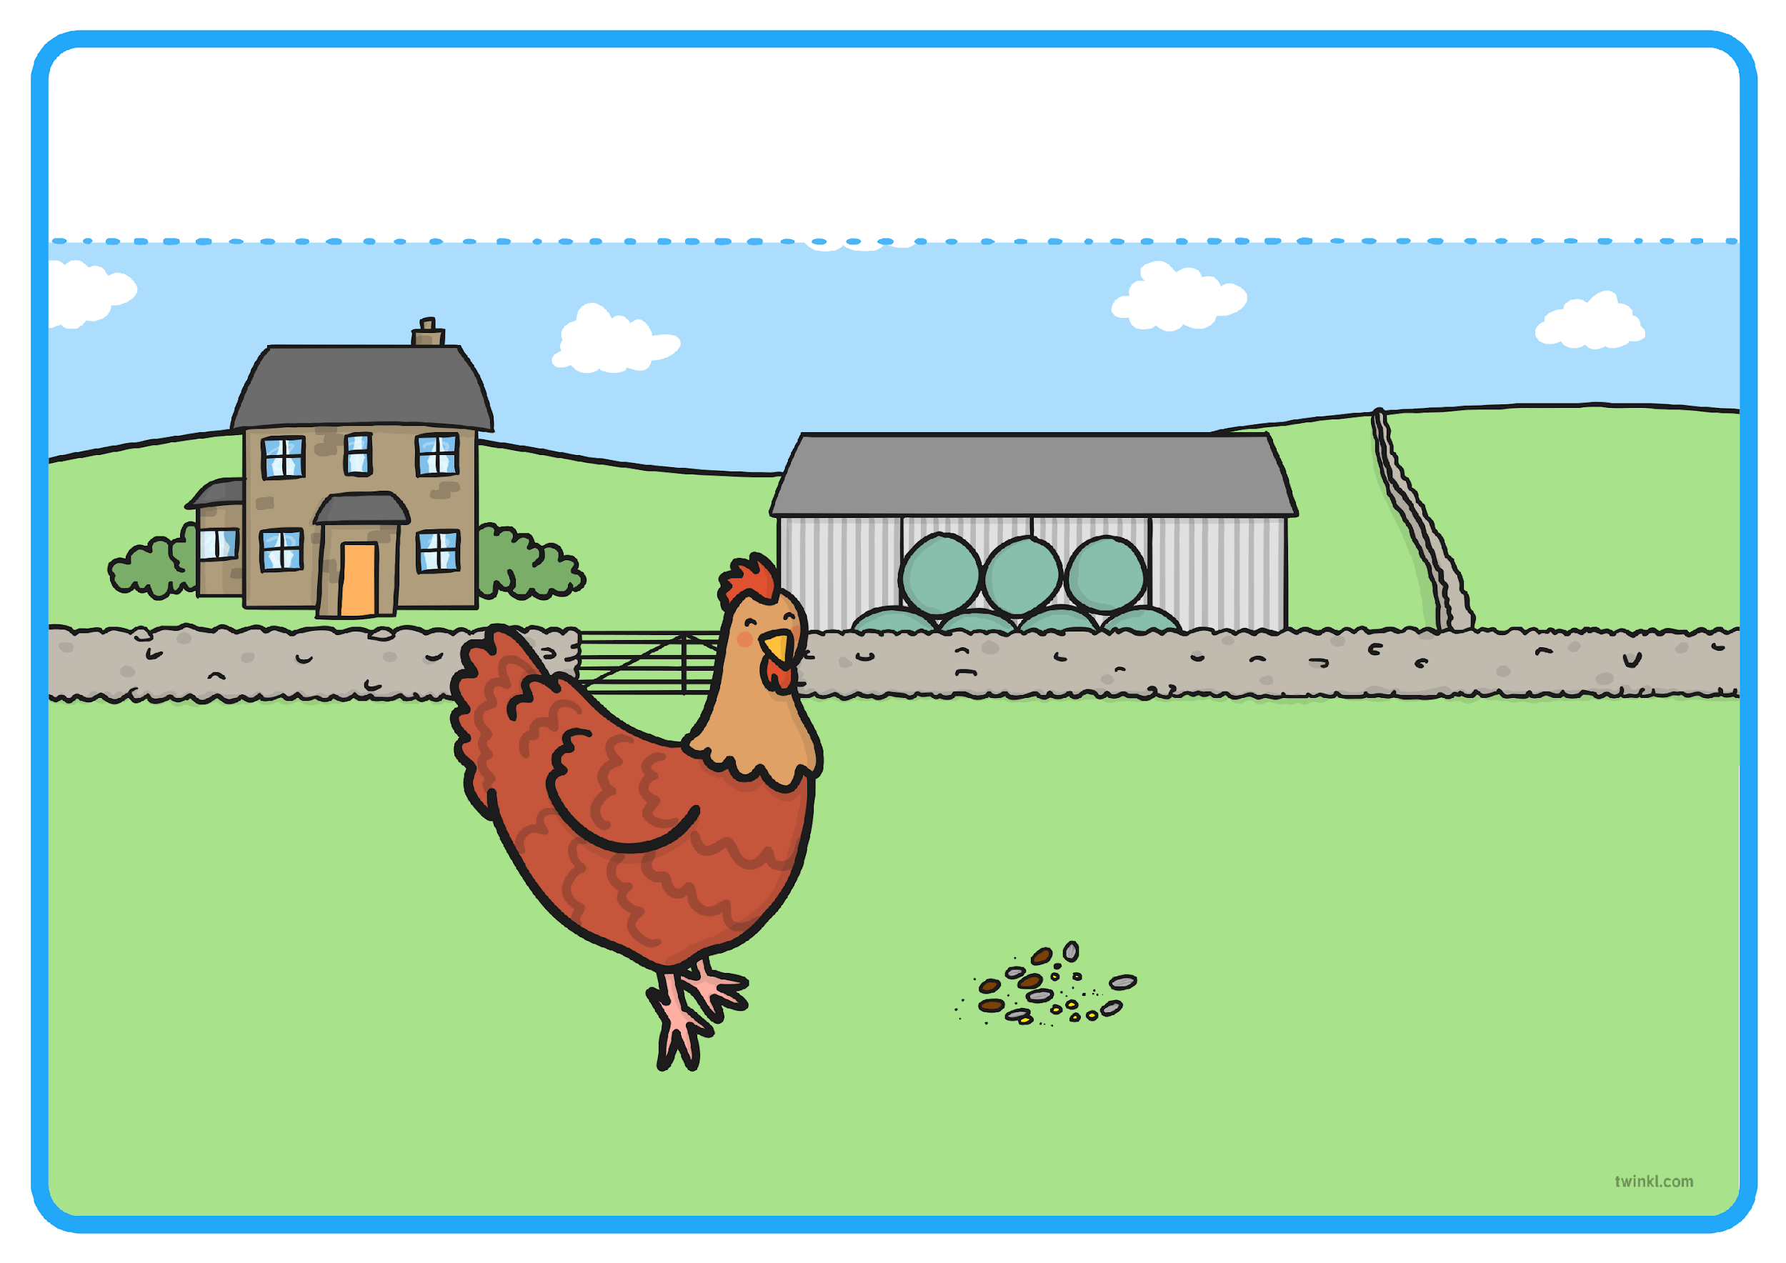
One day, the Little Red Hen found some grains of wheat on the ground. “Who will help me plant these grains of wheat?” the Little Red Hen asked.
Resource: seeds

Slide 7
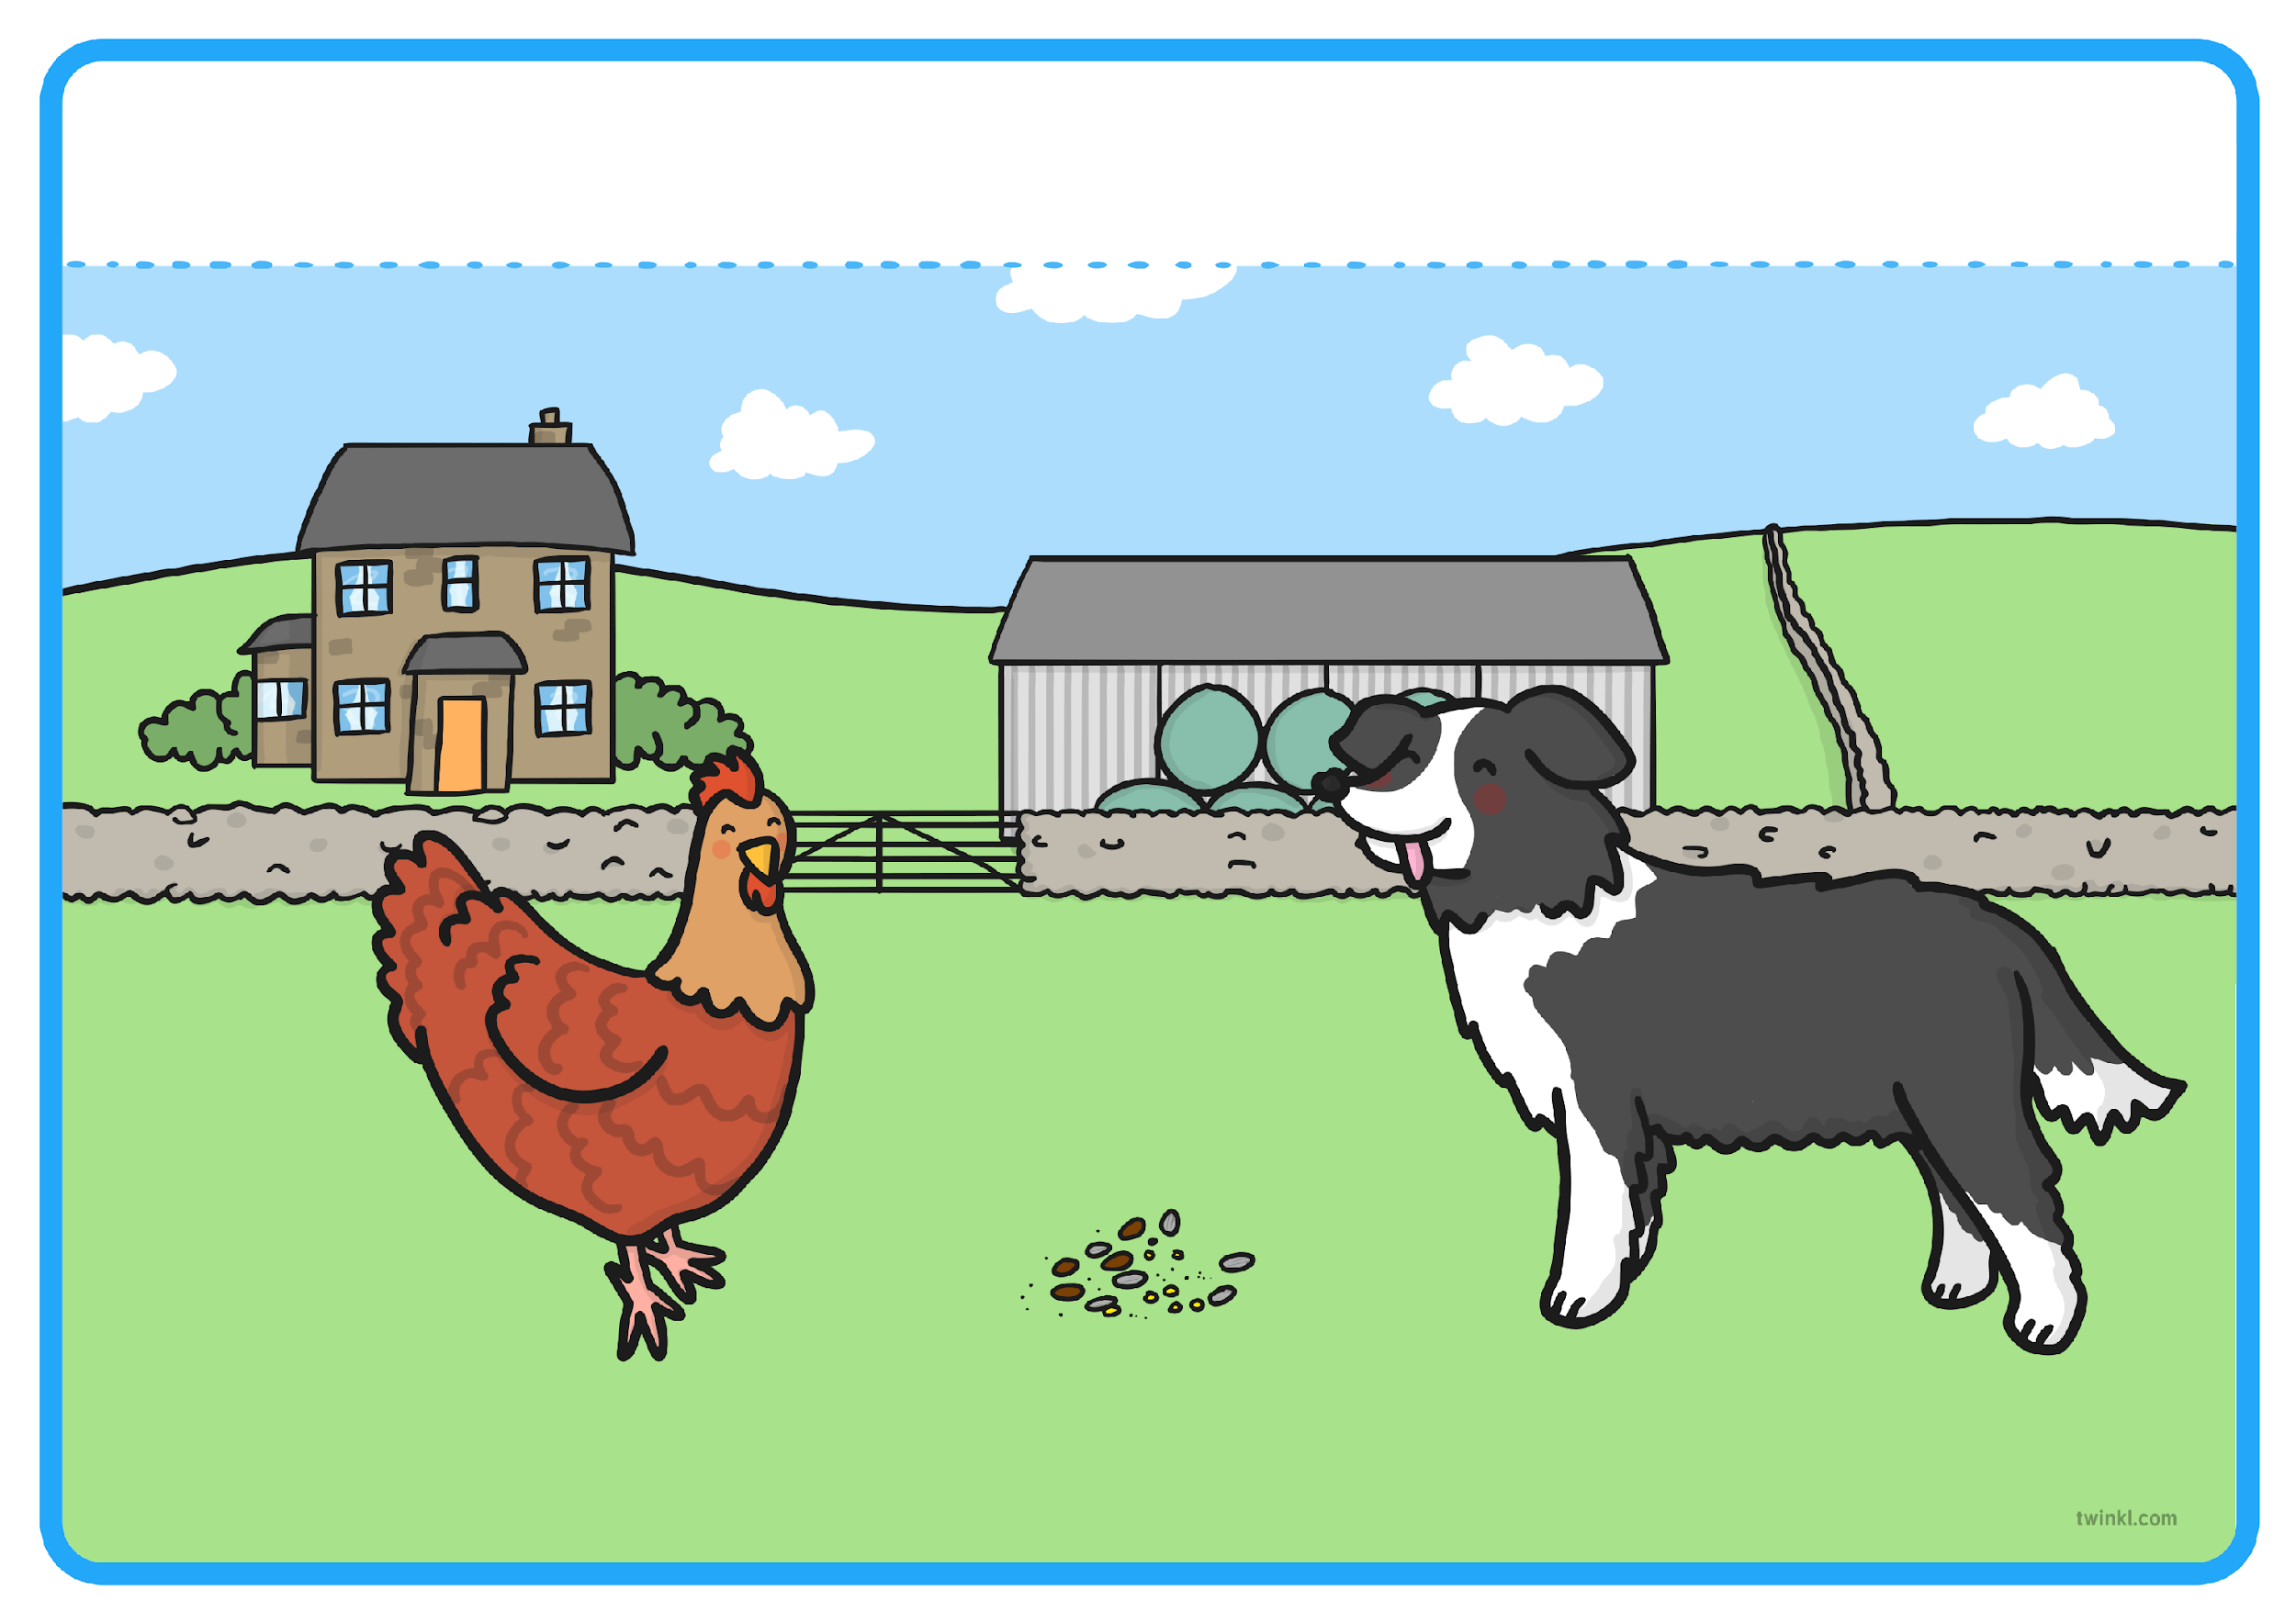
“Not I,” barked the lazy dog.
Resource: dog sound

Slide 8
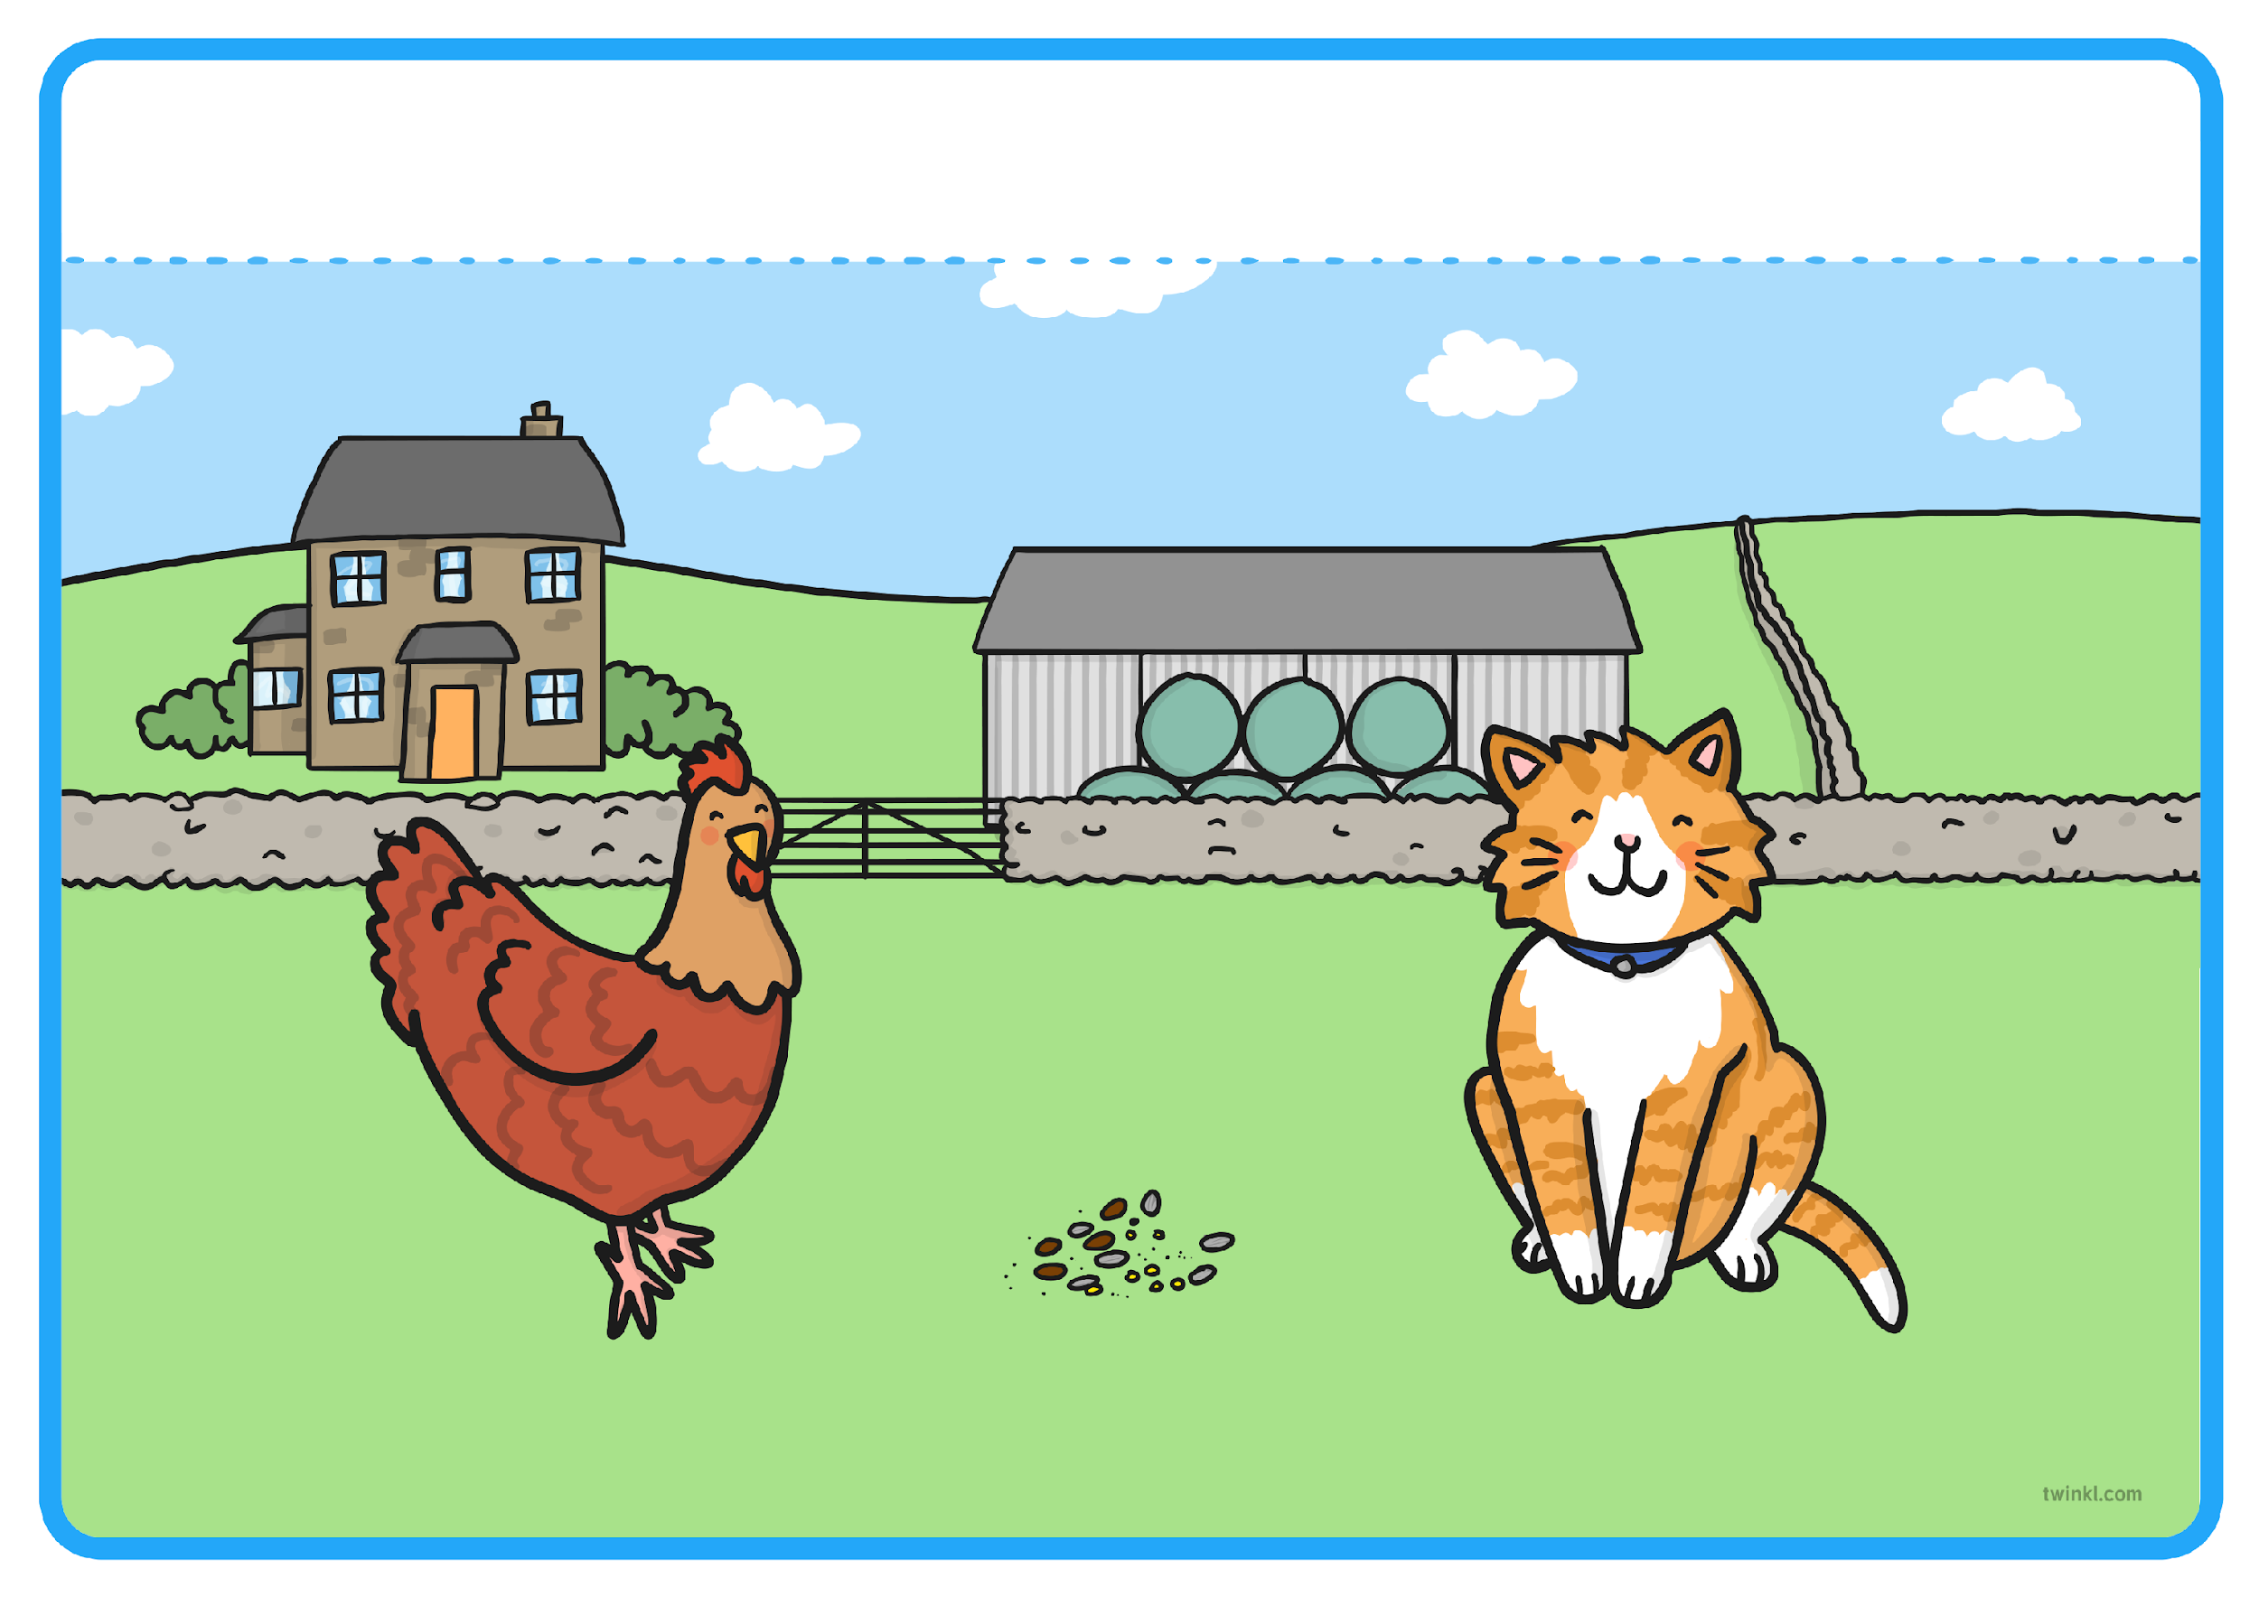
“Not I,” purred the sleepy cat.
Resource: cat sound

Slide 9
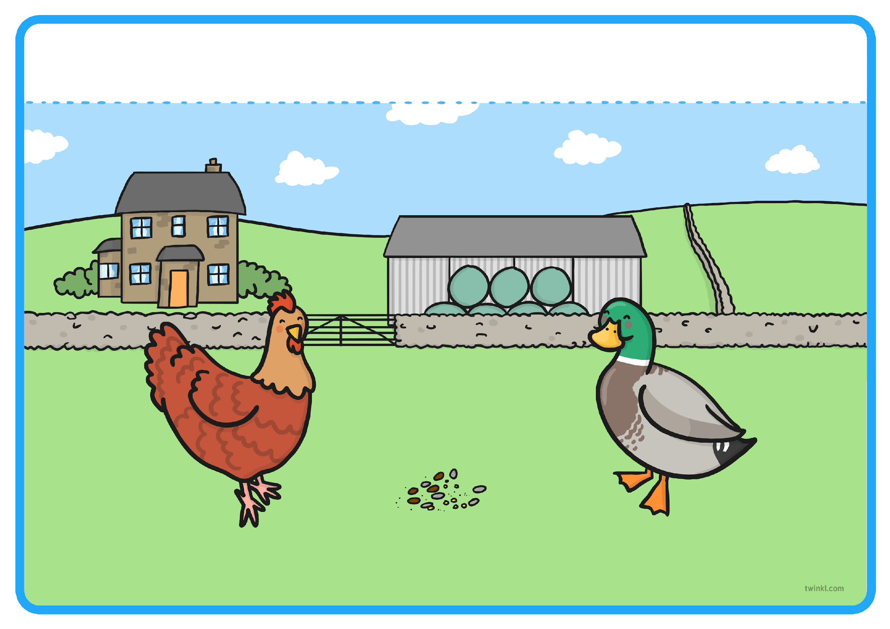
“Not I,” quacked the noisy duck.
Resource: duck sound

Slide 10
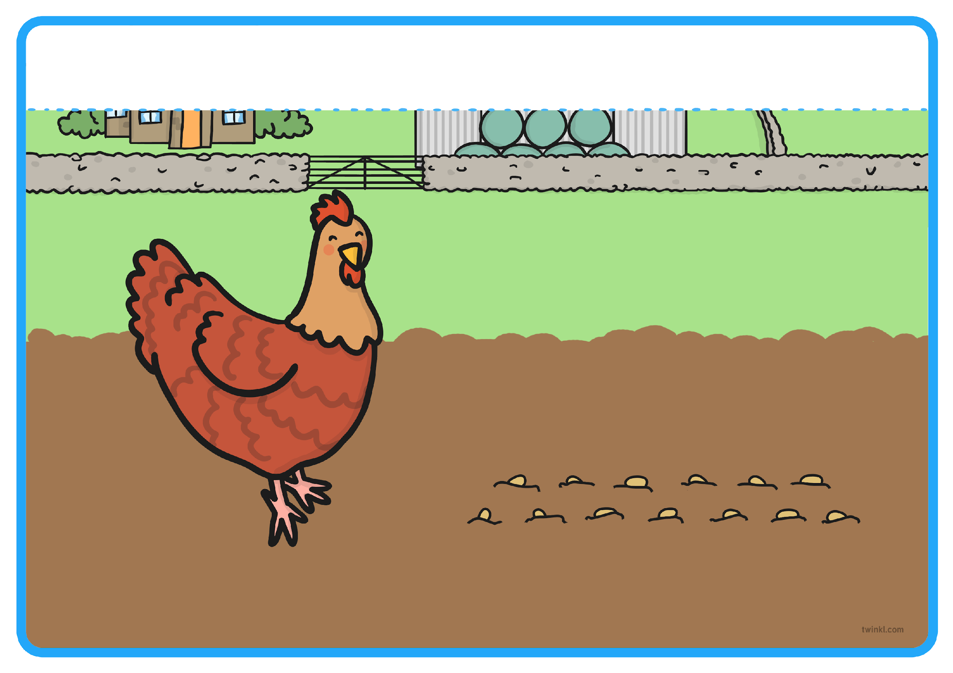
“Then I will,” said the Little Red Hen. So the Little Red Hen planted the grains all by herself.
Resource: soil and a spade

Slide 11
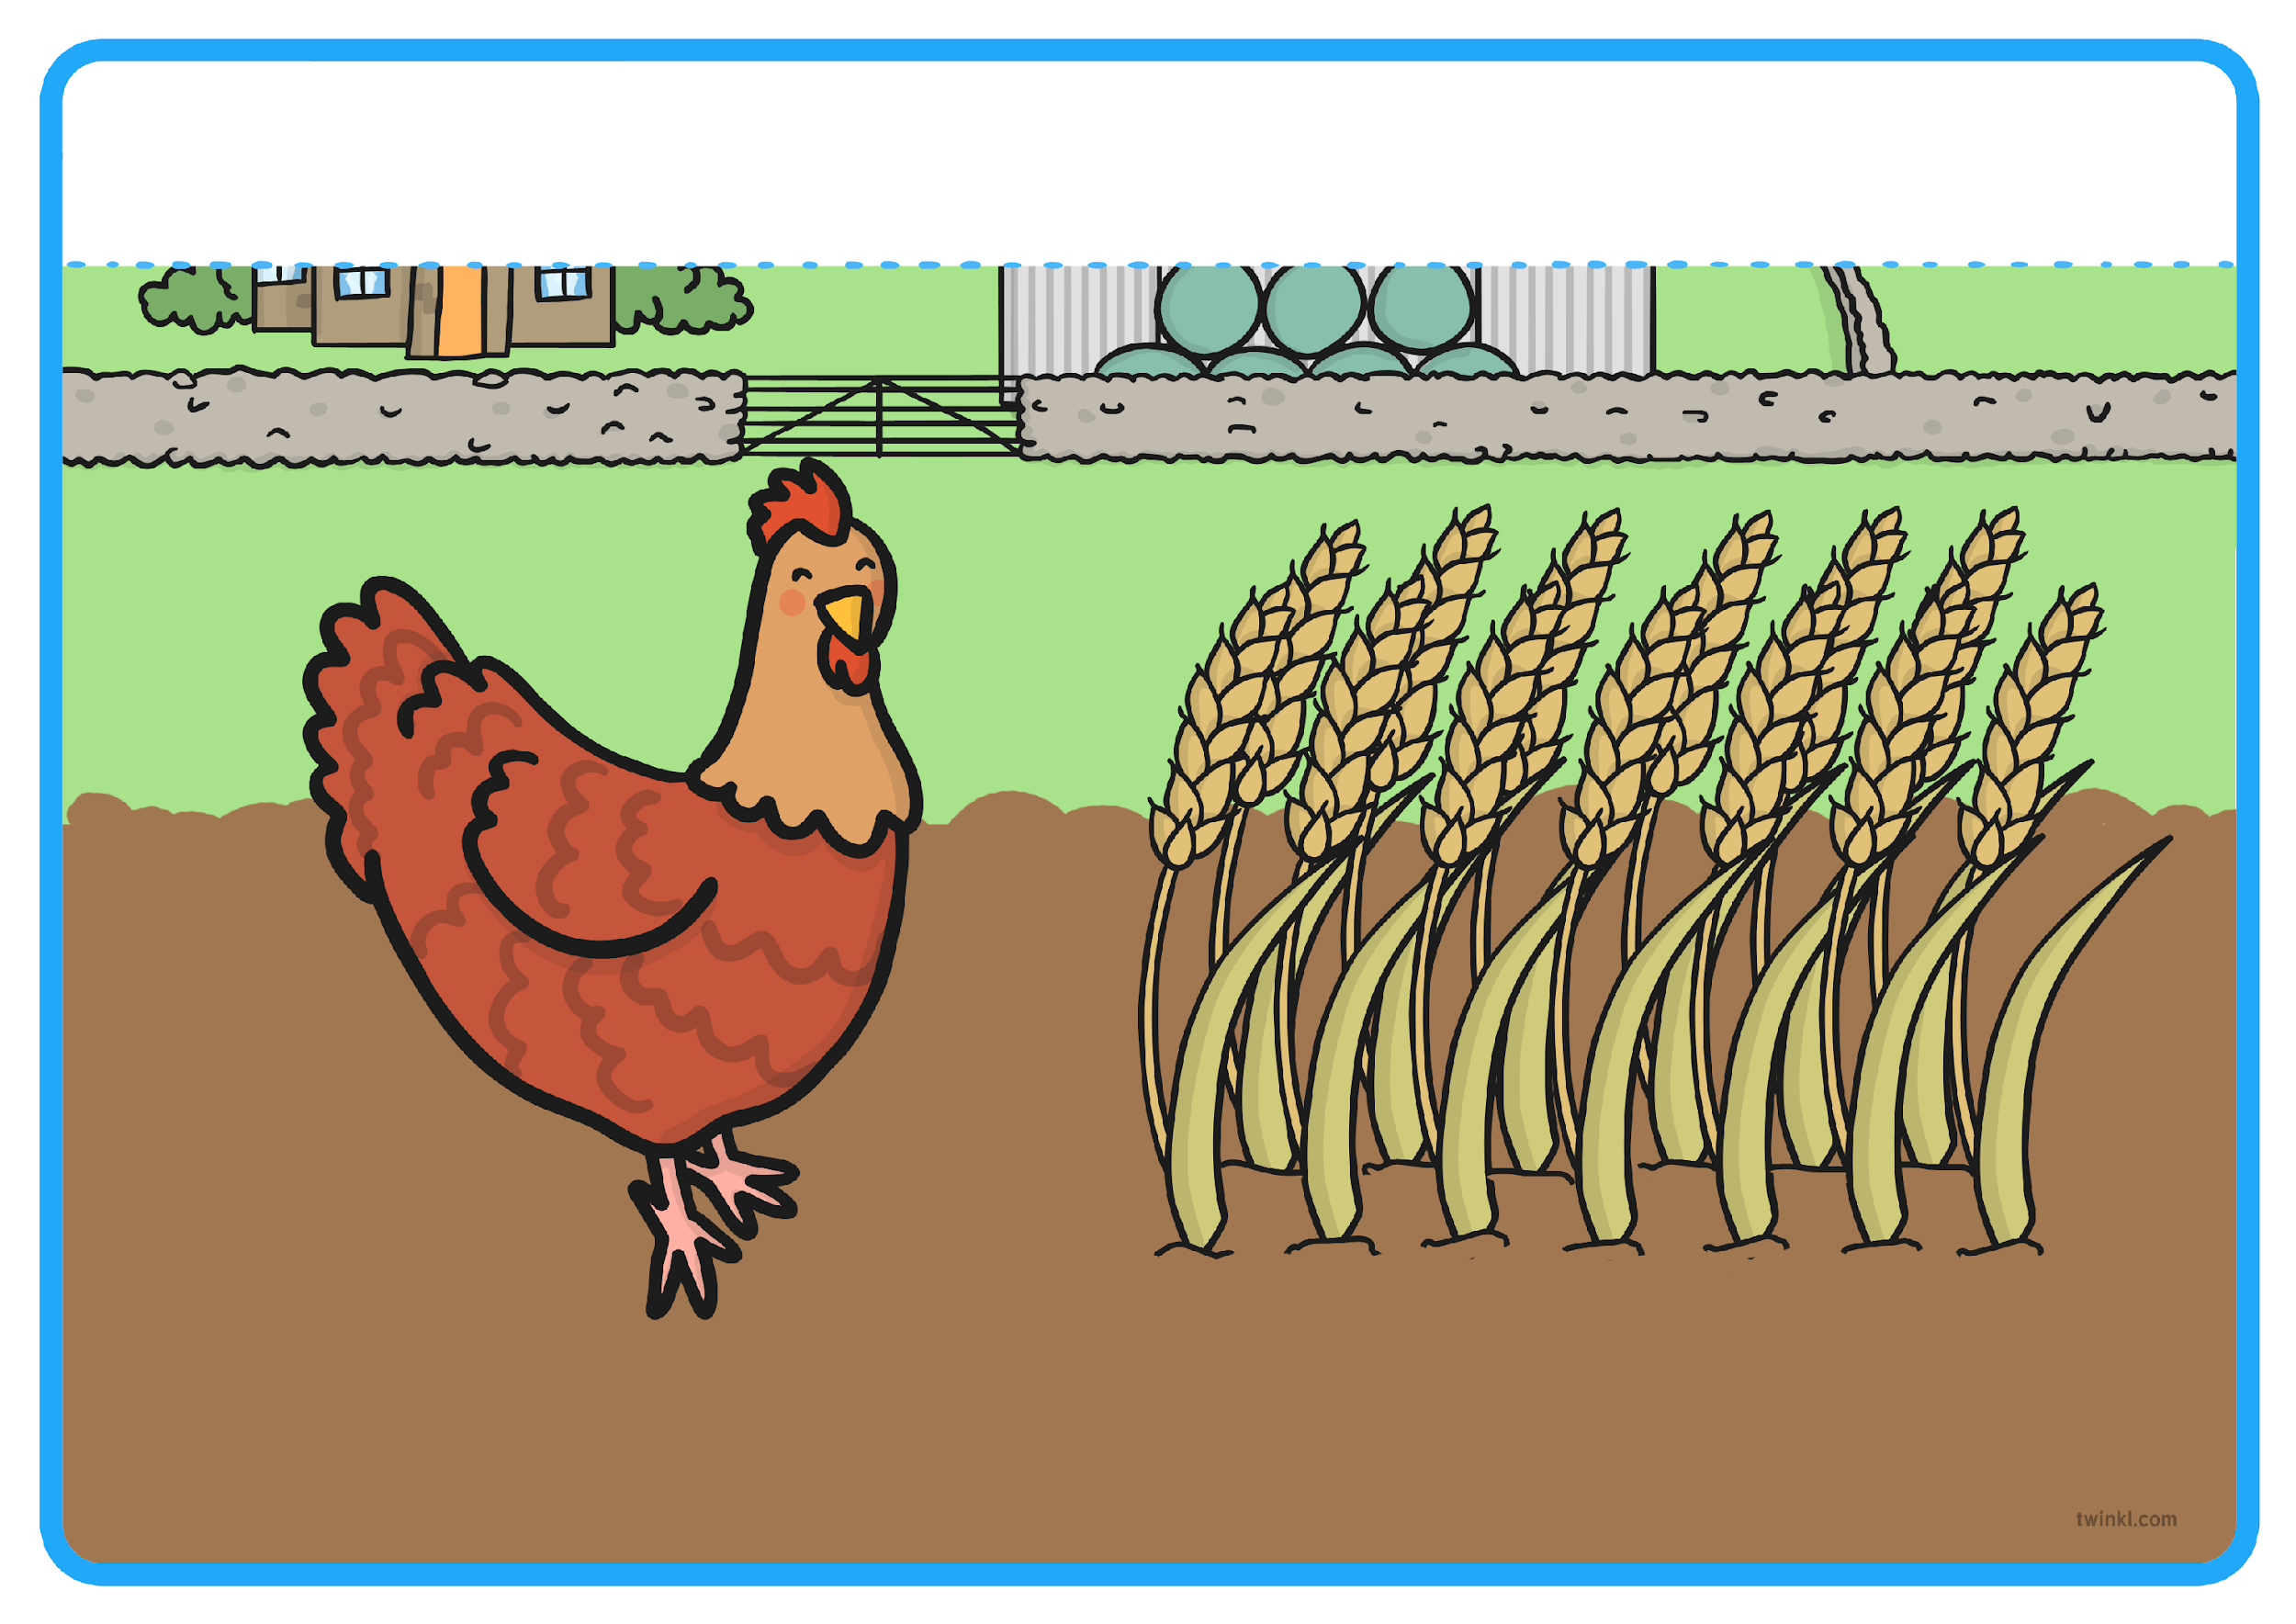
When the wheat had grown, the Little Red Hen asked her friends, “Who will help me cut the wheat?”

Slide 12
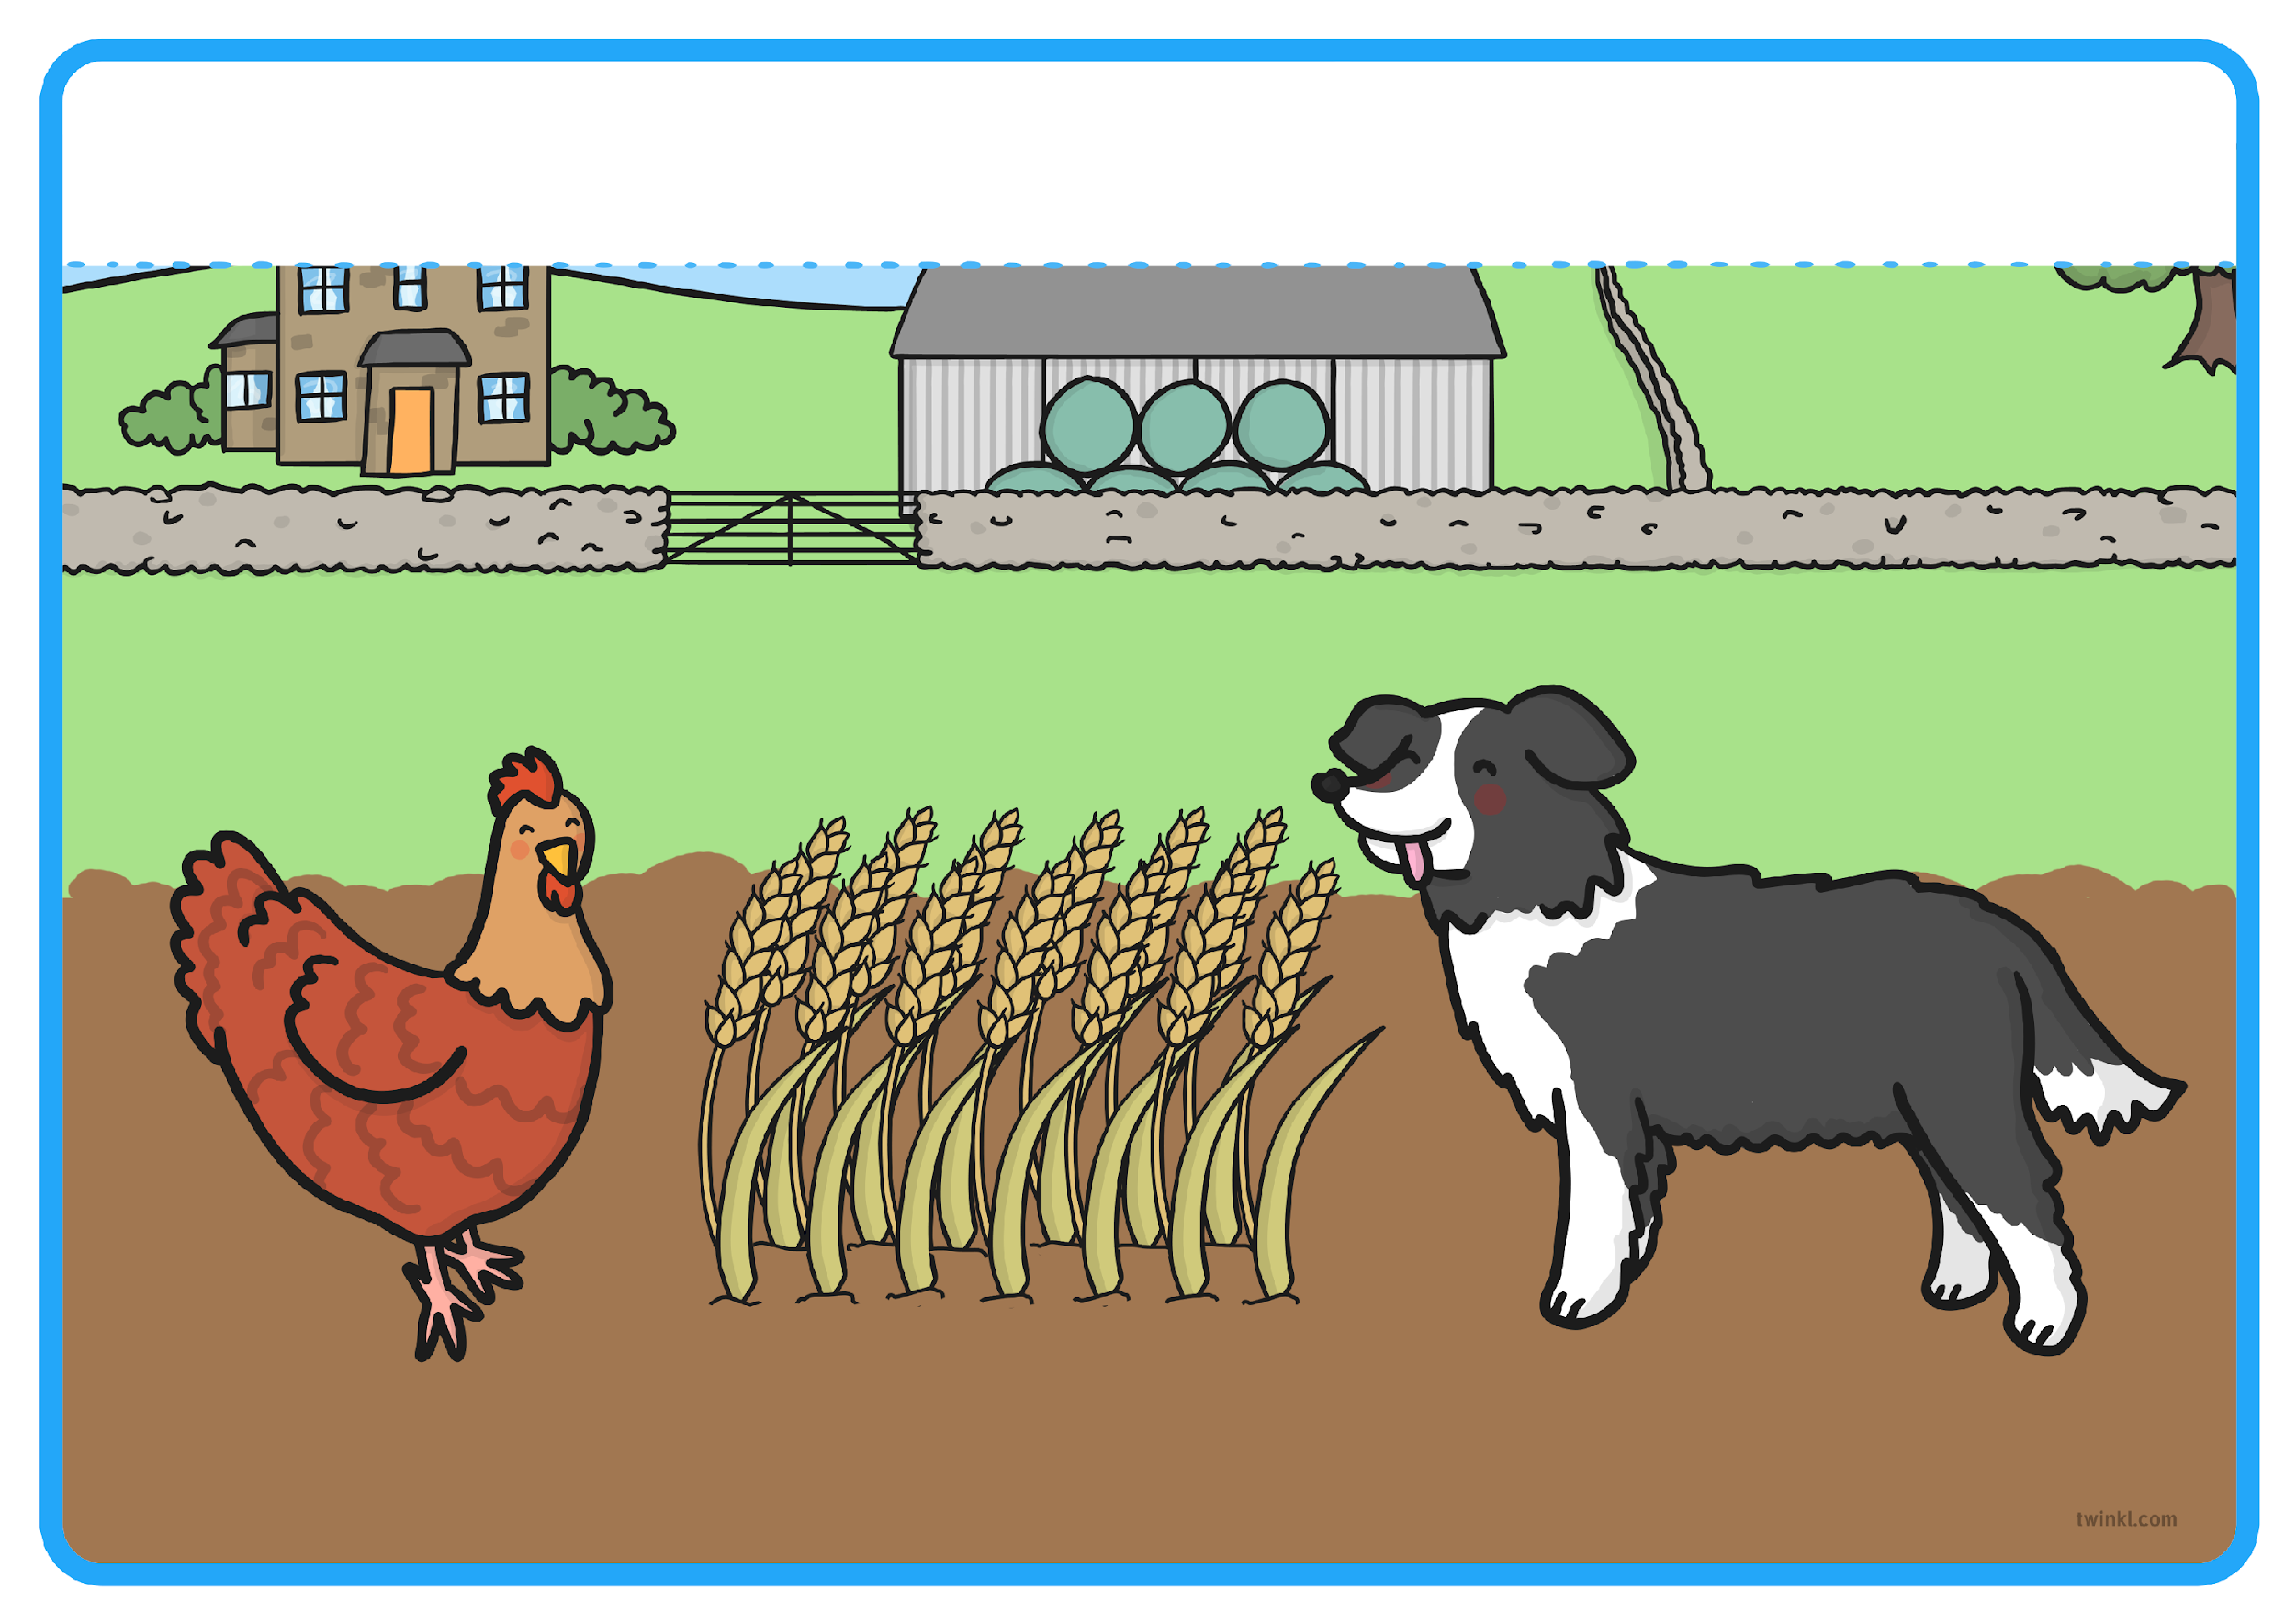
“Not I,” barked the lazy dog.
Resource: dog sound

Slide 13
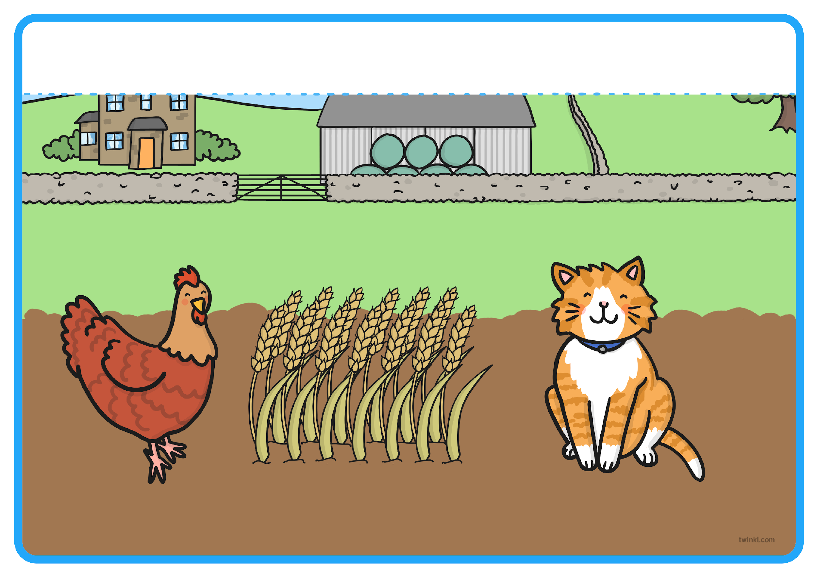
“Not I,” purred the sleepy cat.
Resource: cat sound

Slide 14
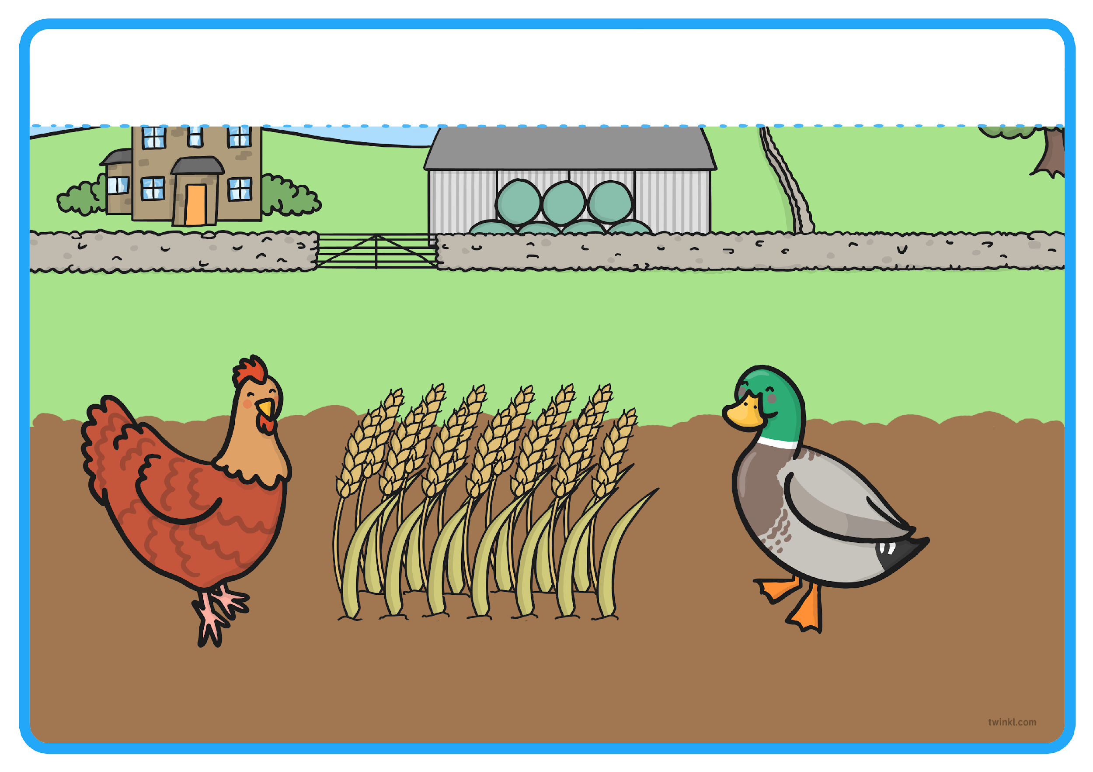
“Not I,” quacked the noisy duck.
Resource: duck sound

Slide 15
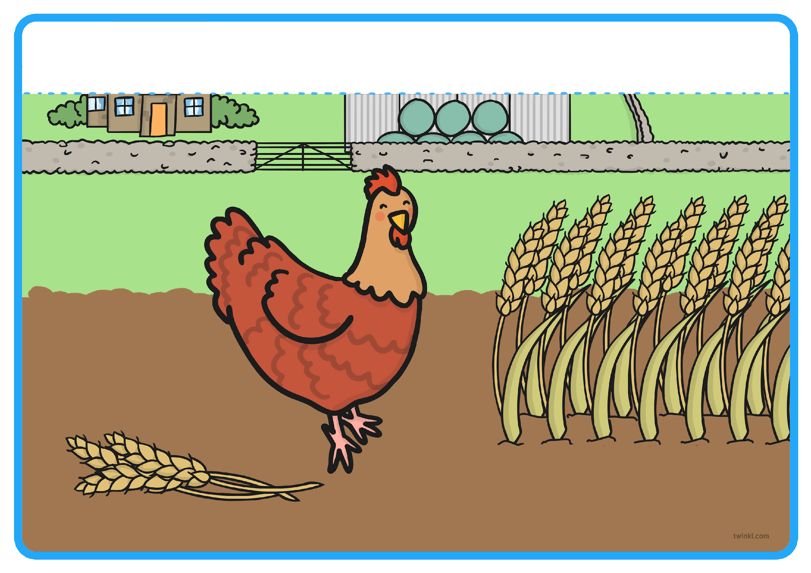
“Then I will,” said the Little Red Hen. So the Little Red Hen cut the wheat all by herself.

Slide 16
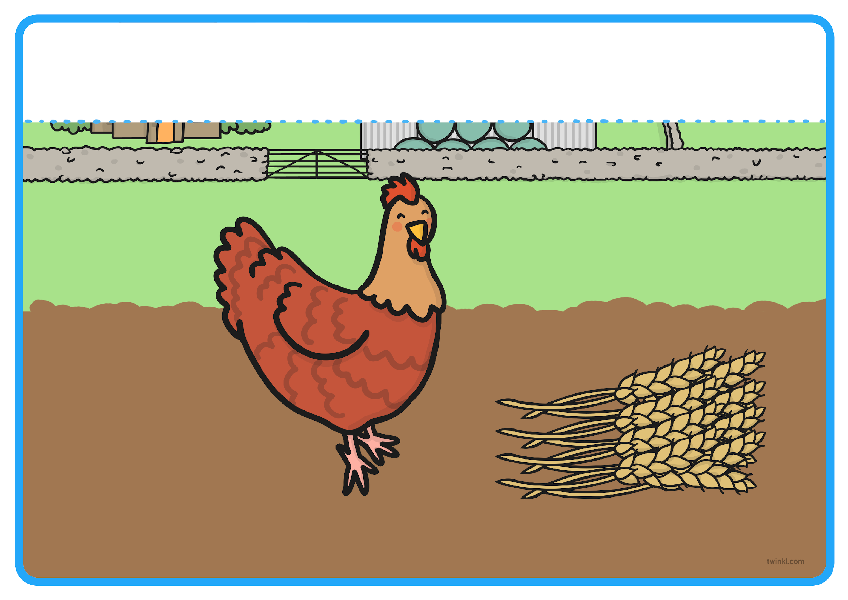
When all the wheat was cut, the Little Red Hen asked, “Who will help me take the wheat to the mill, to be made into flour?”

Slide 17
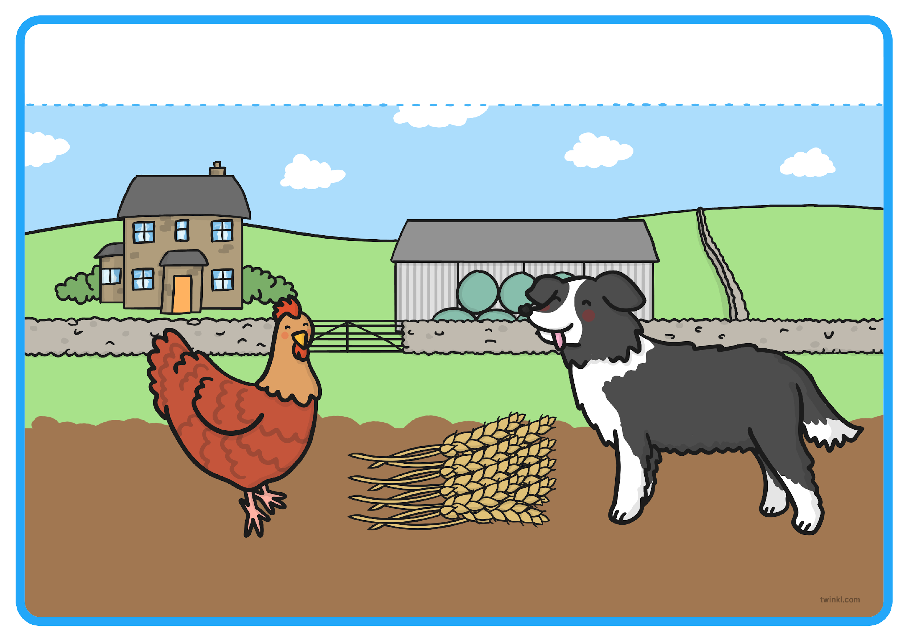
“Not I,” barked the lazy dog.
Resource: dog sound

Slide 18
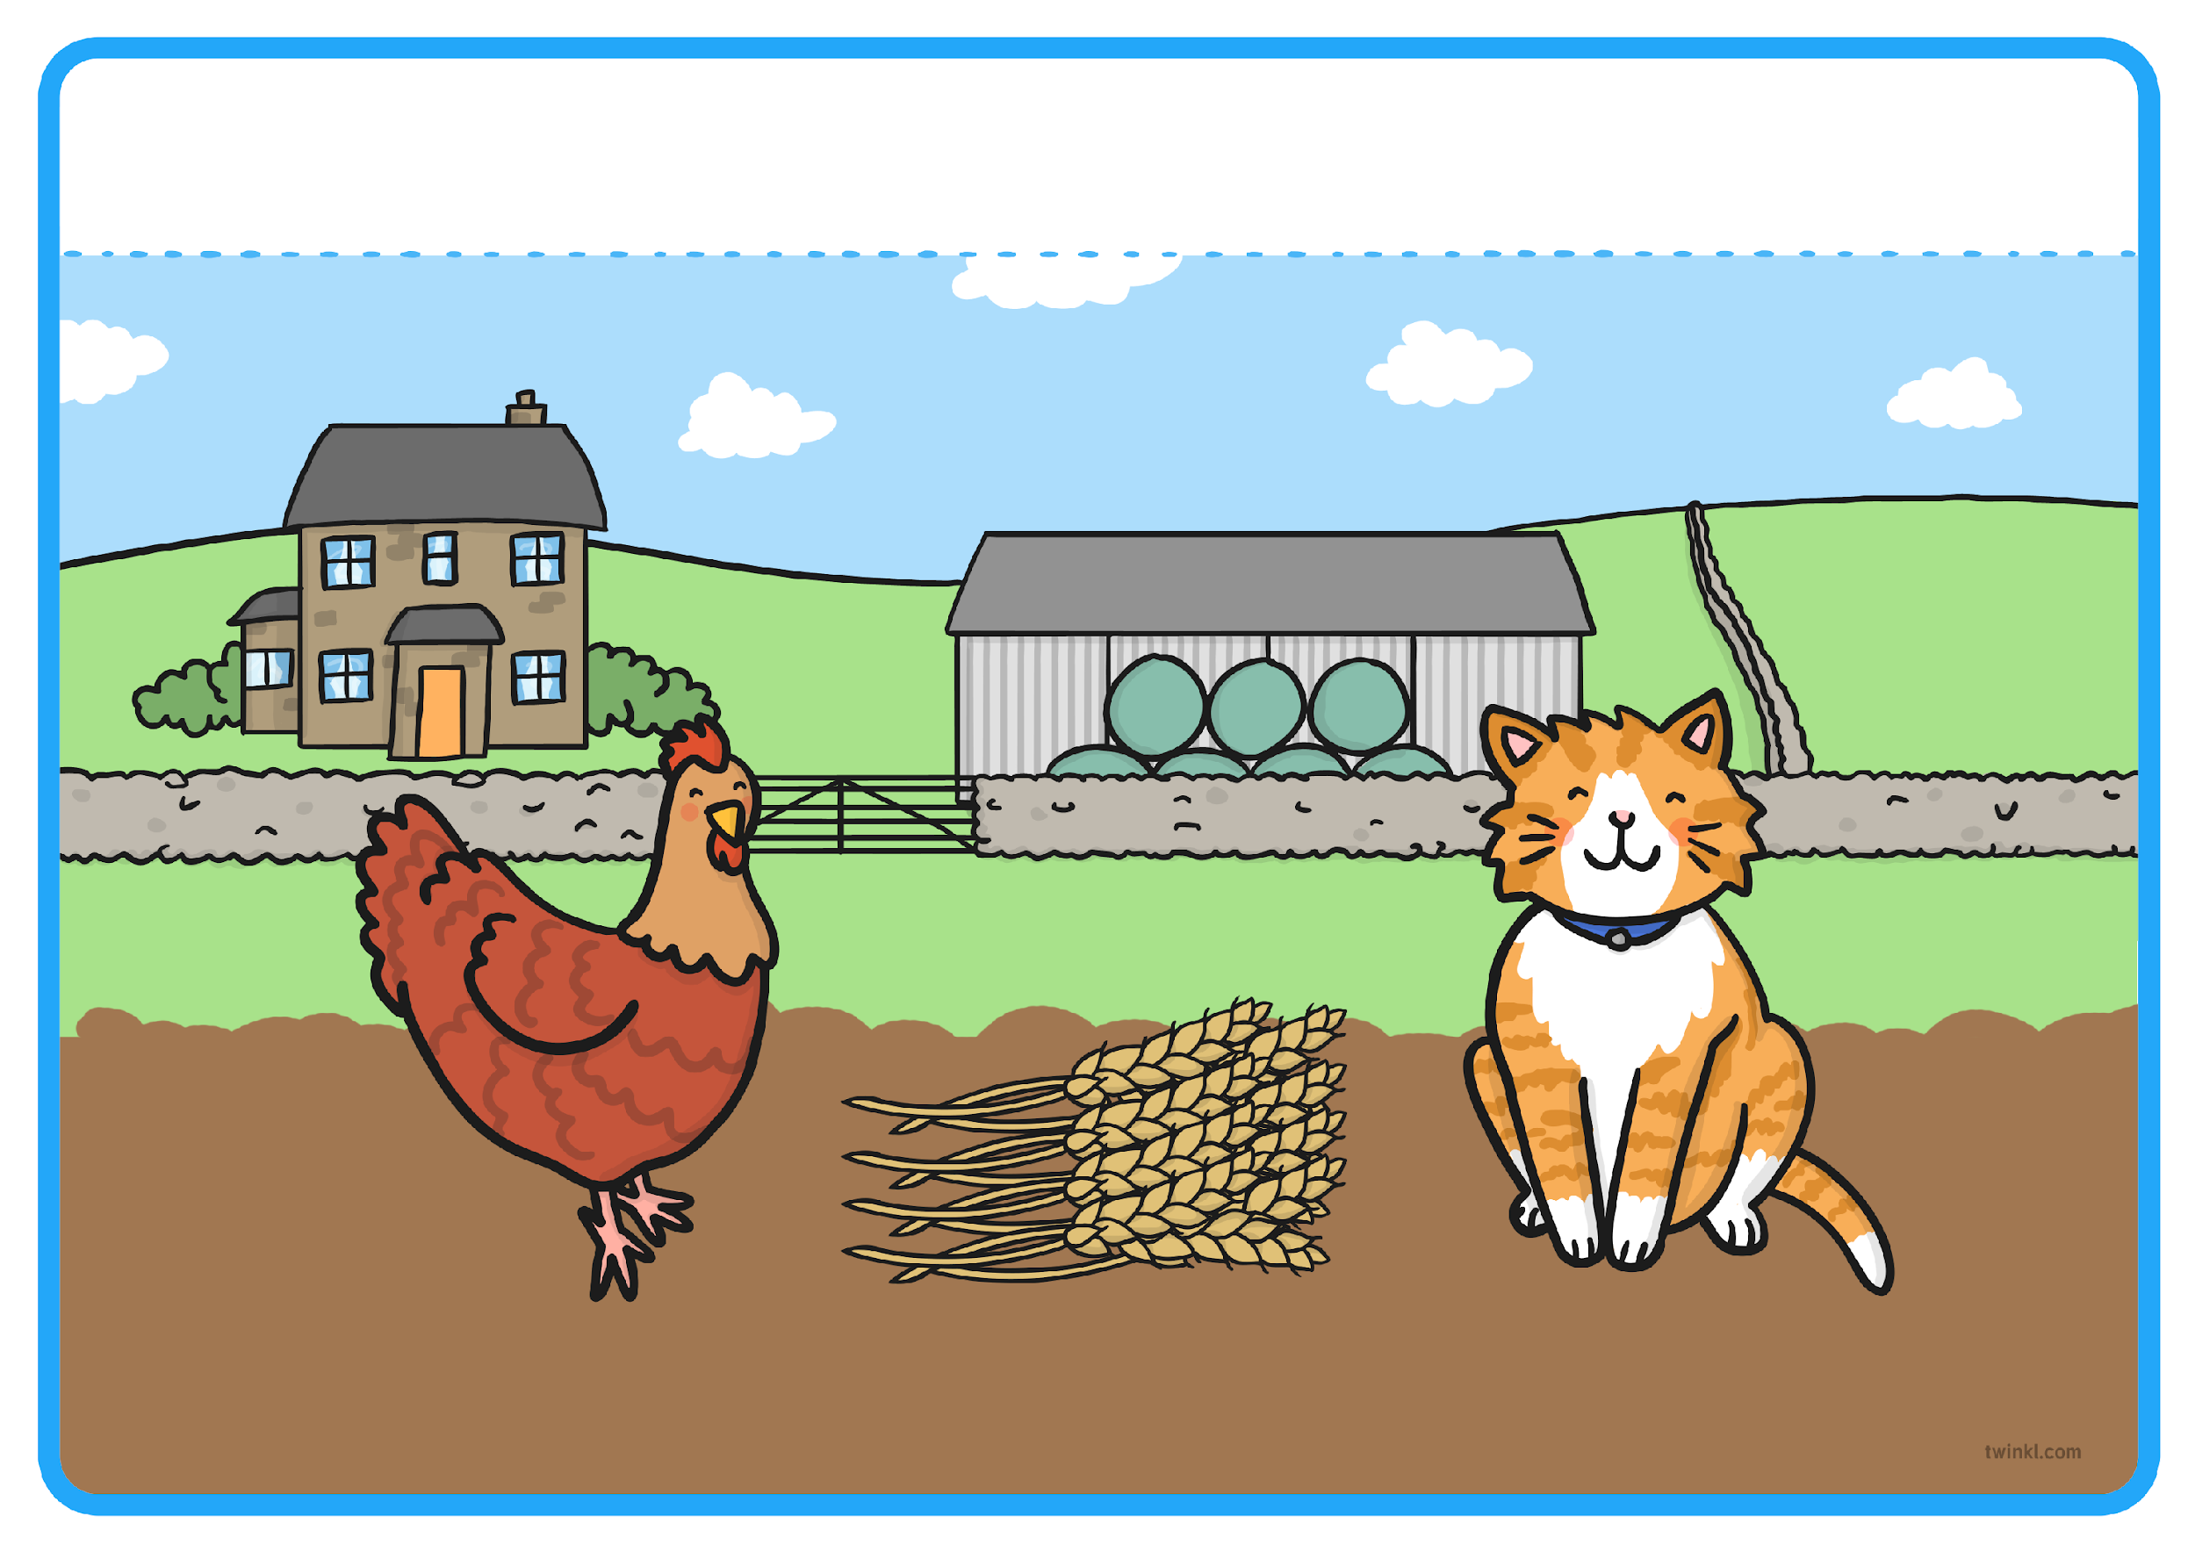
“Not I,” purred the sleepy cat.
Resource: cat sound

Slide 19
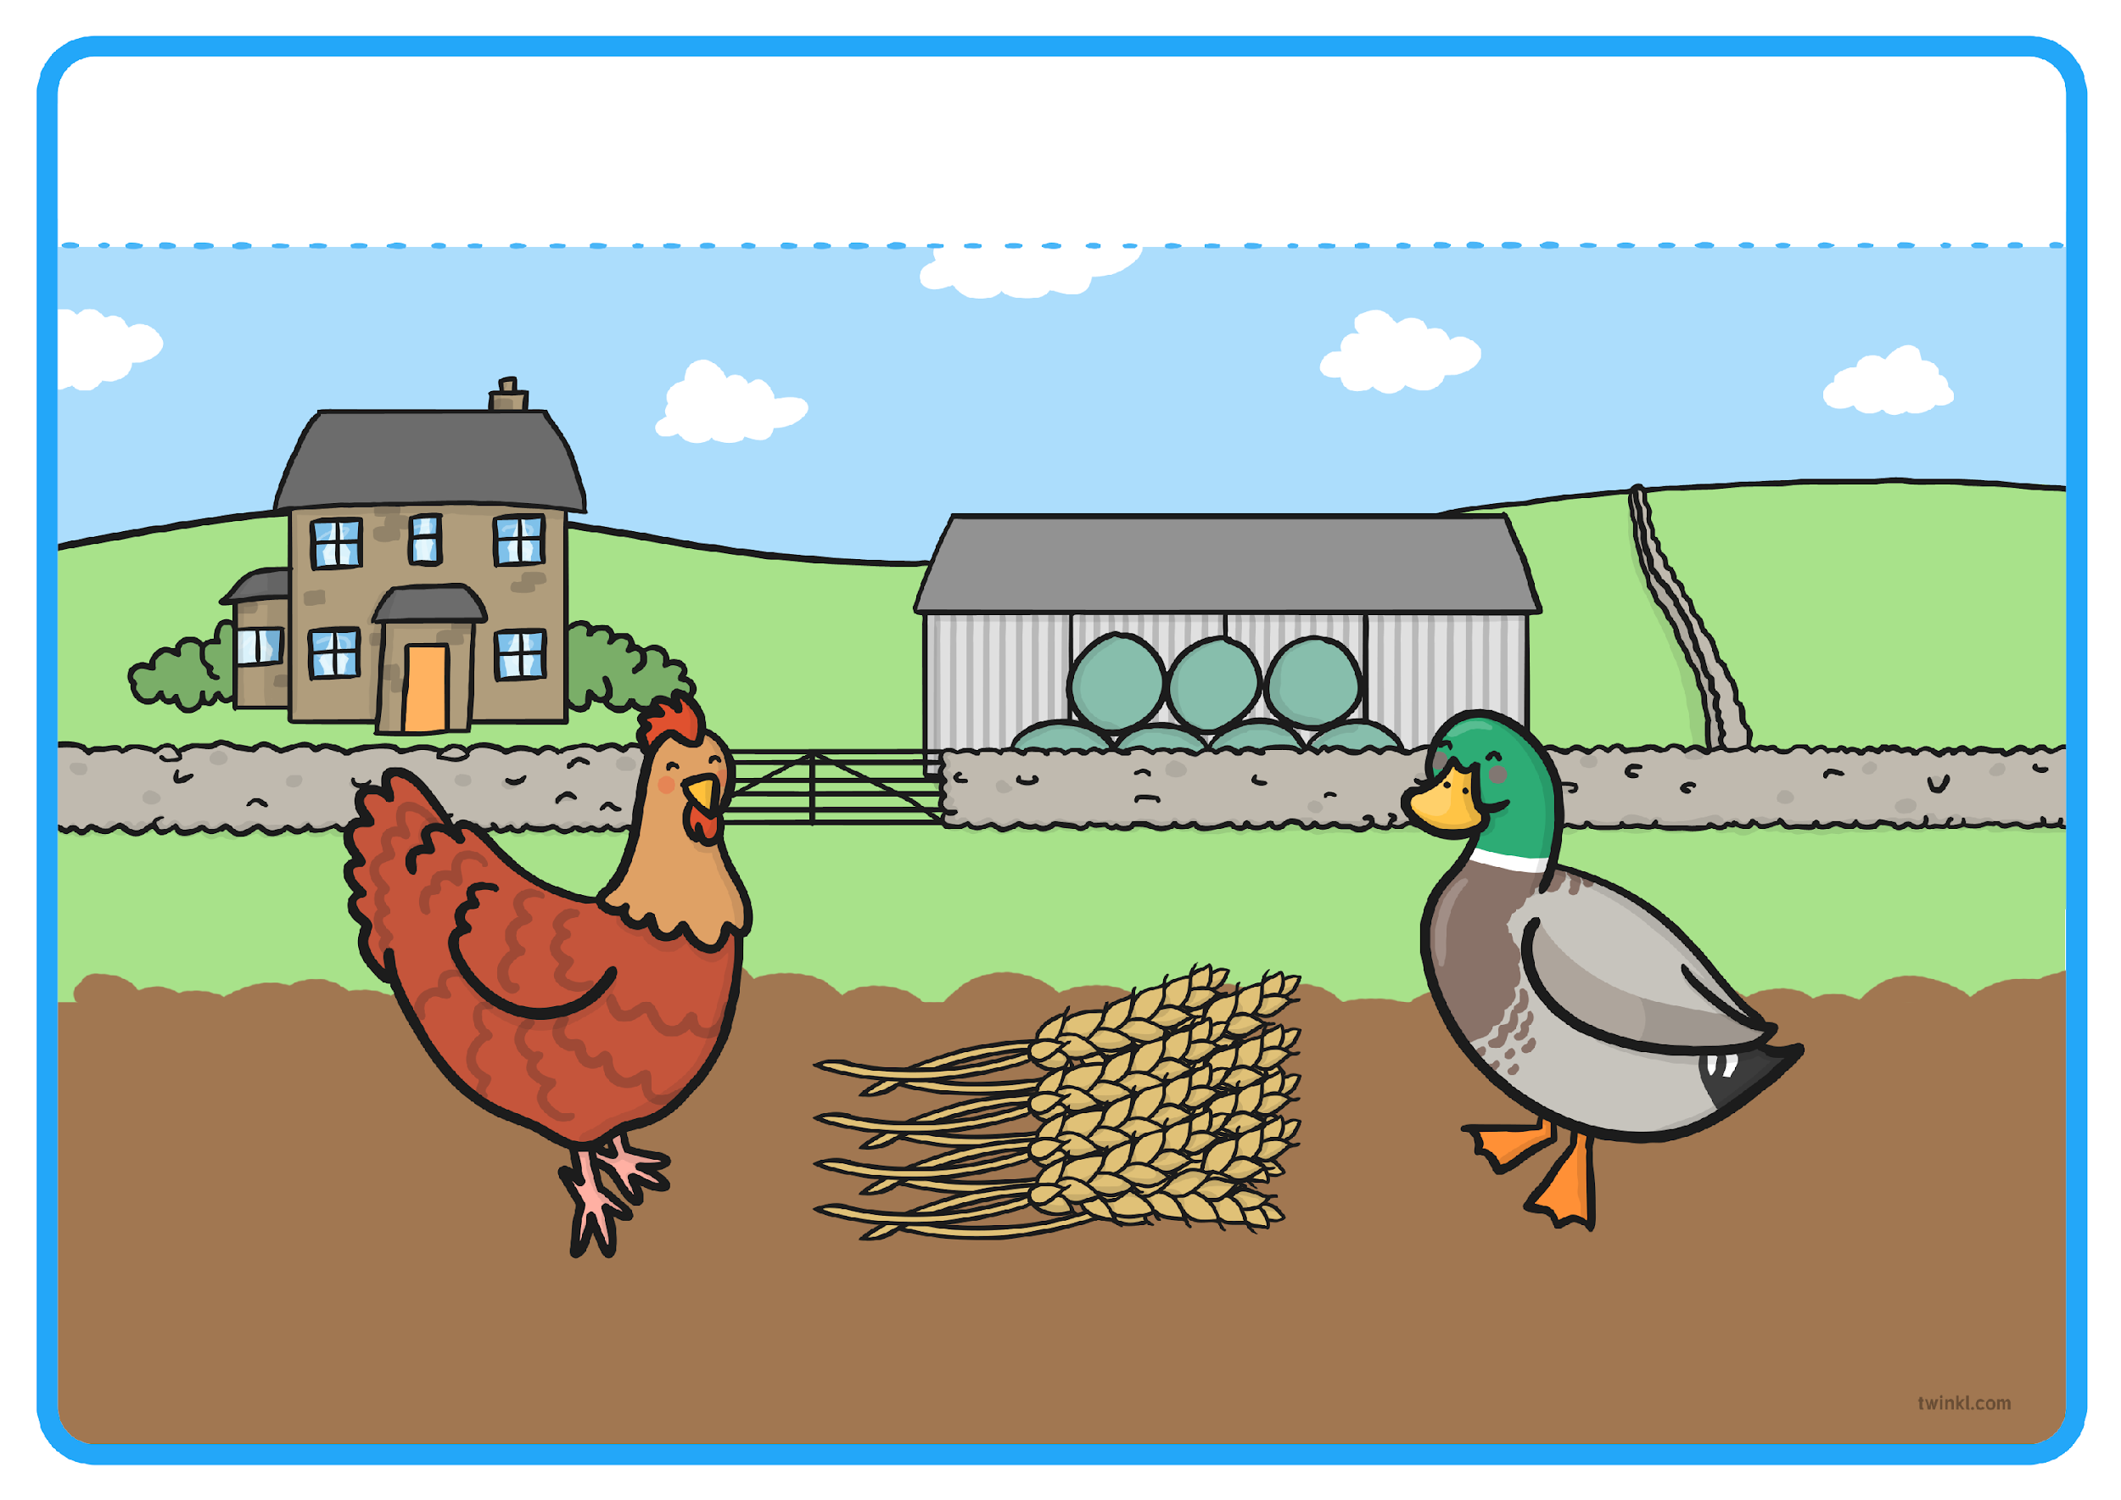
“Not I,” quacked the noisy duck.
Resource: duck sound

Slide 20
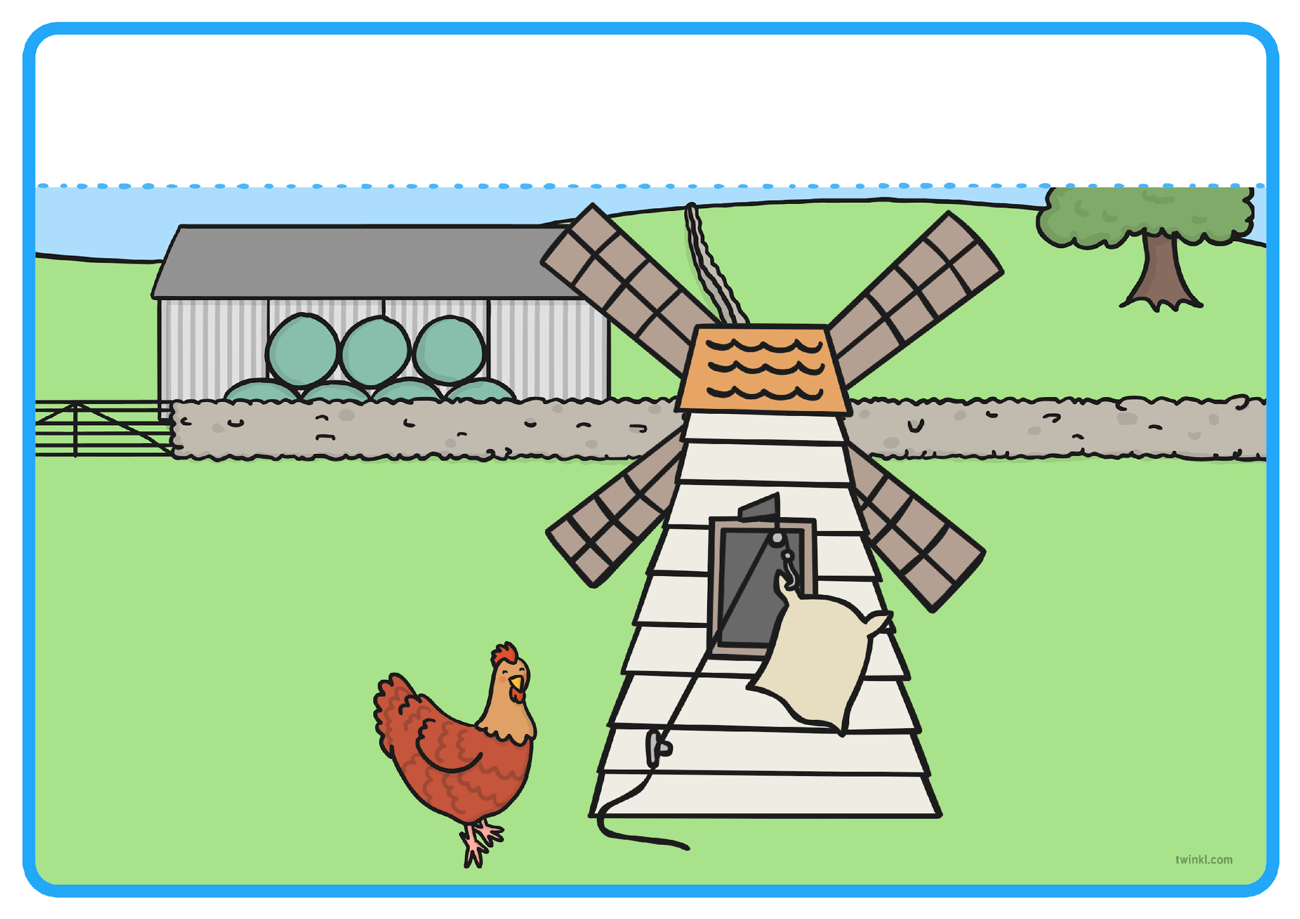
“Then I will,” said the Little Red Hen. So the Little Red Hen took the wheat to the mill, ground the wheat into flour and carried it back to the farm all by herself.
Resource: Flour

Slide 21
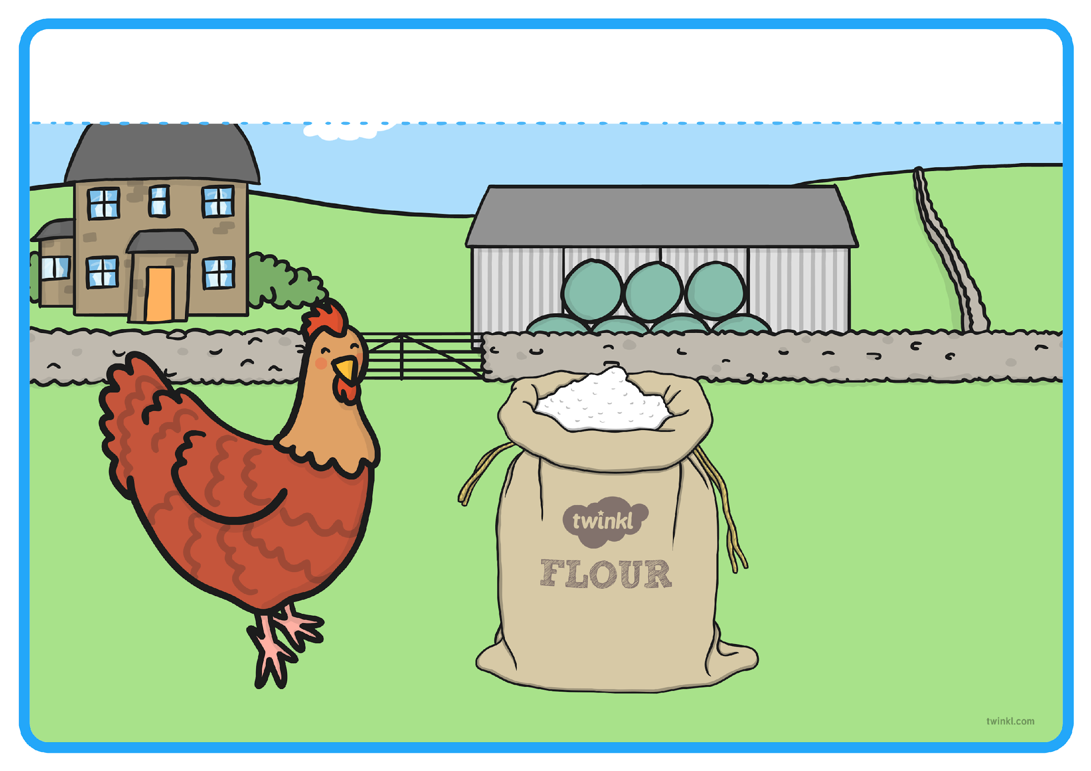
By now, the Little Red Hen was tired. “Who will help me bake the bread?” asked Little Red Hen.

Slide 22
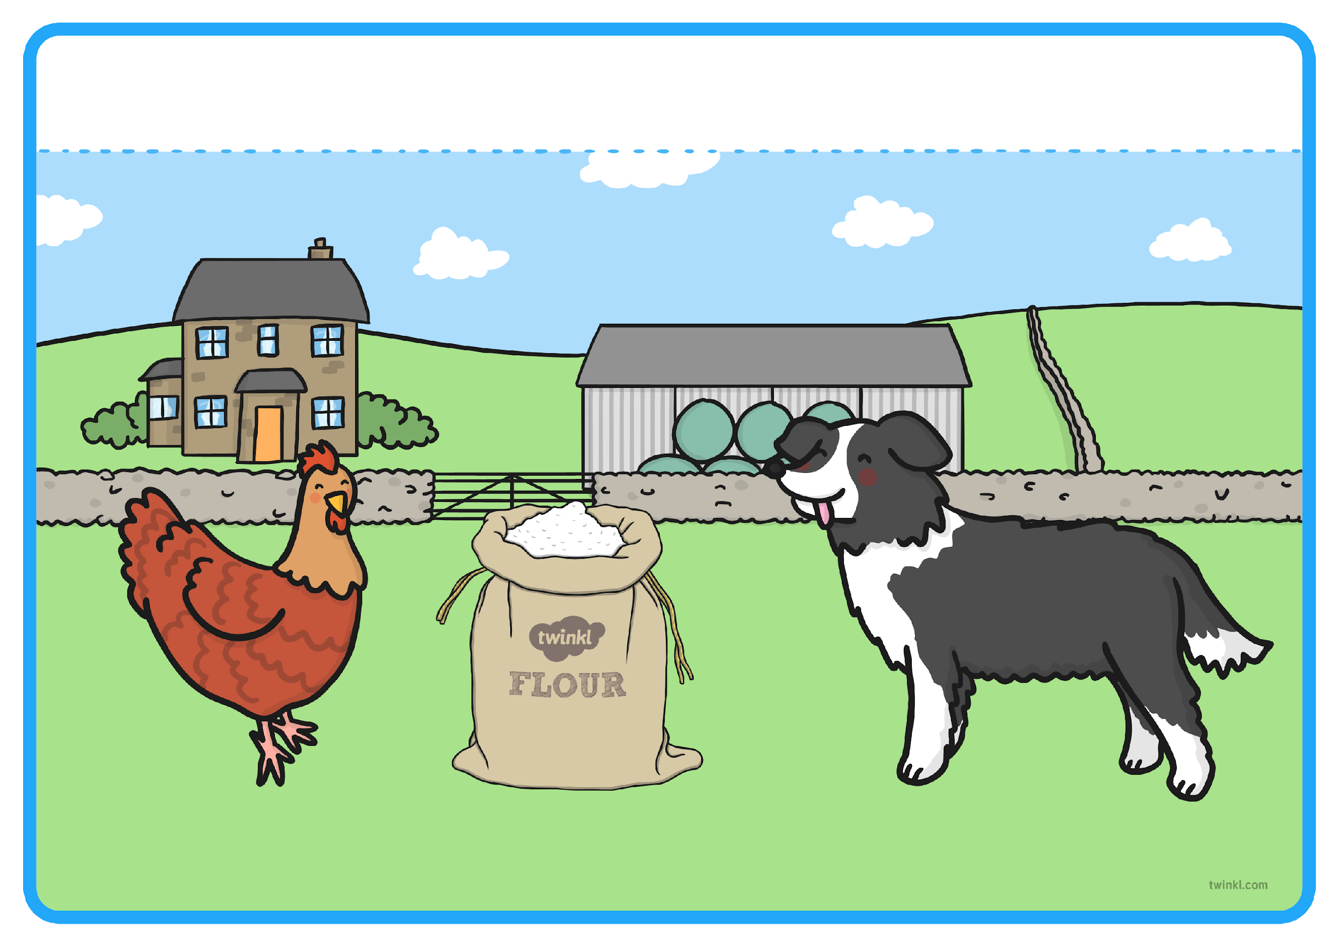
“Not I,” barked the lazy dog.

Slide 23
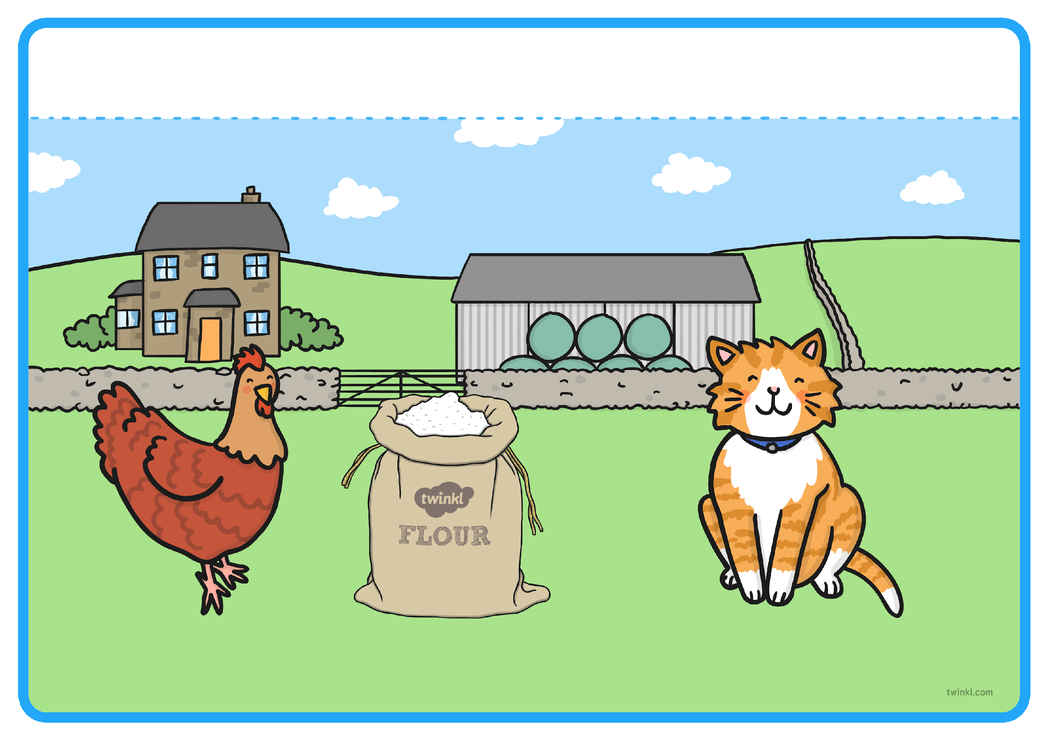
“Not I,” purred the sleepy cat.

Slide 24
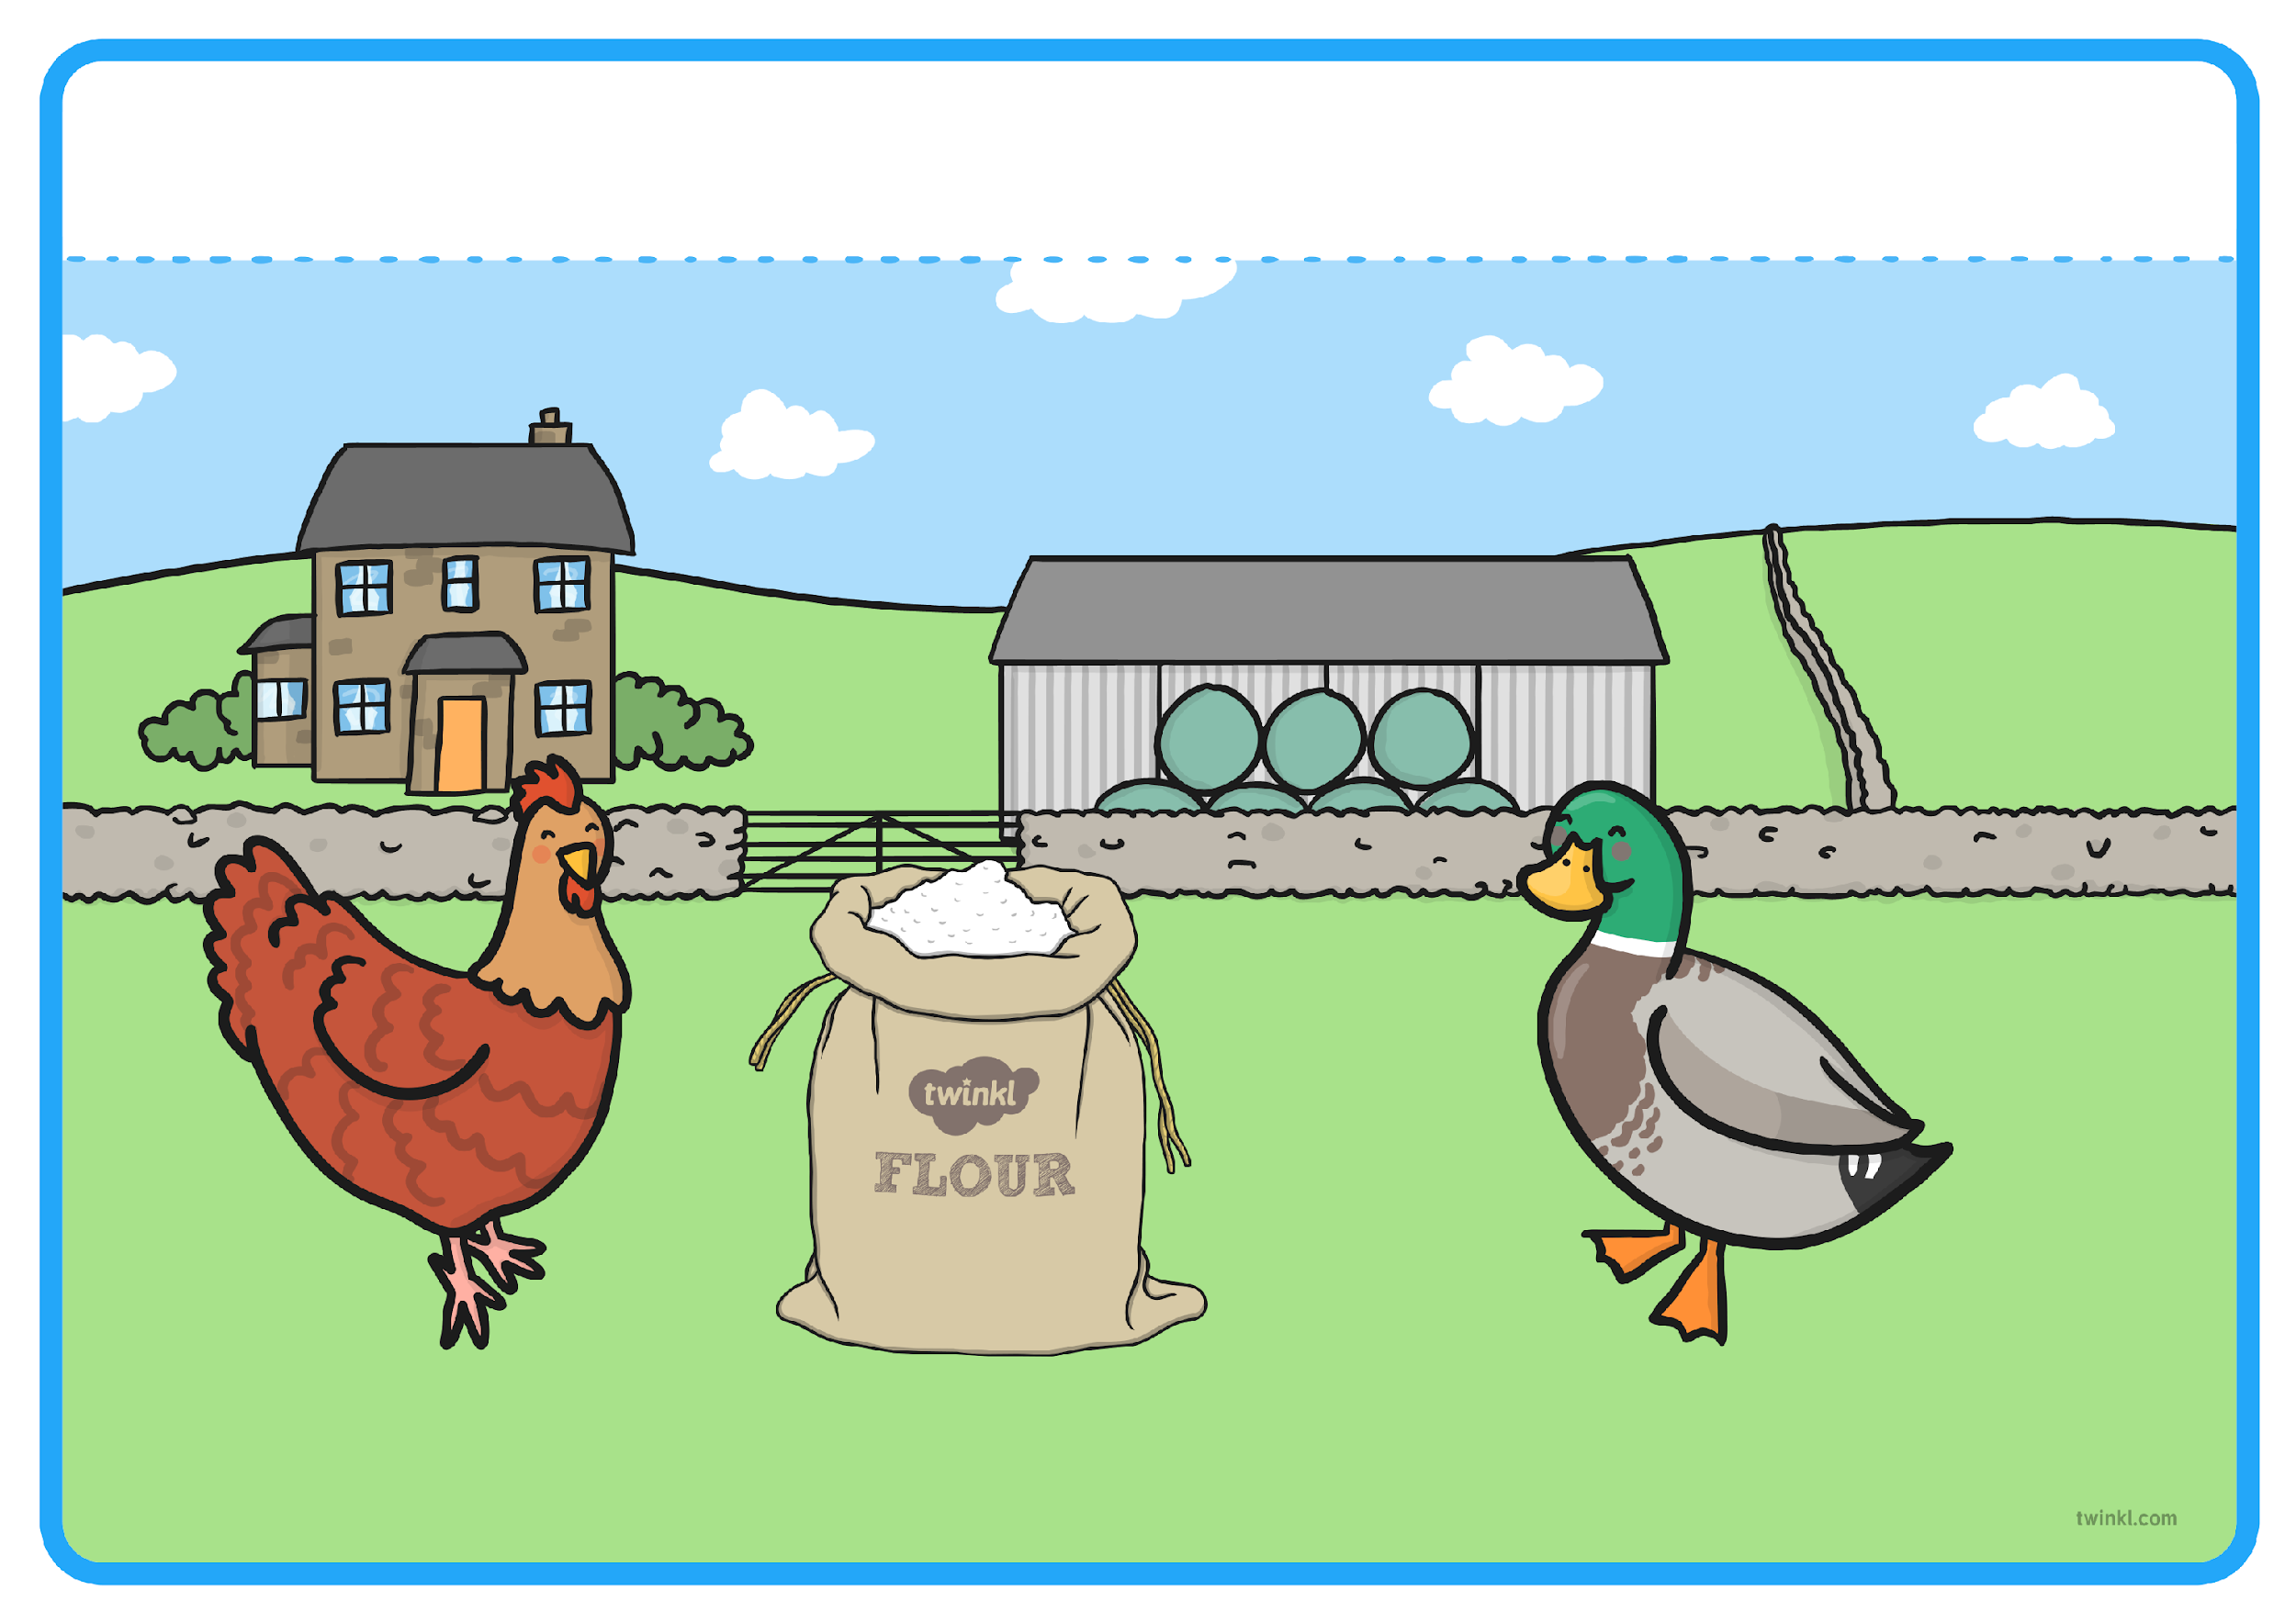
“Not I,” quacked the noisy duck.

Slide 25
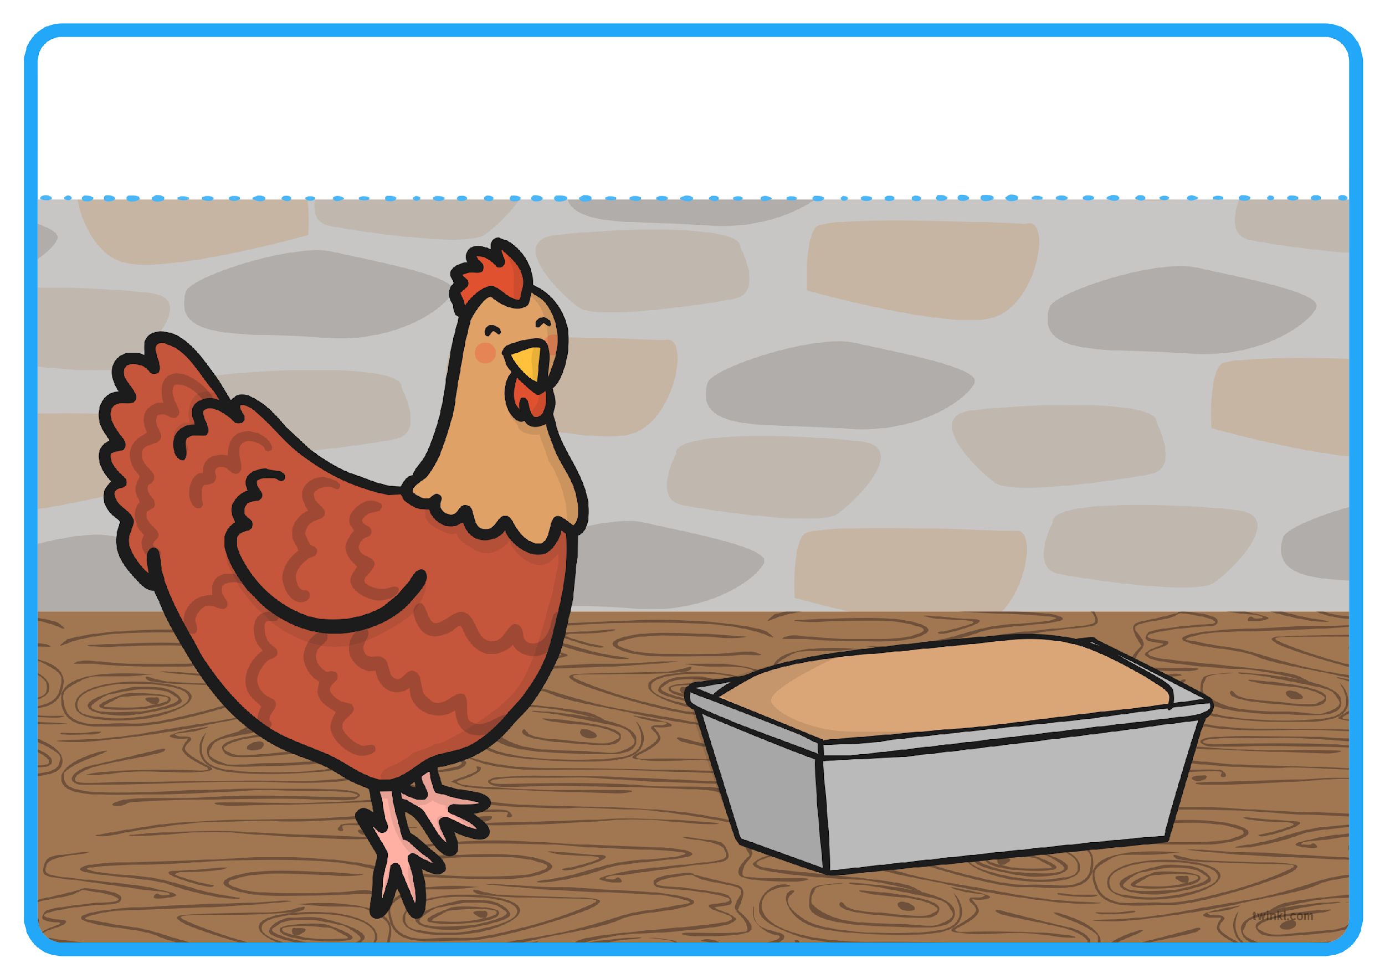
“Then I will,” said the Little Red Hen. So the Little Red Hen baked the bread all by herself. When the bread was finished, the Little Red Hen asked, “Who will help me eat the bread?”
Resource: bowl, spoon, flour or playdough

Slide 26
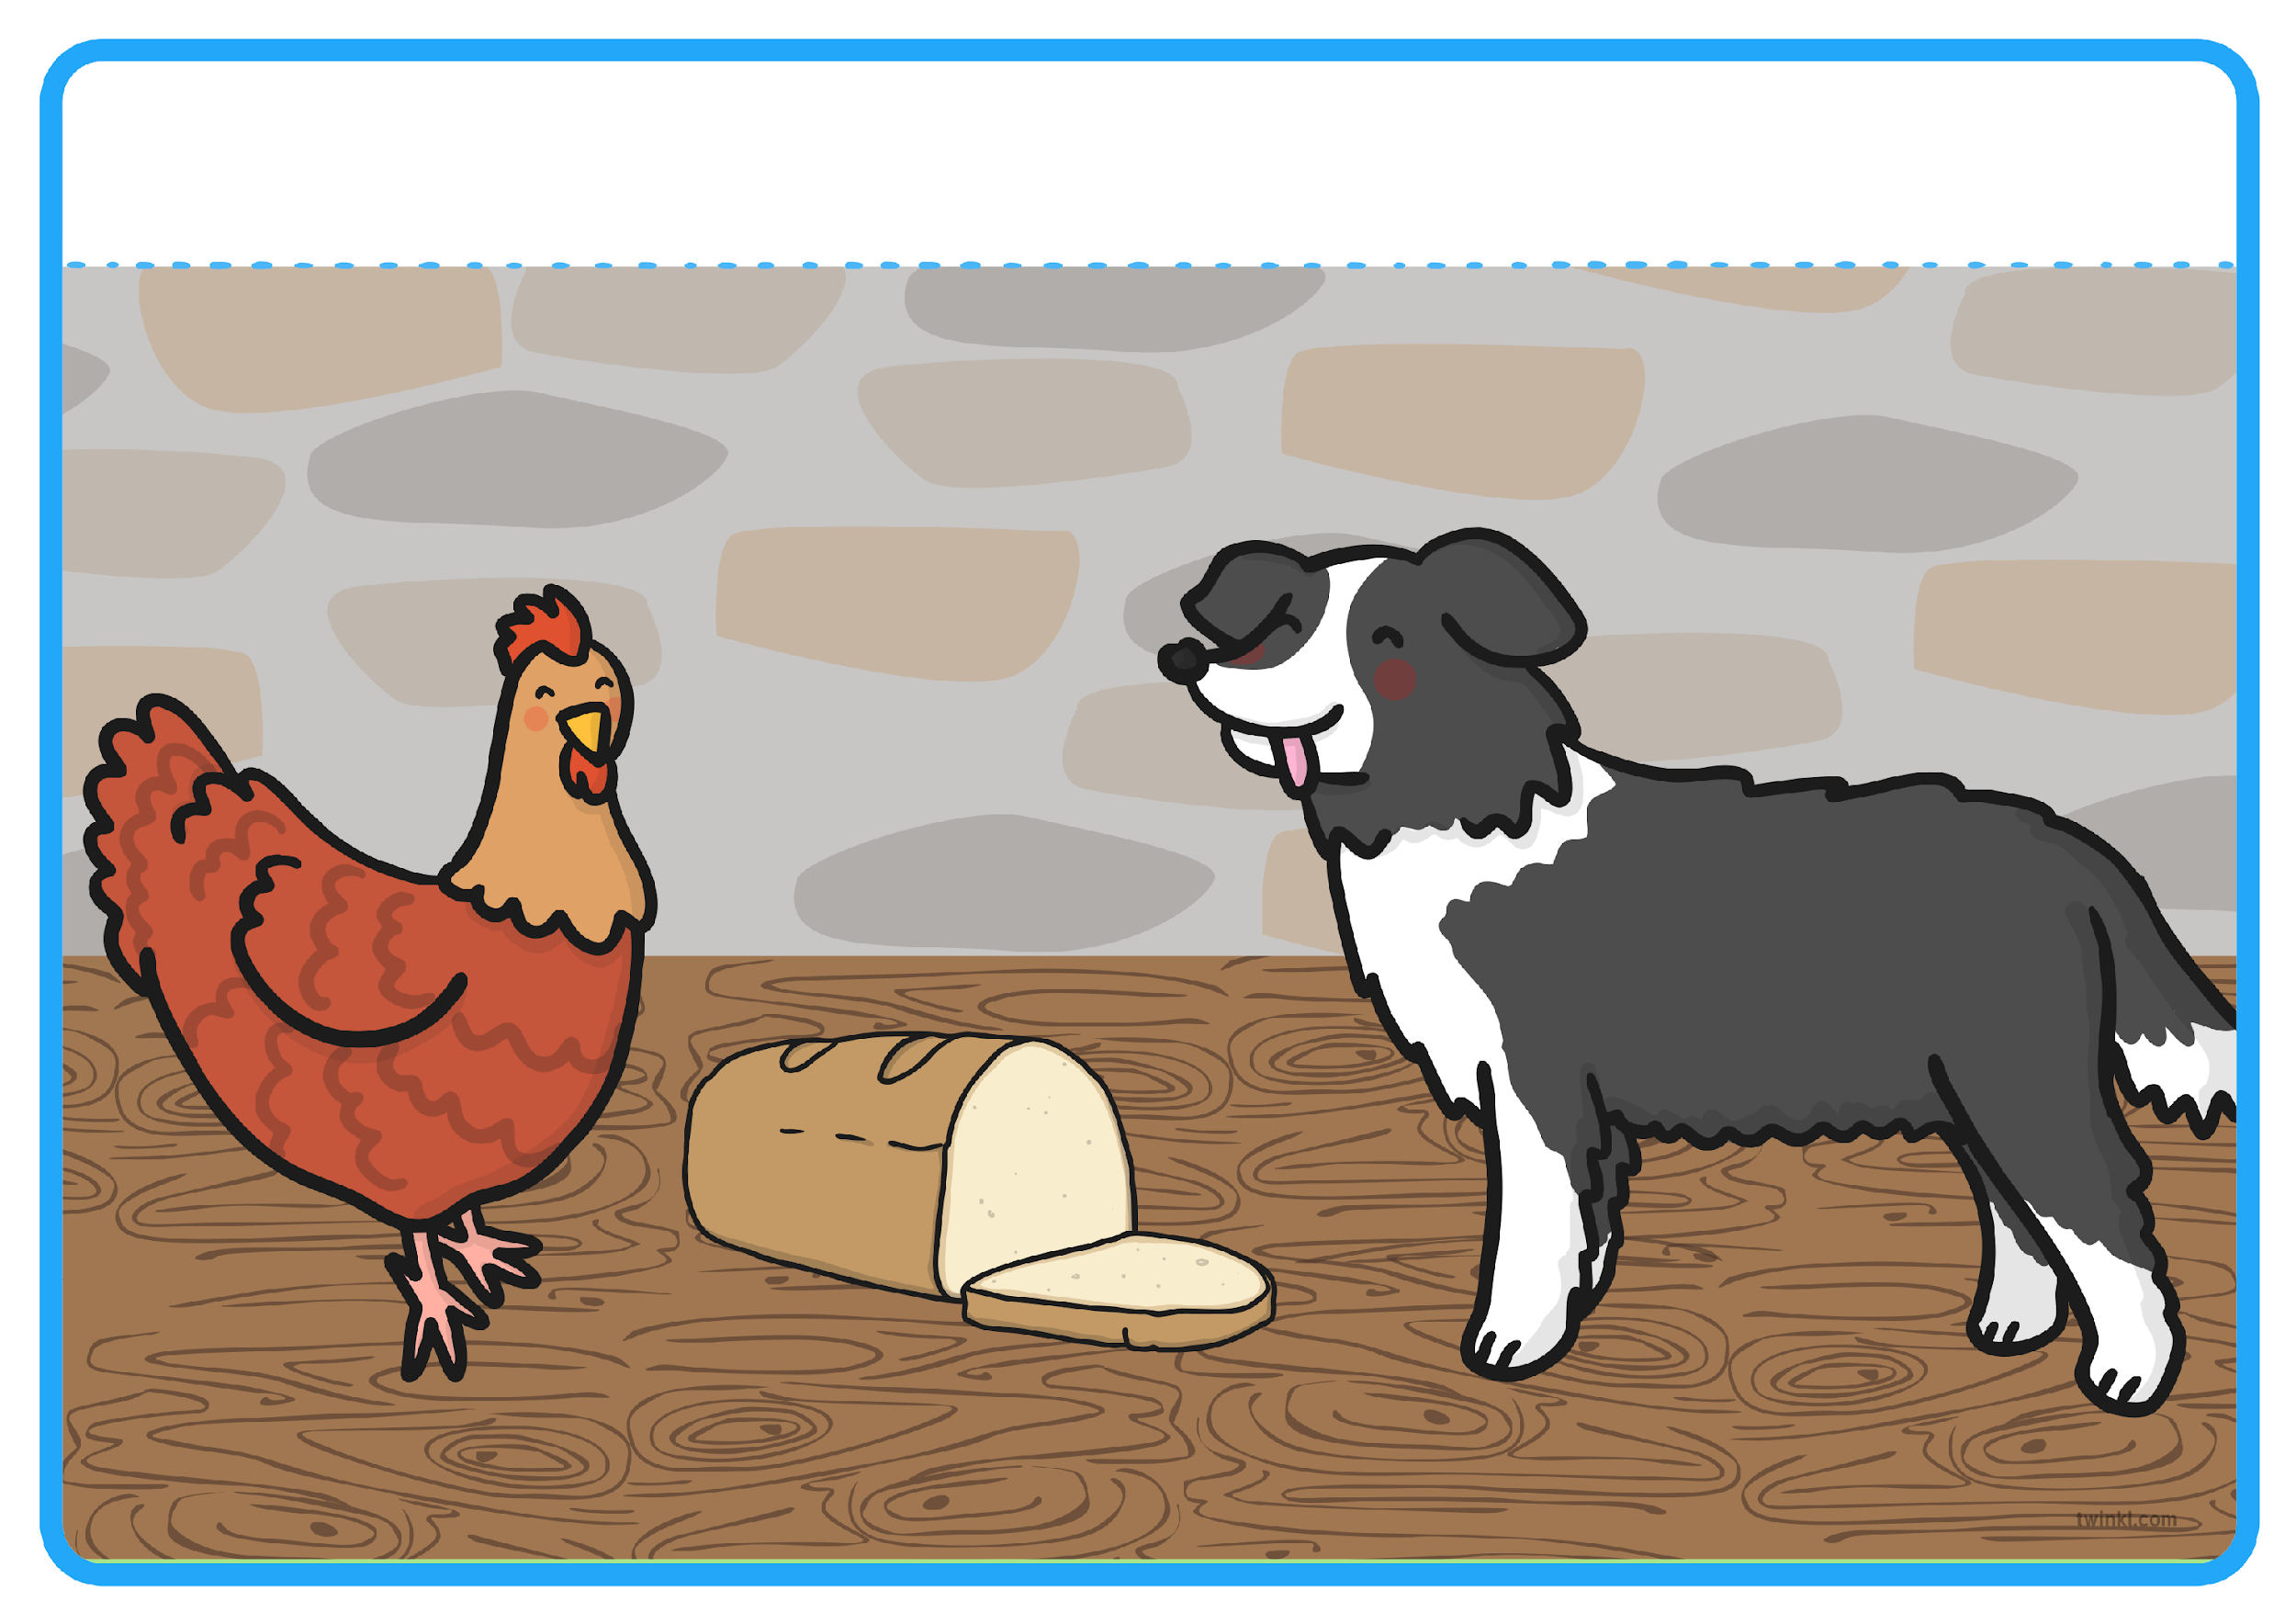
“I will!” barked the lazy dog.

Slide 27
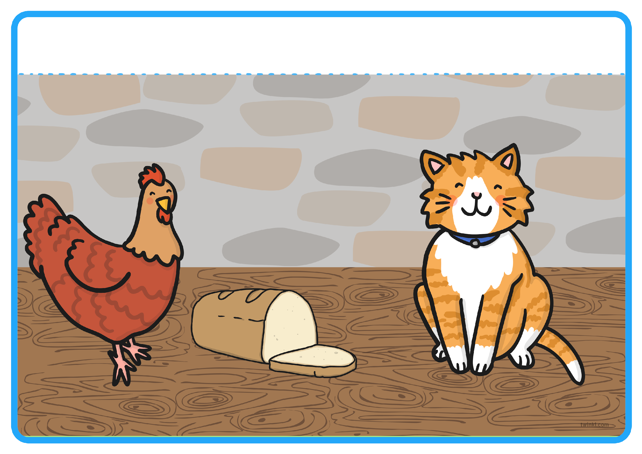
“I will!” purred the sleepy cat.

Slide 28
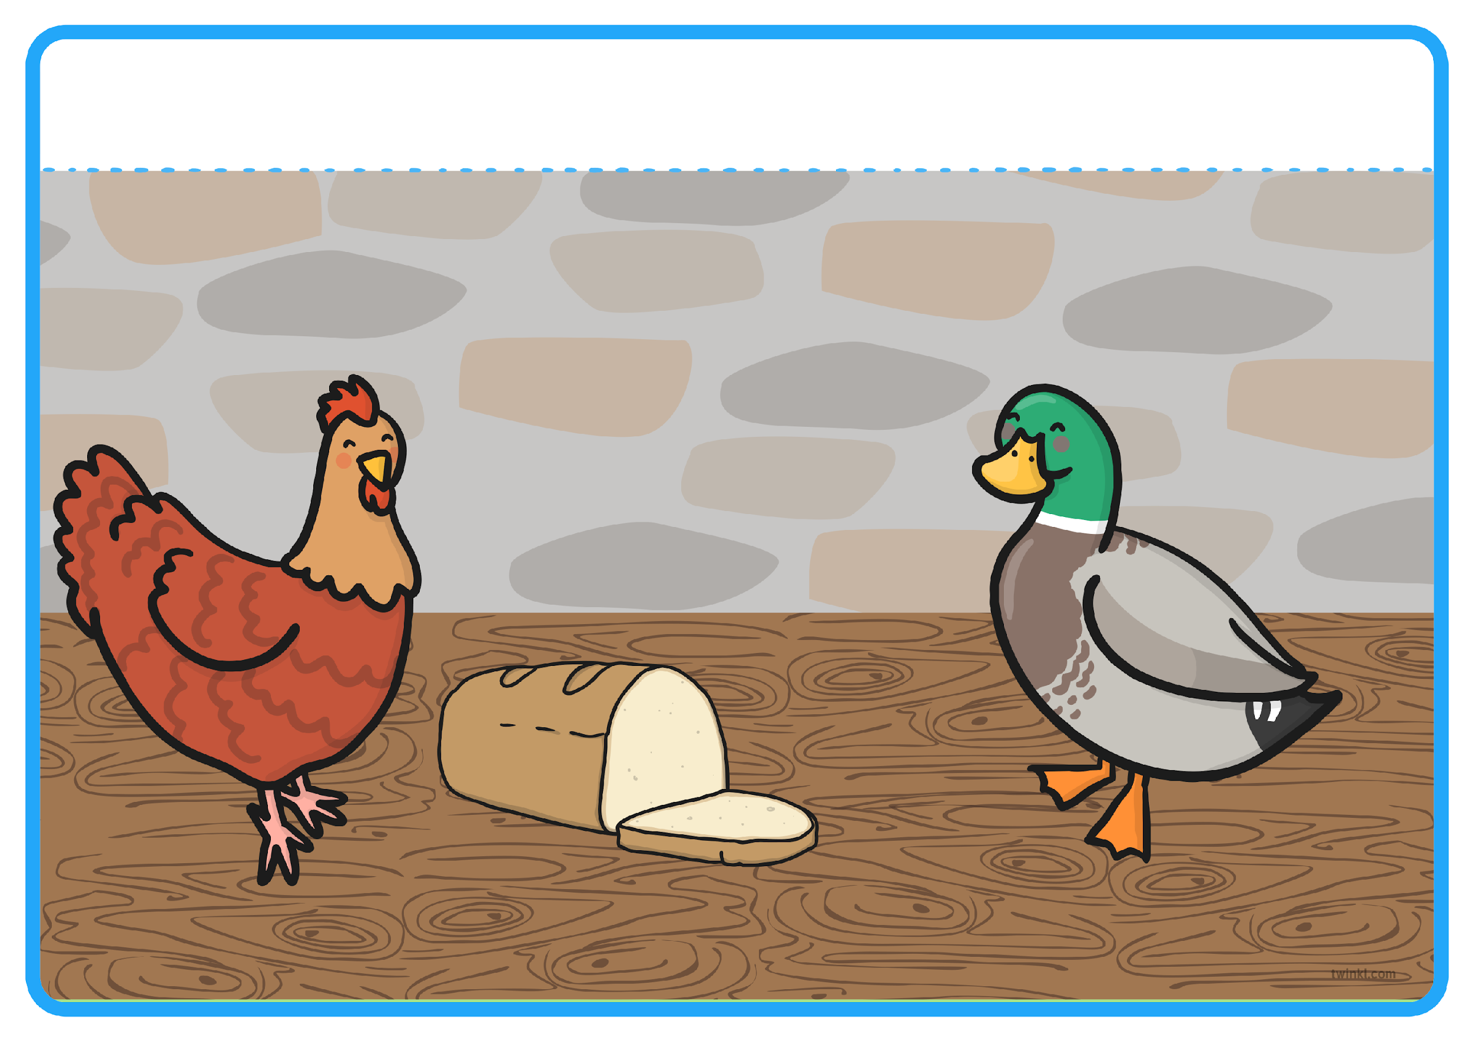
“I will!” quacked the noisy duck.

Slide 29
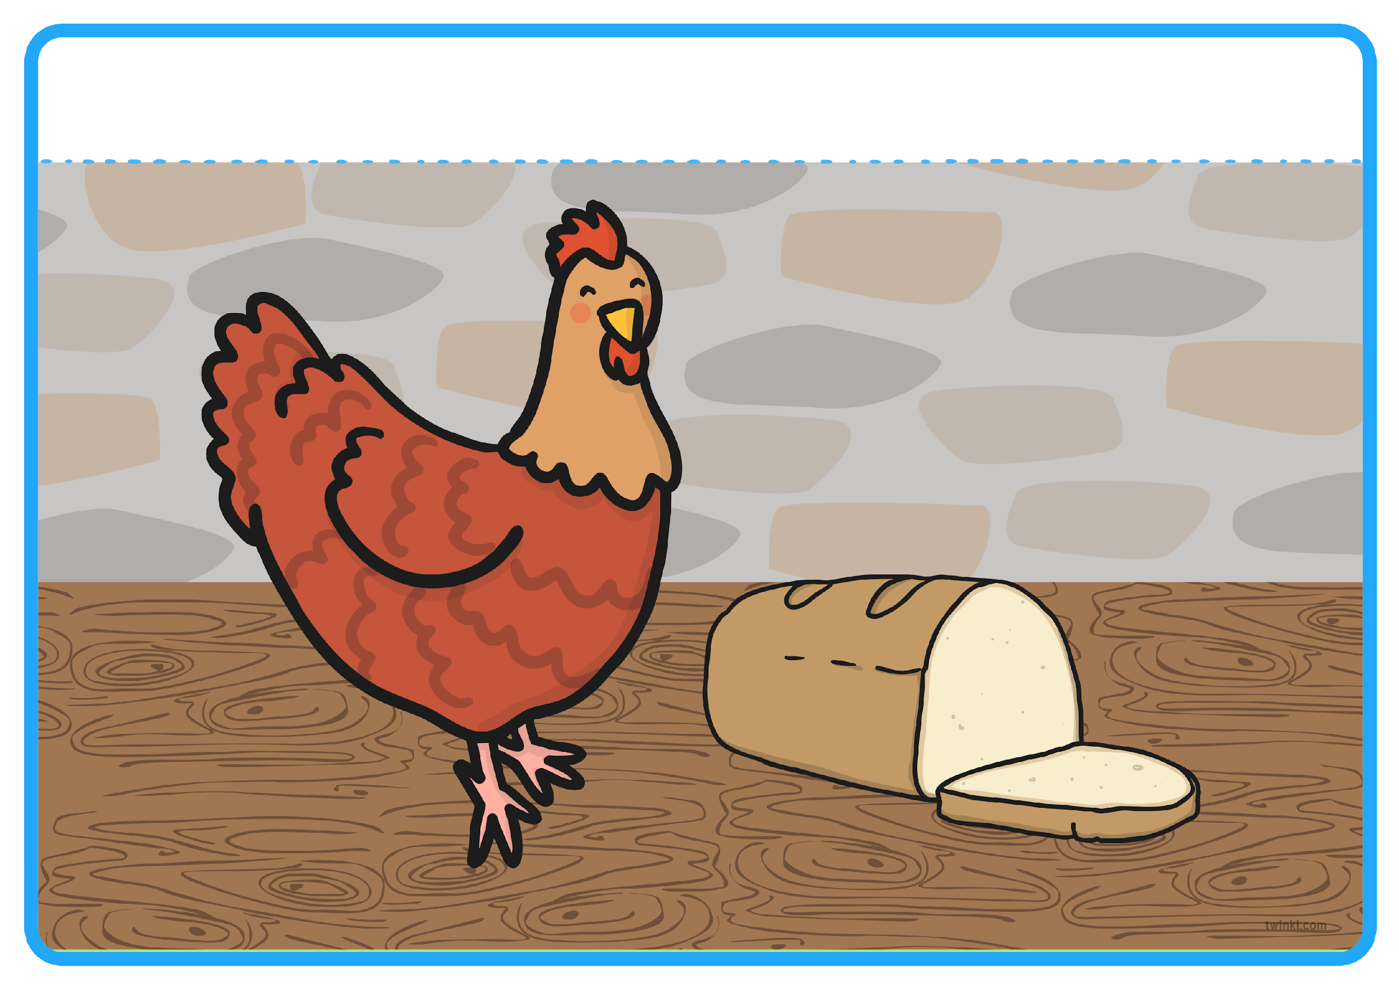
“No, I will!” said the Little Red Hen. So the Little Red Hen ate the bread all by herself.
Resource: bread to feel

Slide 30
The End

