Slide 1
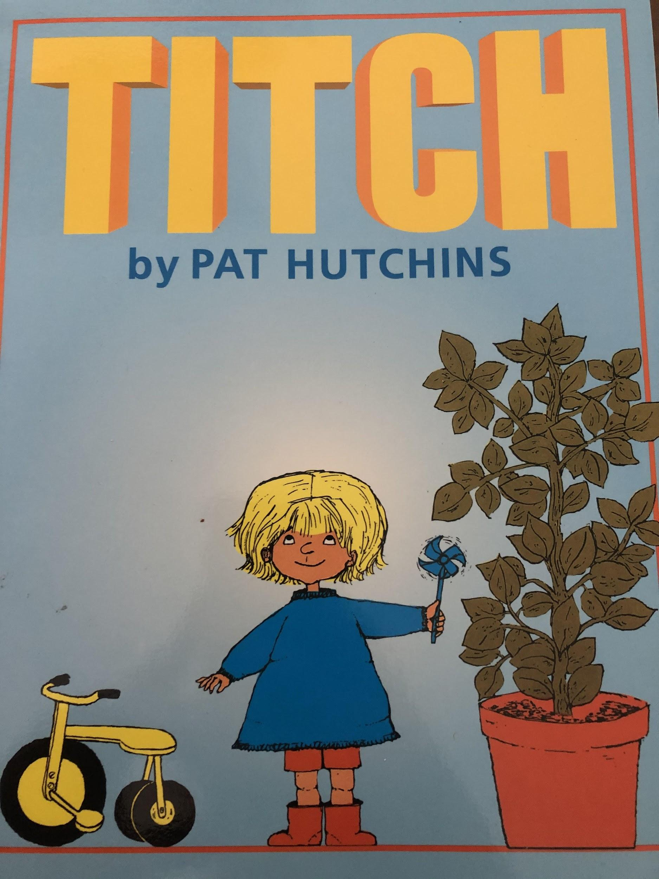

Slide 2
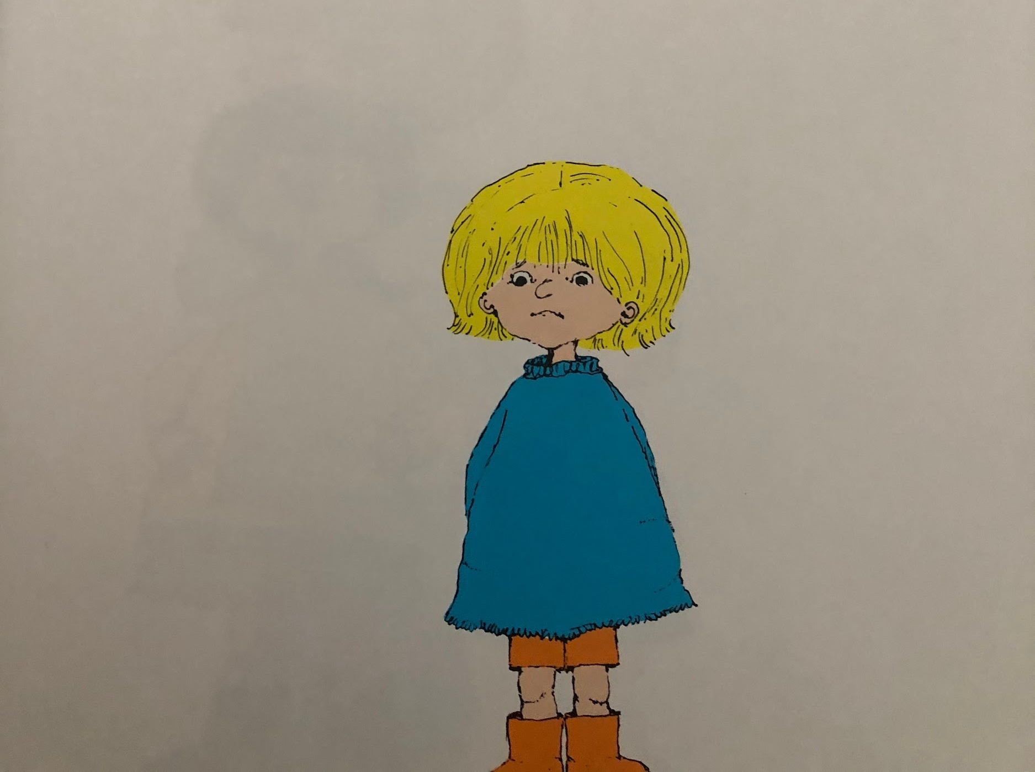
Titch was little
Resource:
Titch stick puppet (and hand movements for small)

Slide 3
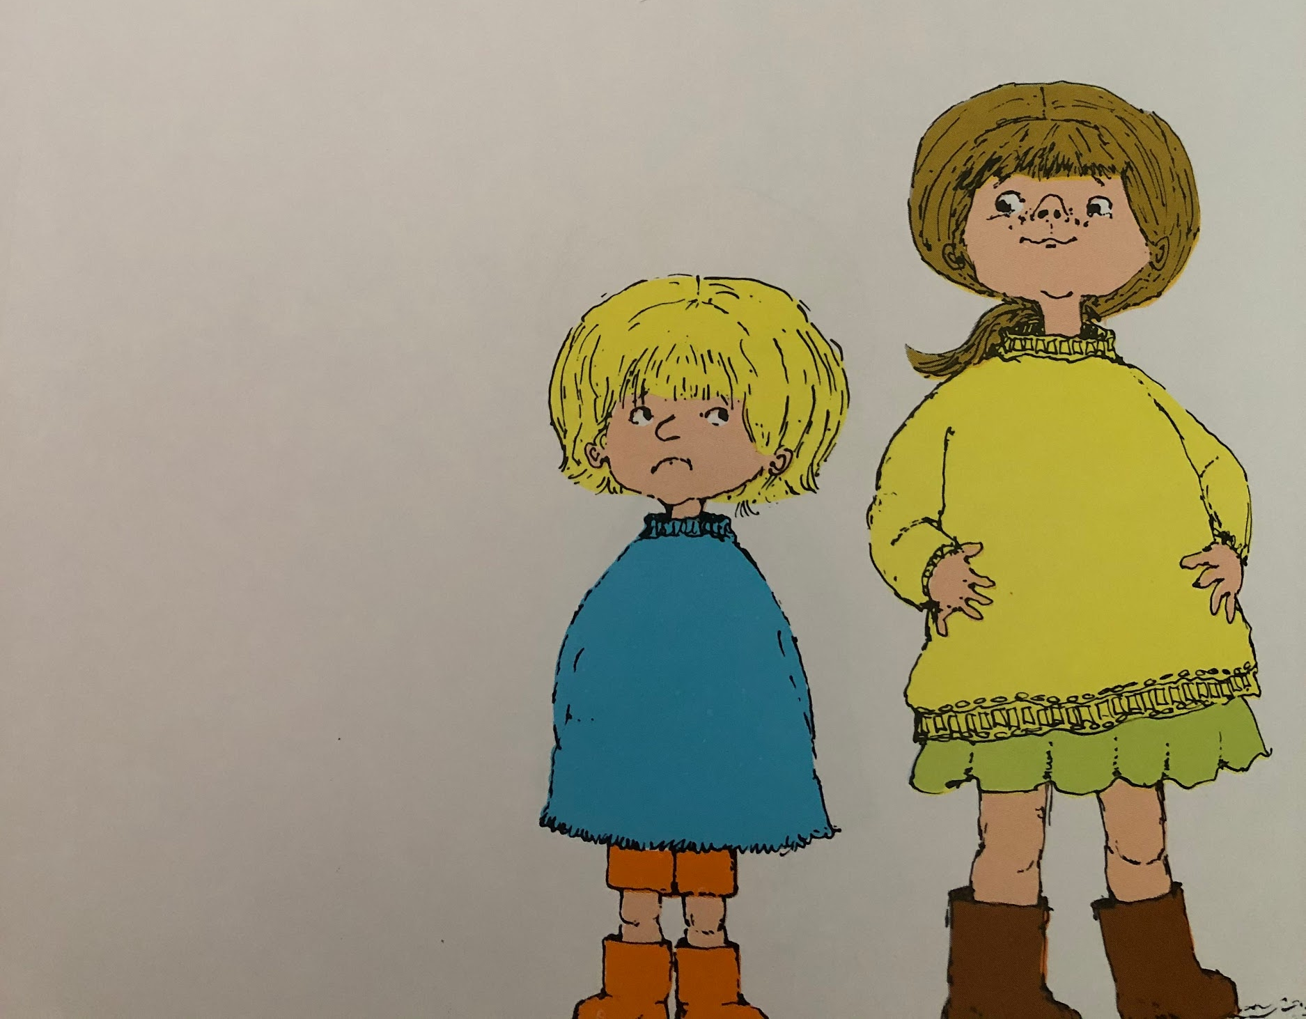
His sister Mary was a bit bigger.
Resource:
Mary stick puppet (and hand movements to show getting a bit bigger)

Slide 4
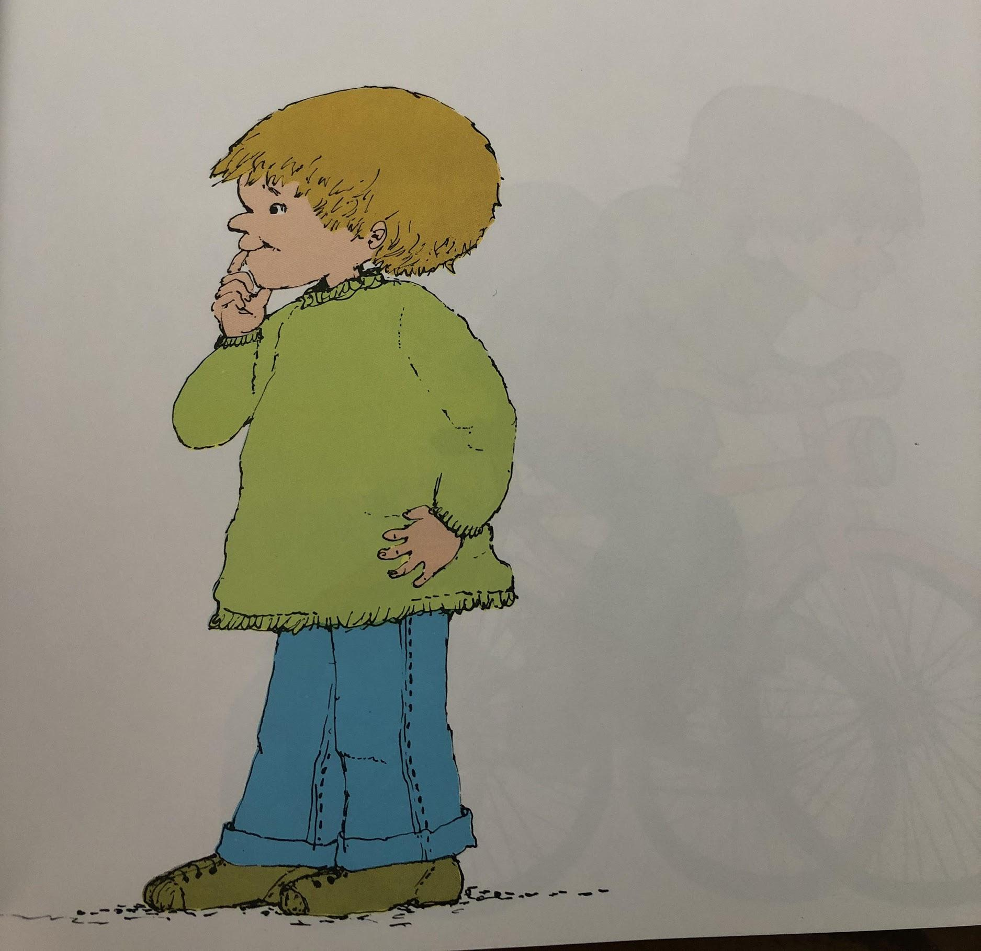
And his brother Pete was a lot bigger.
Resource:
Peter stick puppet (and hand movements for big)

Slide 5
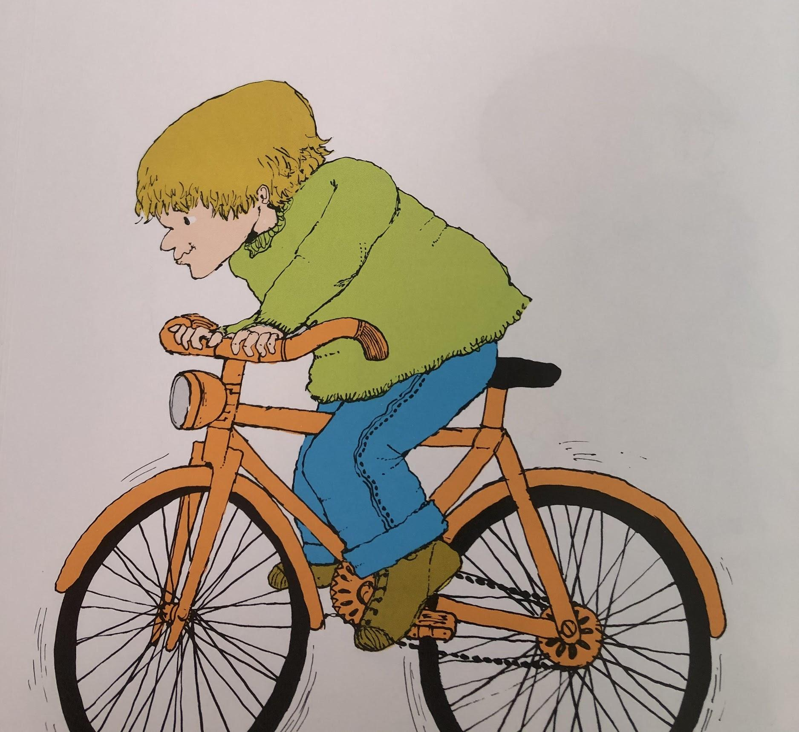
Pete had a great big bike.
Resource:
Bike stick puppet (and hand movements to show big)

Slide 6
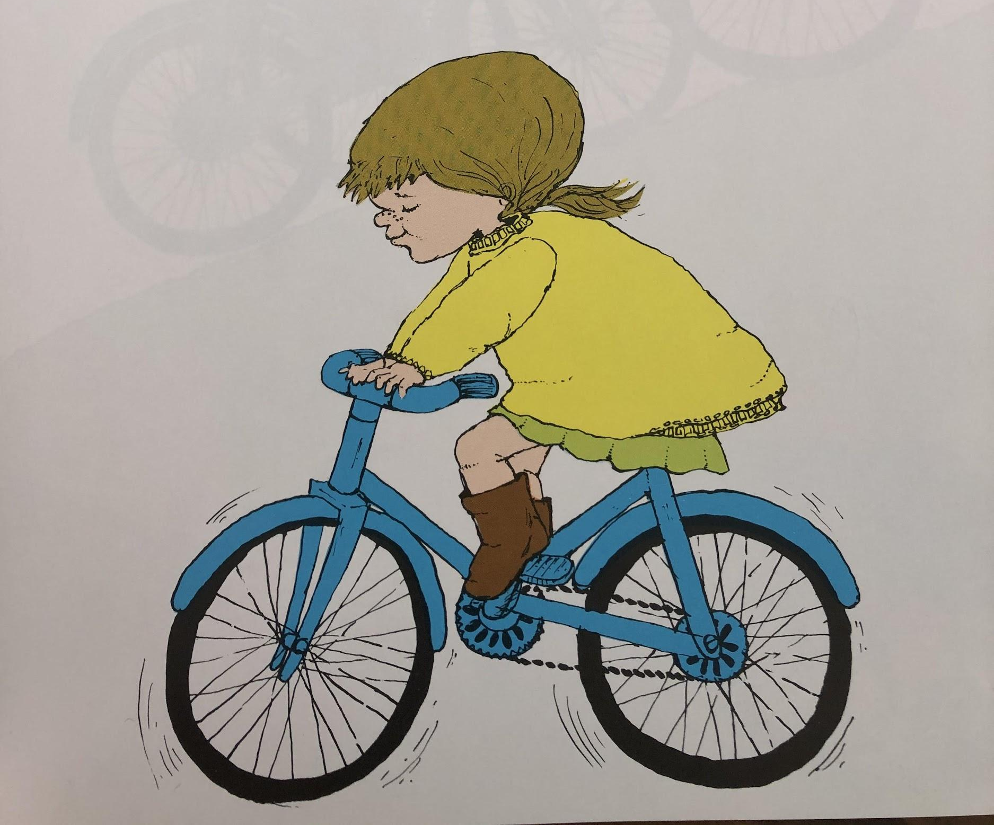
Mary had a big bike
Resource:
Bike stick puppet (and hand movements to show big)

Slide 7
And Titch had a little tricycle.
Resource:
Tricycle stick puppet (and hand movements for small)

Slide 8
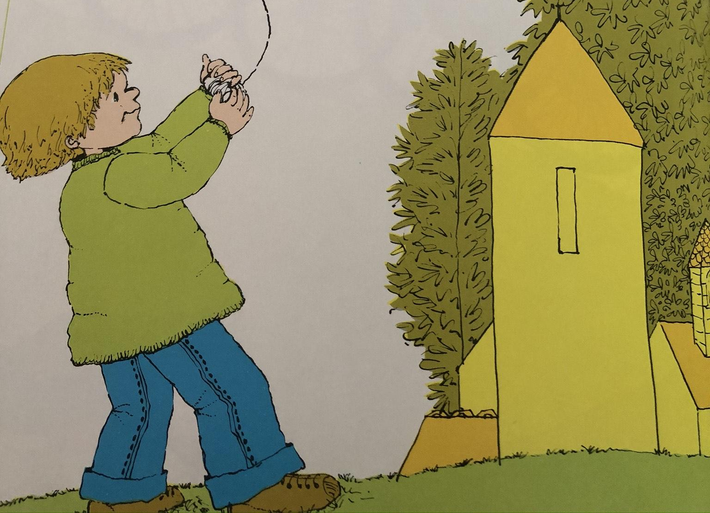
Pete had a kite that flew high above the trees
Resource:
Kite or make a kite out of paper. Show hand movements for high.

Slide 9
Mary had a kite that flew high above the houses
Resource:
Kite or make a kite out of paper. Show hand movements for high.

Slide 10
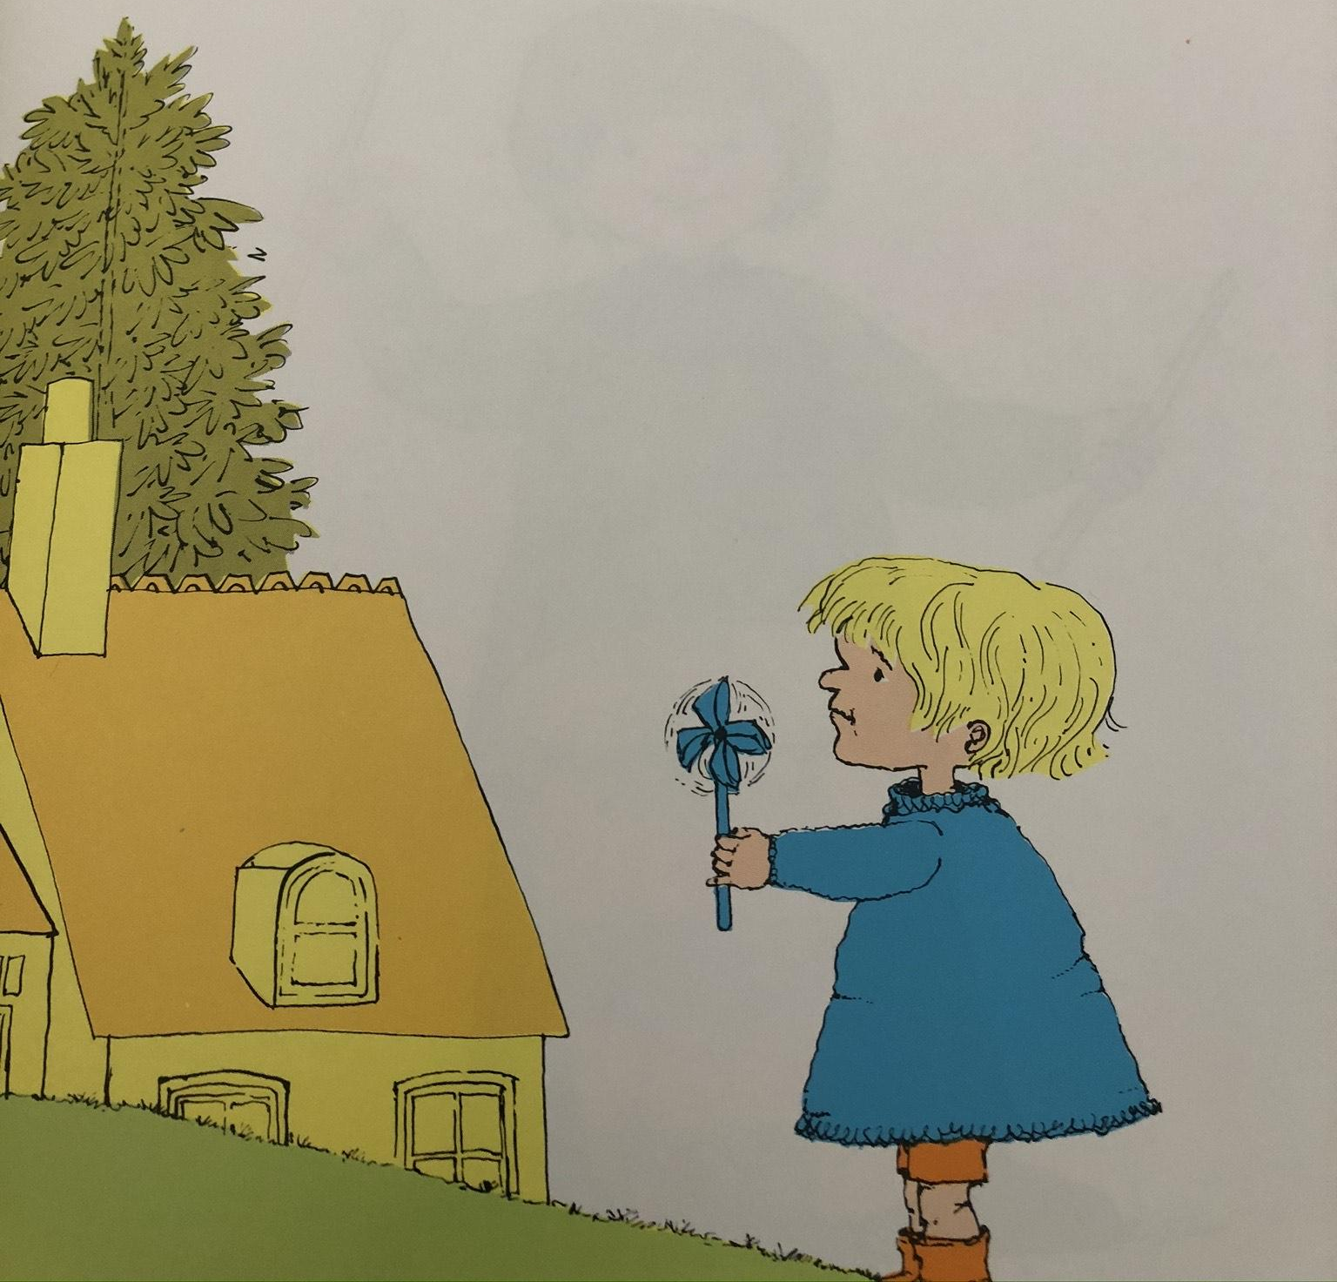
And Titch had a pinwheel that he held in his hand.
Resource:
Pinwheel (or if you don’t have one - something that spins)

Slide 11
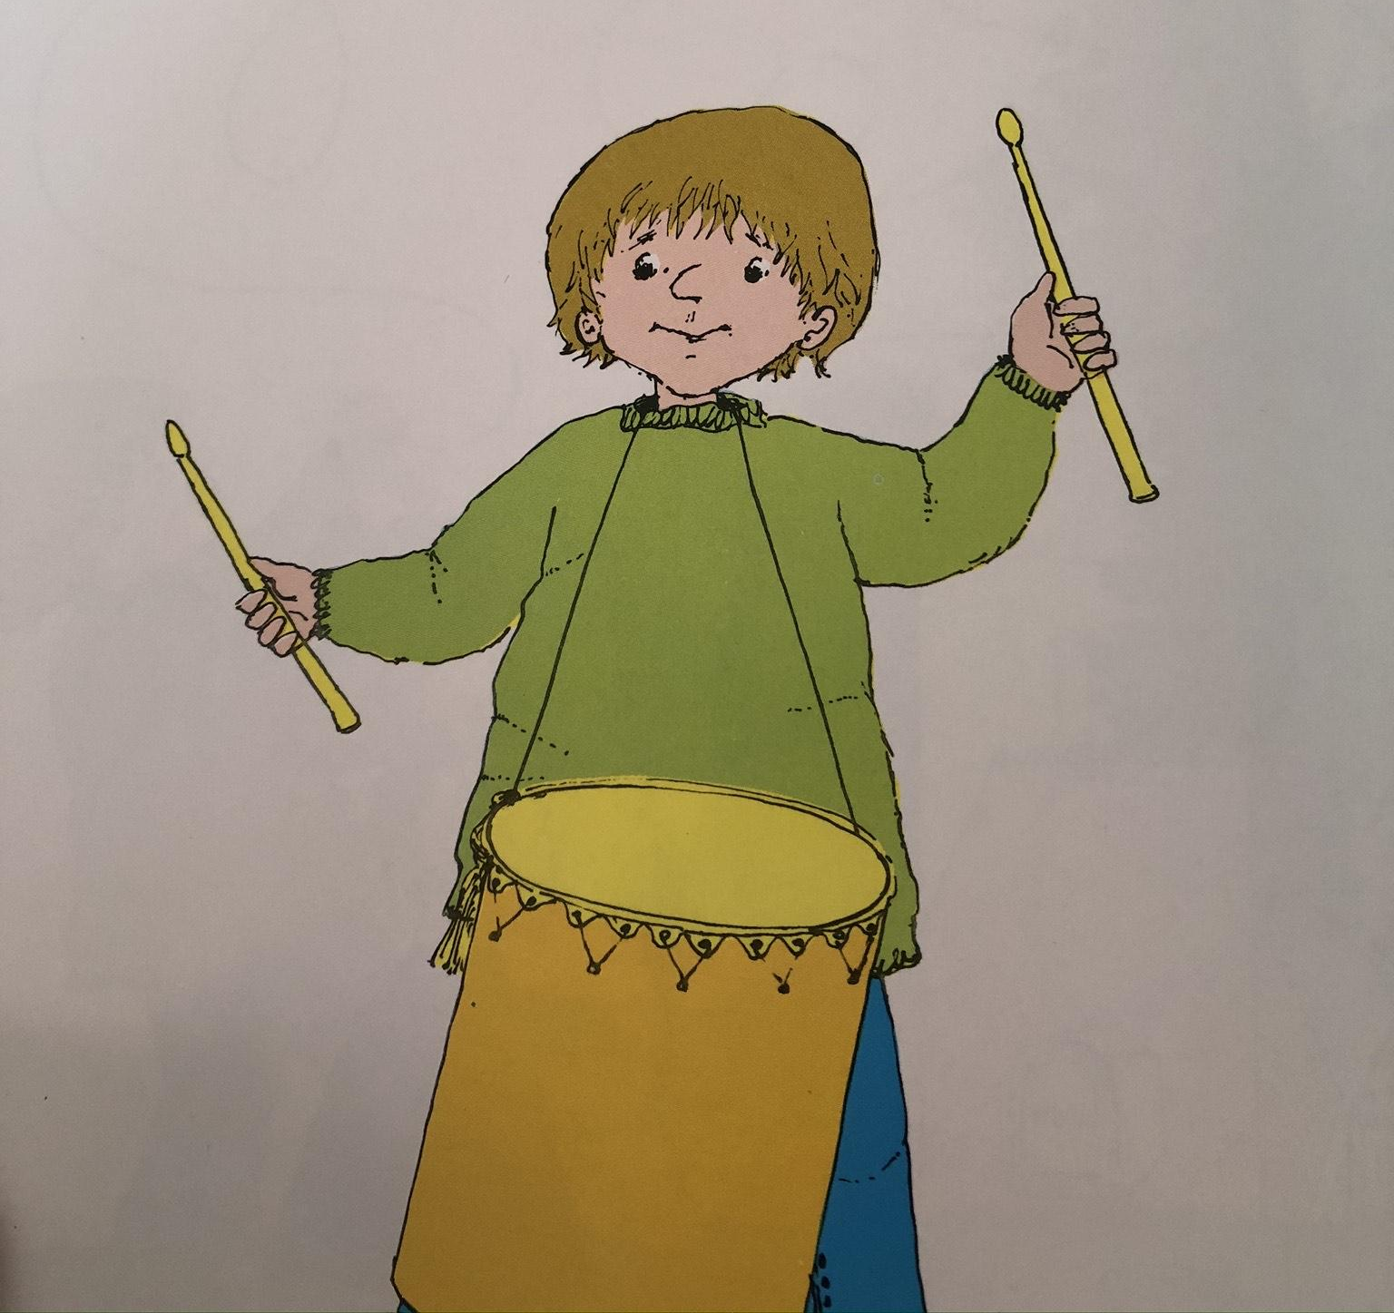
Pete had a big drum
Resource:
Drum

Slide 12
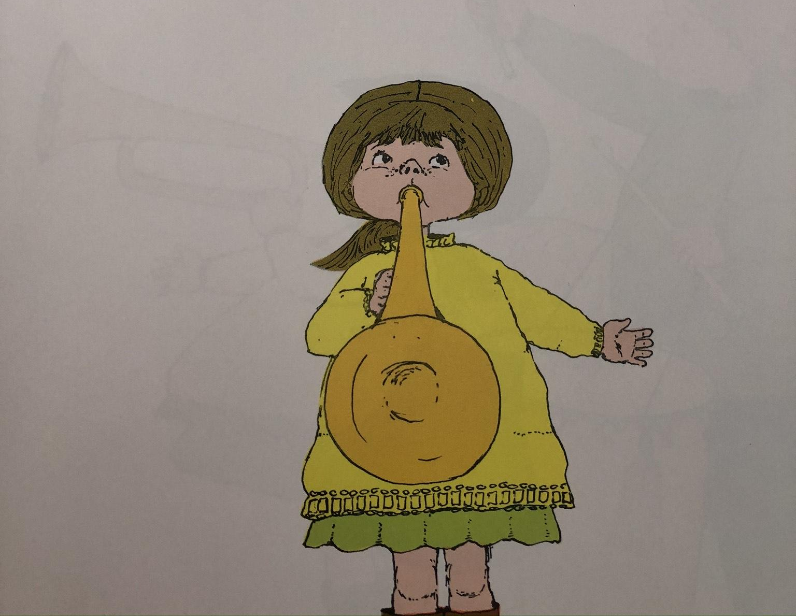
Mary had a trumpet
Resource:
Trumpet sounds

Slide 13
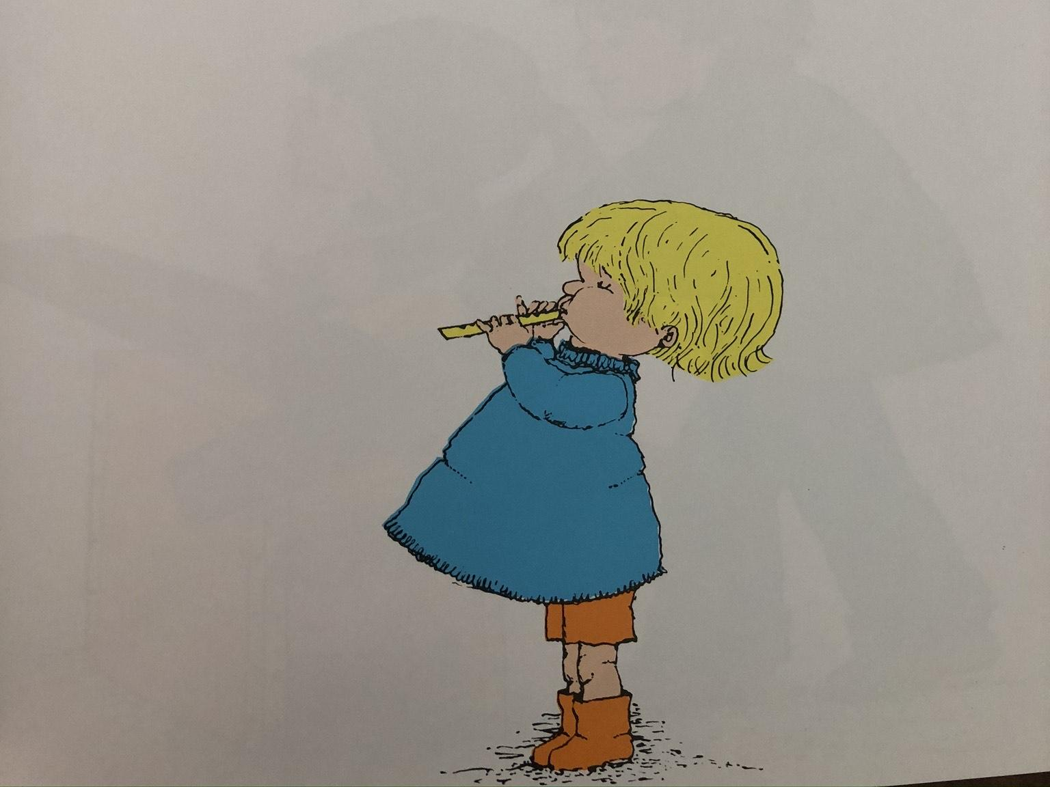
And Titch had a little wooden whistle.
Resource:
Whistle

Slide 14
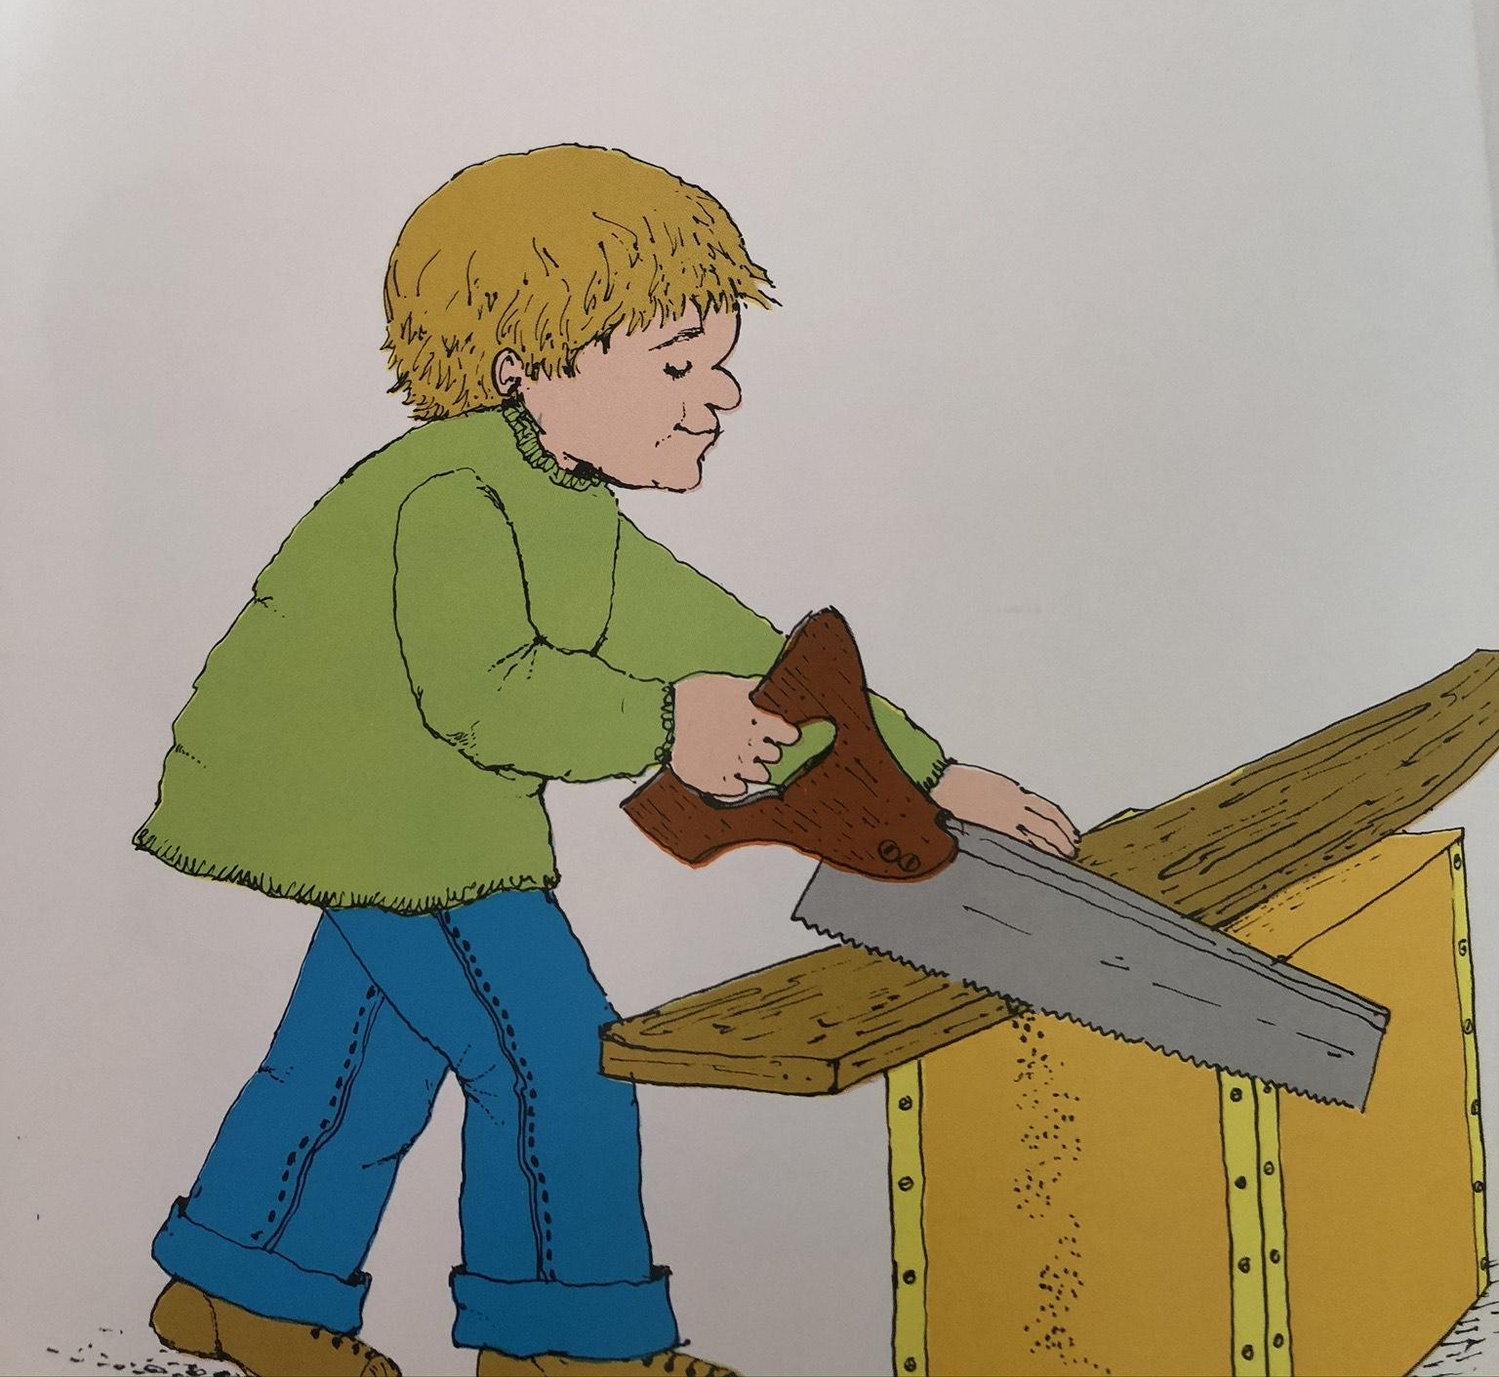
Pete had a big saw.
Resource:
Sawing sound effect

Slide 15
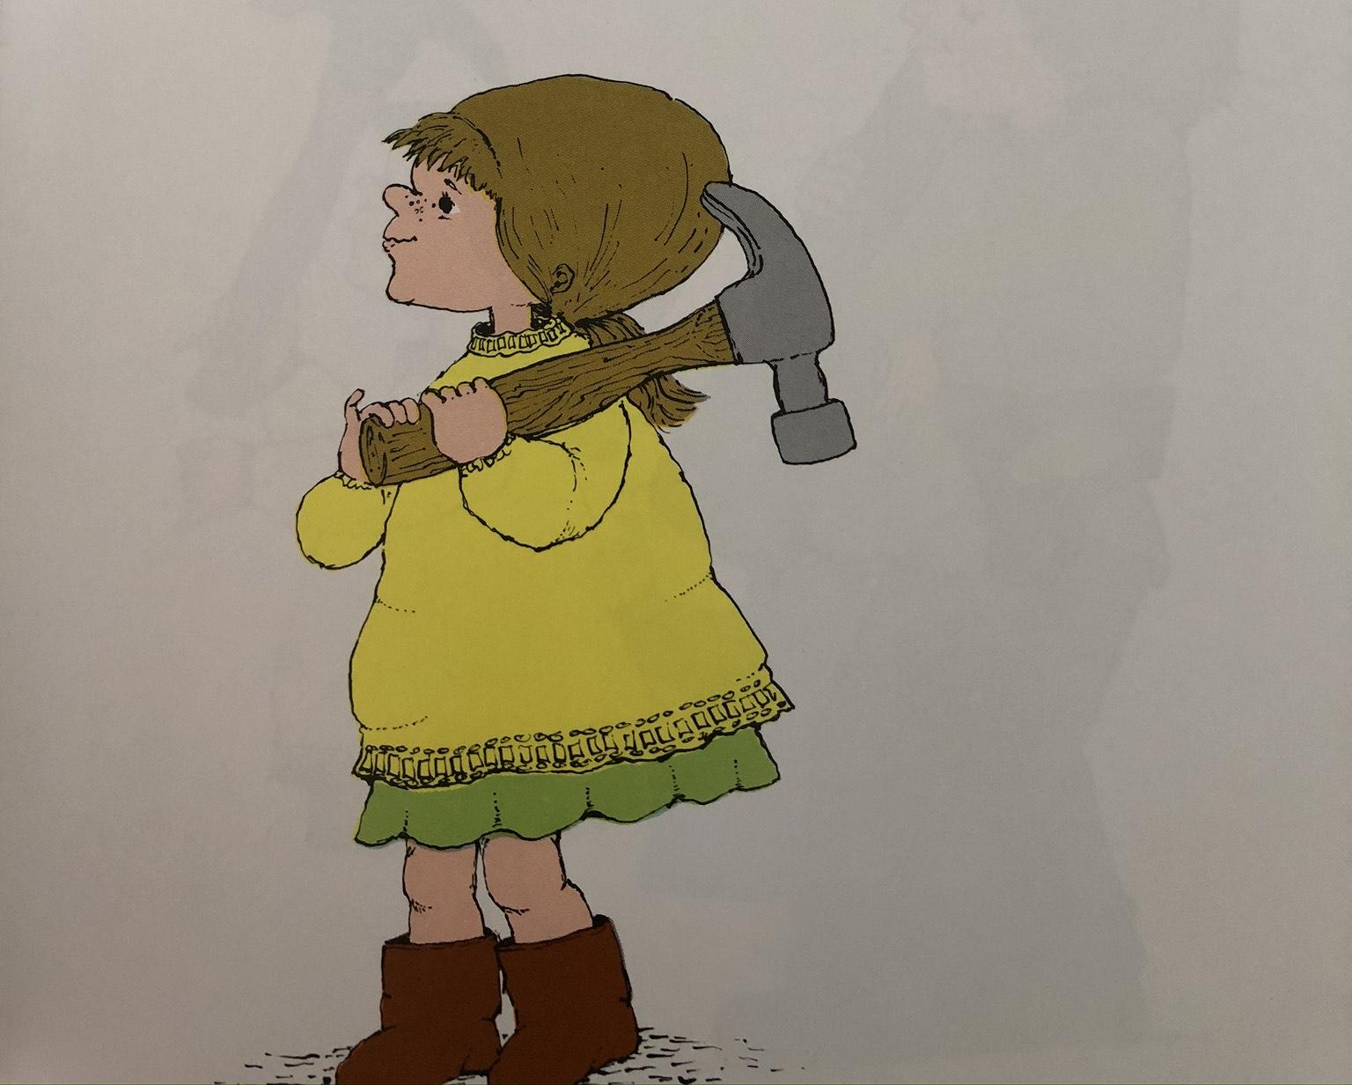
Mary had a big hammer
Resource:
Banging sound effect

Slide 16
And Titch held the nails

Slide 17
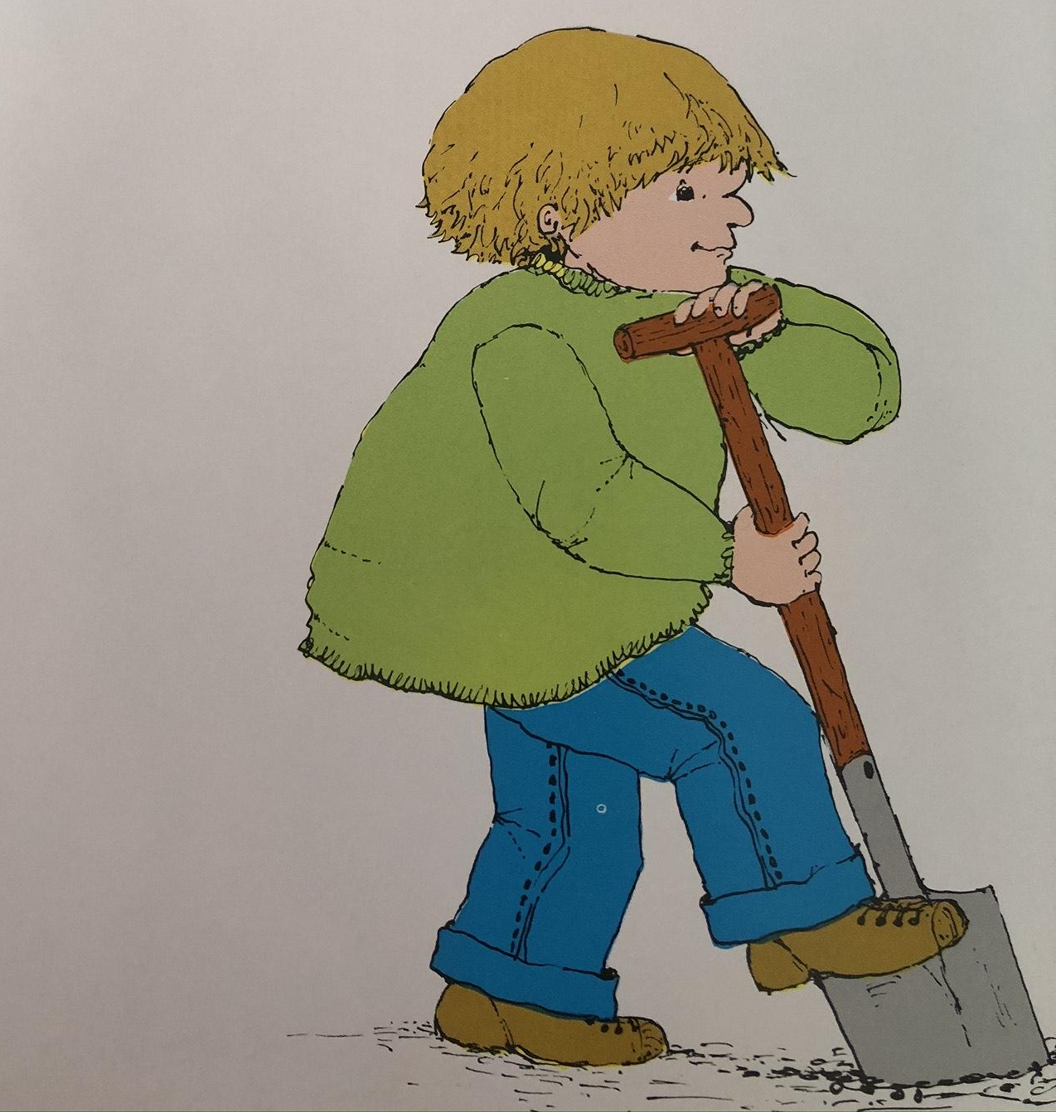
Pete had a big spade
Resource:
spade

Slide 18
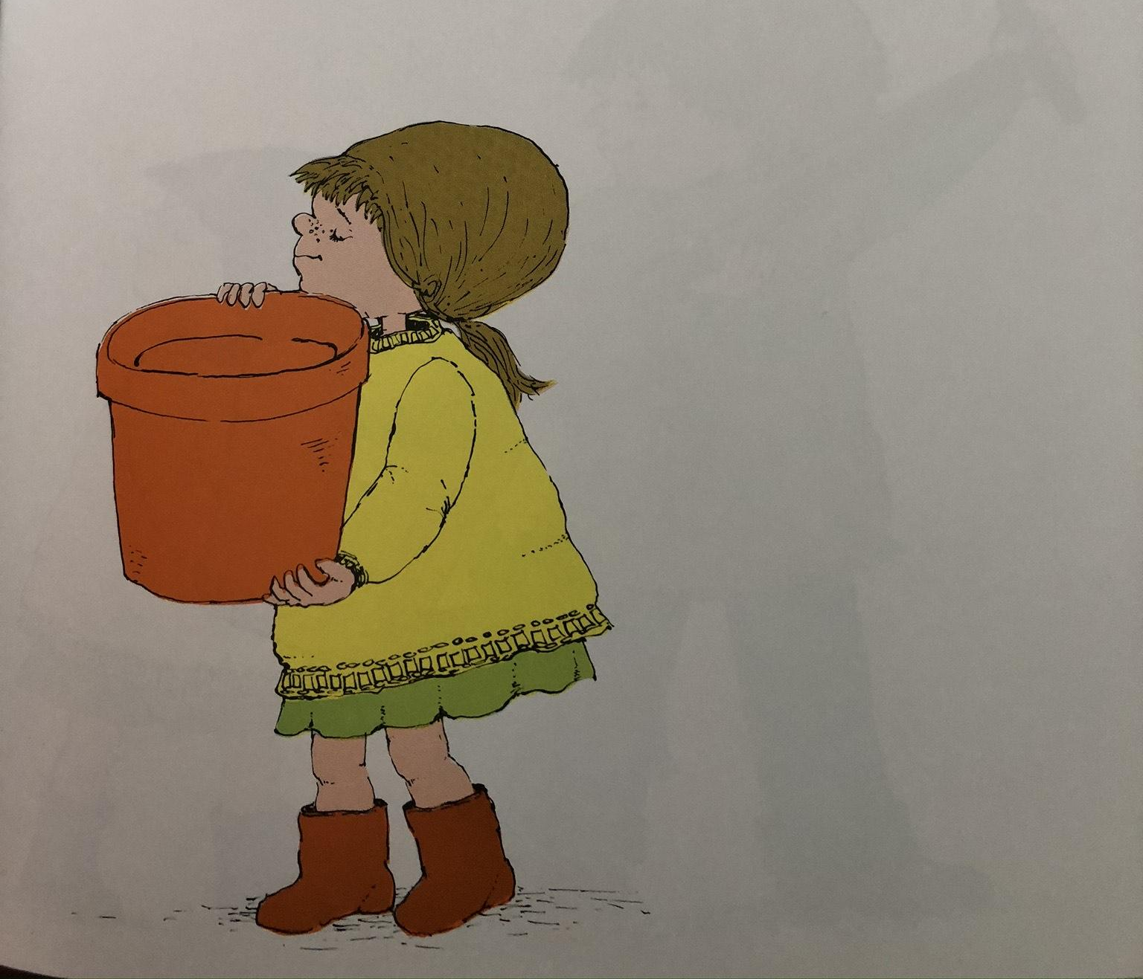
Mary had a fat flowerpot
Resource:
flowerpot

Slide 19
But Titch had the tiny seed
Resource:
Seeds to feel

Slide 20
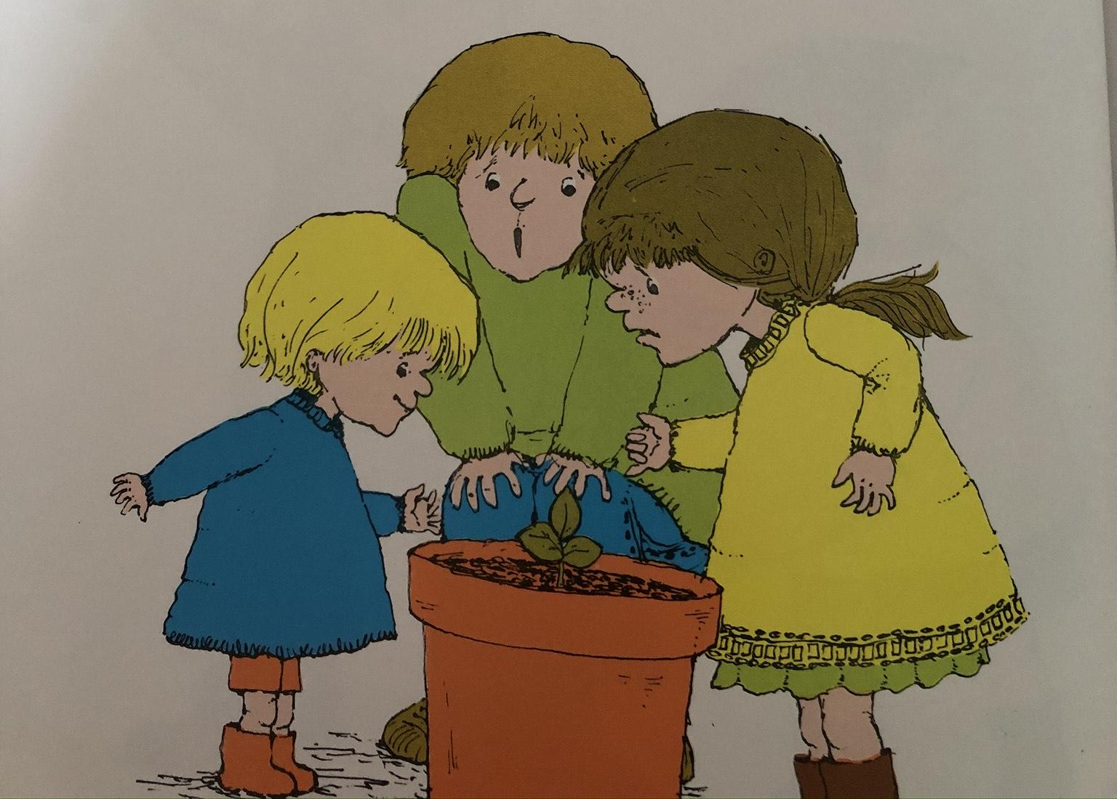
And Titch’s seed grew

Slide 21
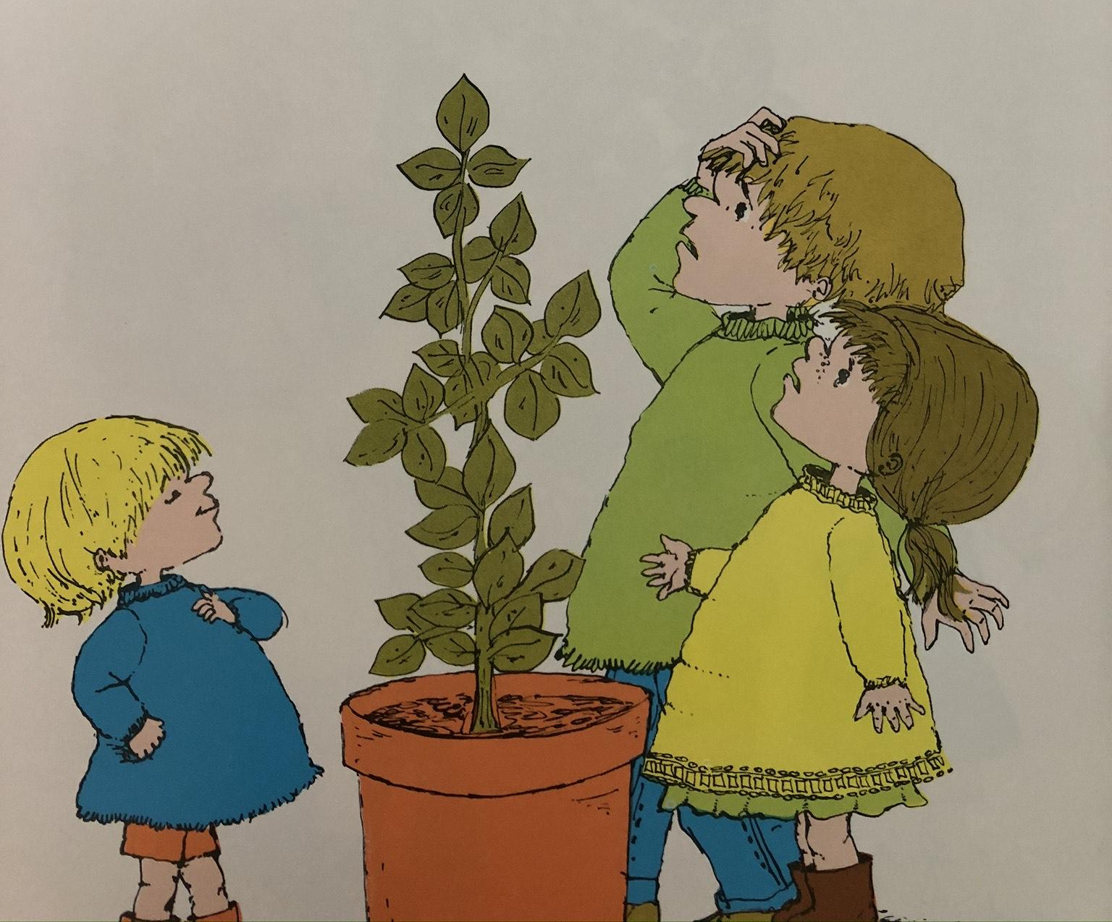
And grew

Slide 22
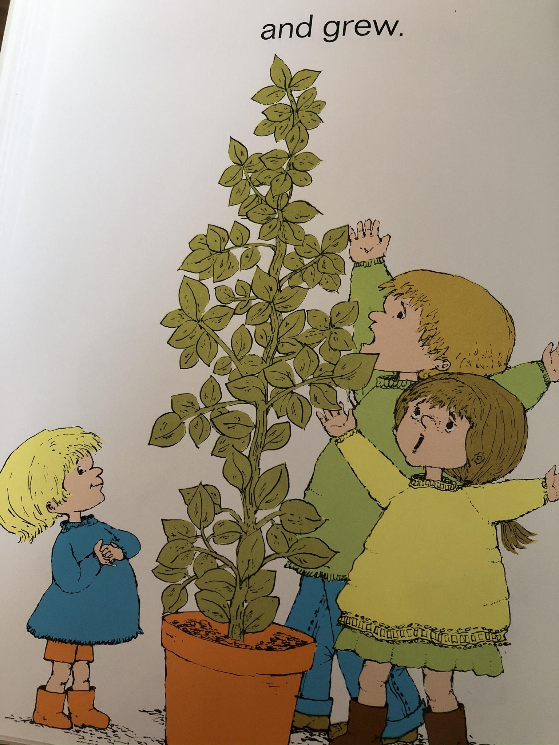
And grew!
Resource:
Show your child a plant that is already grown.

