Slide 1
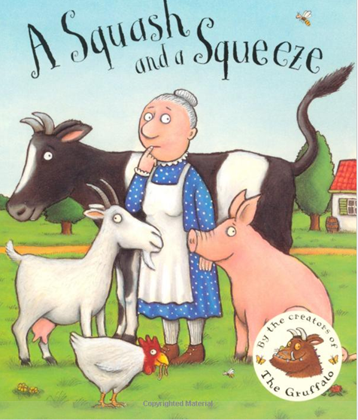

Slide 2
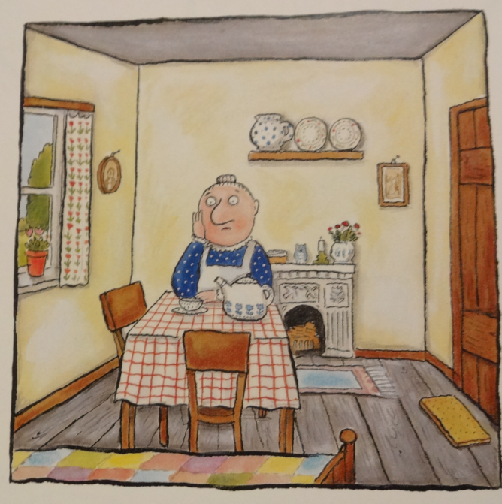
A little old lady lived all by herself, with a table and chairs and a jug on the shelf.
Resource: Puppet

Slide 3
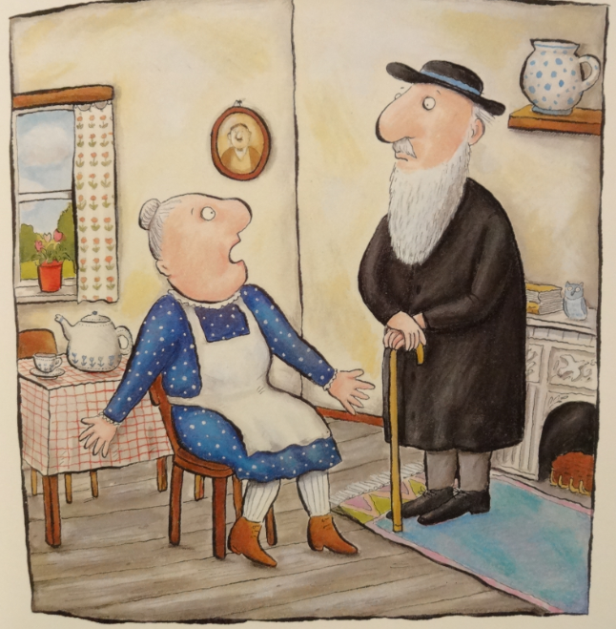
A wise old man heard her grumble and grouse, “There’s not enough room in my house. Wise old man, won’t you help me please? My house is a squash and a squeeze.”

Slide 4
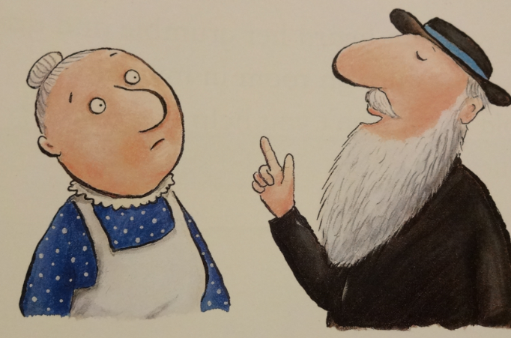
“Take in your hen,” said the wise old man
Resource: Hen toy / picture

Slide 5
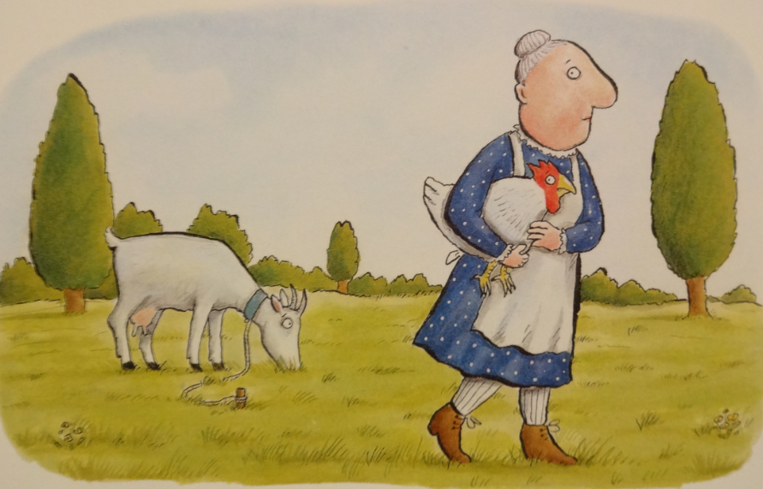
“Take in my hen? What a curious plan.”
Resource: Hen toy / picture/feather

Slide 6
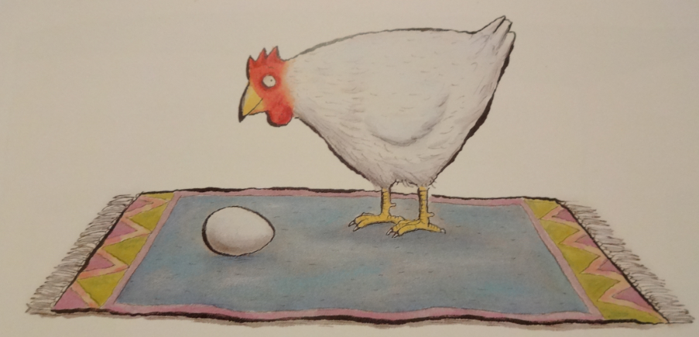
Well, the hen laid an egg on the fireside rug,
Resource: Hen toy / picture and egg

Slide 7
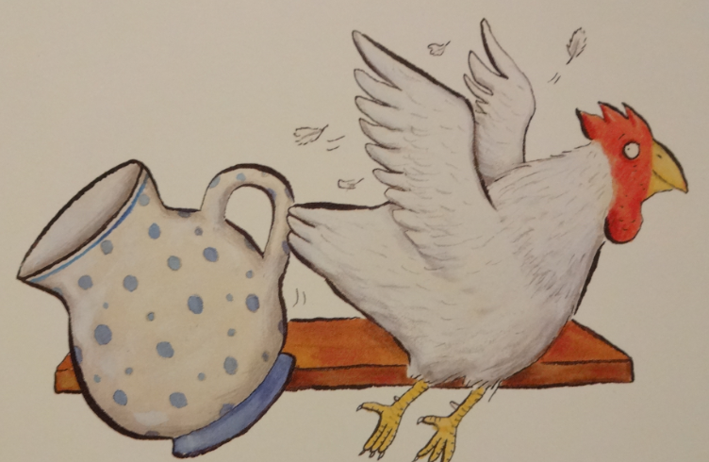
And flapped round the room knocking over the jug.
Resource: Hen toy / picture

Slide 8
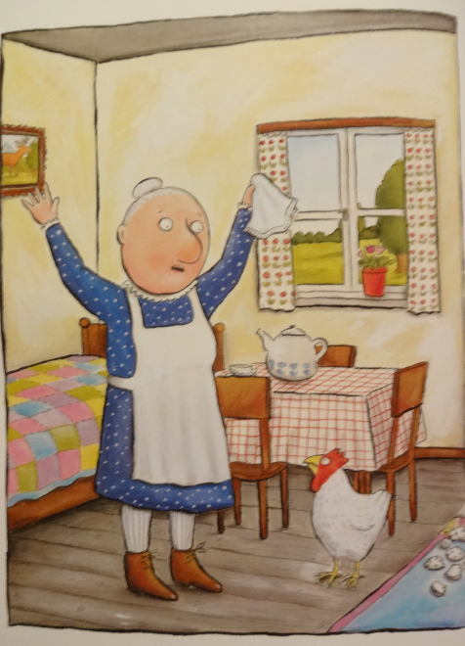
Resource: Puppet
The little old lady cried, “What shall I do? It was pokey for one and it’s tiny for two. My nose has a tickle and there’s no room to sneeze. My house is a squash and a squeeze.”

Slide 9
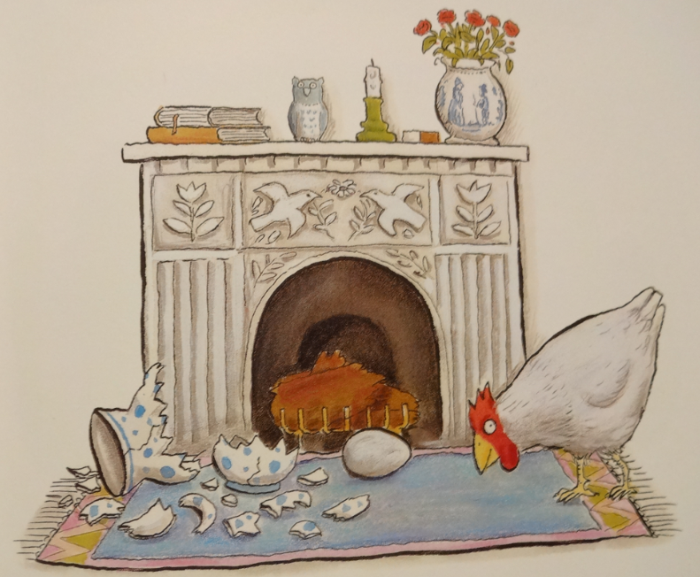
And she said, “Wise old man, won’t you help me please? My house is a squash and a squeeze.”

Slide 10
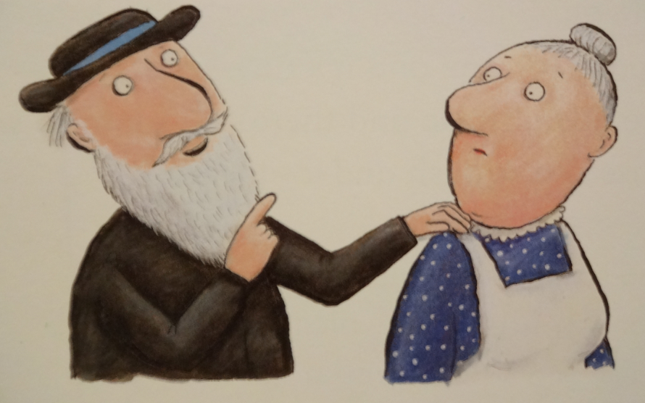
“Take in your goat,” said the wise old man.

Slide 11
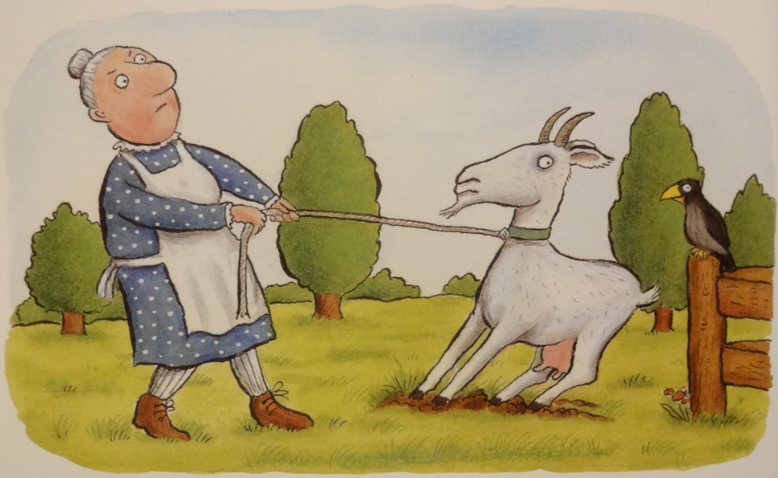
“Take in my goat? What a curious plan.”
Resource: Goar toy / picture

Slide 12
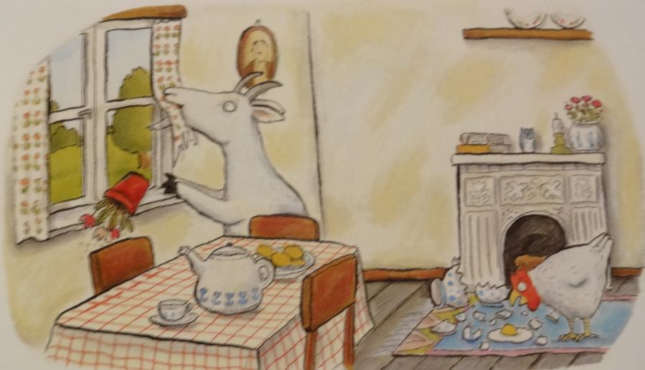
Well, the goat chewed the curtains and trod on an egg,
Resource: Goat toy / picture, material and egg

Slide 13
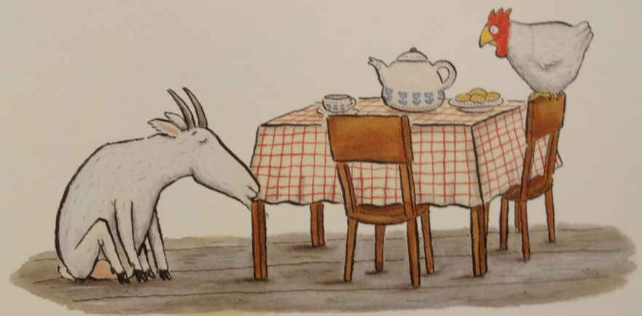
Then sat down to nibble on the table leg.

Slide 14
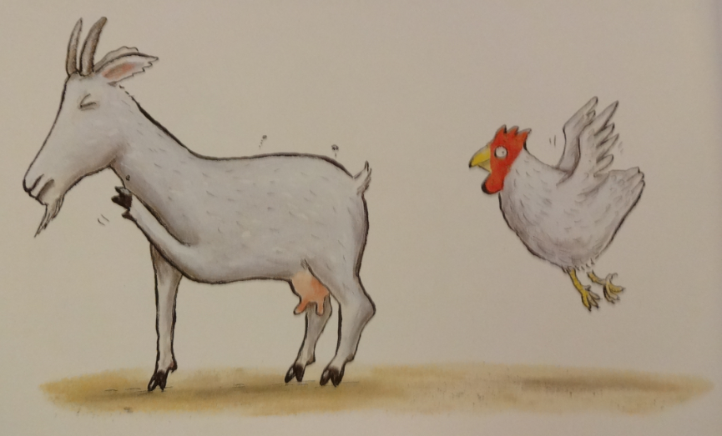
The little old lady cried, “Glory be! It was tiny for two and it’s titchy for three. The hen pecks the goat and the goat’s got fleas. My house is a squash and a squeeze.”

Slide 15
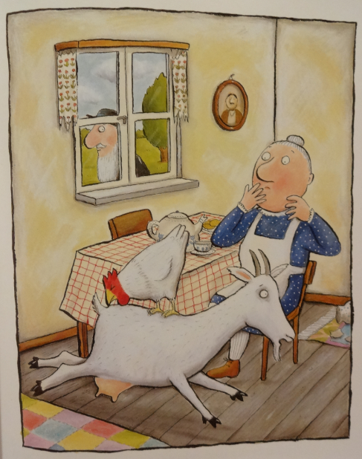
And she said, “Wise old man, won’t you help me, please? My house is a squash and a squeeze.”
Resource: Puppet

Slide 16
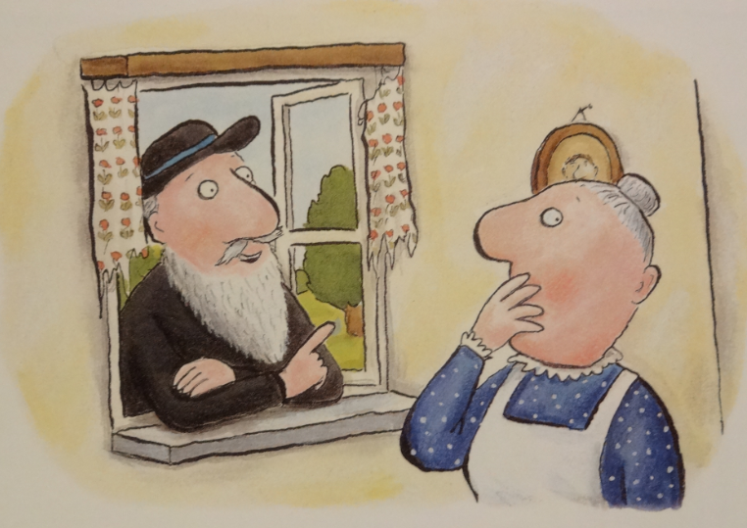
“Take in your pig,” said the wise old man.

Slide 17
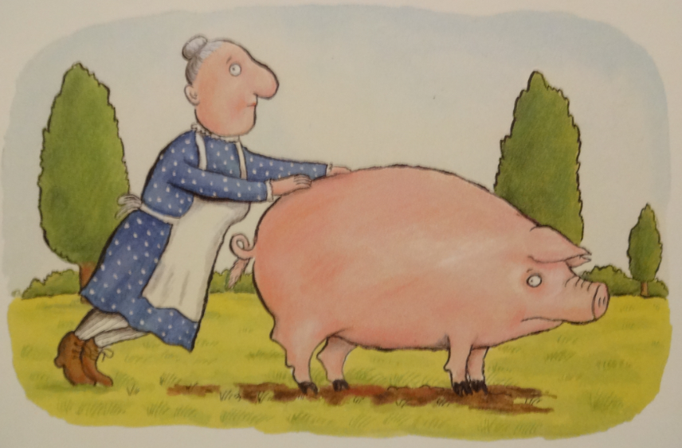
“Take in my pig? What a curious plan.”
Resource: Pig toy / picture

Slide 18
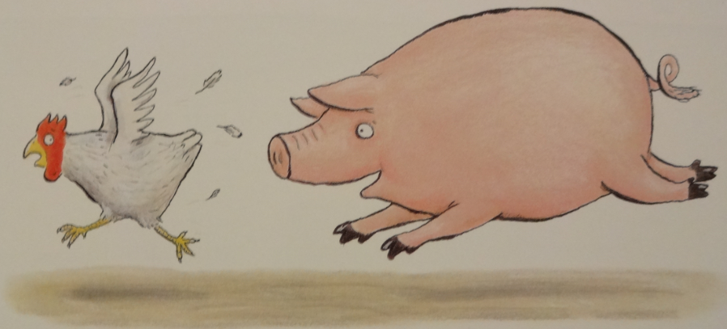
So she took in the pig who kept chasing the hen,
Resource: Pig and hen toy / picture

Slide 19
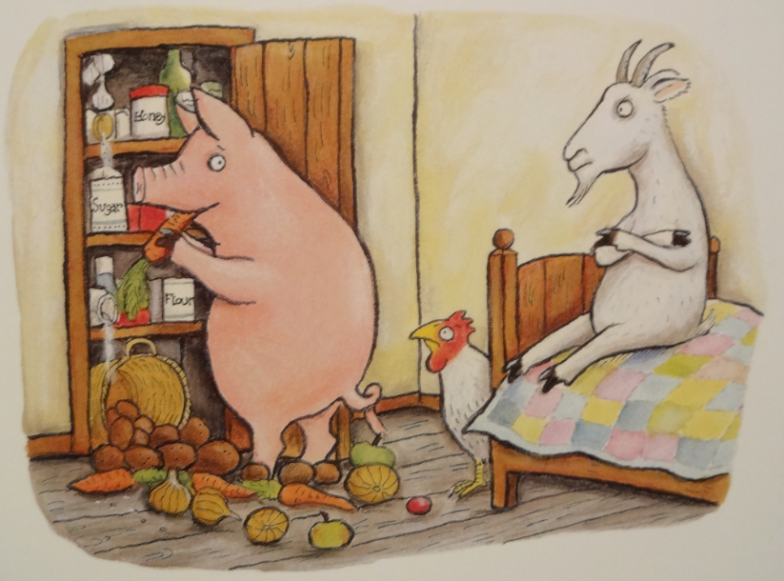
And raiding the larder again and again.
Resource: Pig toy / picture

Slide 20
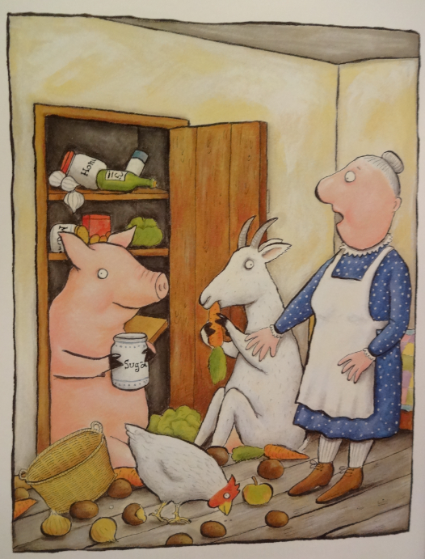
The little old lady cried, “Stop I implore! It was titchy for three and it’s teeny for four. Even the pig in the larder agrees. My house is a squash and a squeeze.”

Slide 21
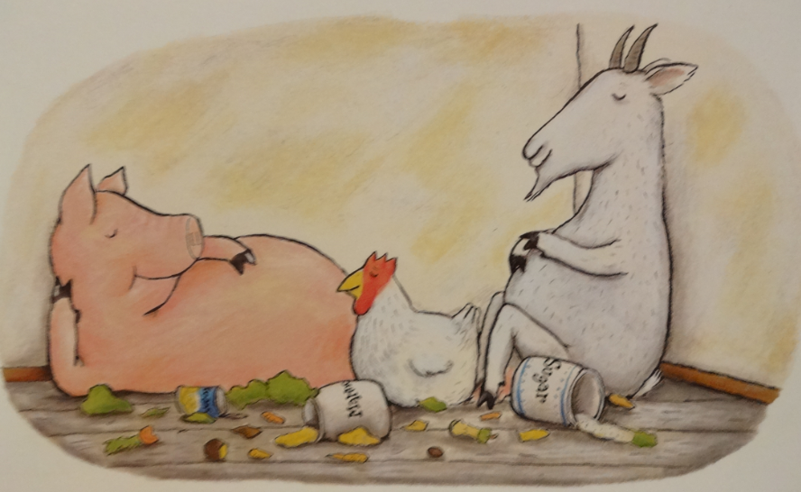
And she said, “Wise old man, won’t you help me, please? My house is a squash and a squeeze.”

Slide 22
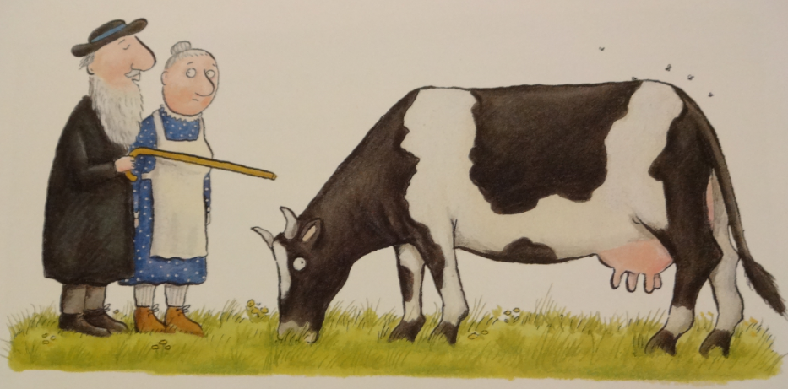
“Take in your cow,” said the wise old man,
Resource: Cow toy / picture

Slide 23
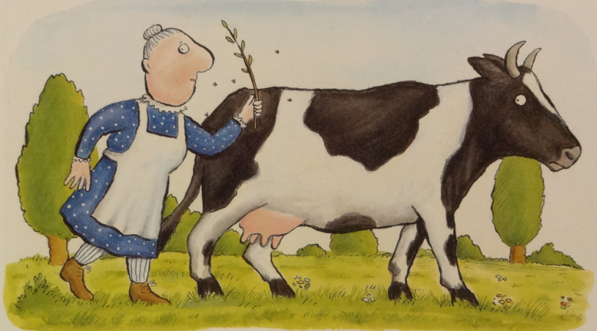
“Take in my cow? What a curious plan.”
Resource: Cow toy / picture

Slide 24
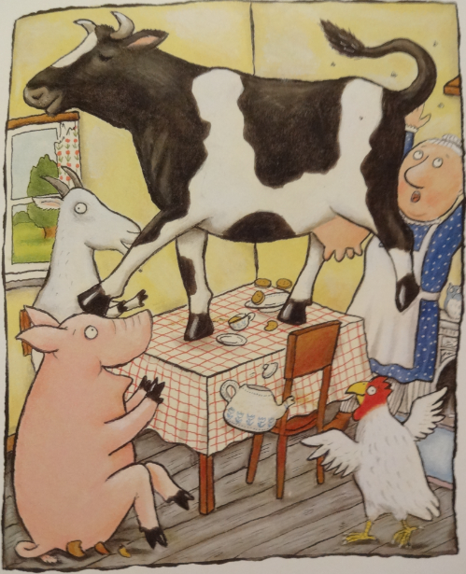
Well, the cow took one look and charged straight at the pig, then jumped on the table and tapped out a jig.
Resource: Cow toy / picture

Slide 25
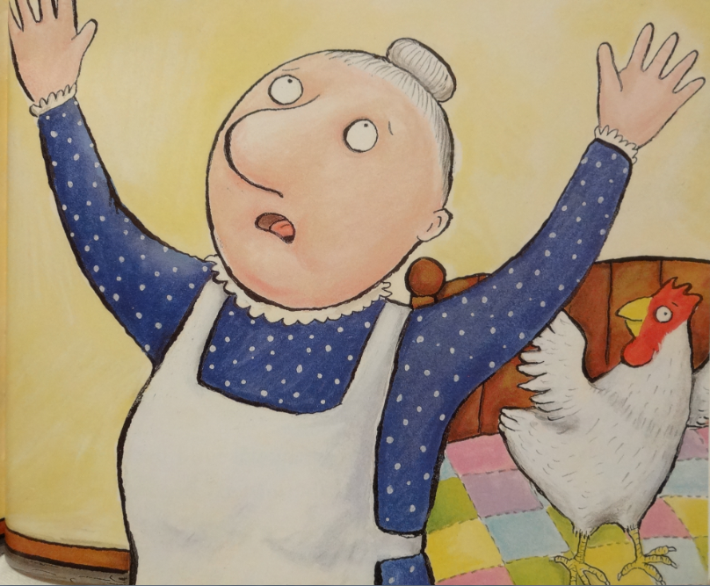
The little old lady cried, “Heavens alive! It was teeny for four and it’s weeny for five. I’m tearing my hair out, I’m down on my knees. My house is a squash and a squeeze.”

Slide 26
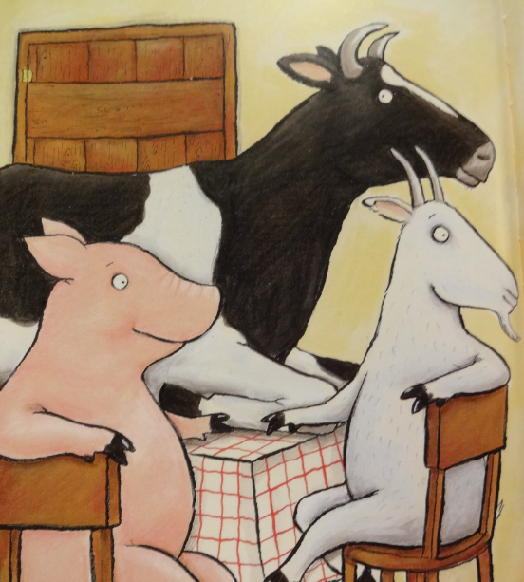
And she said, “Wise old man, won’t you help me, please? My house is a squash and a squeeze.”

Slide 27
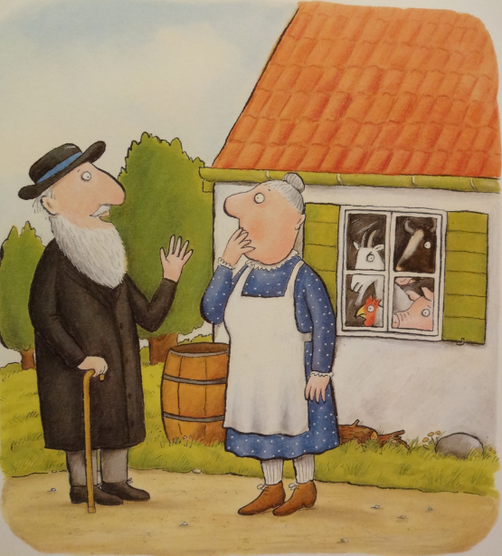
“Take then all out,” said the wise old man. “But then I’ll be back where I first began.”

Slide 28
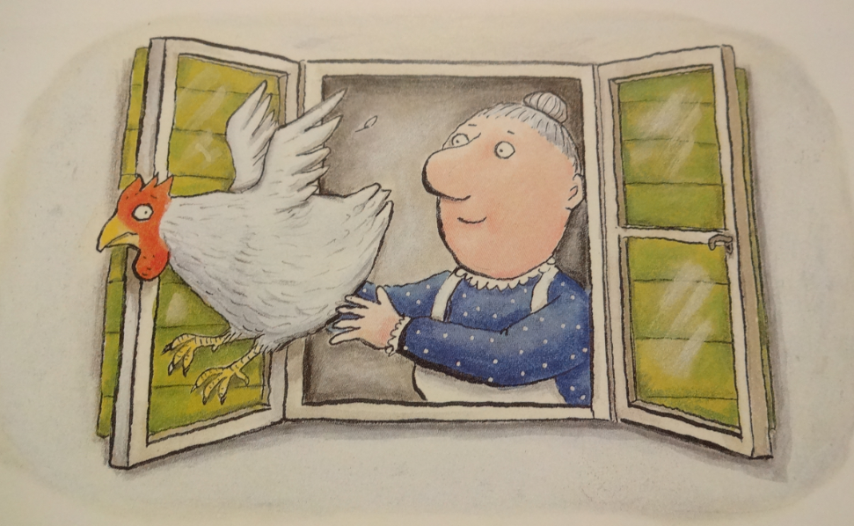
So she opened the window and out flew the hen. “That’s better – at last I can sneeze again.”
Resource: Hen toy / picture

Slide 29
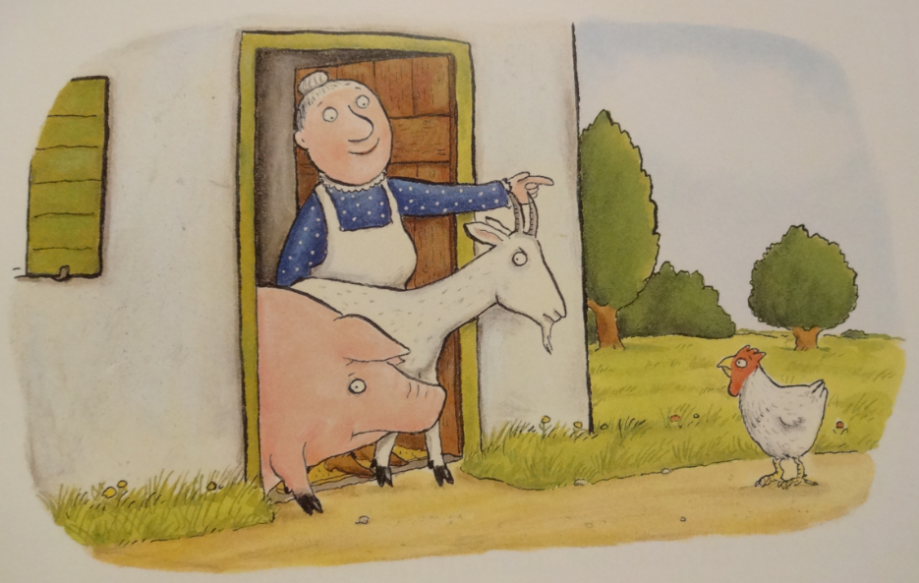
She shooed out the goat and she shoved out the pig. “My house is beginning to feel pretty big.”
Resource: Goat toy / picture

Slide 30
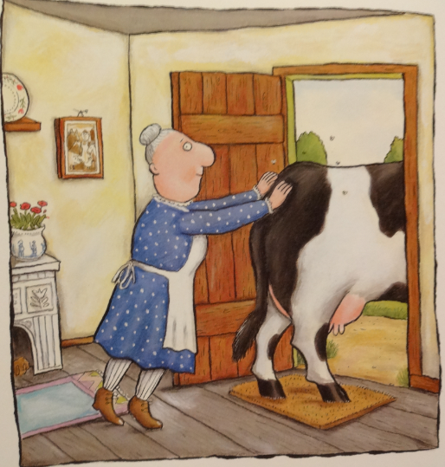
She huffed and she puffed and she pushed out the cow. “Just look at my house, it’s enormous now.”
Resource: Cow toy / picture

Slide 31
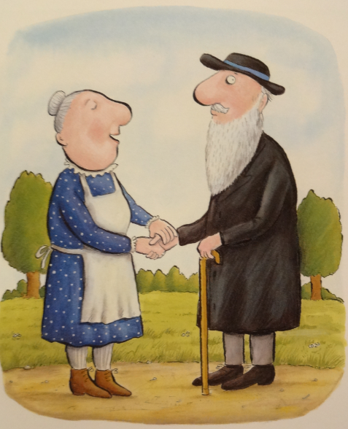
“Thank you, old man, for the work you have done. It was weeny for five, it’s gigantic for one. There’s no need to grumble and there’s no need to grouse. There’s plenty of room in my house.”

Slide 32
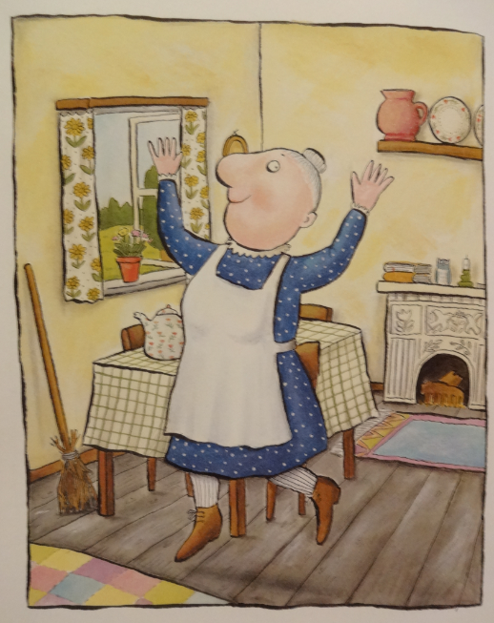
And now she’s full of frolics and fiddle-de-dees. It isn’t a squash and it isn’t a squeeze.

Slide 33
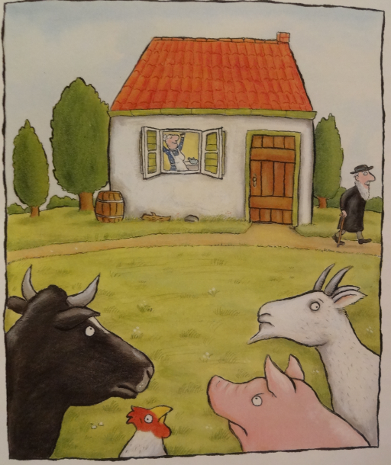
Yes, she’s full of frolics and fiddle-de-dees. It isn’t a squash or a squeeze.

