Slide 1
Notes:
Drag the day of the week and the taste of the day into the box
Taste and smell the Pineapple if available.

Slide 2
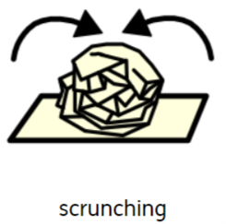
https://www.youtube.com/watch?v=LSoXrR2Xec4
Notes:
Turn the lights off and make a relaxing setting. Scrunch any materials available.
Also stand up and sit down (big to small).

Slide 3
HP, TI, SO, BS and BG- Drag the red items into the box
Notes:
This slide is suitable for SO, TI, HP, BG and BS

Slide 4
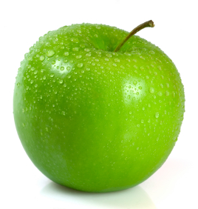
ML, JM and AM- Drag the red items into the box

Slide 5
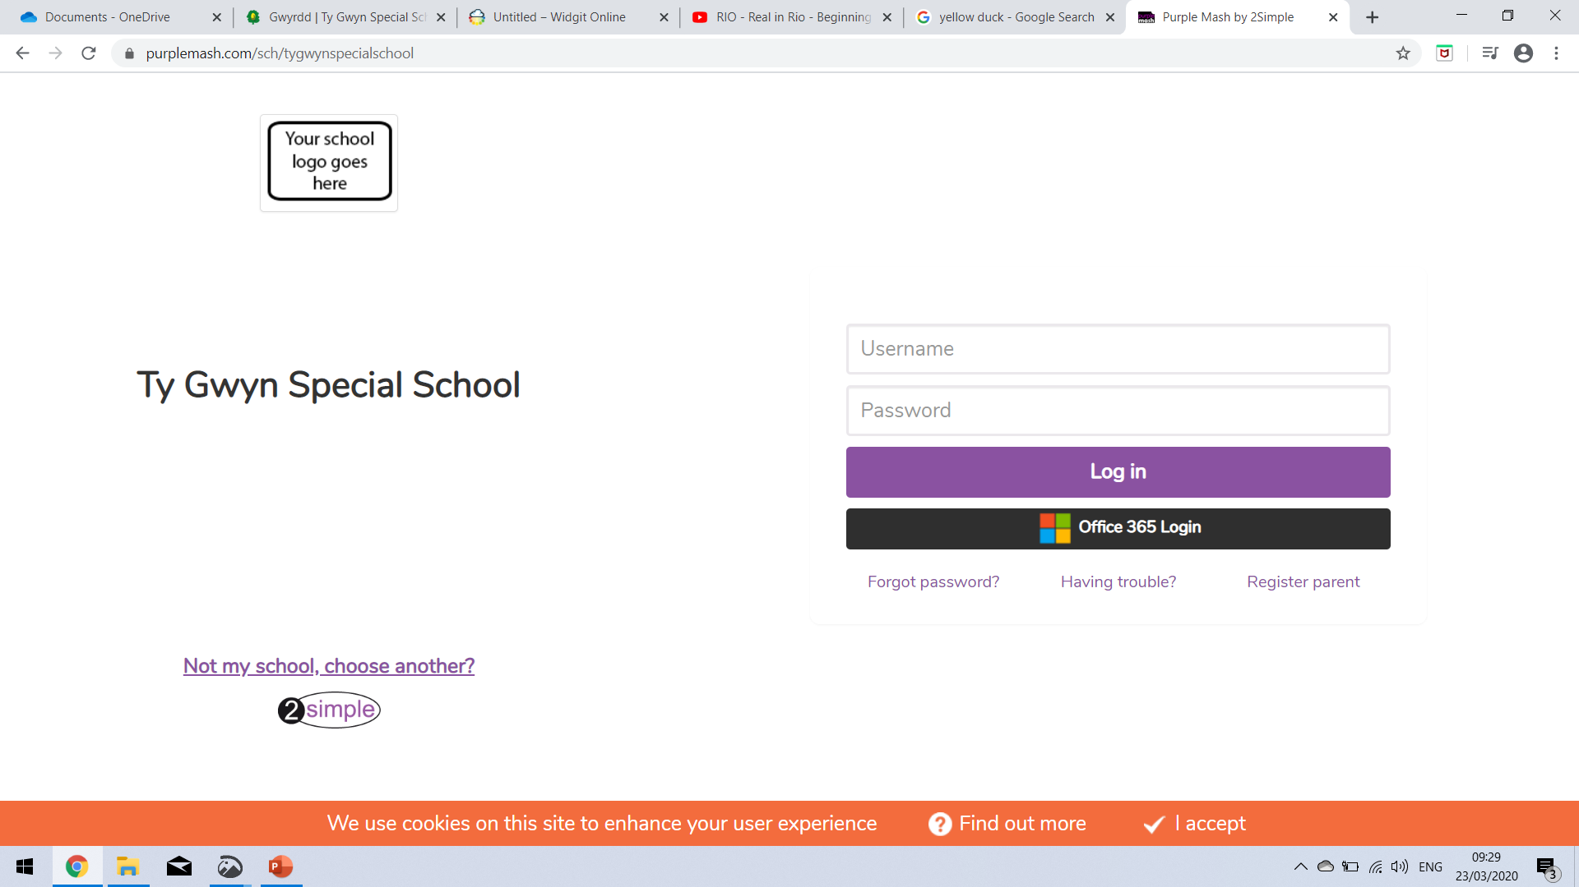
Science & Technology- Purple Mash- explore any activity! ‘Go to schools portal’- type in Ty Gwyn Special School Log in- Username- tasneemi Password- 41 Go to ‘Mini Mash’ and explore any of the activities
Notes:
Science and Technology

