Slide 1
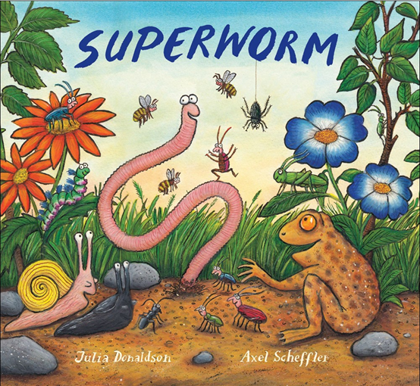

Slide 2
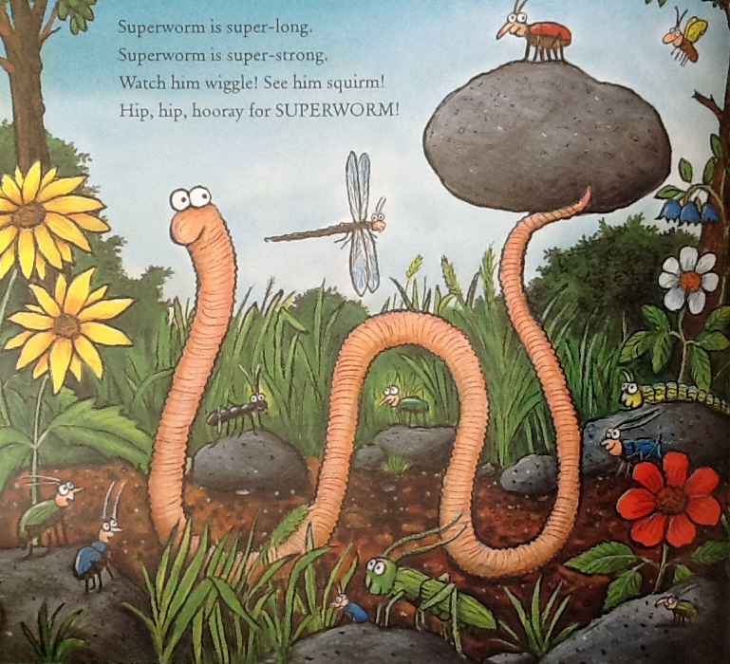
Resource: Stuff a sock with cotton wool to make a worm

Slide 3
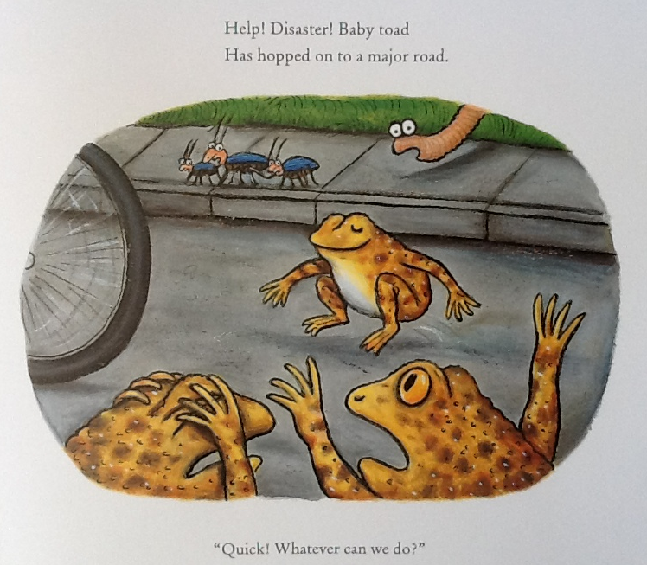
Resource: Frog toy or picture

Slide 4
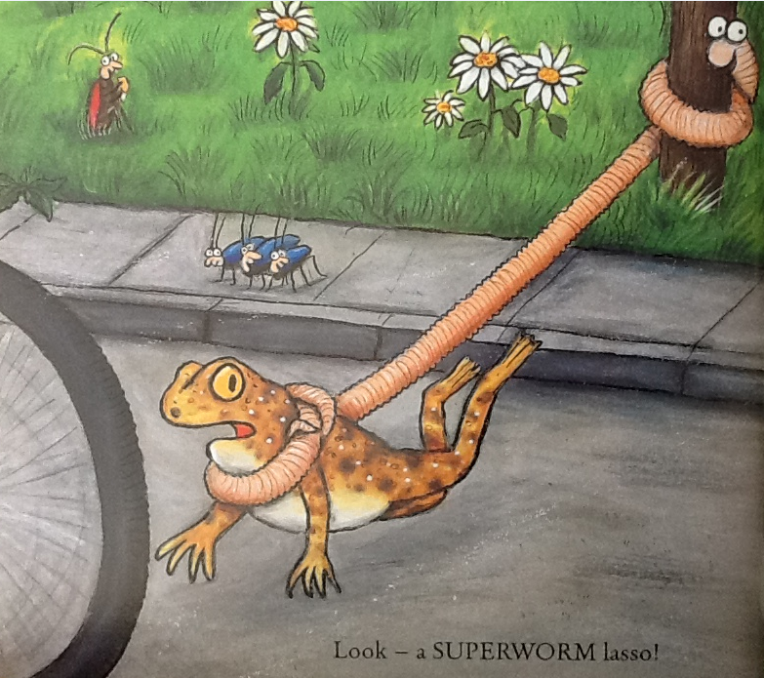
Resource: Stuff a sock with cotton wool to make a worm

Slide 5
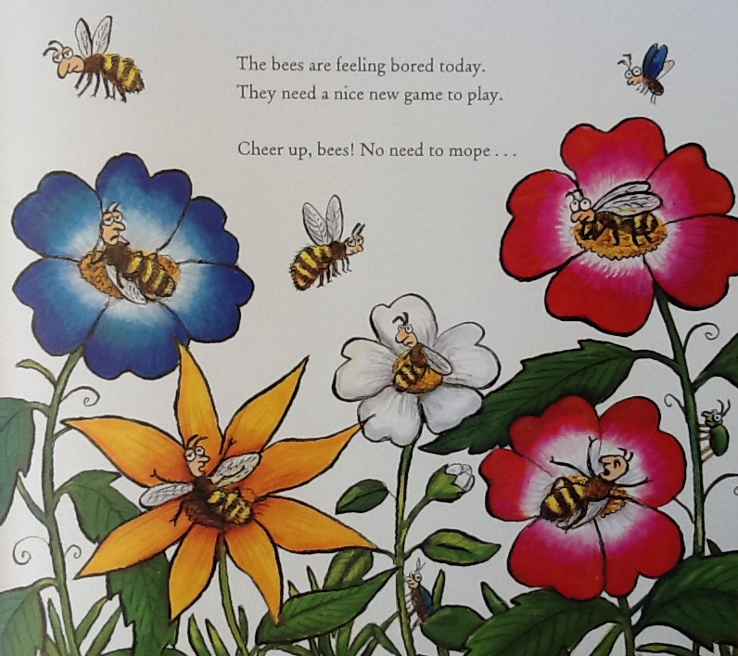
Resource: honey to smell

Slide 6
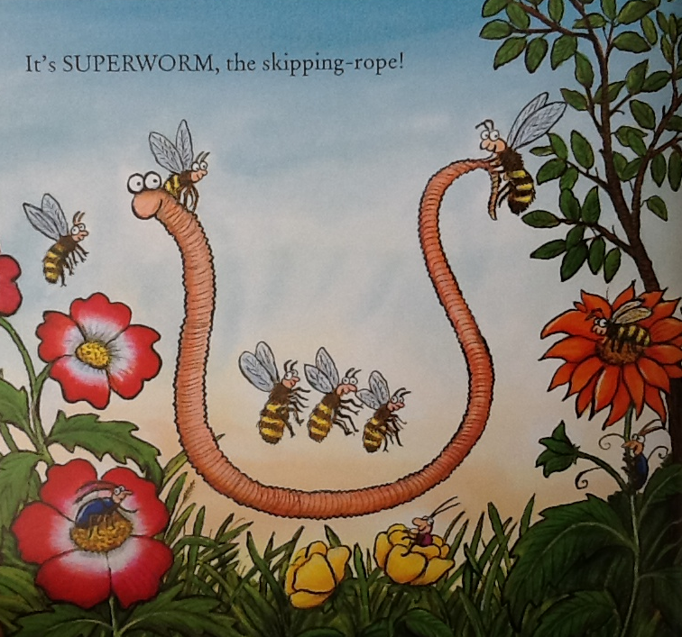
Resource: Stuff a sock with cotton wool to make a worm

Slide 7
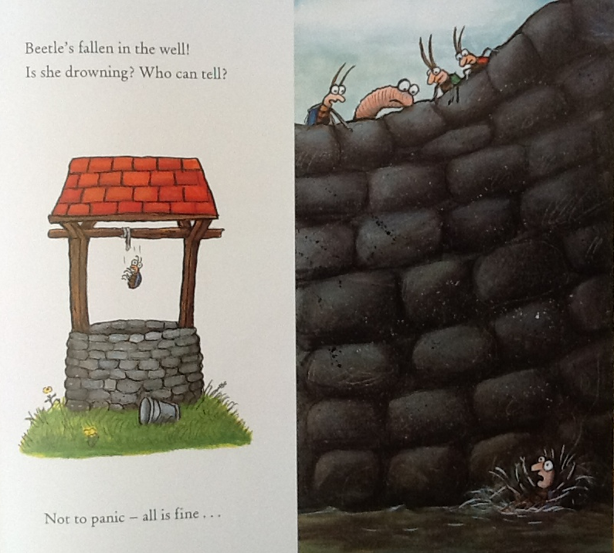
Resource: water spray

Slide 8
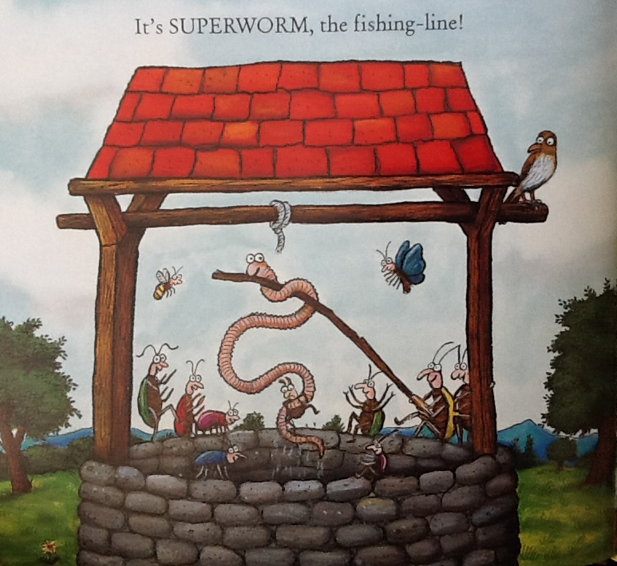
Resource: Stuff a sock with cotton wool to make a worm

Slide 9
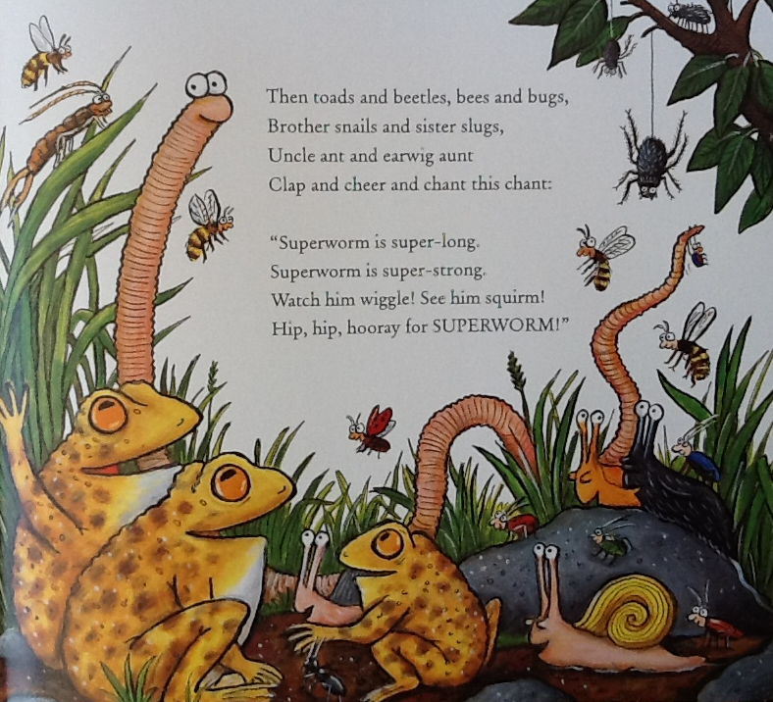
Resource: Stuff a sock with cotton wool to make a worm

Slide 10
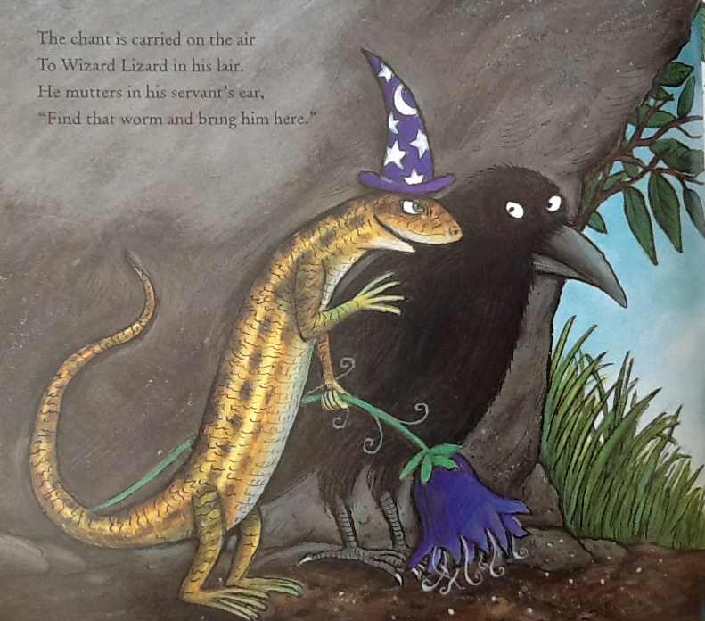
Resource: Wizard hat / picture of wizard hat

Slide 11
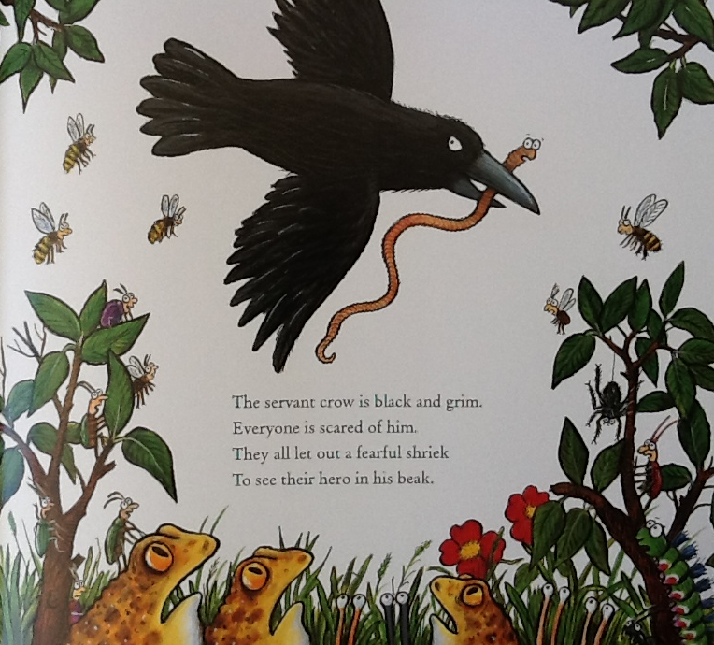
Resource: Black material

Slide 12
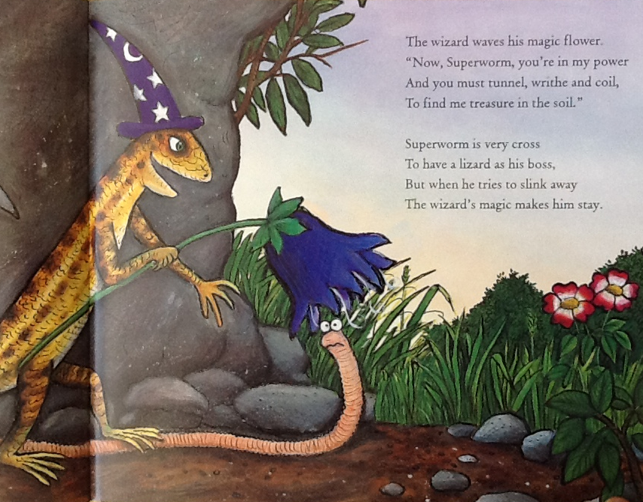
Resource: Fake flower

Slide 13
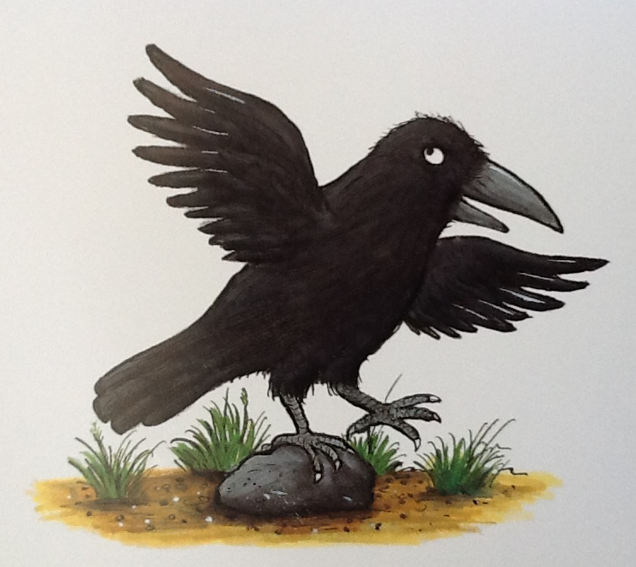
Resource:
Soil
For days he tunnels, twists and winds, but all the treasure that he finds,
Is two small buttons, half a cork, a toffee and a plastic fork.

Slide 14
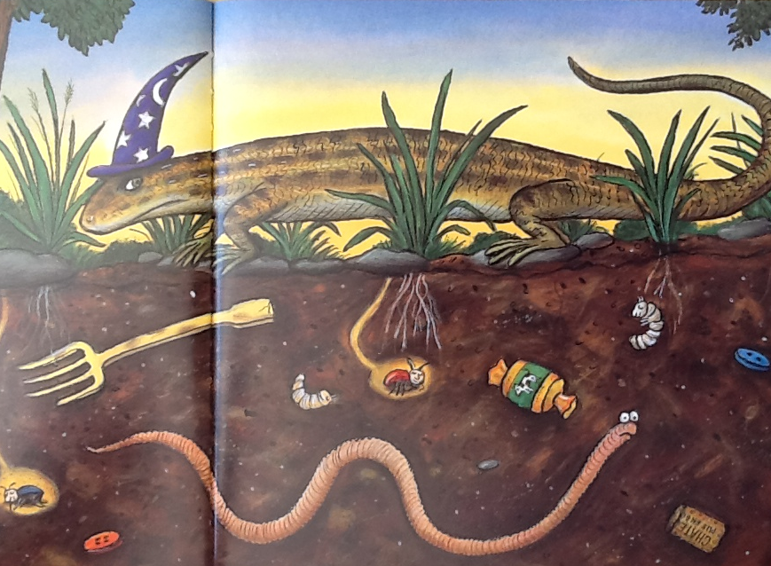
Resource:
Soil
The lizard flicks and angry tail. “Have one last try, and if you fail,
To find that treasure down below, I’ll feed you to my hungry crow.”

Slide 15
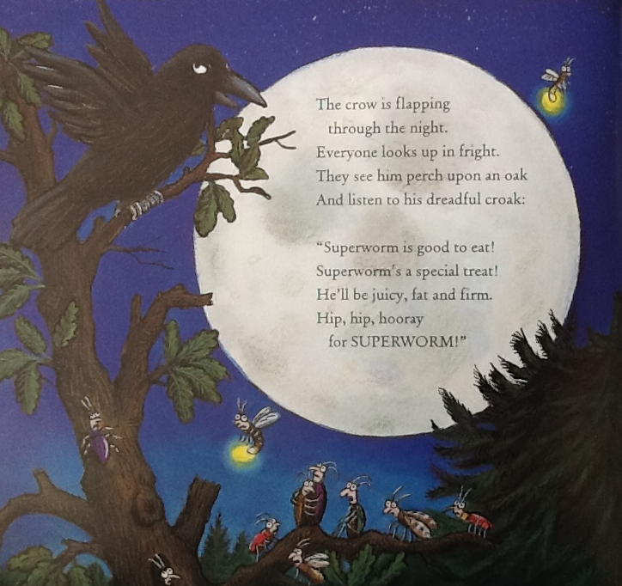
Resource: Stuff a sock with cotton wool to make a worm

Slide 16
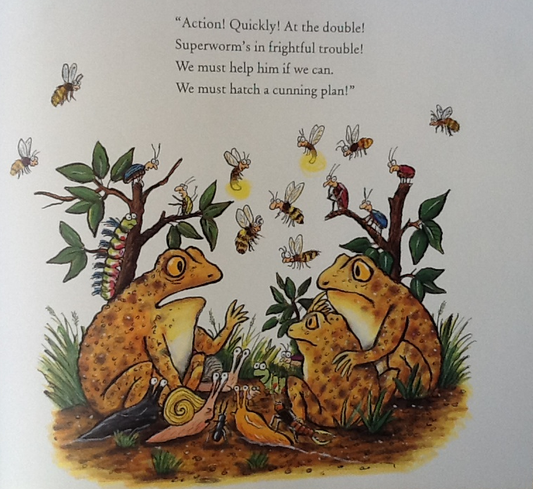

Slide 17
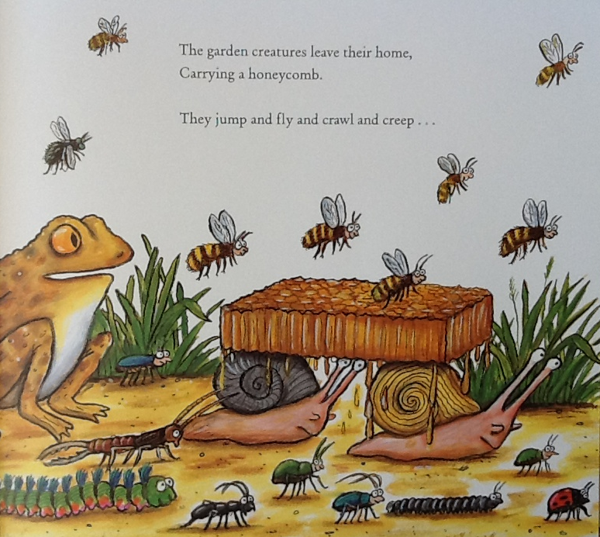
Resource: Honey to smell

Slide 18
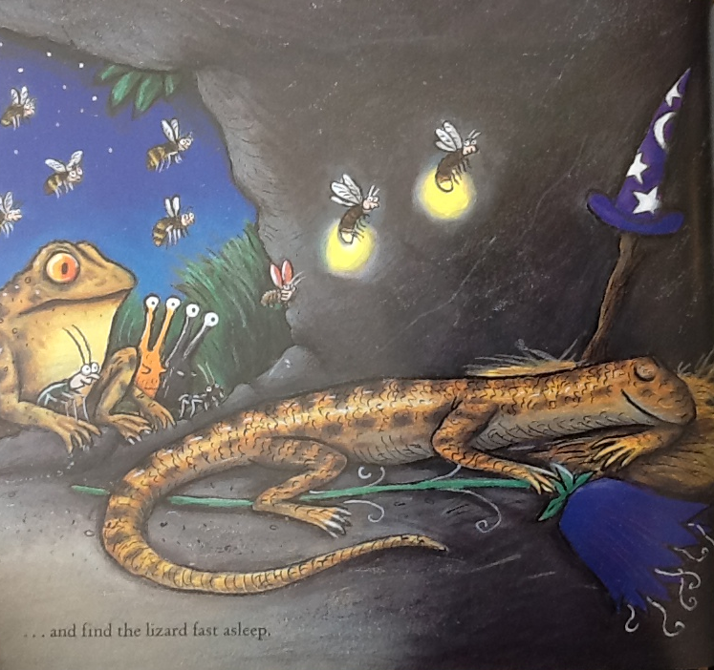

Slide 19
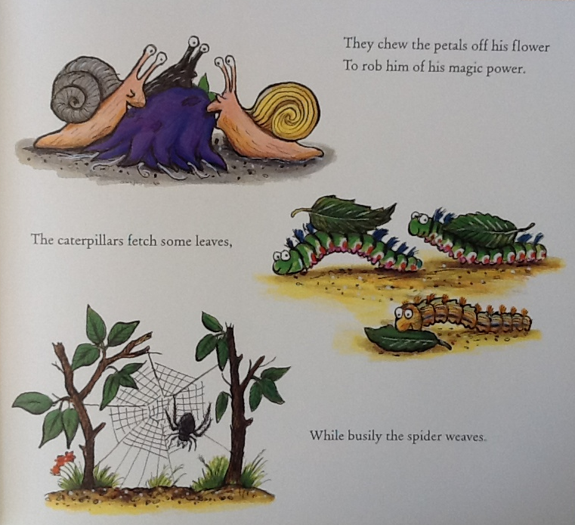
Resource: Spider

Slide 20
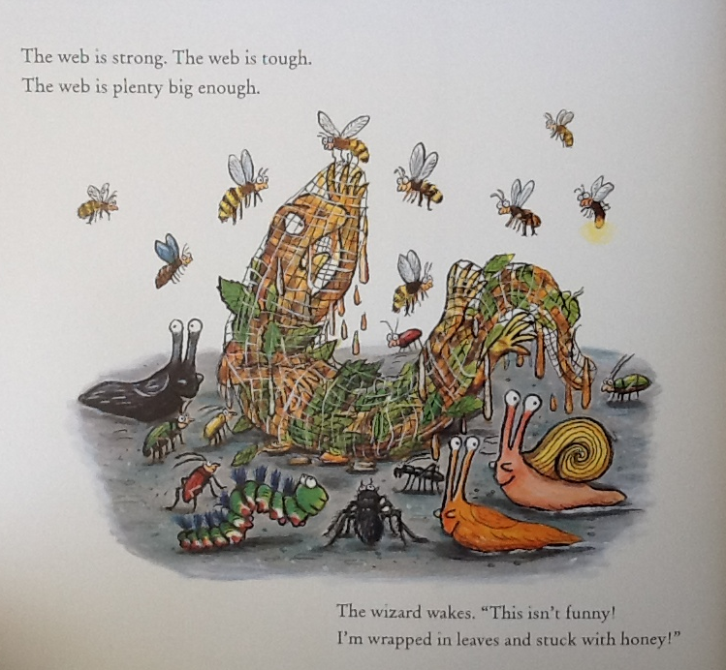
Resource: cotton wool

Slide 21
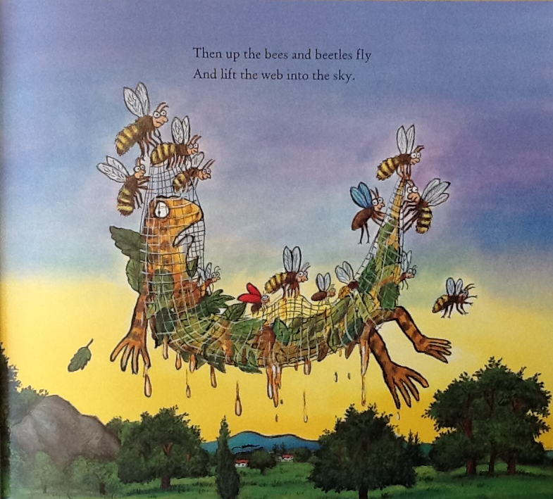

Slide 22
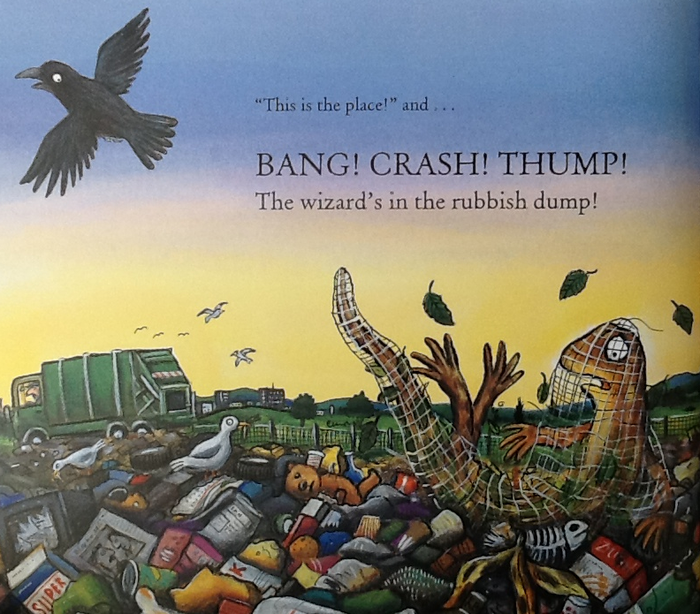
Resource: Drum or clap

Slide 23
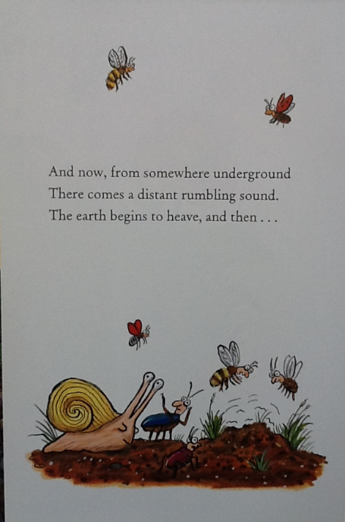

Slide 24
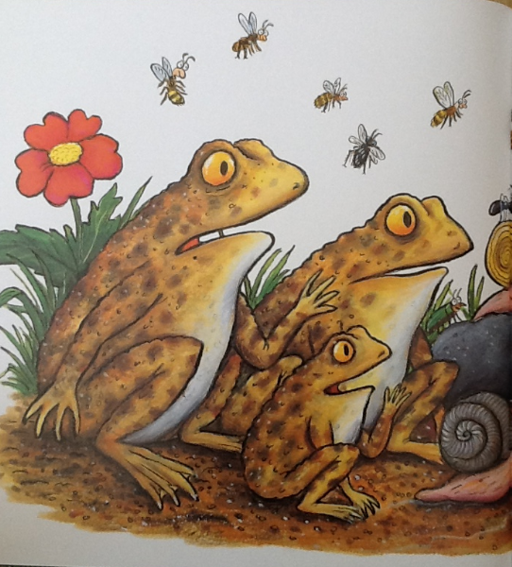

Slide 25
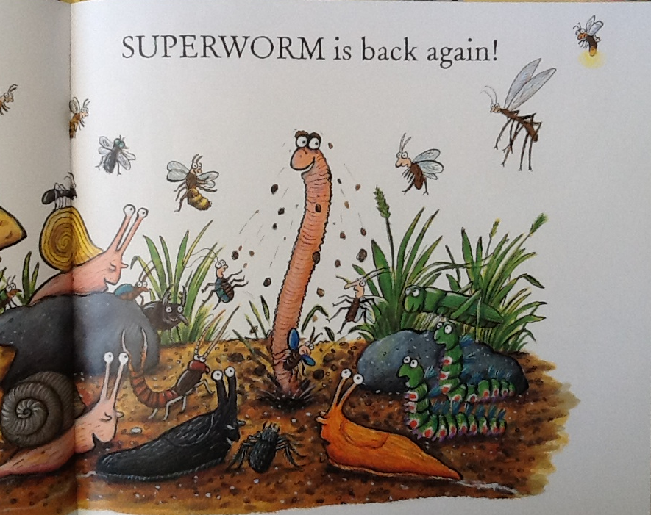
Resource: Stuff a sock with cotton wool to make a worm

Slide 26
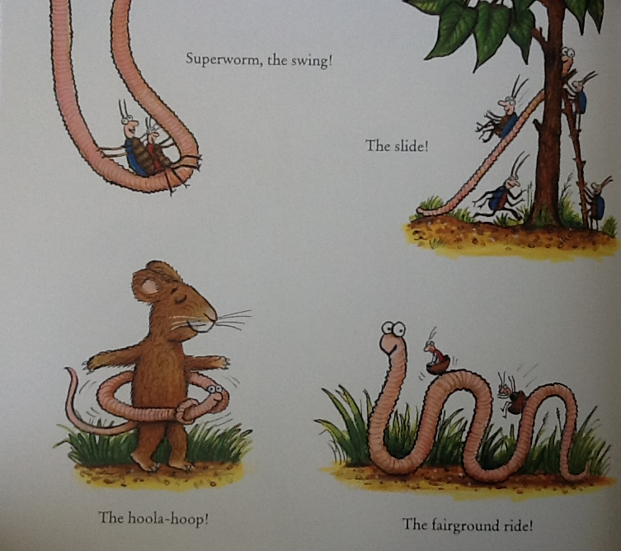

Slide 27
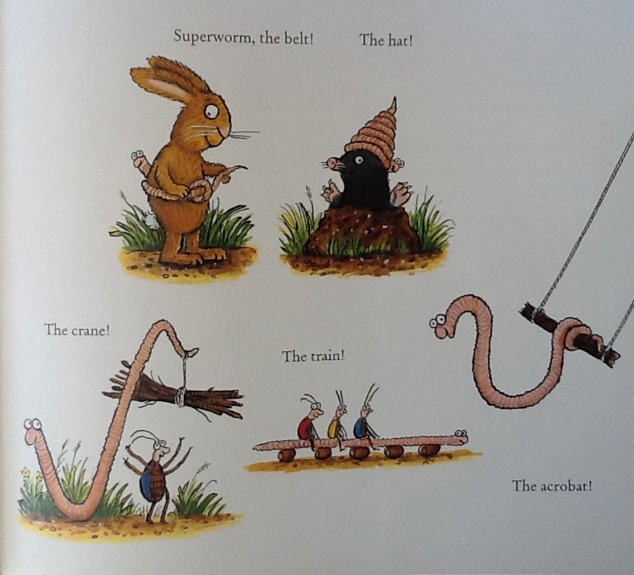

Slide 28
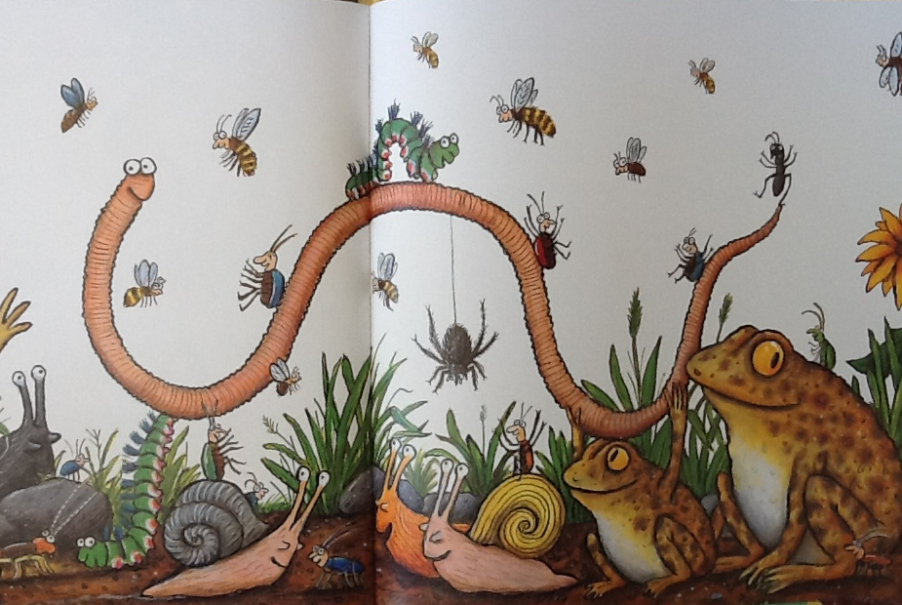
Then toads and beetles, bees and bugs, brother snails and sister slugs,
Uncle ant and earwig aunt, clap and cheer and chant this chant…
“Superworm is super long. Superworm is super strong.
Watch him wiggle! See him squirm! Hip, hip, hooray for SUPERWORM!”

