Slide 1
The Very Hungry Caterpillar.
By Eric Carle
Powerpoint from: https://www.tes.com/resource-detail/download/3009267

Slide 2
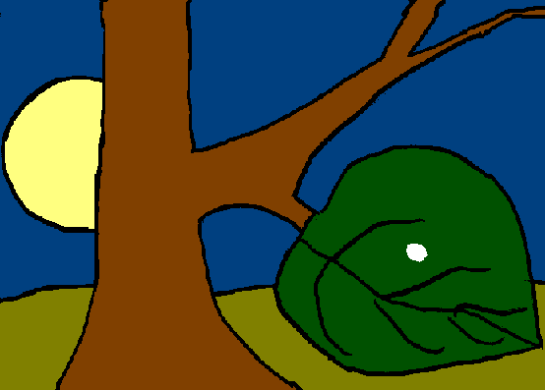
In the light of the moon a little egg lay on a leaf.
Resource: a leaf, torch

Slide 3
One Sunday morning the warm sun came up and pop! Out of the egg came a tiny and very hungry caterpillar.
Resource: pipcleaner or caterpillar toy

Slide 4
He started to look for some food.
Resource: pipcleaner or caterpillar toy
I’m hungry!

Slide 5
On Monday he ate through one apple. But he was still hungry.
Resource: apple or apple scent
I’m still hungry!

Slide 6
On Tuesday he ate through two pears, but he was still hungry.
Resource: pear or pear scent
I’m still hungry!

Slide 7
On Wednesday he ate through three plums, but he was still hungry.
Resource: plums or plum scent
I’m still hungry!

Slide 8
On Thursday he ate through four strawberries, but he was still hungry.
Resource: Strawberries or strawberry scent
I’m still hungry!

Slide 9
On Friday he ate through five oranges, but he was still hungry.
I’m still hungry!
Resource: oranges or orange scent

Slide 10
On Saturday he ate through…..
That night he had stomach-ache!

Slide 11
The next day was Sunday again. The caterpillar ate through one nice green leaf, and after that he felt much better.

Slide 12
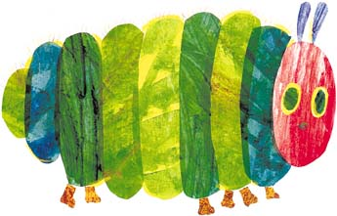
Now he wasn’t hungry anymore- and he wasn’t a little caterpillar any more.
He was a big, fat caterpillar.

Slide 13
He built a small house, called a cocoon, around himself. He stayed inside for more than two weeks.
Then he nibbled a hole in the cocoon, pushed his way out ………
Resource: pipcleaner or caterpillar toy wrapped in a blanket

Slide 14
He was a beautiful butterfly!
Resource: colourful material

