Slide 1
Going on a Treasure Hunt.

Slide 2
We’re going on a treasure hunt.
We’re going to find some treasure.
What a beautiful day.
Yo ho ho!

Slide 3
Oh no!
An ocean.
A big, wet, ocean.
We can't go over it.
We can't go under it.
Oh no!
We’ve got to swim through it!
Resource: Water spray / water
Splish splash, splish splash, splish splash.

Slide 4
We’re going on a treasure hunt.
We’re going to find some treasure.
What a beautiful day.
Yo ho ho!

Slide 5
Oh no!
Sand.
Warm, golden sand.
We can't go over it.
We can't go under it.
Oh no!
We’ve got to stomp through it!
Resource: sand / crushed biscuit
Stomp stomp, stomp stomp, stomp stomp.

Slide 6
We’re going on a treasure hunt.
We’re going to find some treasure.
What a beautiful day.
Yo ho ho!

Slide 7
Oh no!
Grass.
Tall, wavy grass.
We can't go over it.
We can't go under it.
Oh no!
We’ve got to go through it!
Resource: grass
Swishy swashy, swishy swashy, swishy swashy.

Slide 8
We’re going on a treasure hunt.
We’re going to find some treasure.
What a beautiful day.
Yo ho ho!

Slide 9
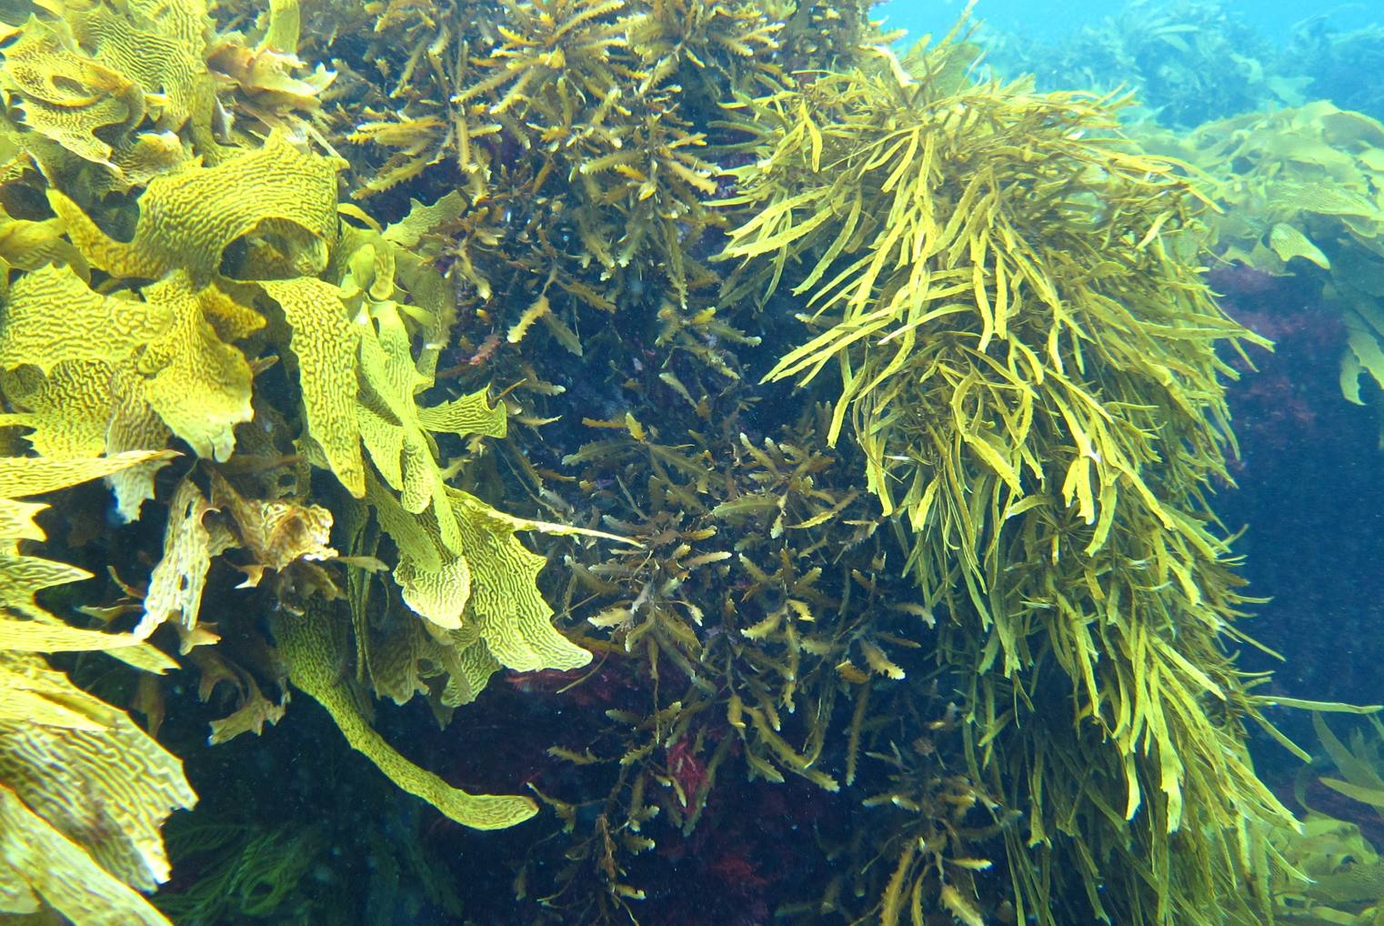
Resource: slimey material
Oh no!
Seaweed.
Squelchy, slimey seaweed.
We can't go over it.
We can't go under it.
Oh no!
We’ve got to go through it!
Squish squelch squish squelch squish squelch.

Slide 10
We’re going on a treasure hunt.
We’re going to find some treasure.
What a beautiful day.
Yo ho ho!

Slide 11
Oh no!
A cave.
A dark, scary cave.
We can't go over it
We can't go under it.
Oh no!
We’ve got to through it!
Tiptoe, tiptoe, tiptoe.
Resource: Dark material

Slide 12
What’s that?!
Oh look!
X marks the spot, that must mean one thing…..

Slide 13
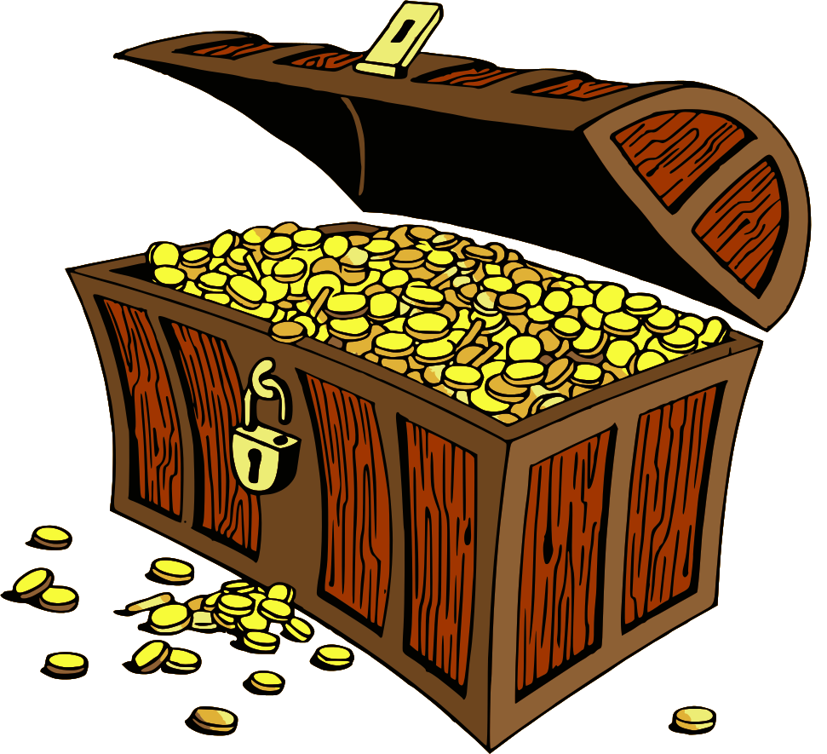
Resource: box filled with treasure
We’ve found the treasure!
Let’s have a look and see what is inside!

