Slide 1
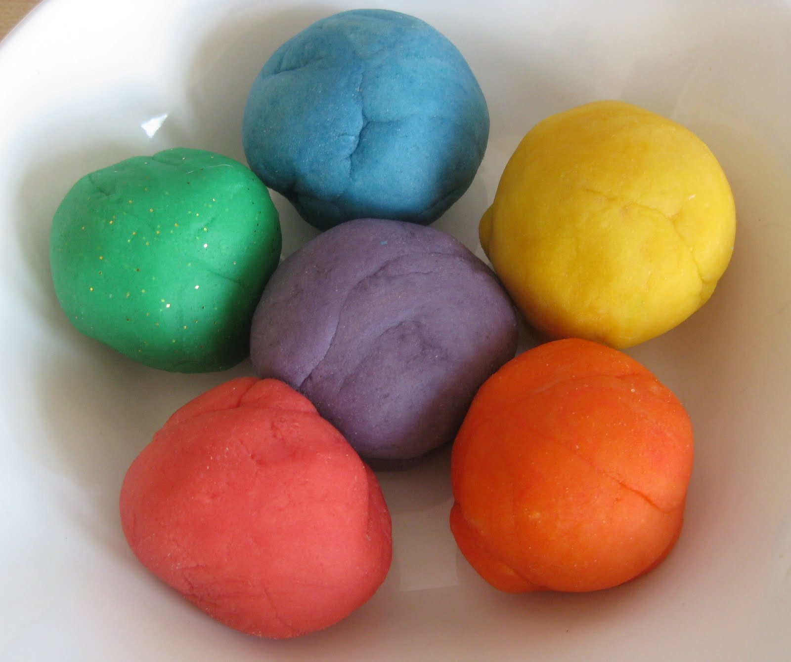
Playdough Disco Hello Yellow

Slide 2
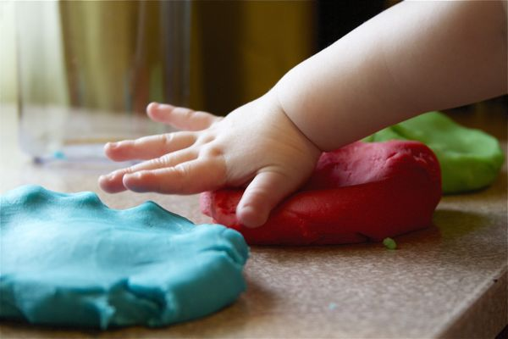
Patting dough with hands
Song: Mellow Yellow - https://www.youtube.com/watch?v=nrbni0tVBZ8

Slide 3
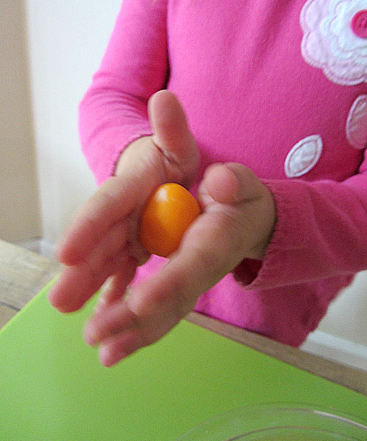
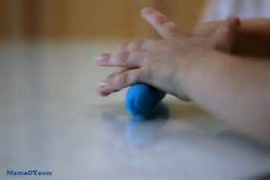
Rolling dough with hands
Song: Black and yellow (lego movie version) https://www.youtube.com/watch?v=nXxq-LeiXy8

Slide 4
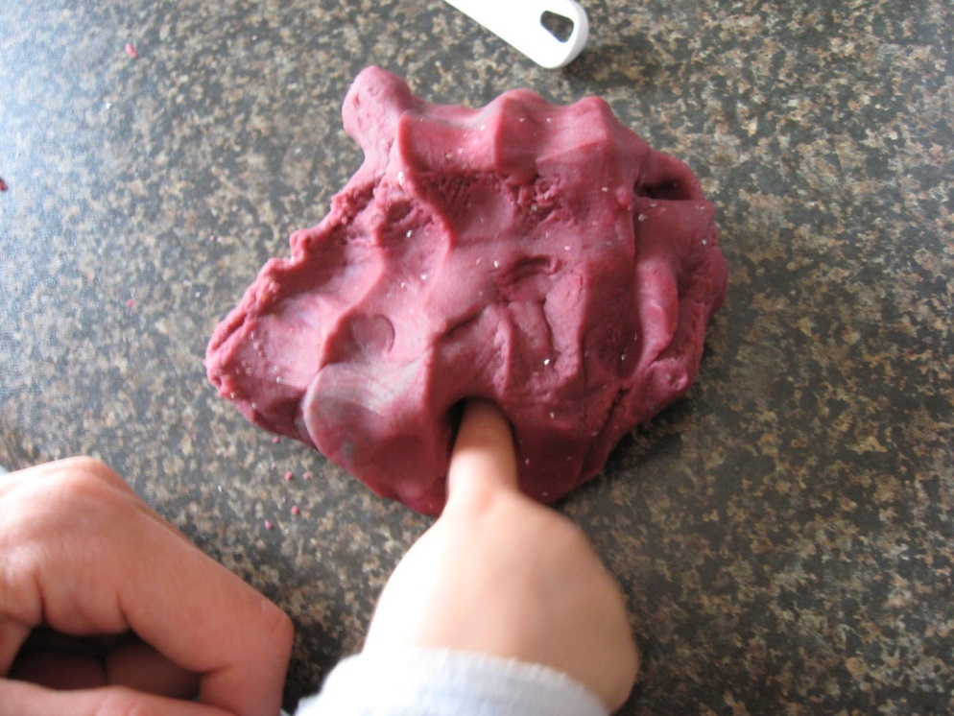
Poking dough with fingers
Song: Itsie Bitsie Tinie winie yellow polka dot bikini - https://www.youtube.com/watch?v=lpv-RGZJjP0

Slide 5
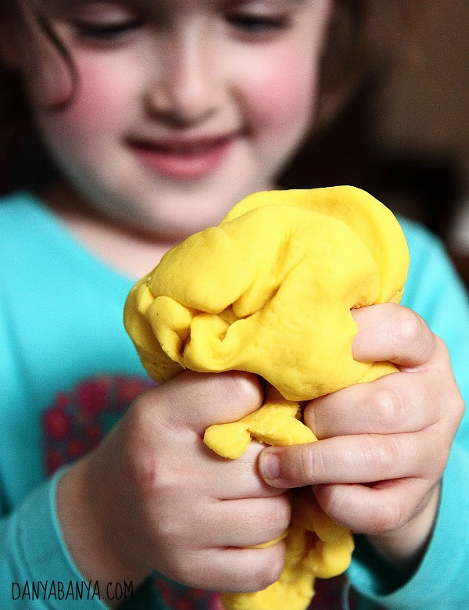
Squeezing dough with hands

