Slide 1
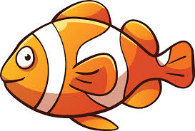
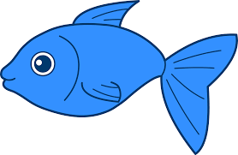
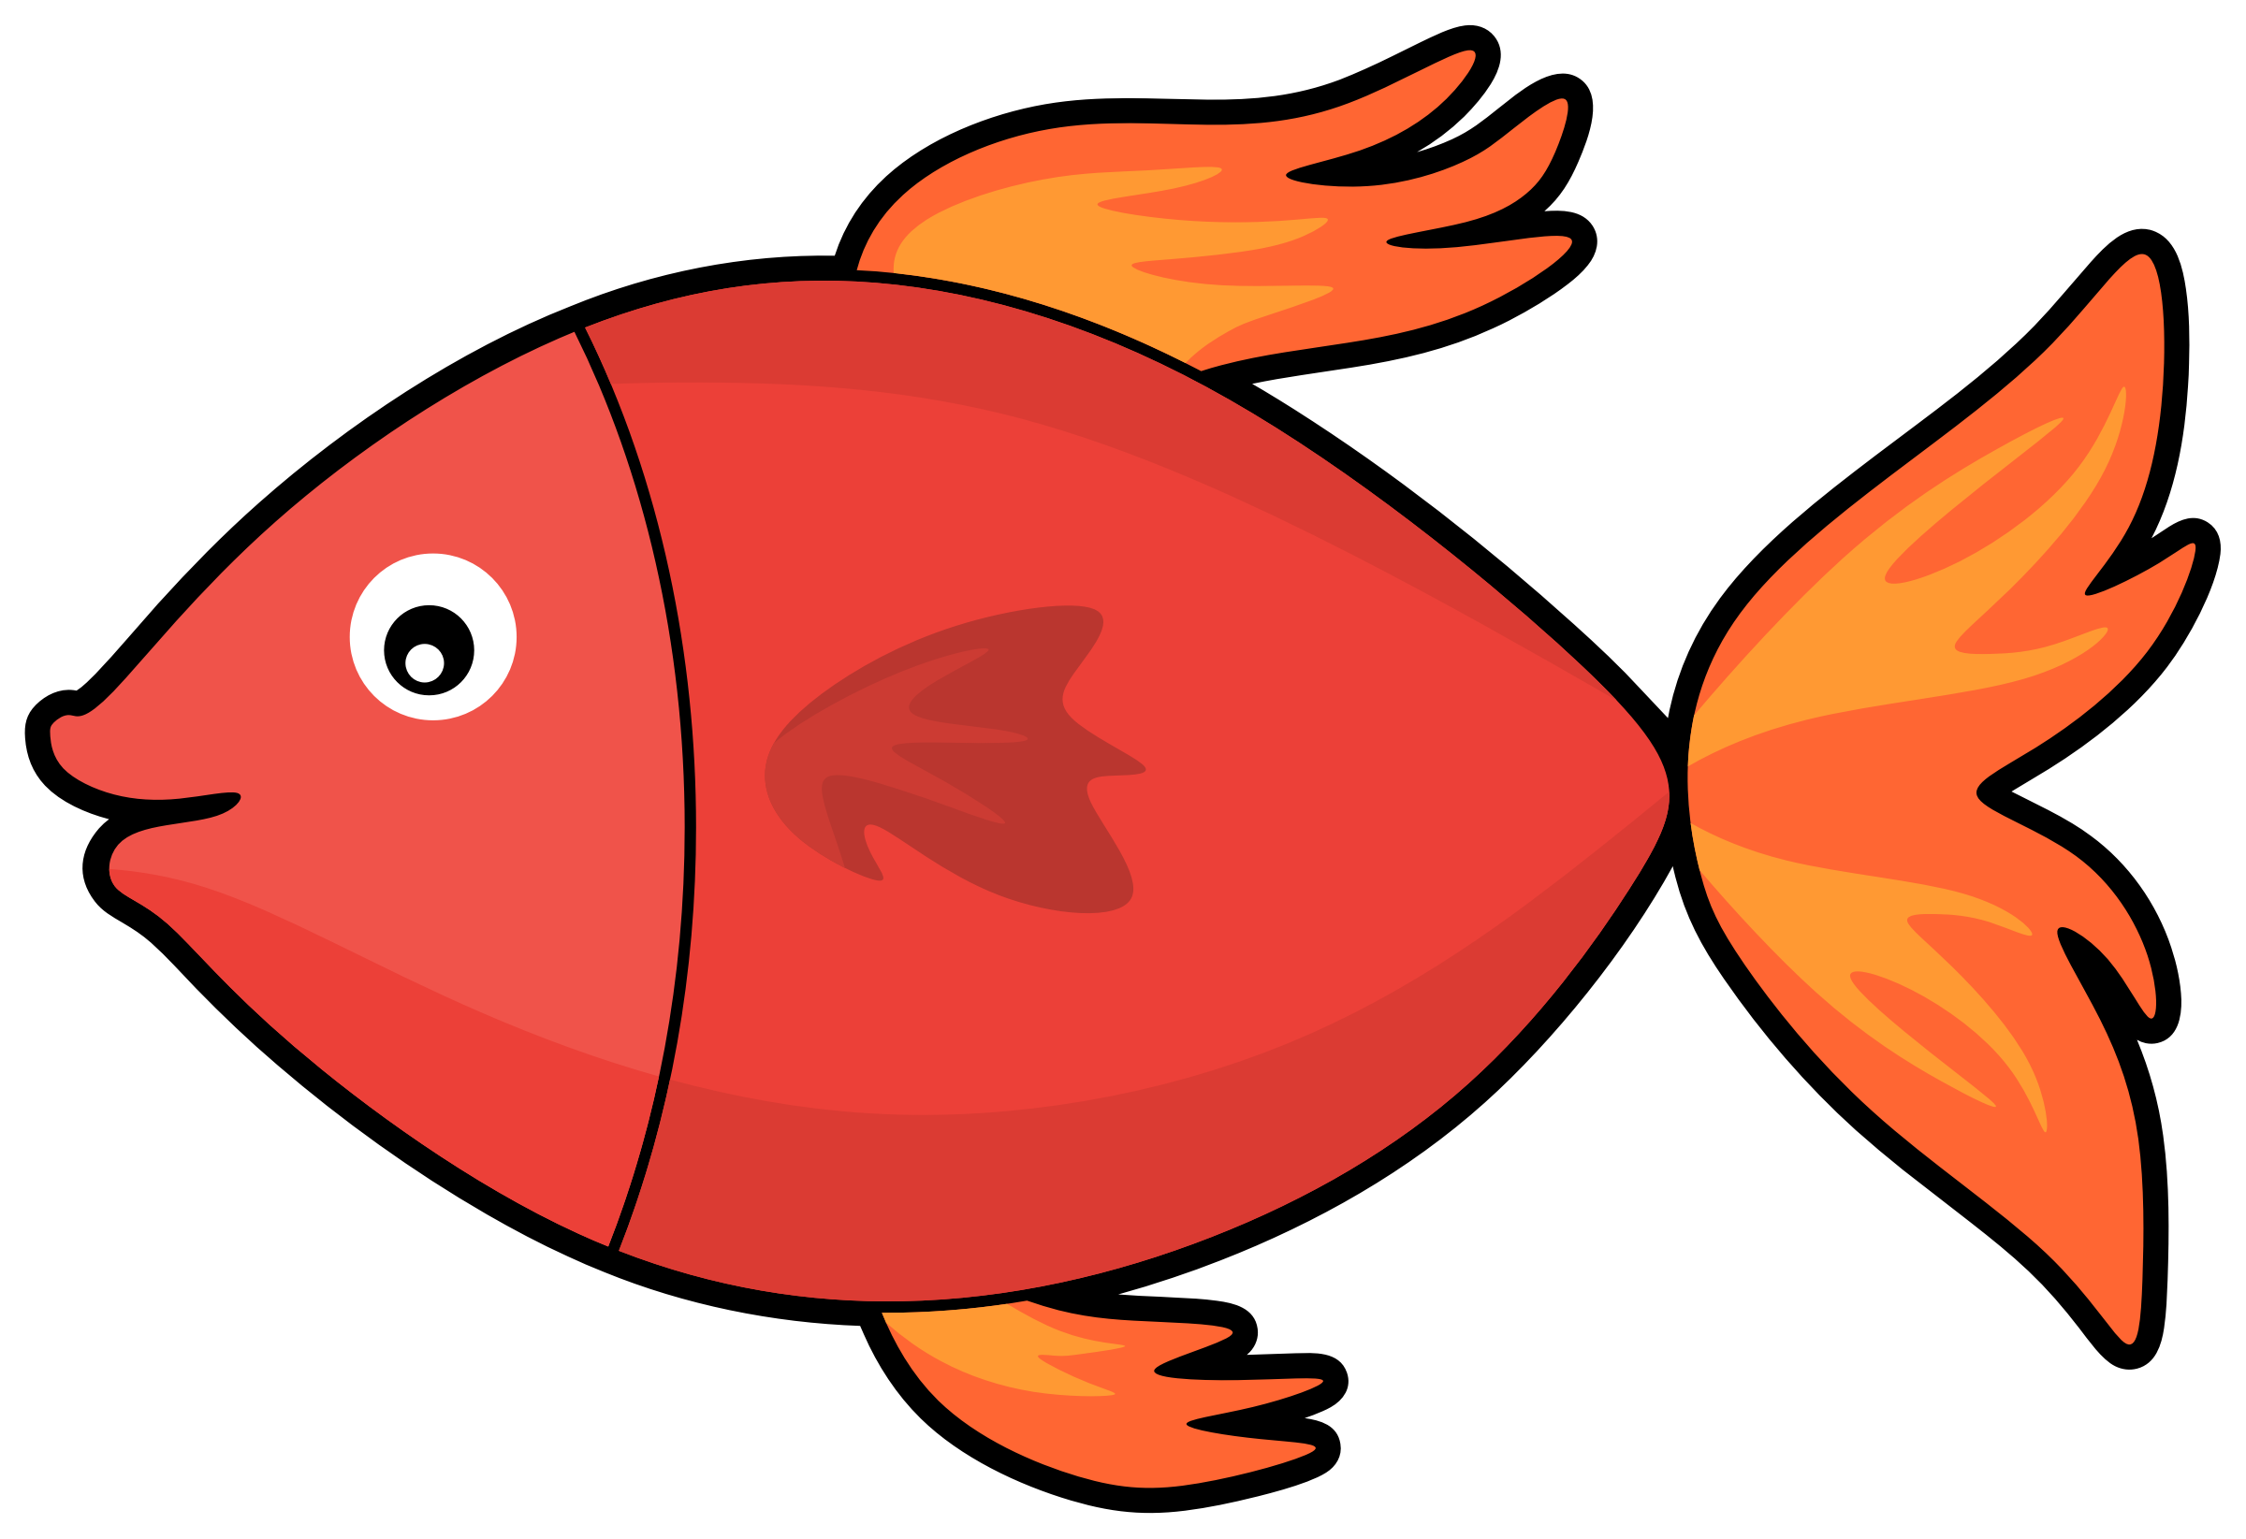
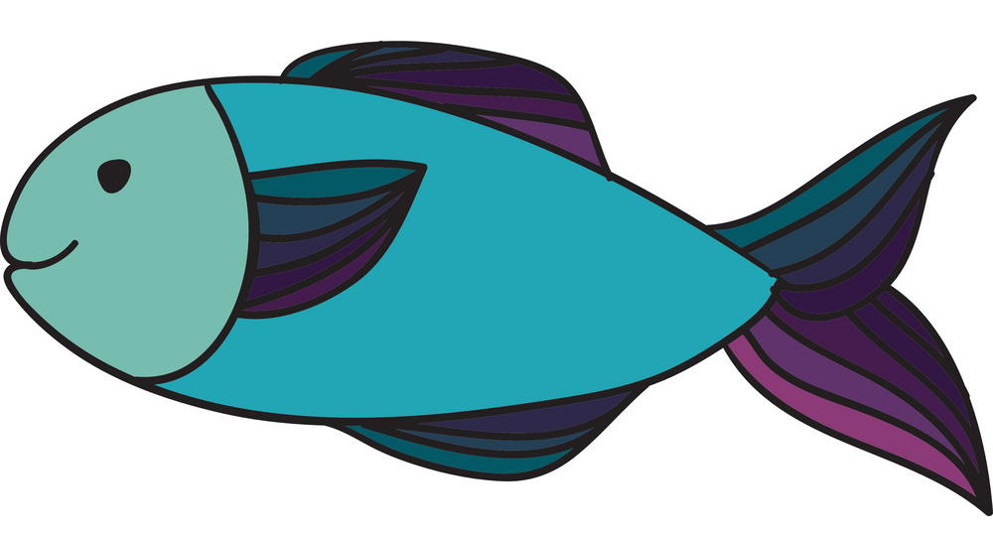
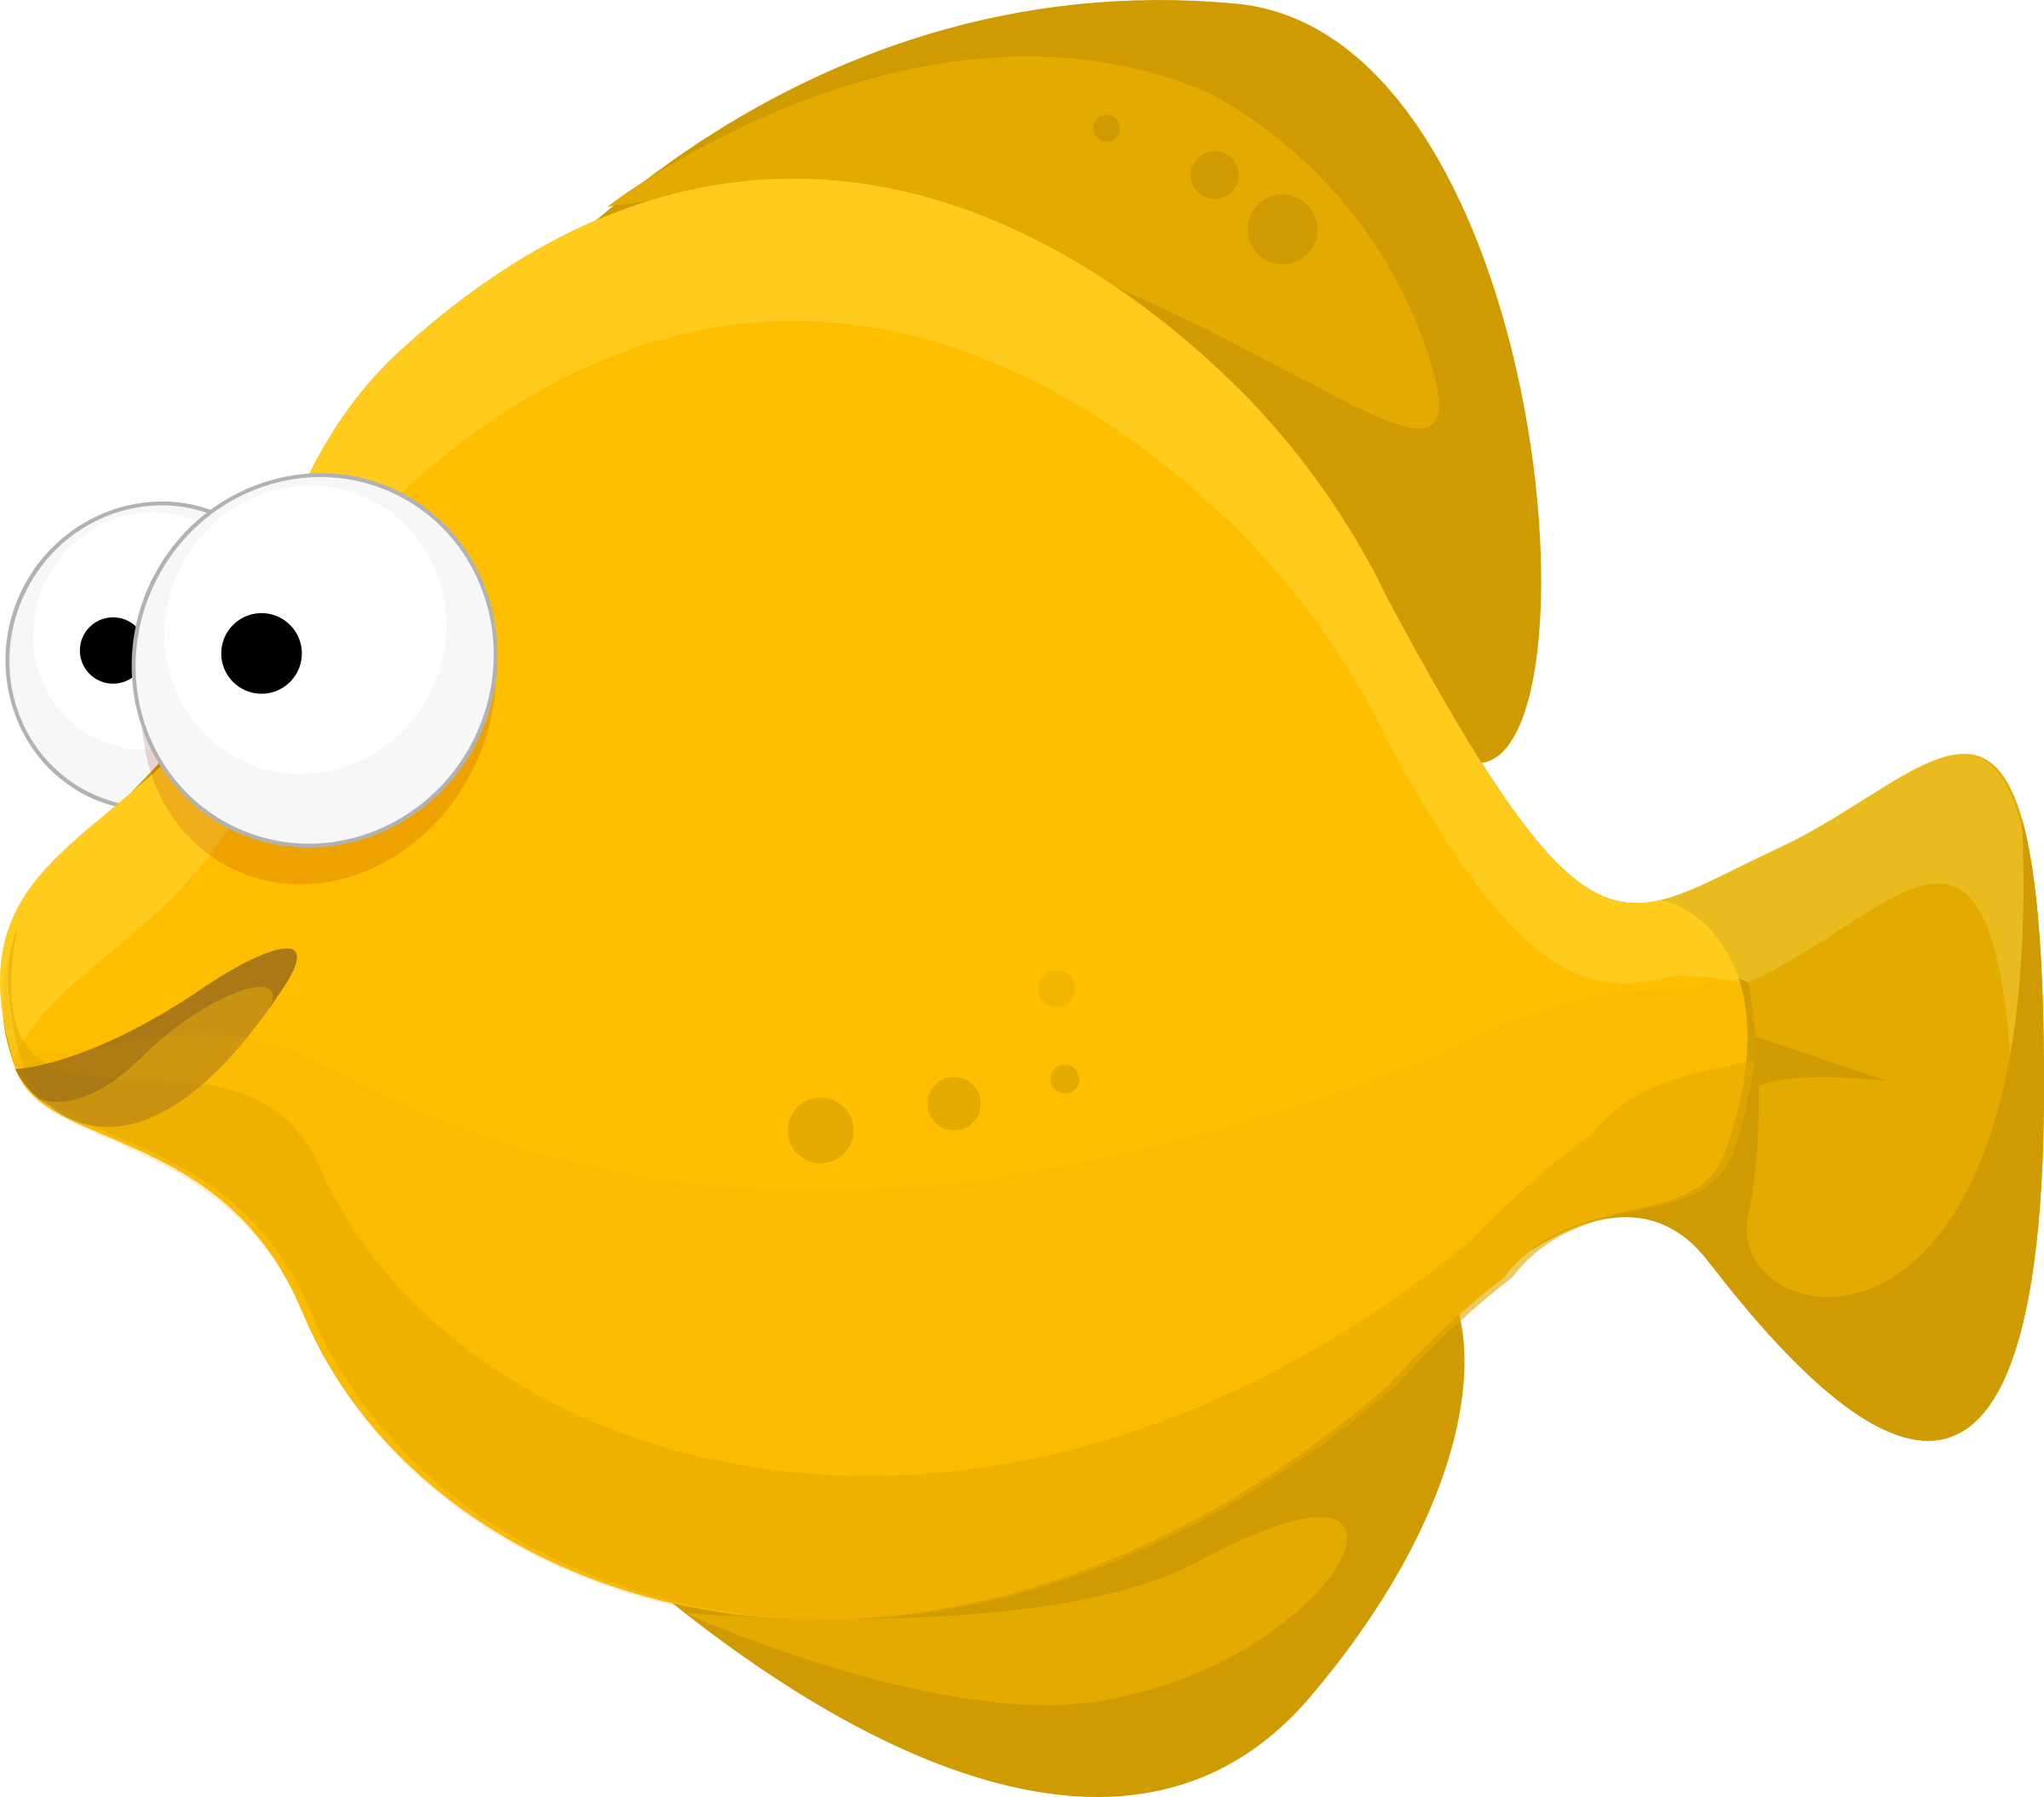
5 Little Fish Song To the tune of ’10 green bottles’

Slide 2
5

Slide 3
5 little fish swimming by the shore, 5 little fish swimming by the shore but one little fish got accidently caught, how many fish are swimming by the shore?

Slide 4
4

Slide 5
4 little fish swimming by the shore, 4 little fish swimming by the shore but one little fish got accidently caught, how many fish are swimming by the shore?

Slide 6
3

Slide 7
3 little fish swimming by the shore, 3 little fish swimming by the shore but one little fish got accidently caught, how many fish are swimming by the shore?

Slide 8
2

Slide 9
2 little fish swimming by the shore, 2 little fish swimming by the shore but one little fish got accidently caught, how many fish are swimming by the shore?

Slide 10
1

Slide 11
1 little fish swimming straight for home, 1 little fish swimming straight for home this little fish decided not to roam, 1 little fish swimming straight for home.

