Slide 1
Farmyard Hullabaloo
Story Massage

Slide 2
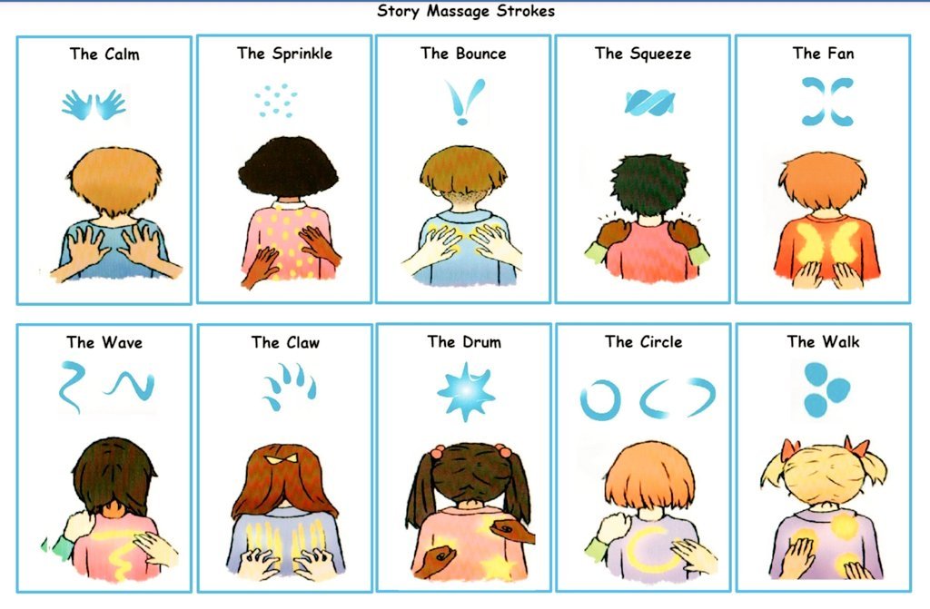

Slide 3
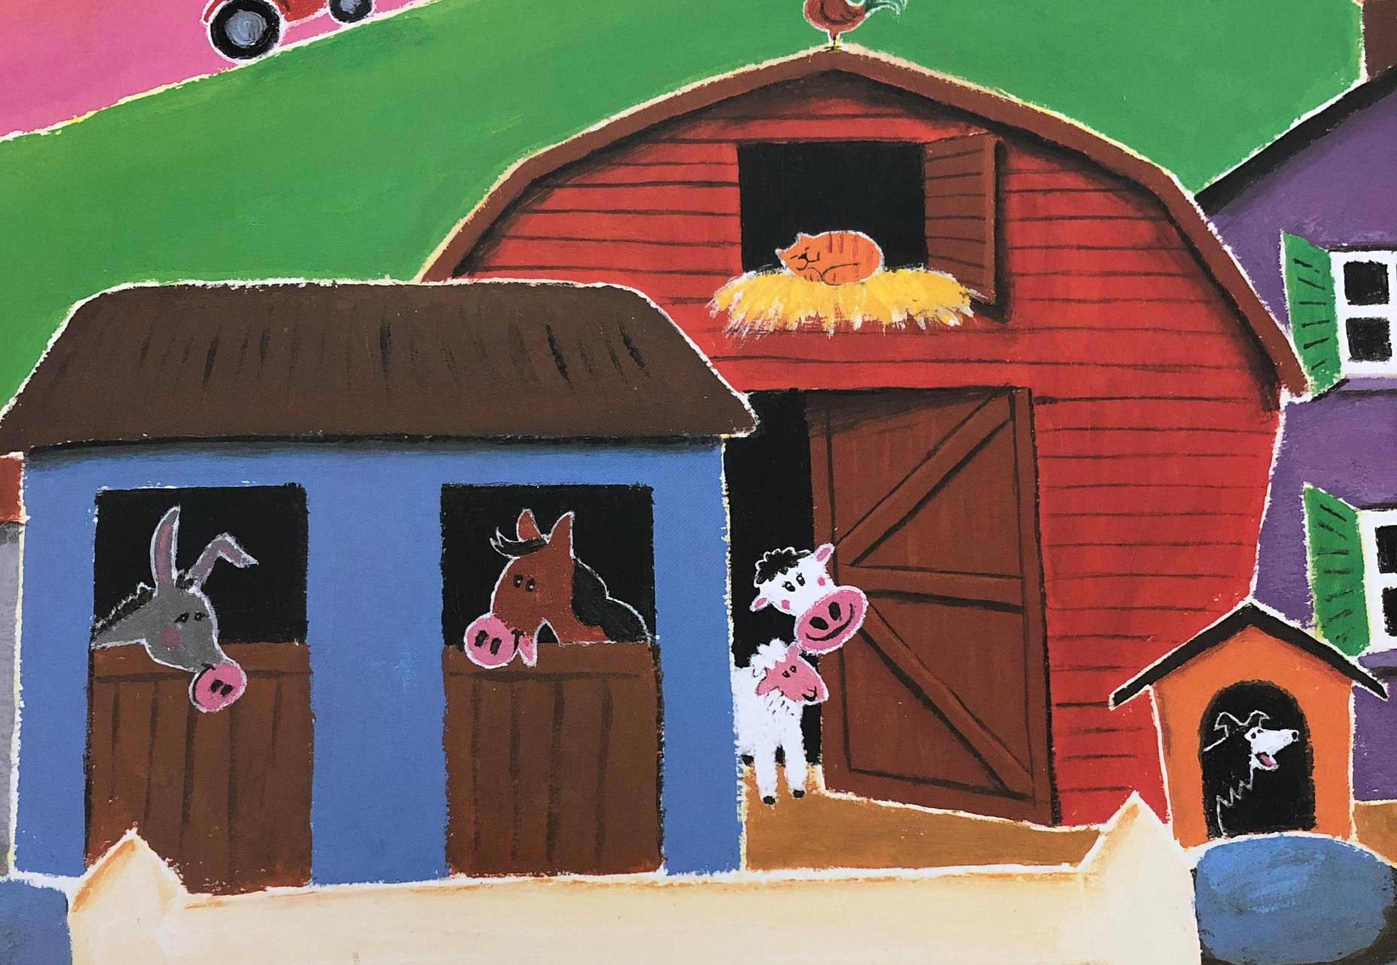
Early in the morning
As the sun begins to rise
The pigs are feeling hungry
And they’re snorting in their sties.
The rooster wakes the farm up
With a cock-a-doodle-doo!
The sheepdog won’t stop barking
And the cows begin to moo.
There’s a stomping in the stables
And there’s bleating in the barn
So let’s jump aboard the tractor
And explore the noisy farm.

Slide 4
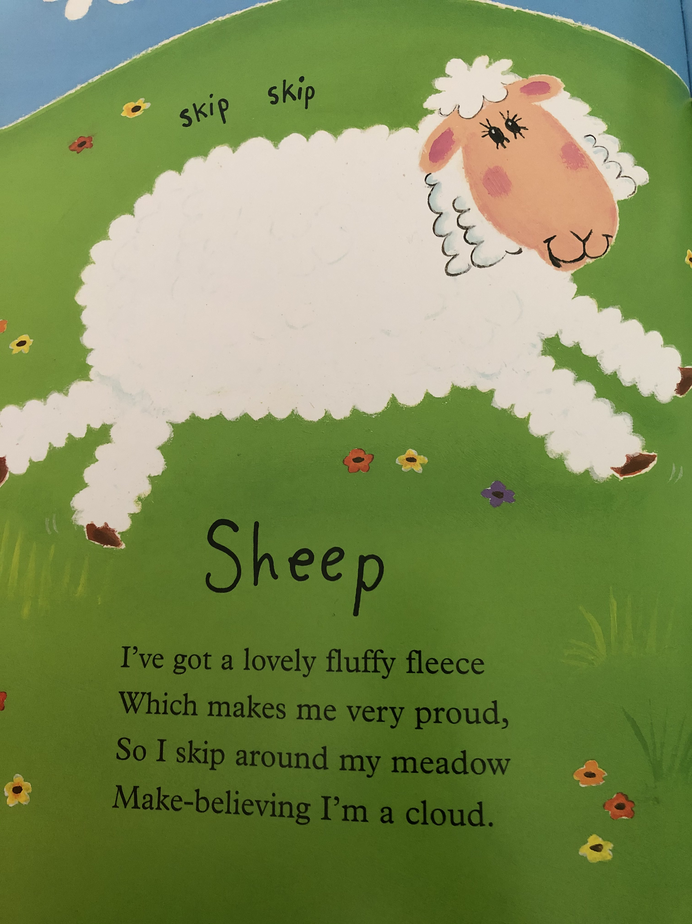

Slide 5
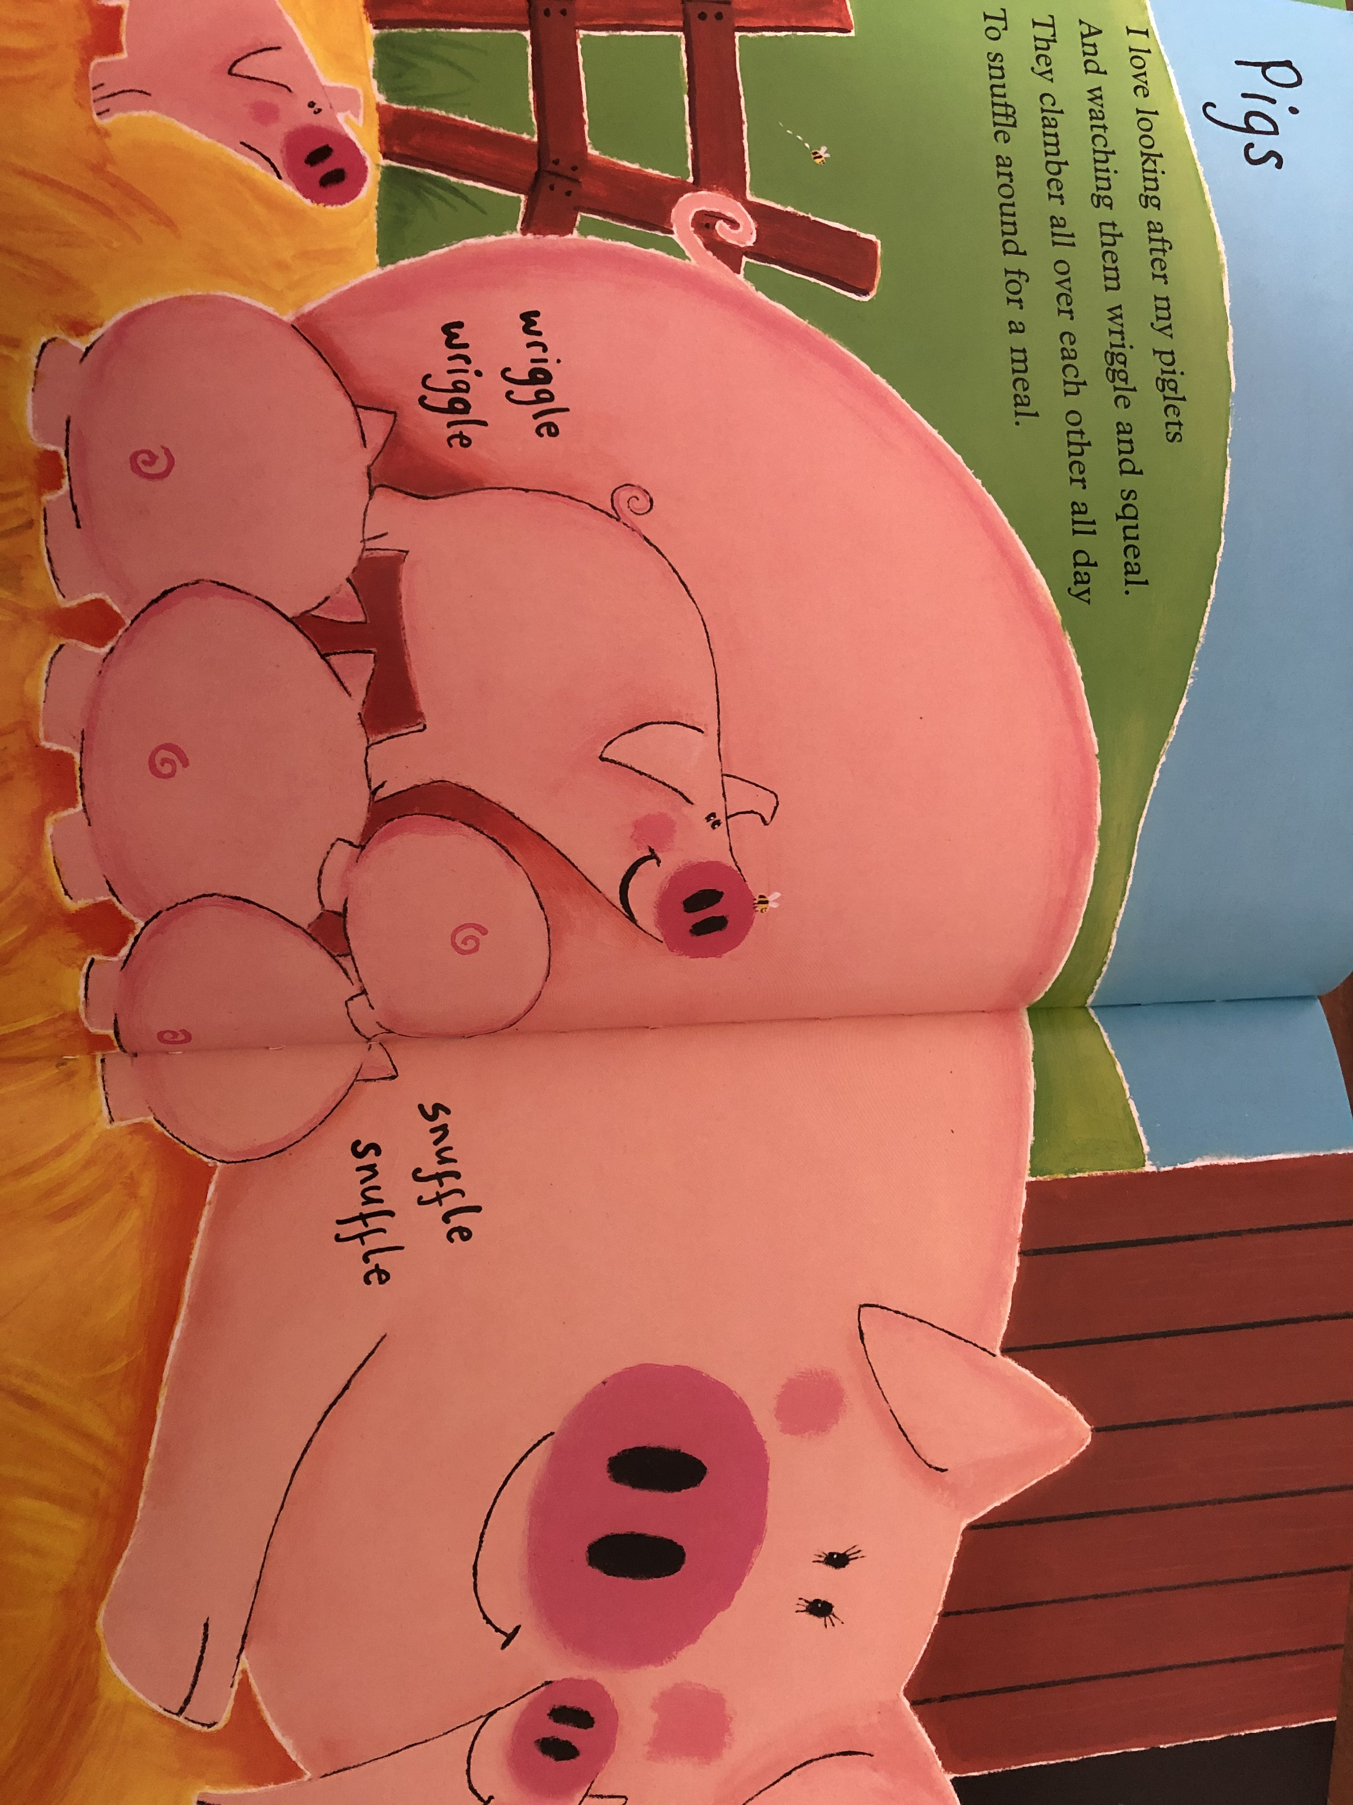

Slide 6
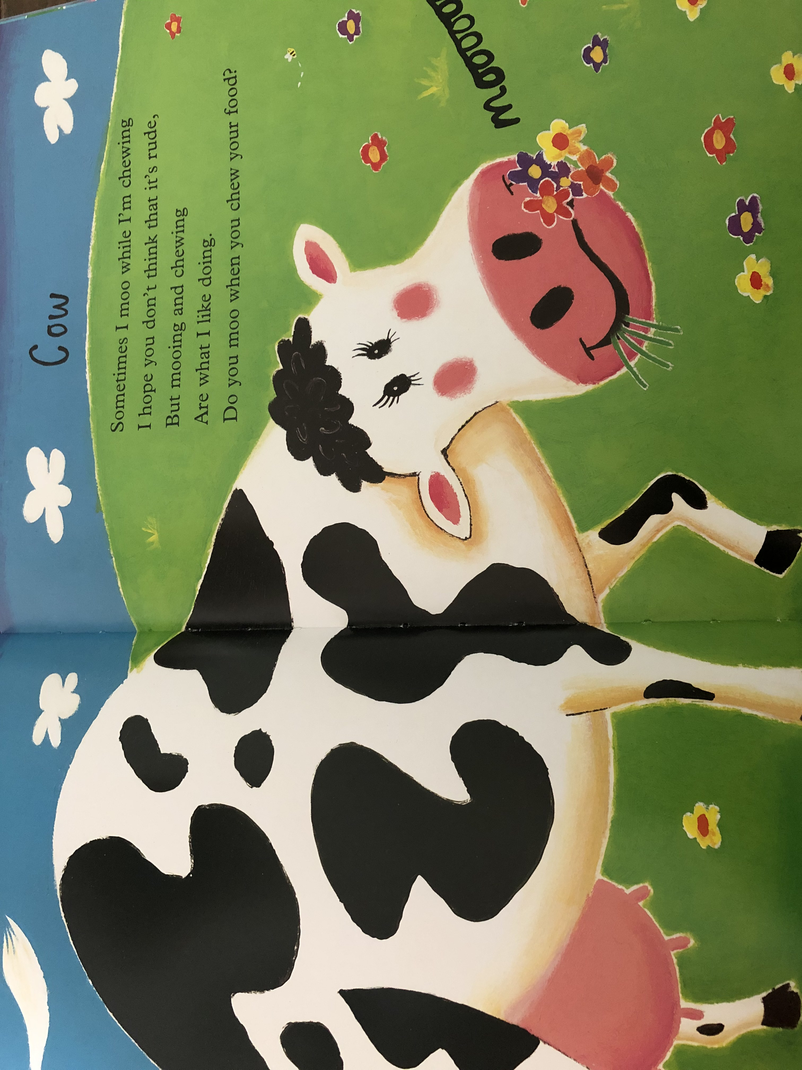

Slide 7
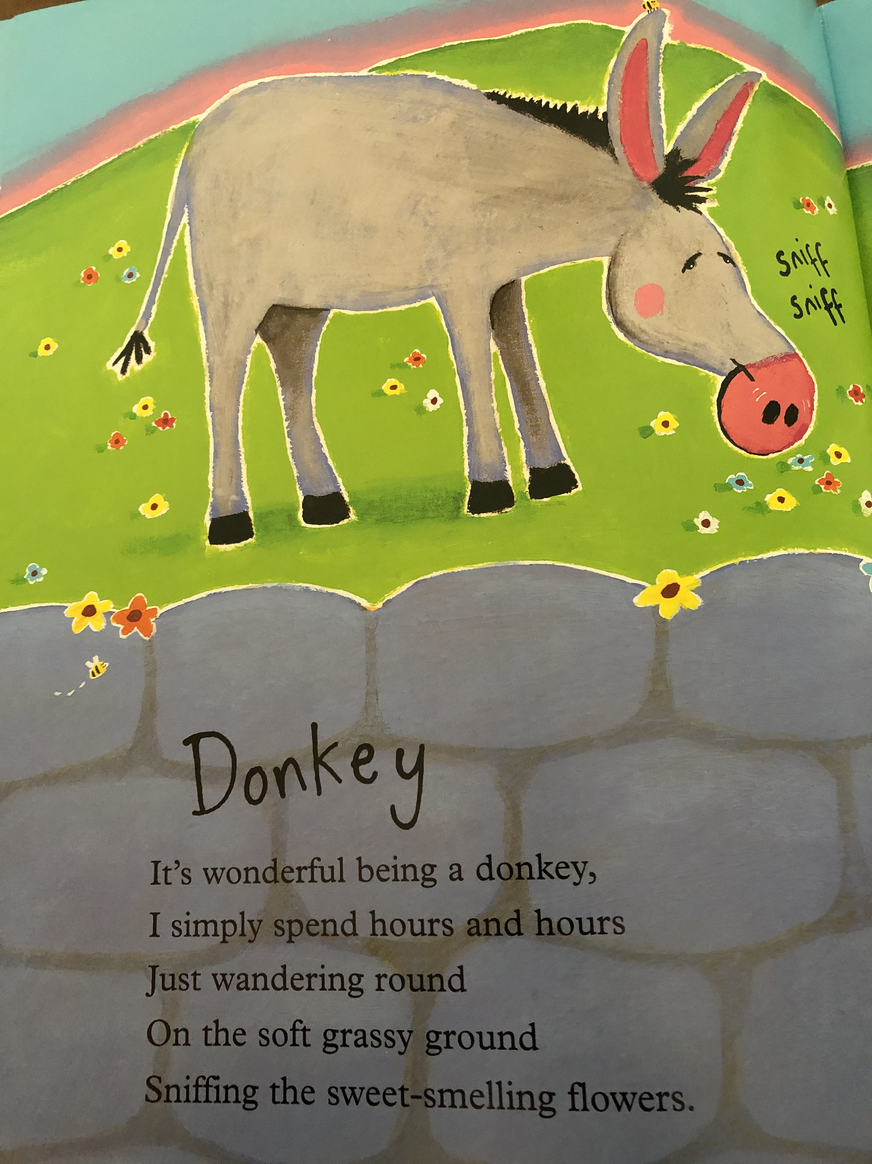

Slide 8
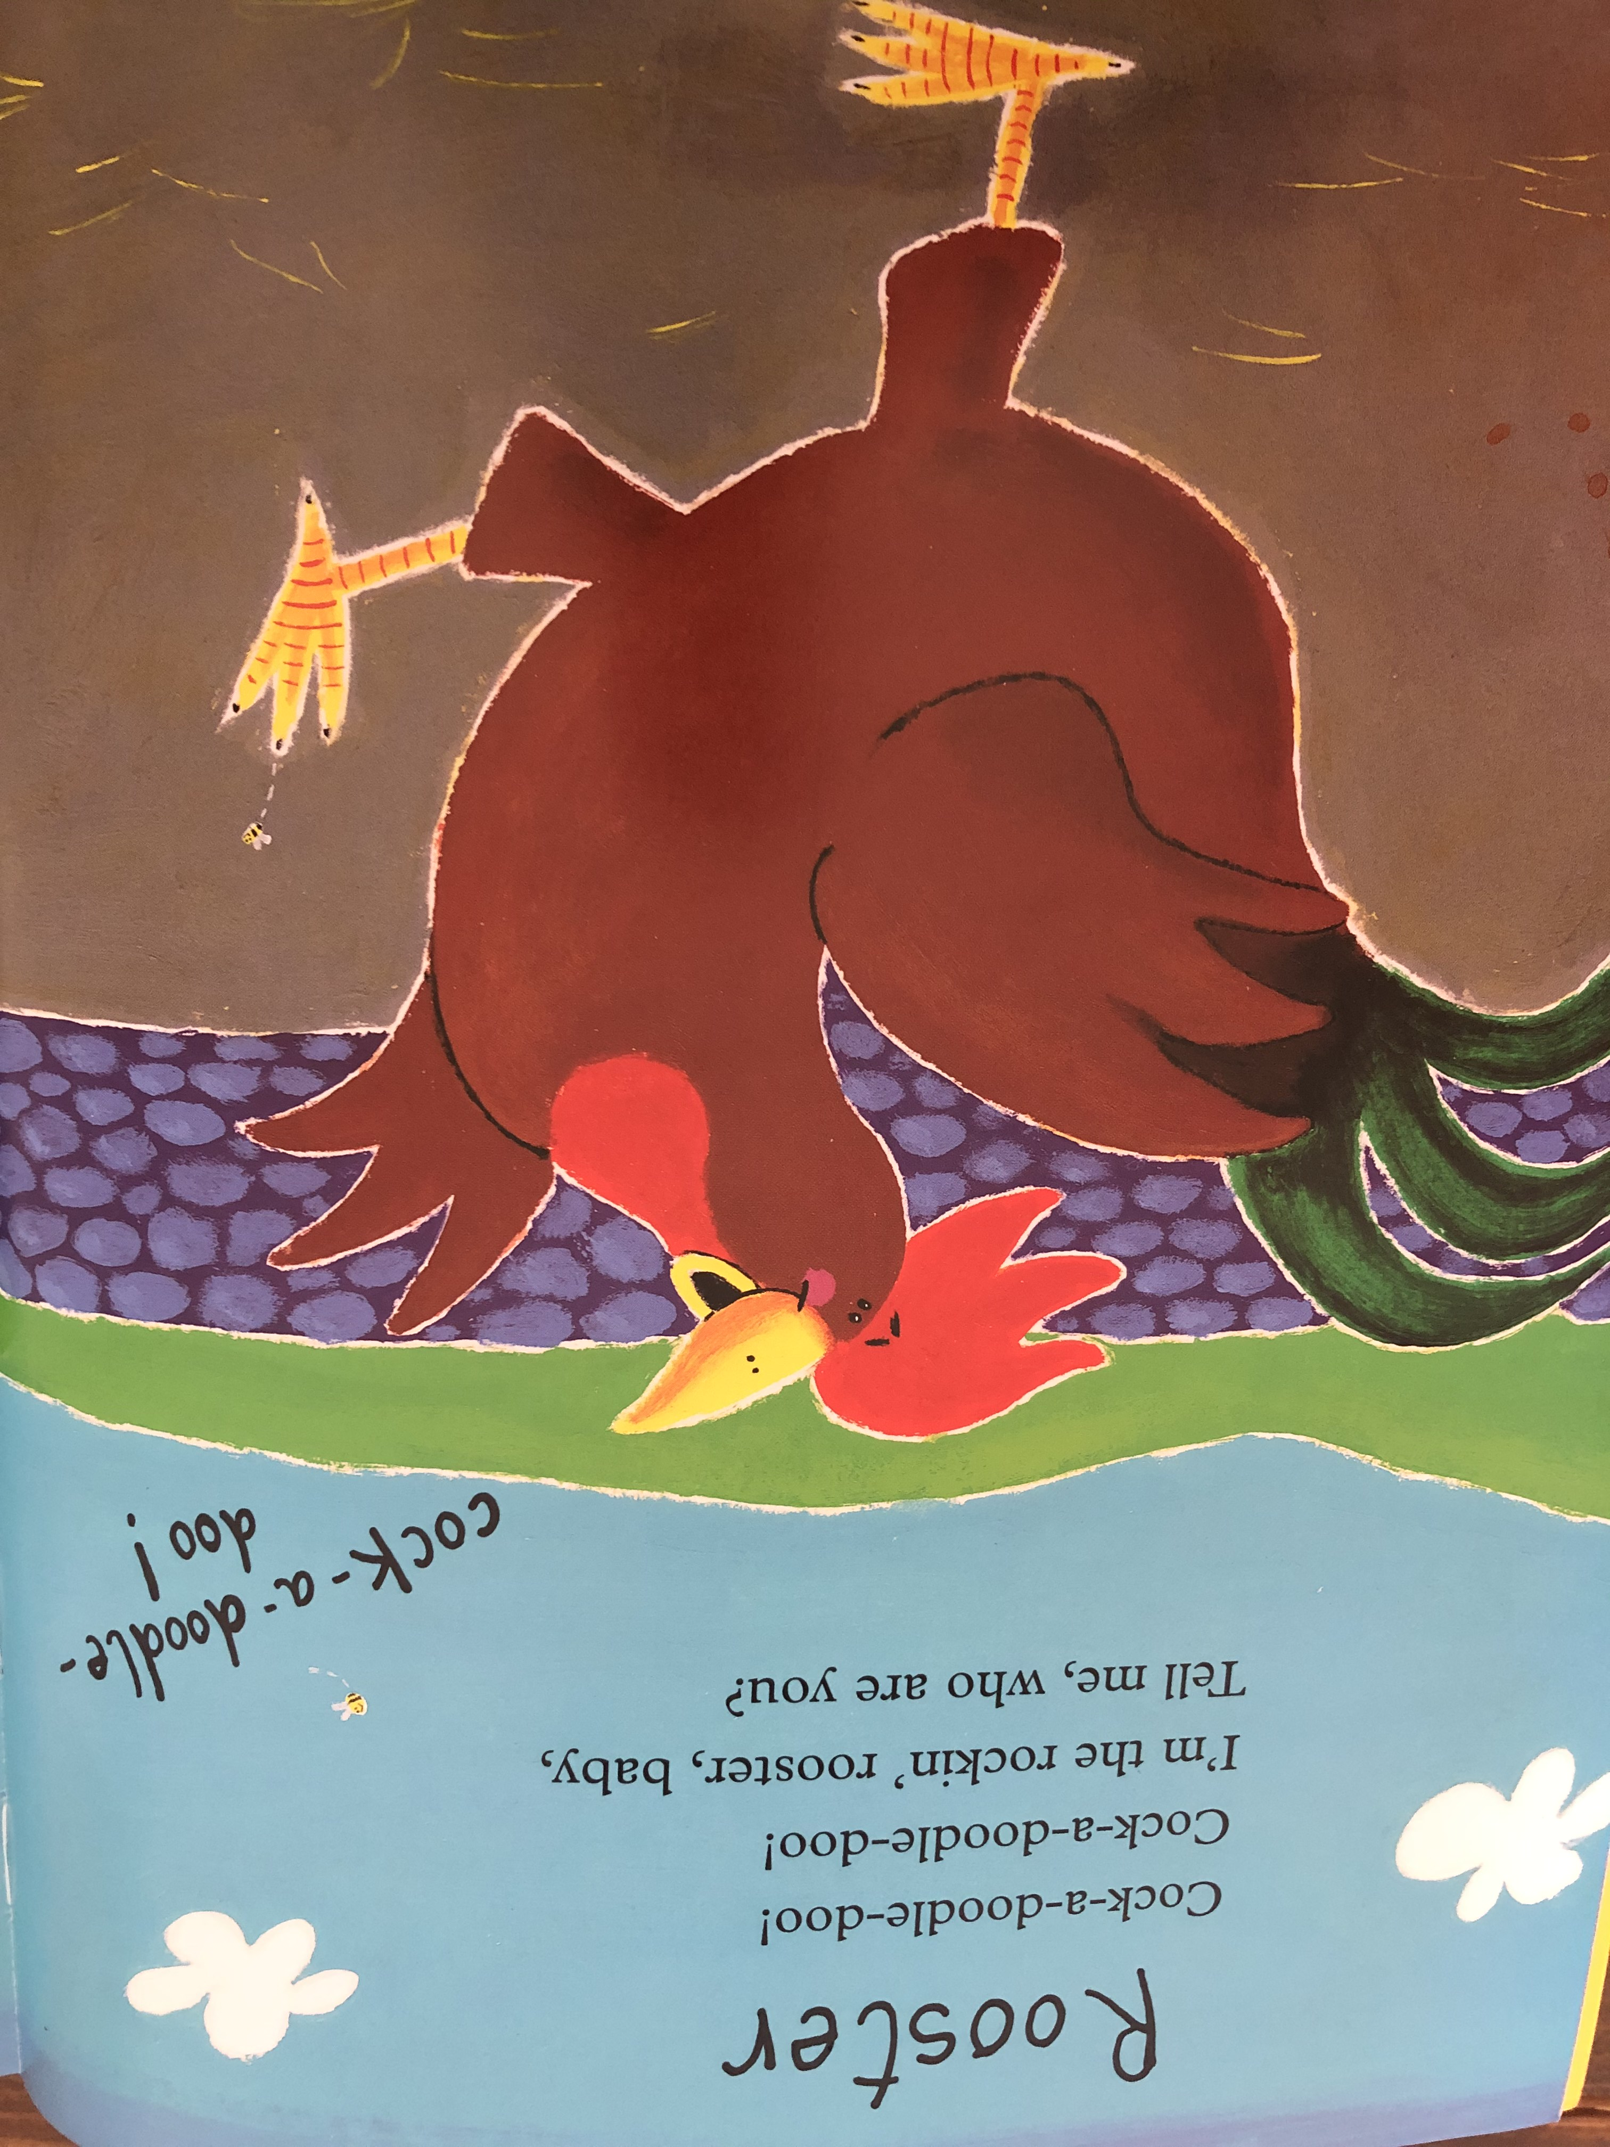

Slide 9
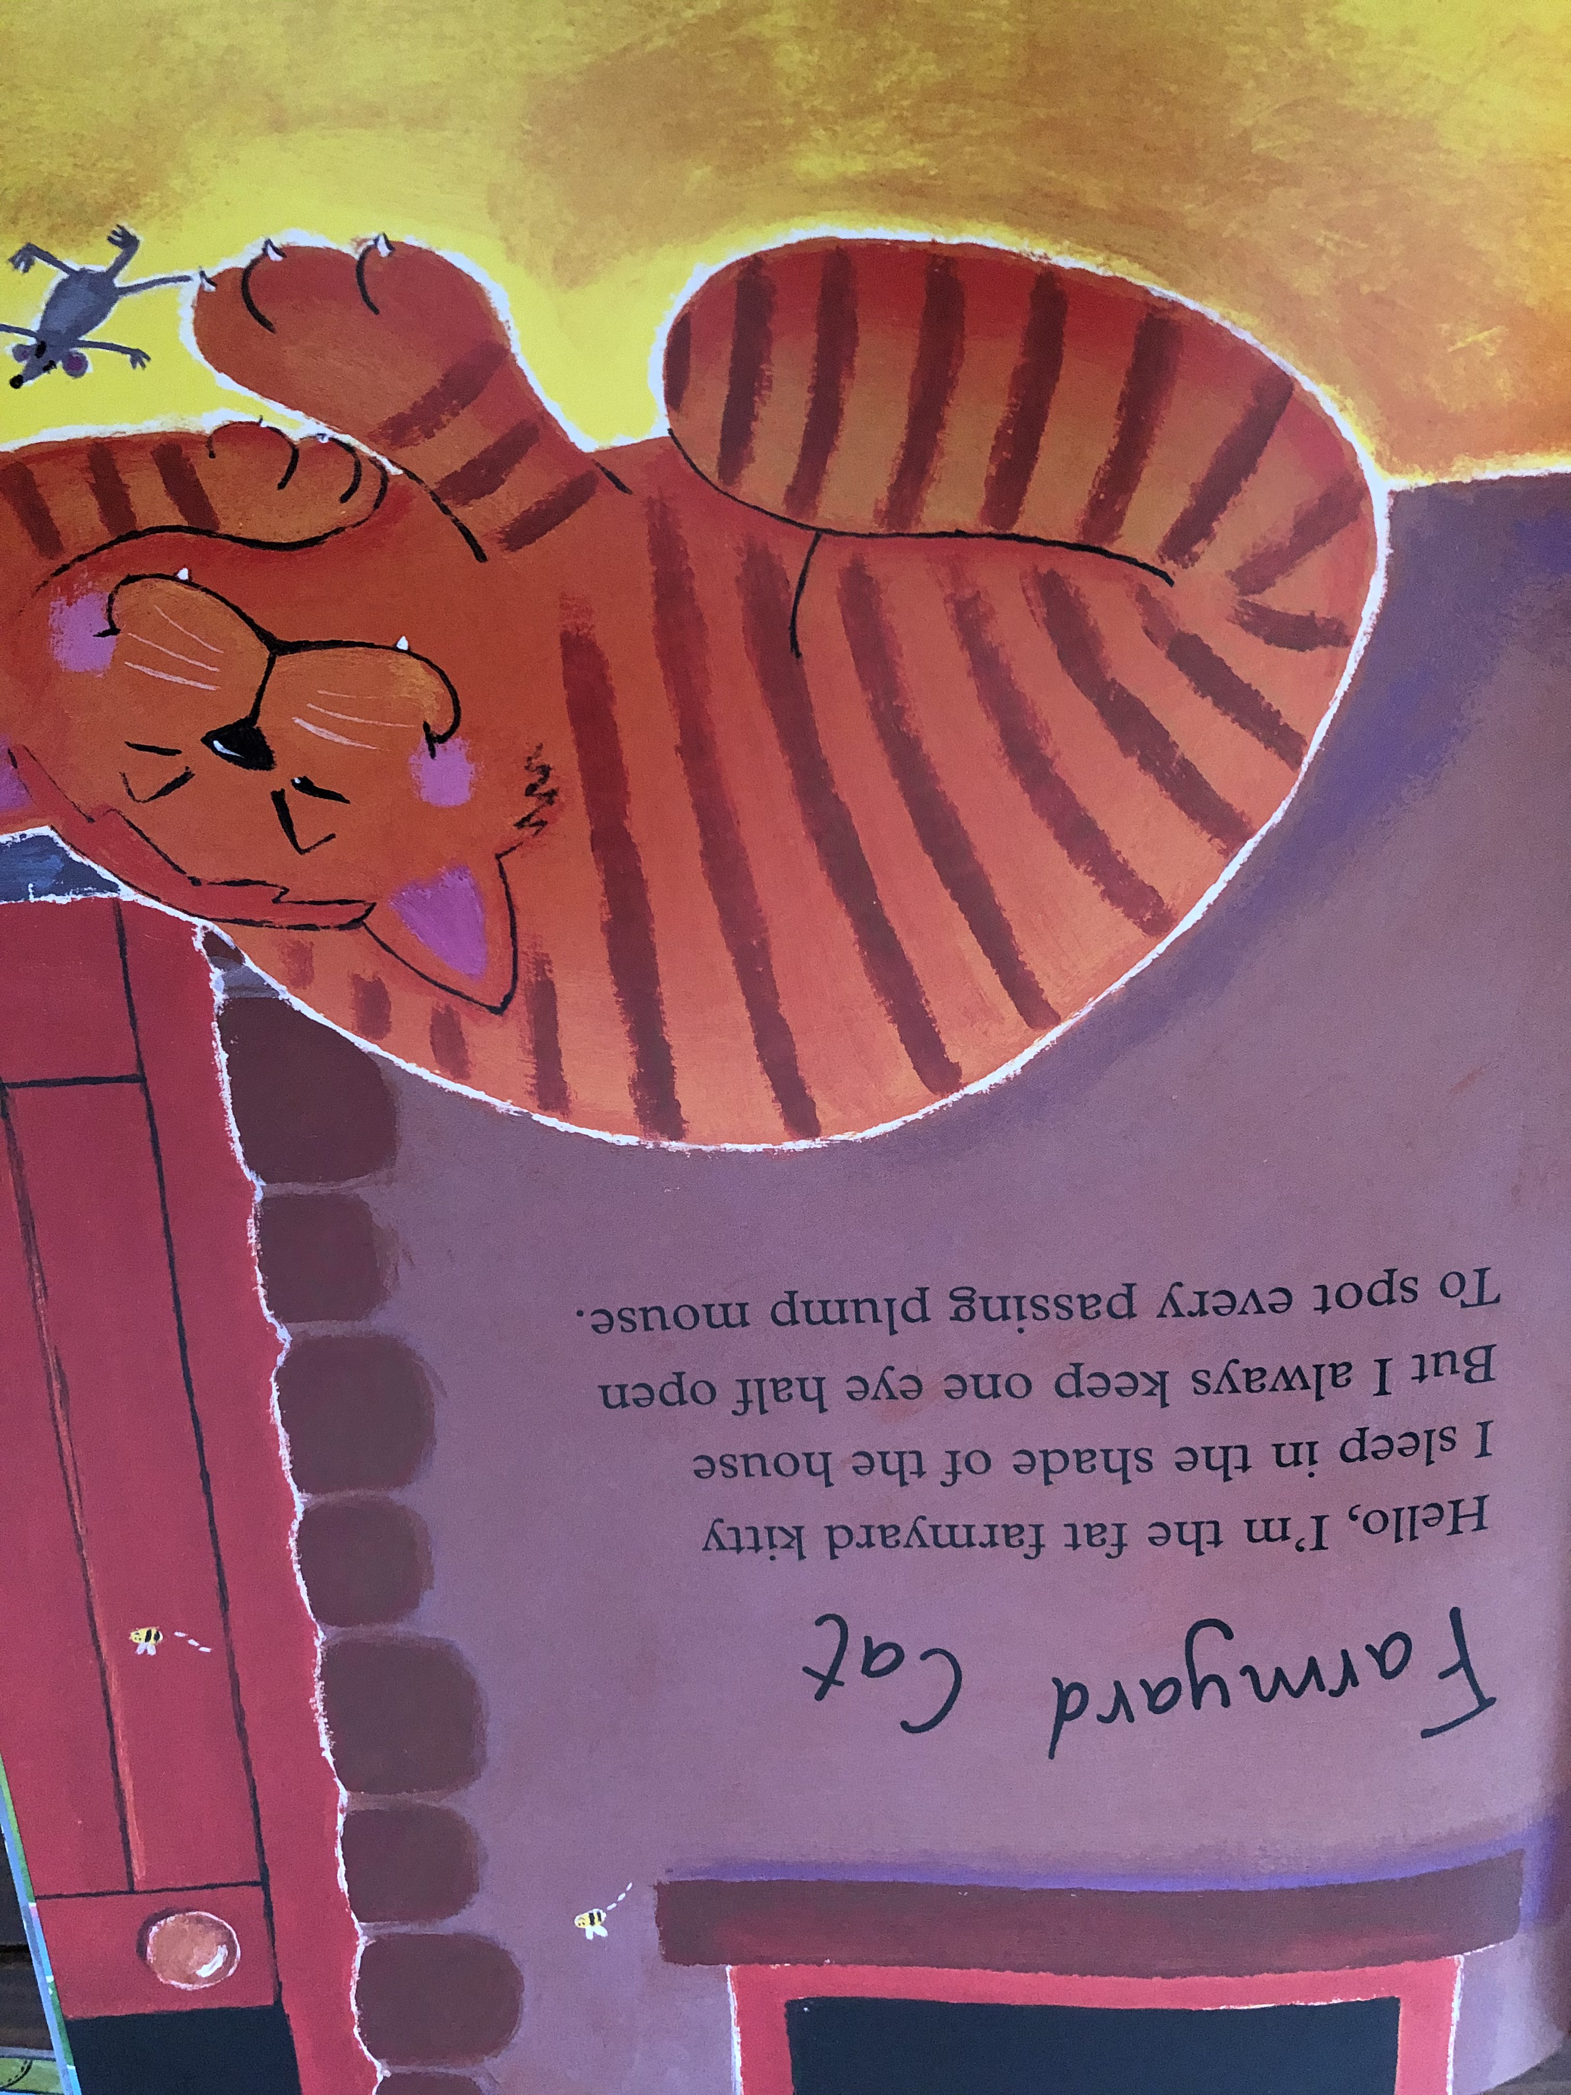

Slide 10
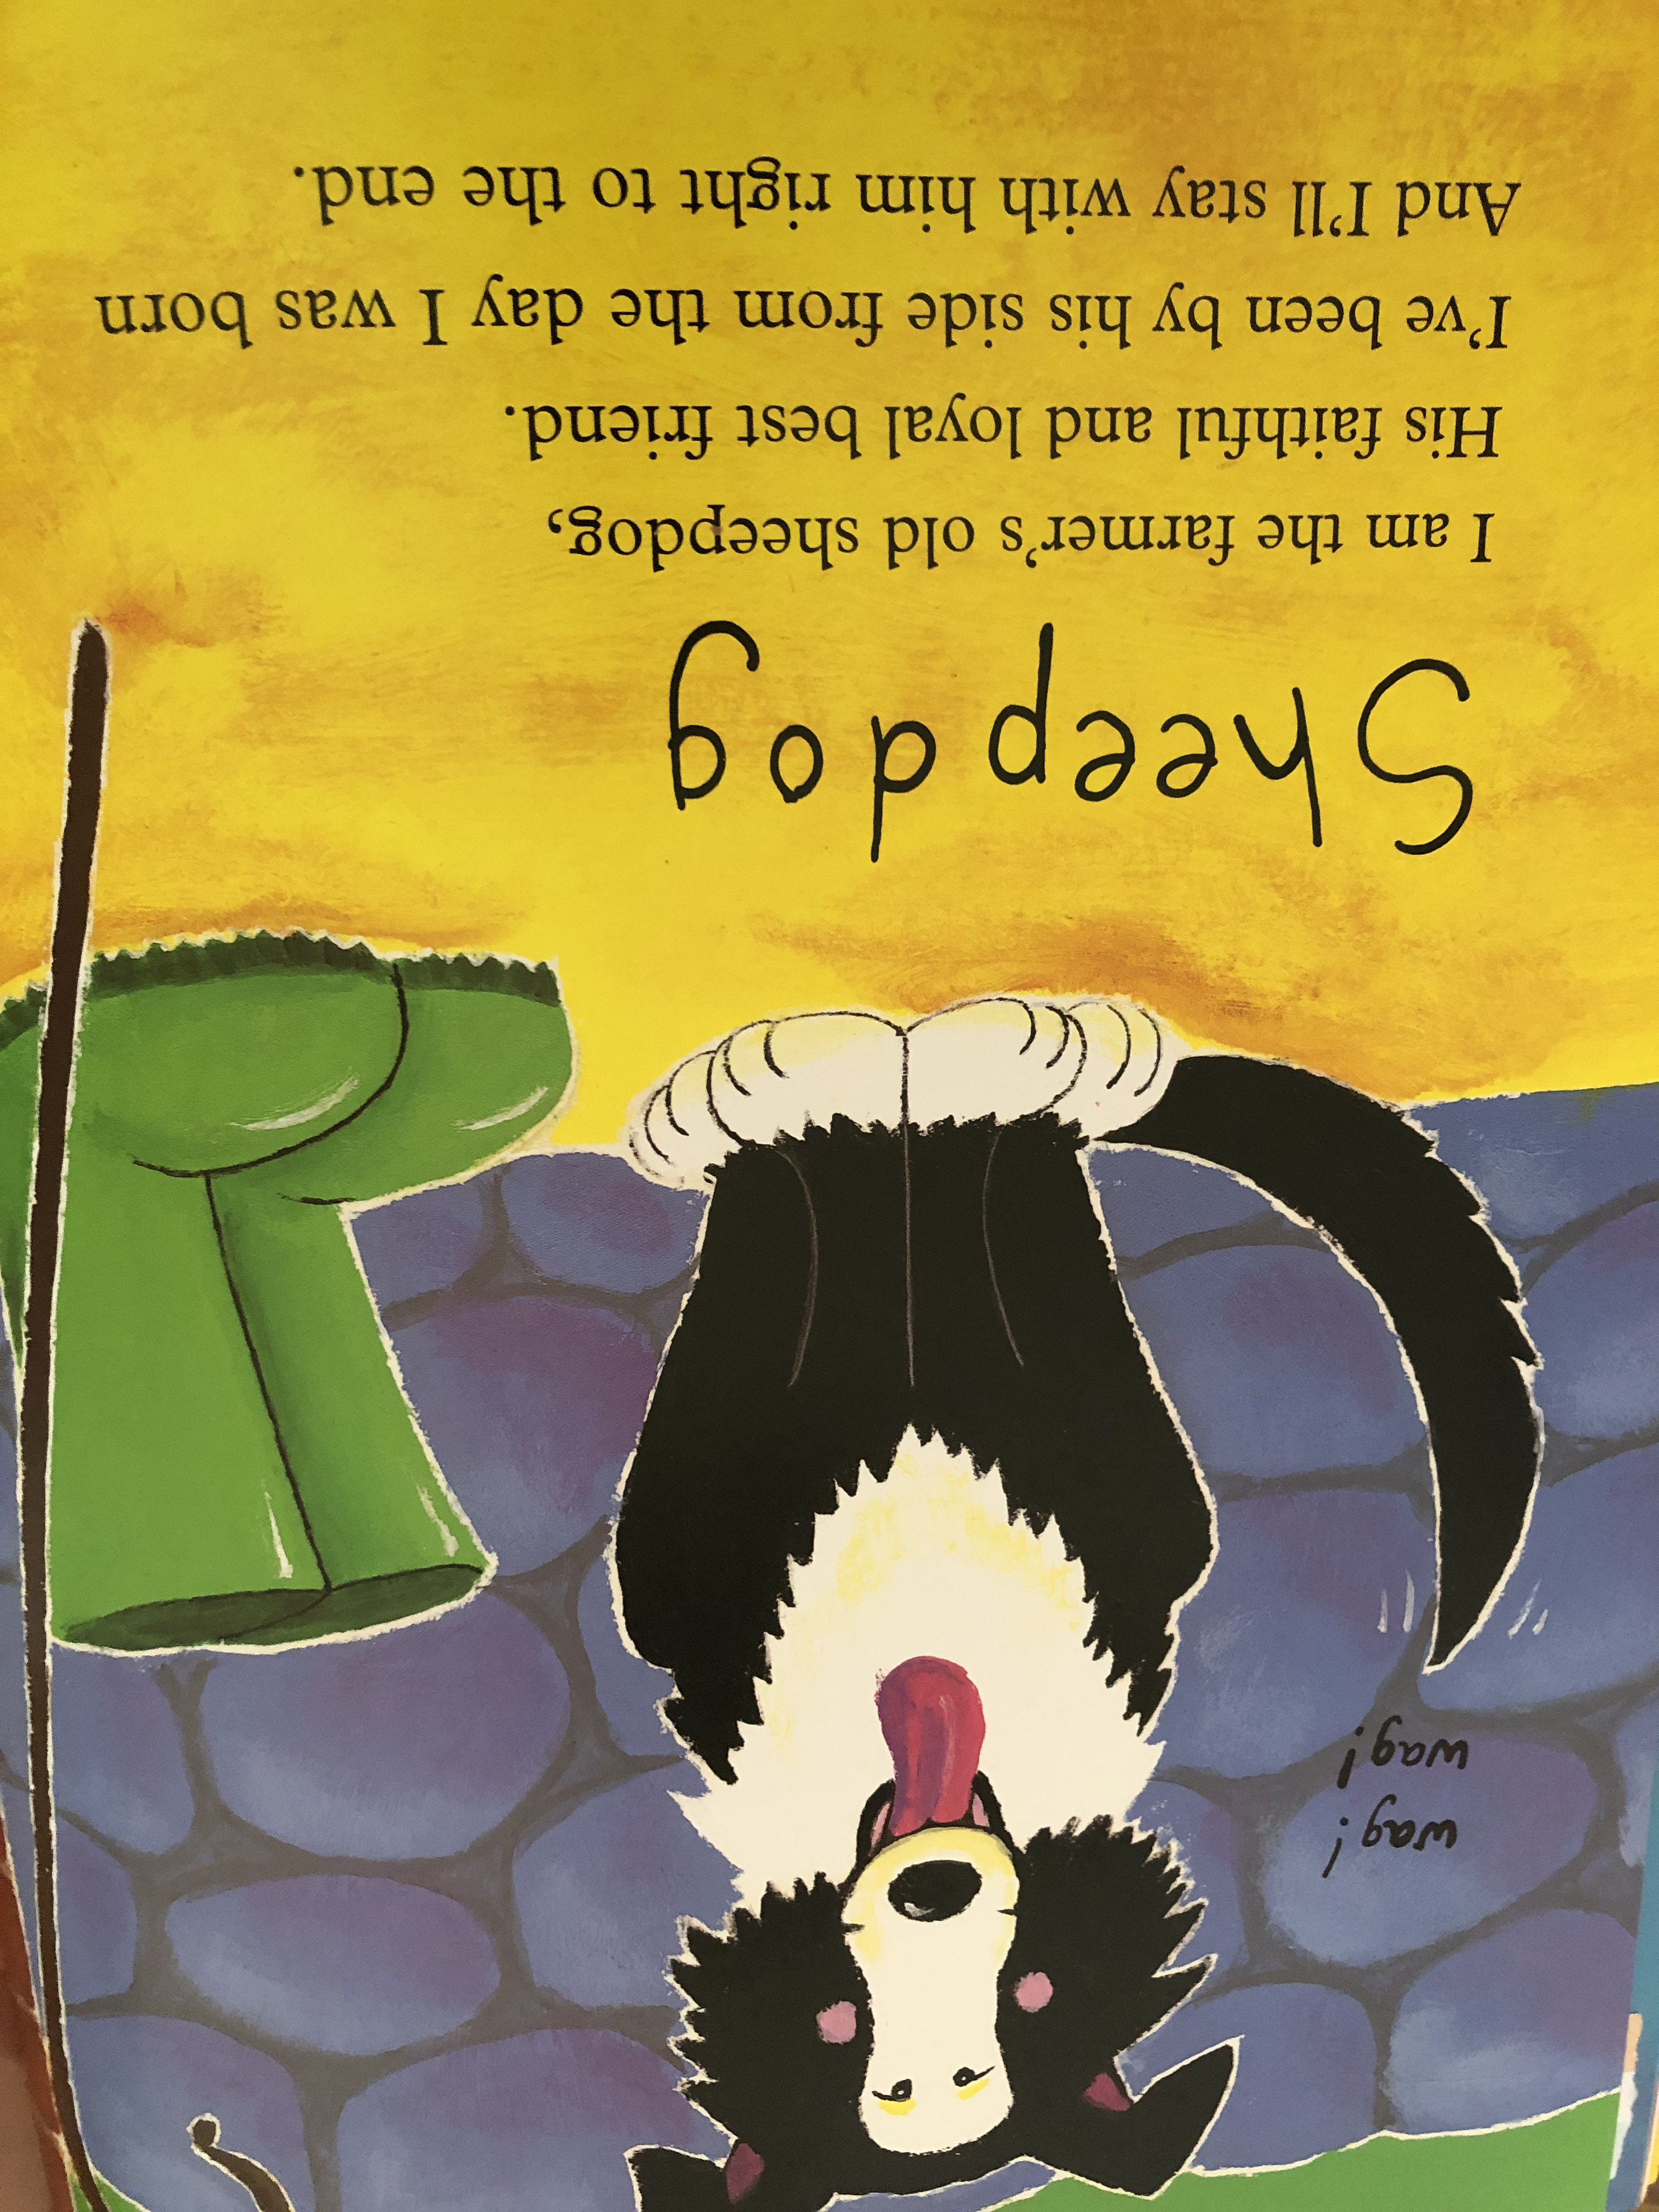

Slide 11
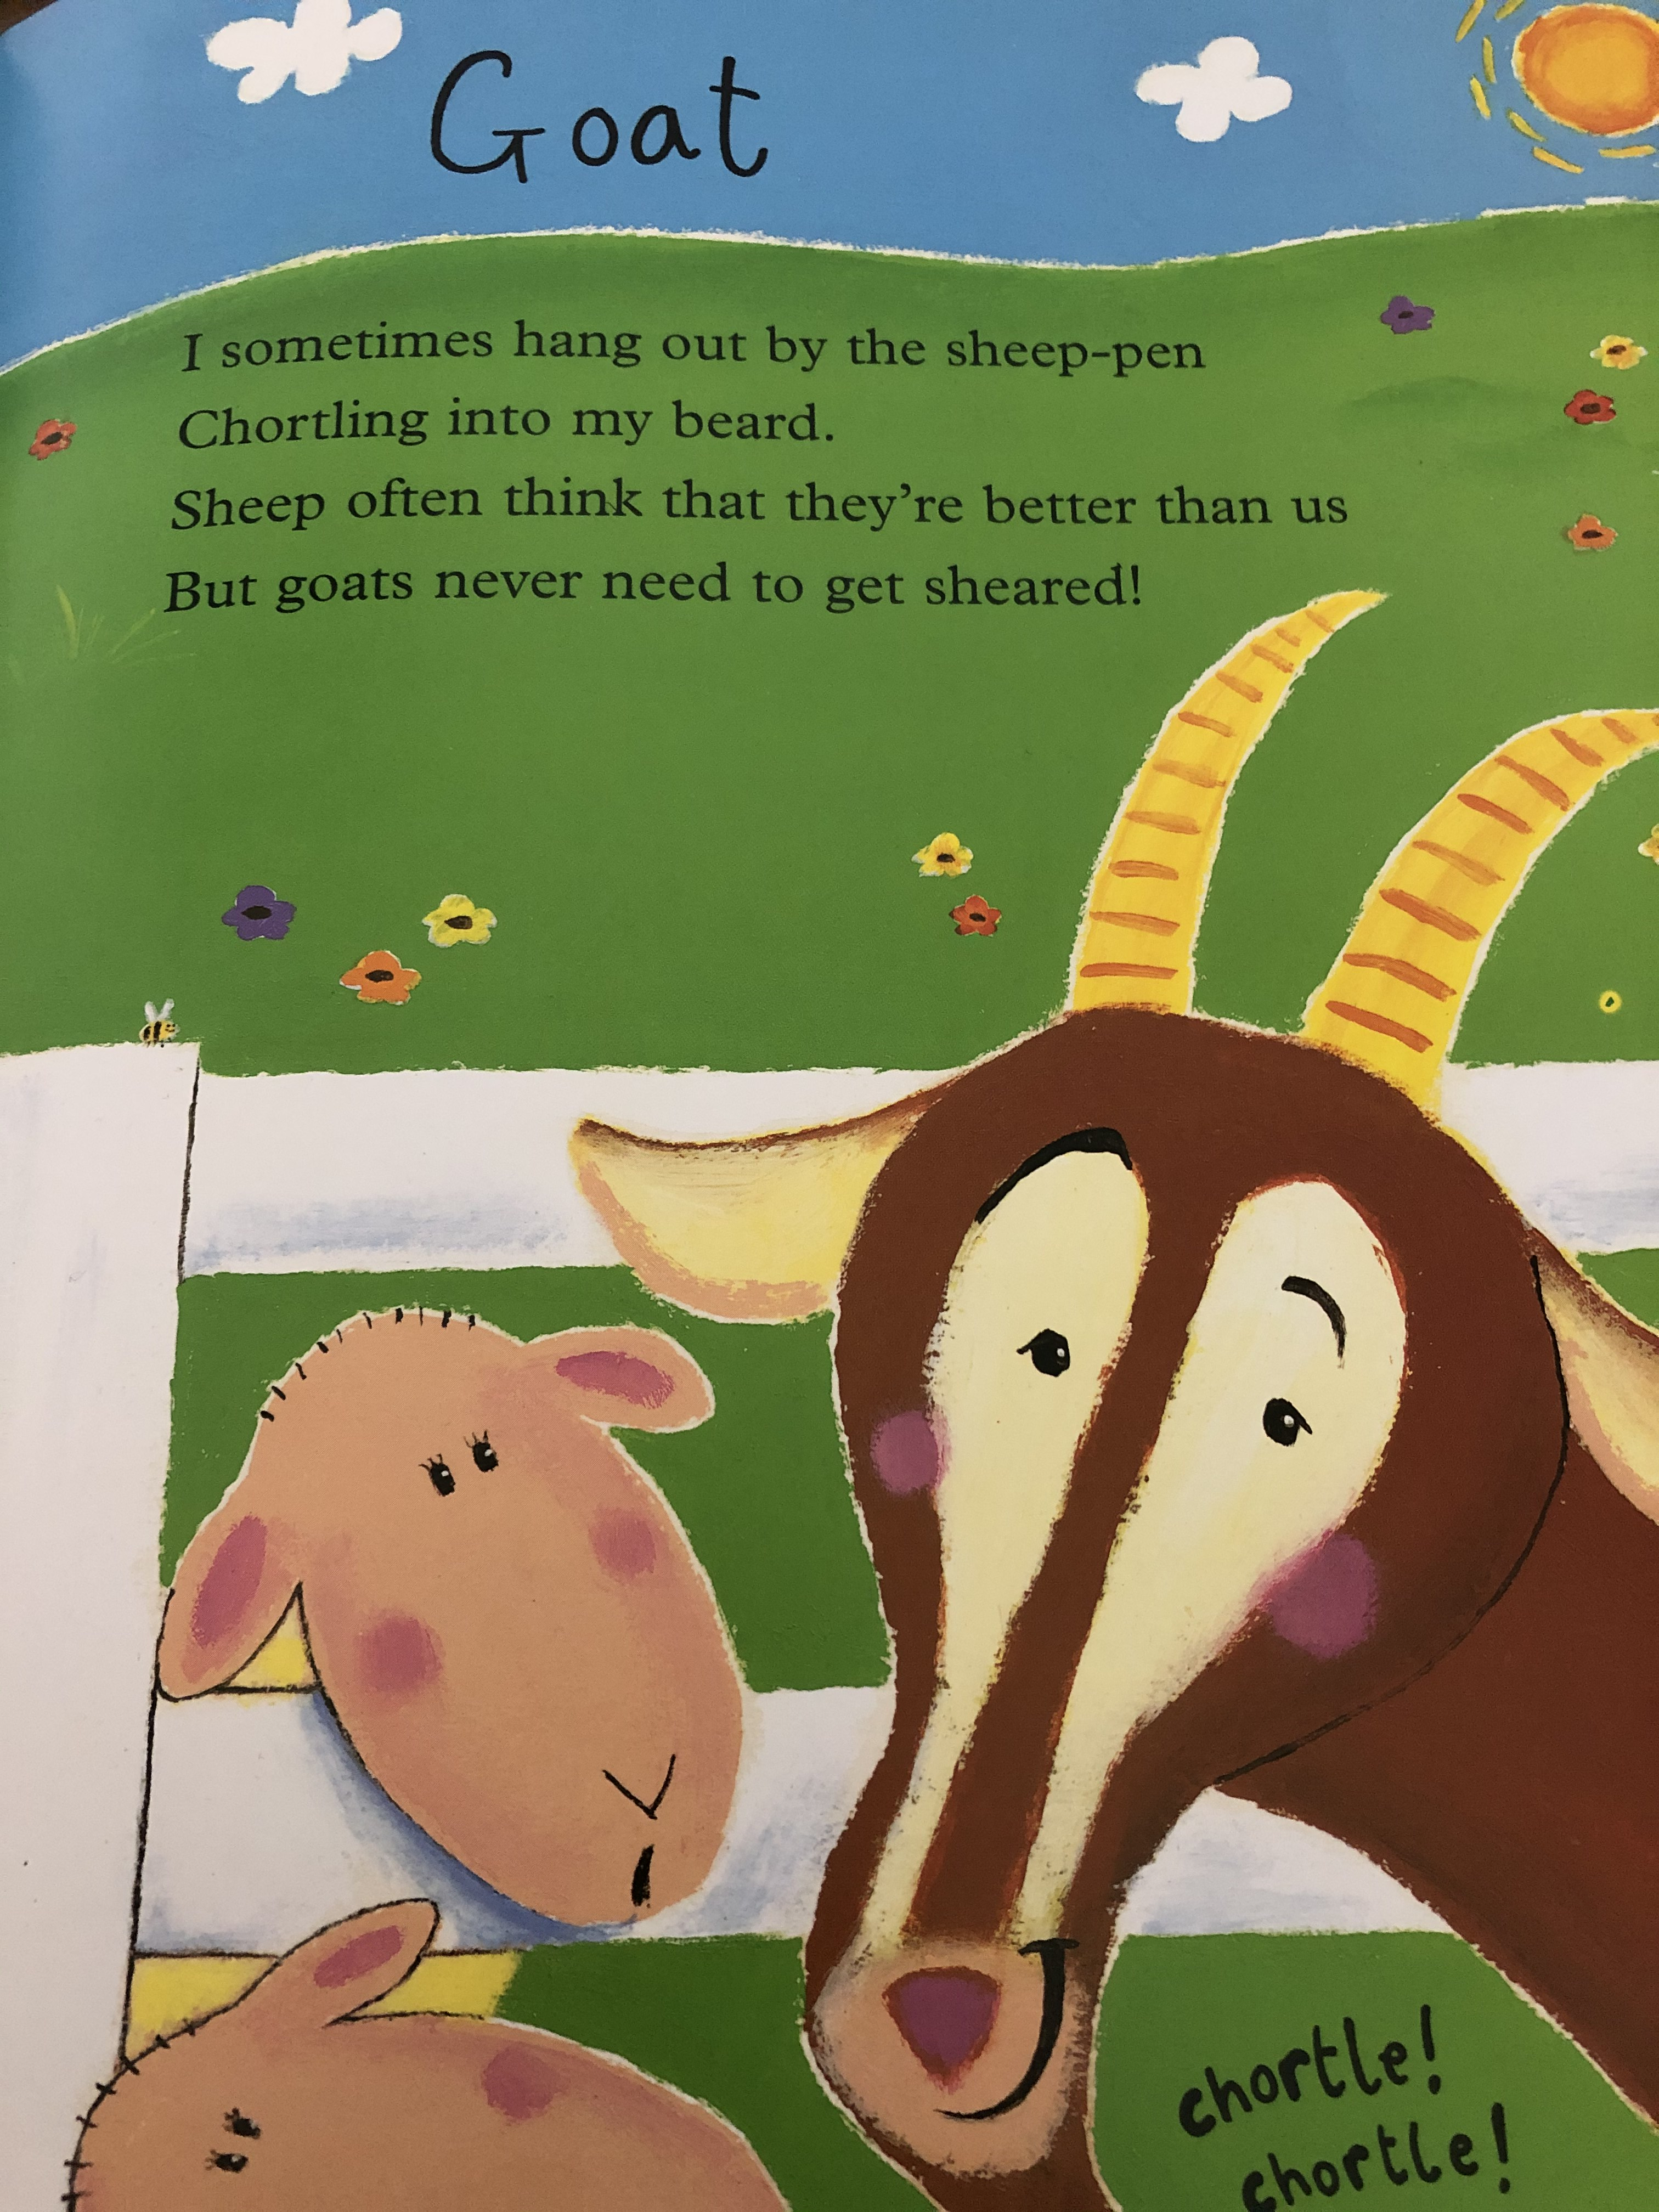

Slide 12
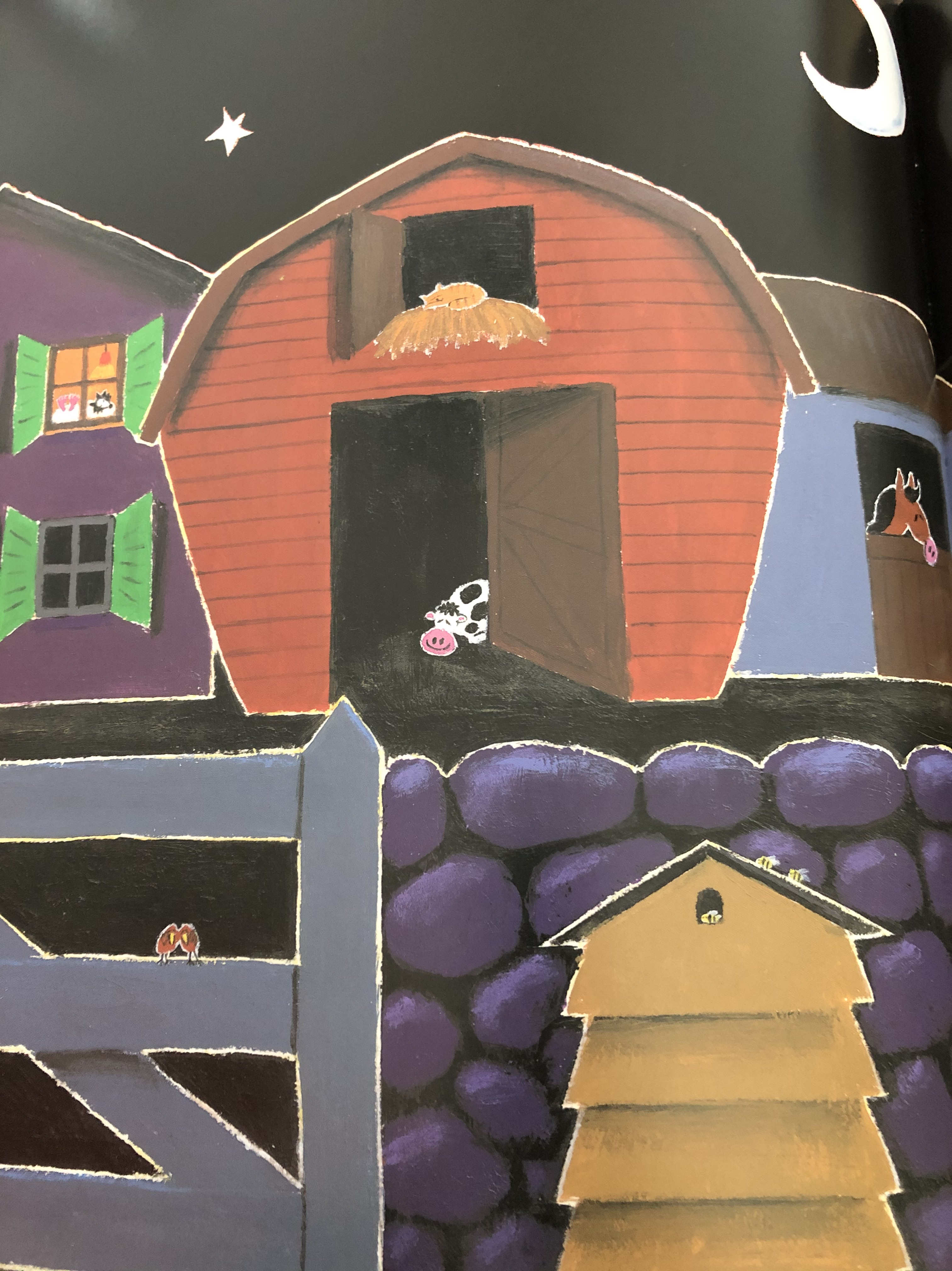
Now it’s night time on the farmyard
And the moon is shining bright,
It’s time to leave the animals
And wave them all goodnight.
The cows are feeling drowsy
So they settle on the ground,
It won’t be very long now
Till they’re sleeping safe and sound.
The horse is in his stable
And the hens are in their shed
But the sheepdog’s fallen fast asleep
Inside the farmer’s bed!

