Slide 1
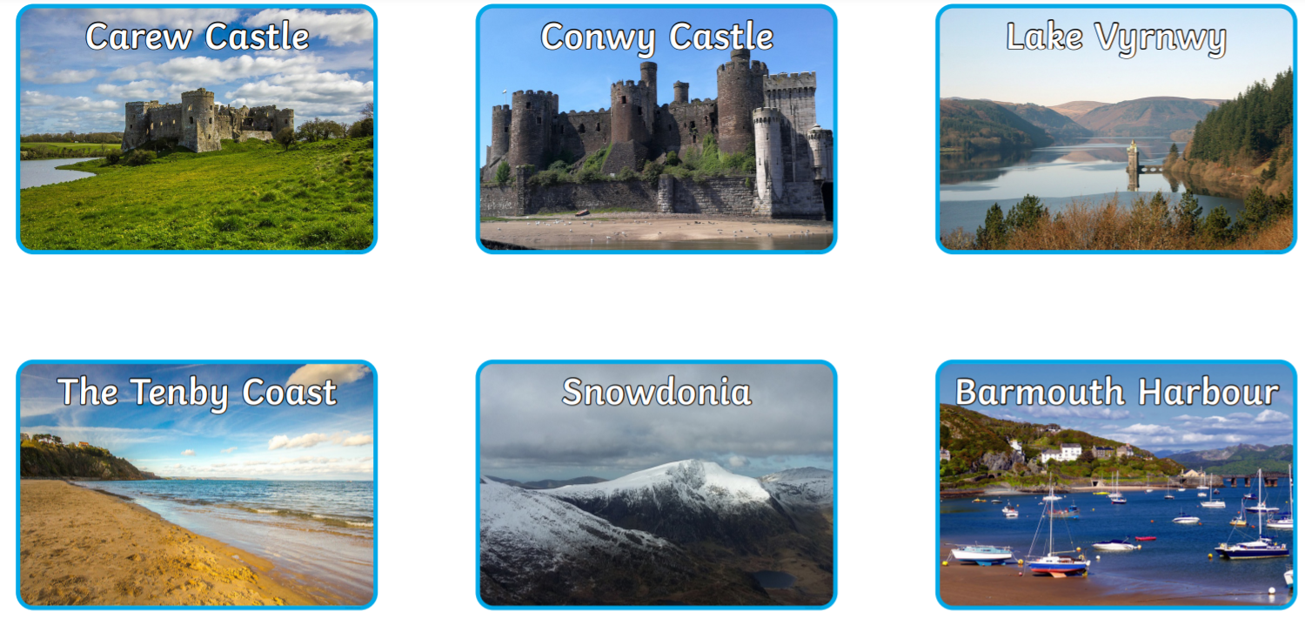
Can you match the different Welsh landmarks?

Slide 2
Can you match the different Welsh landmarks?

