Slide 1

Felix Akulw

Slide 2
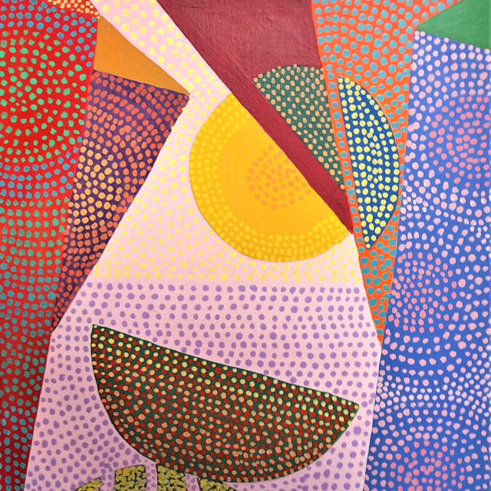

Slide 3
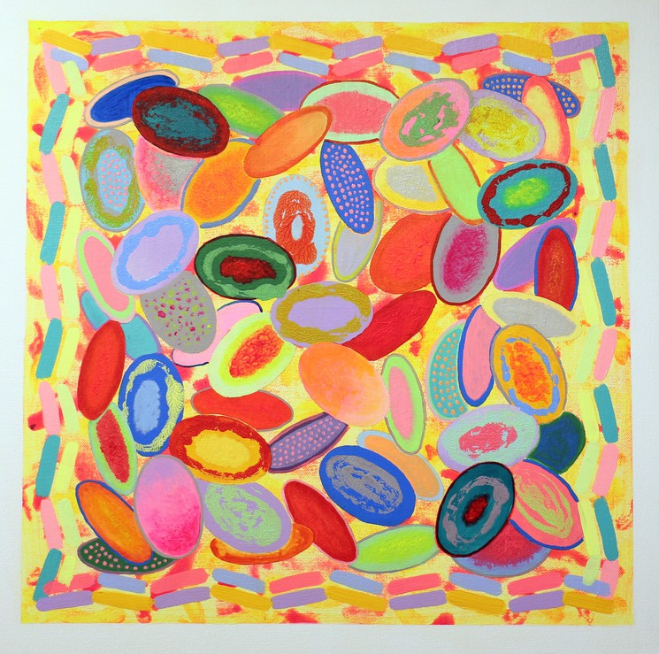

Slide 4
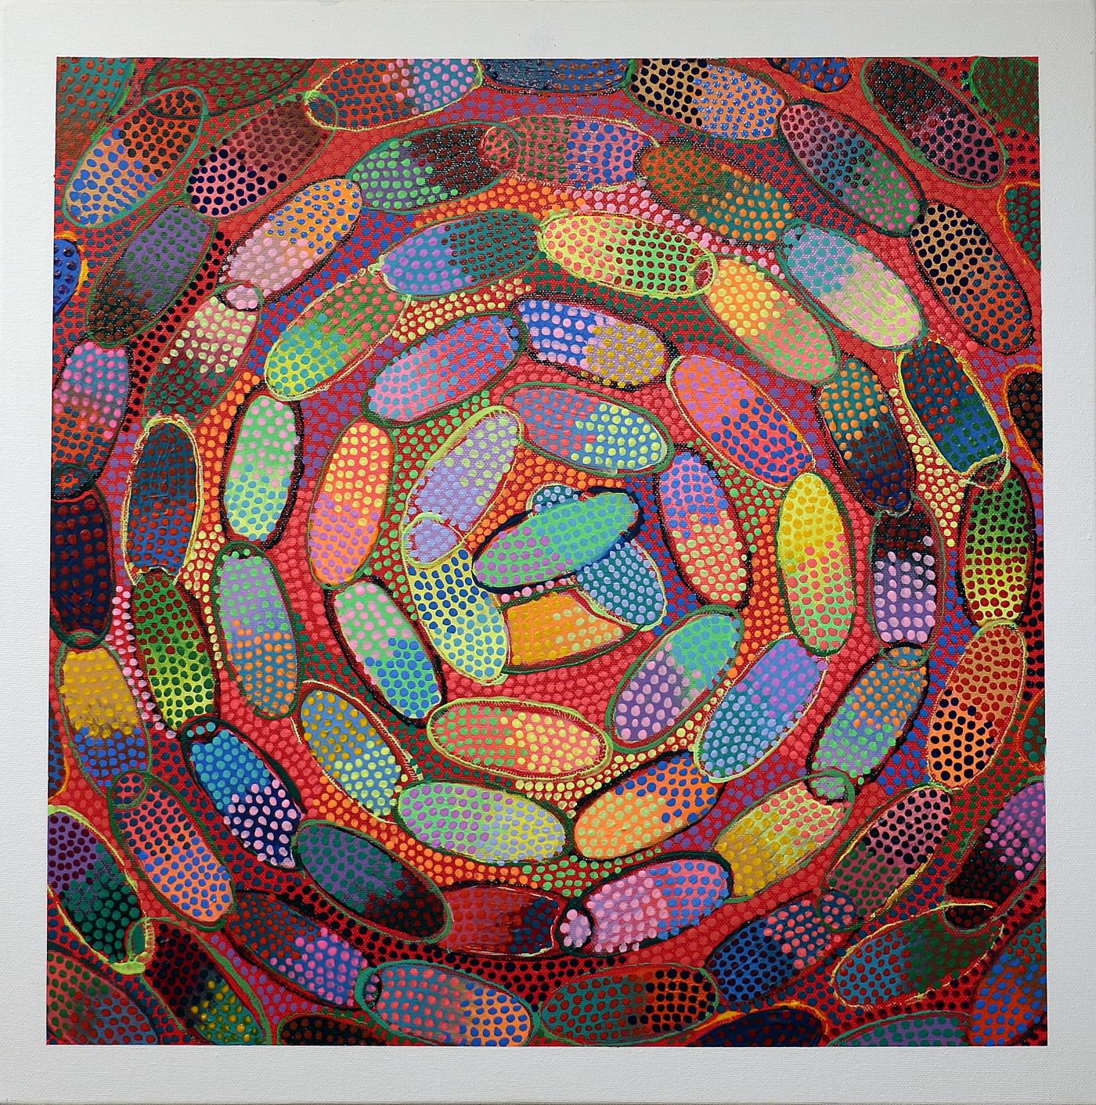

Slide 5
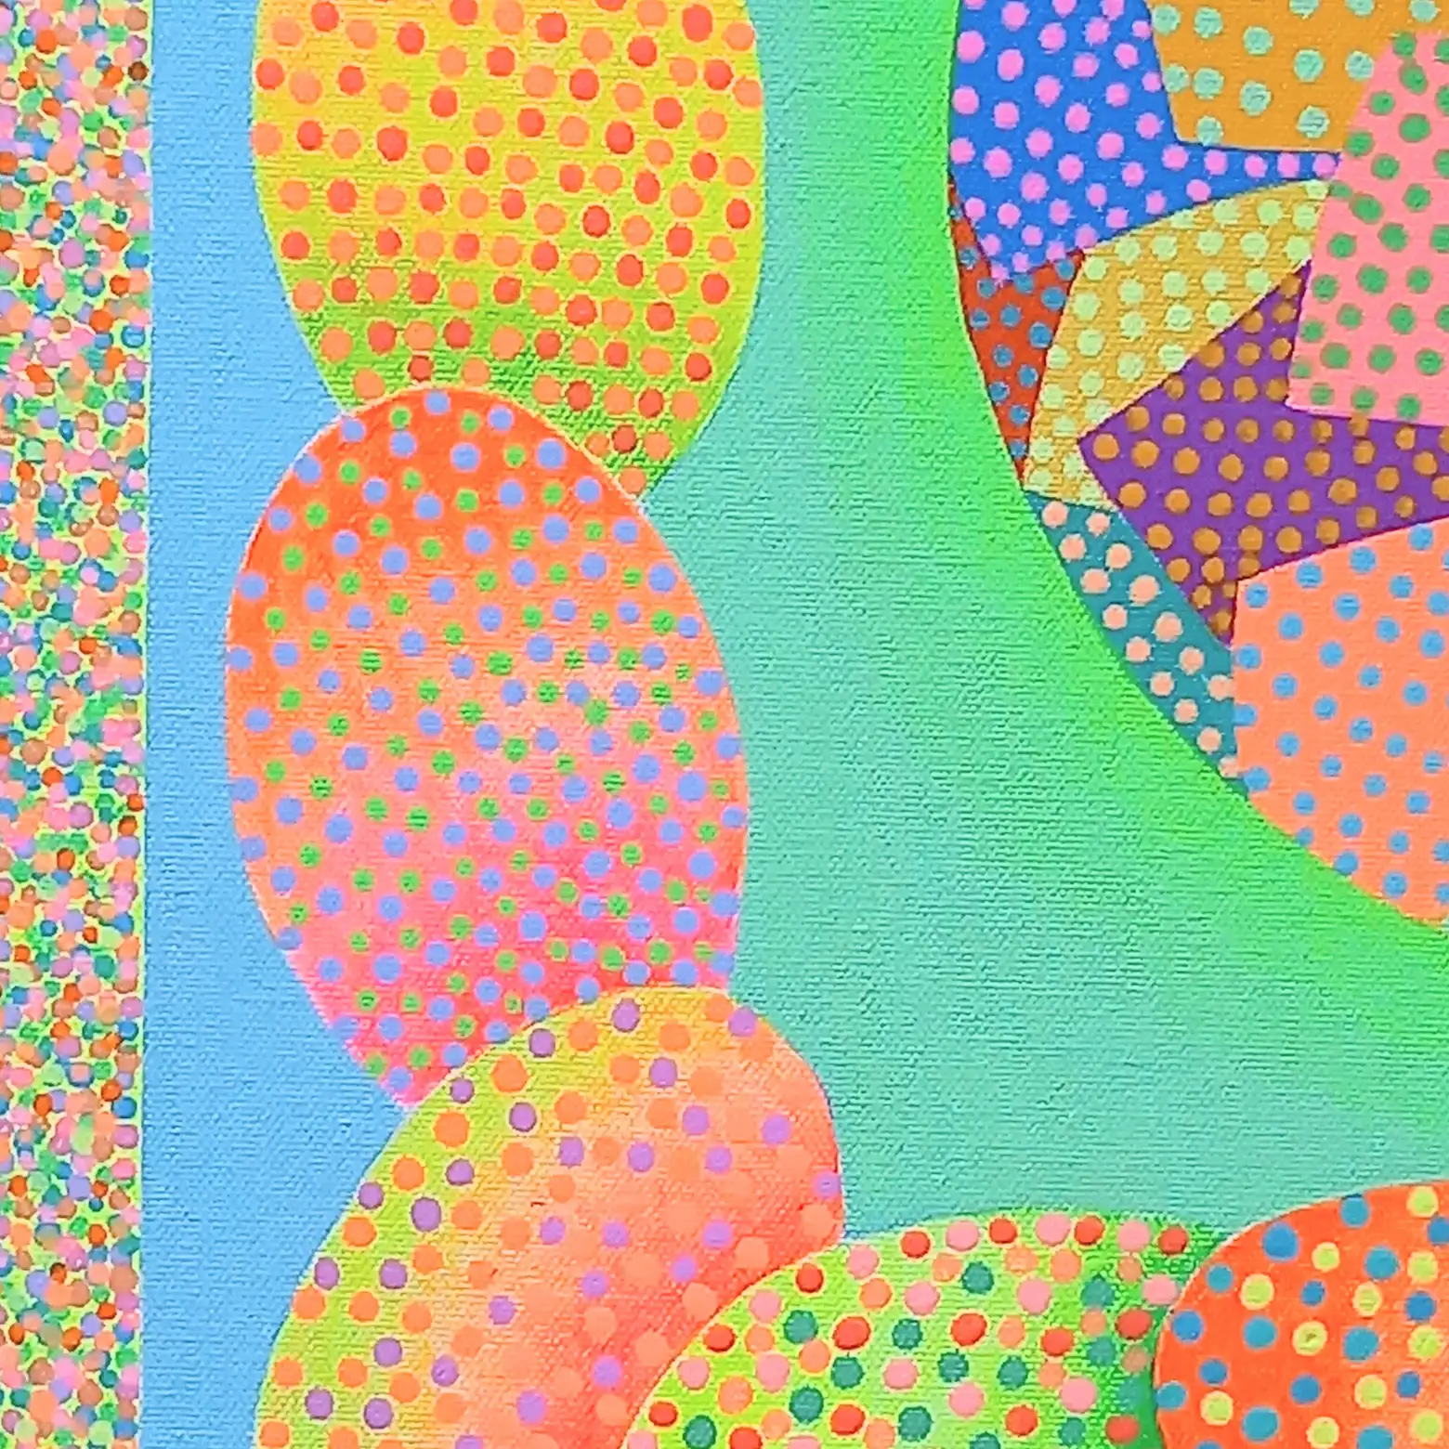

Slide 6
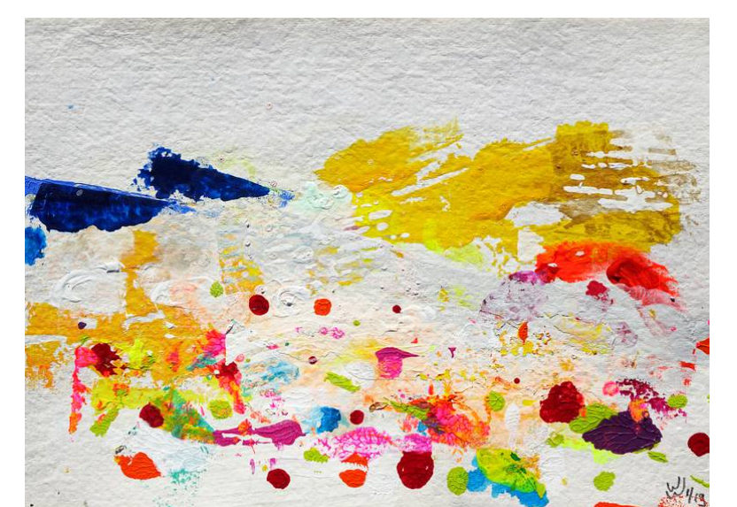
Music to paint you dots to:
https://www.youtube.com/watch?v=MLFvb0GfZ5Q&ab_channel=BackgroundMusicForVideos%2FBlanketBarricade%28indierockband%26funupbeatinstrumentalmusic%29

Slide 7
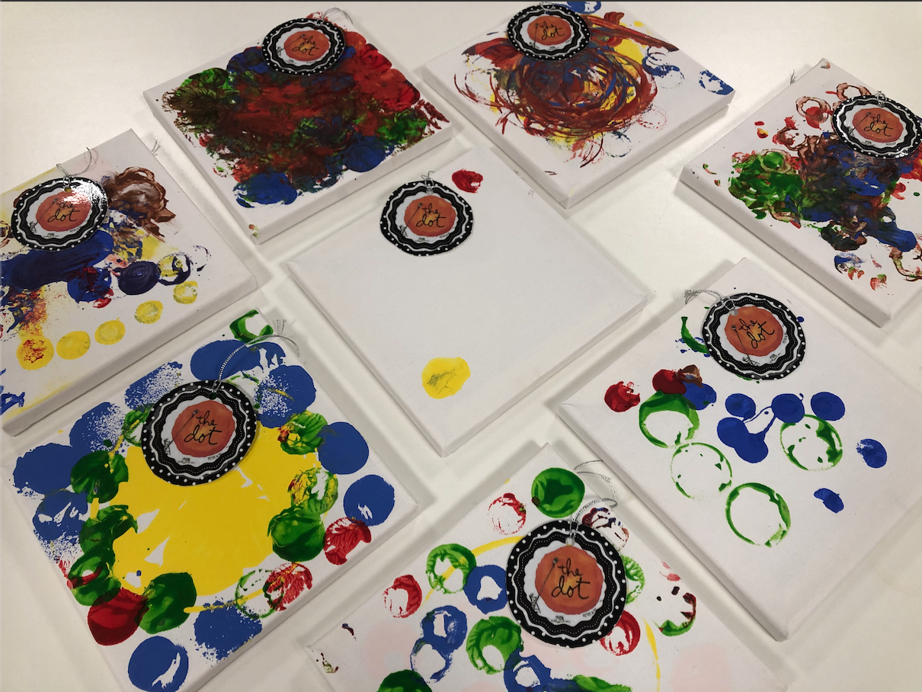
Dosbarth Lleuad examples

Slide 8
See a story about Dots here!
https://www.youtube.com/watch?v=TMowDLXx0MA&ab_channel=TyGwynSchool

