Slide 1
Numeracy activities
To do at home

Slide 2
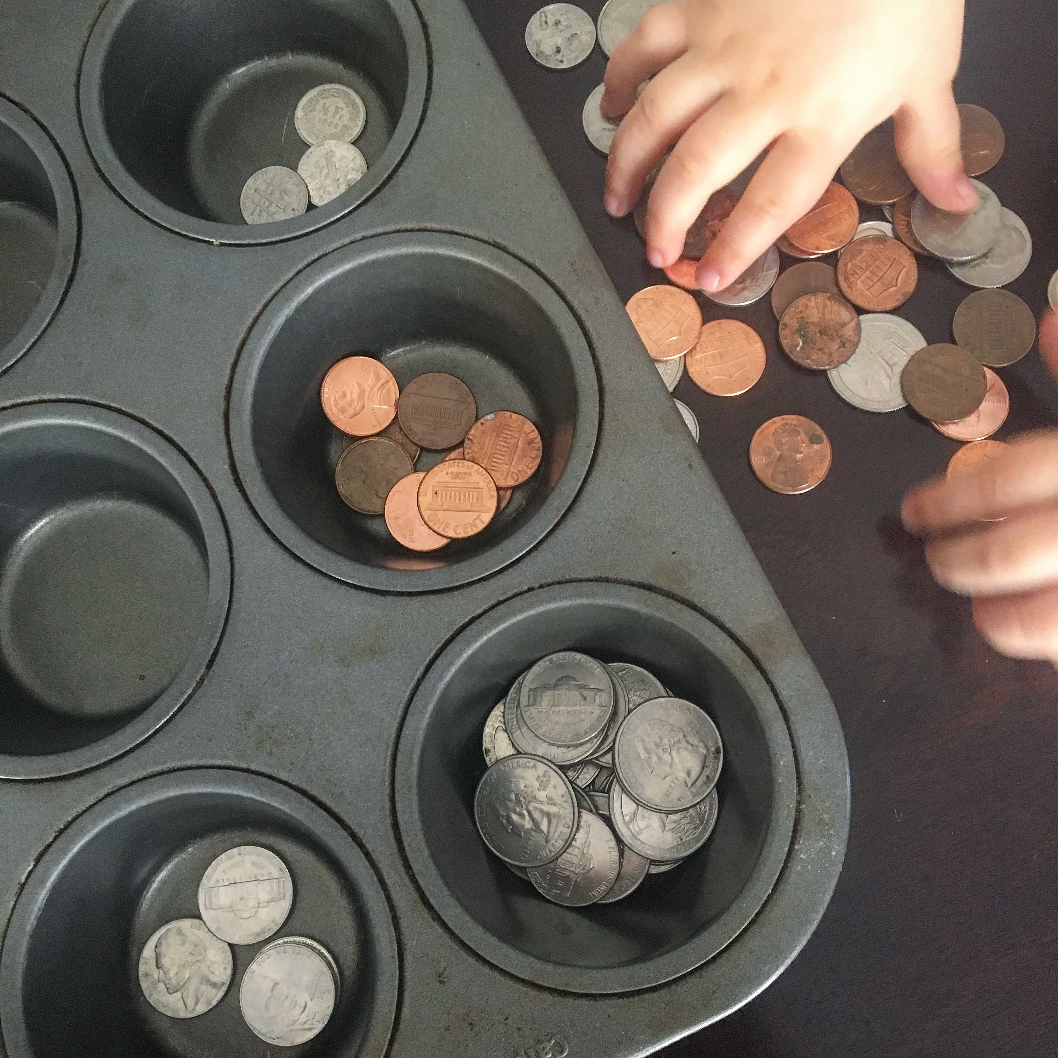
Coin sorting
You will need
Cupcake tray
Mixture of coins real, plastic or paper
Activity – Sort the coins into the different sections putting all the same coins in the same sections.

Slide 3
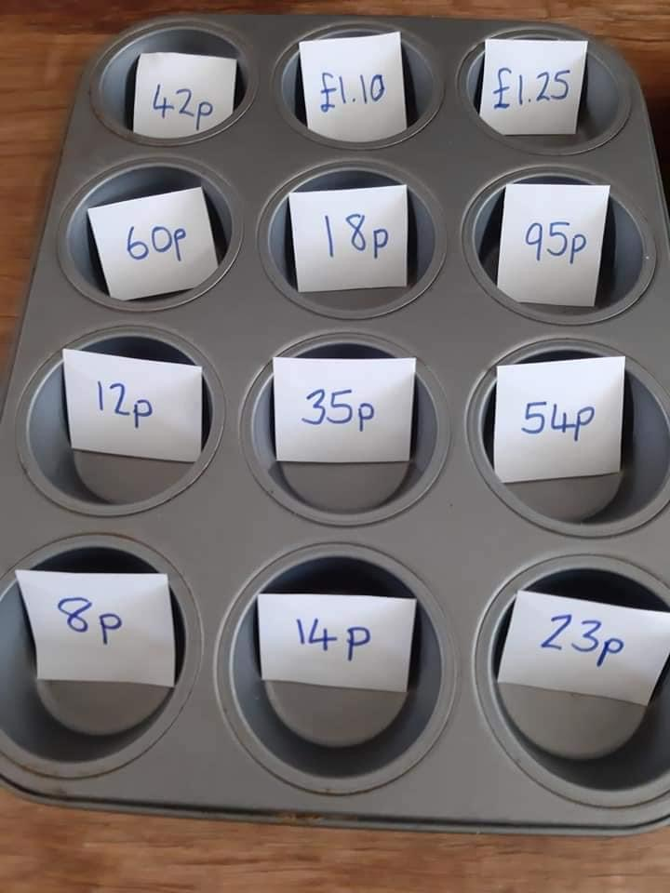
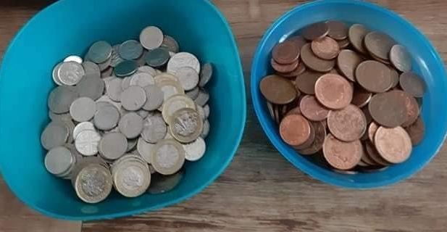
Can you make……with coins
you will need
Cupcake tray
Paper with different values on
A mixture of coins
Activity – Using the coins make up the amounts in the tray.

Slide 4
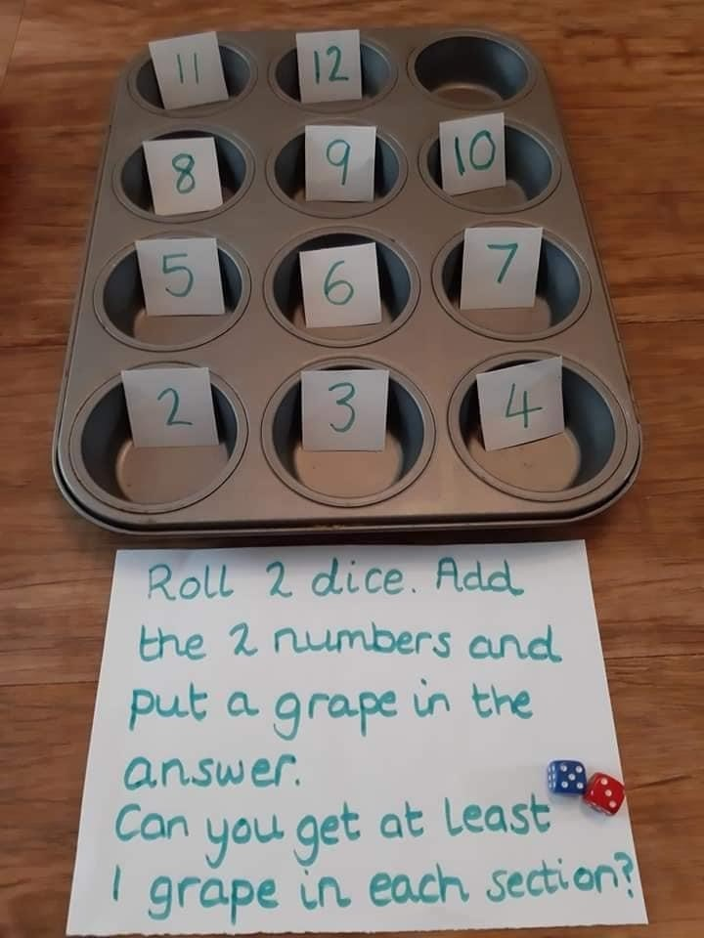
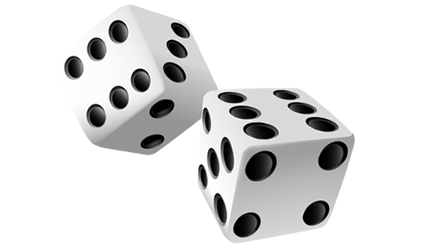
Dice game 1
You will need
Cupcake tin
Number bits of paper 2-12
2 dice
Activity – Roll the dice and add the totals up as you match the numbers on the paper put them down. try to put them all down.

