Slide 1
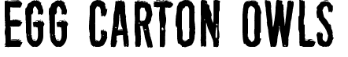
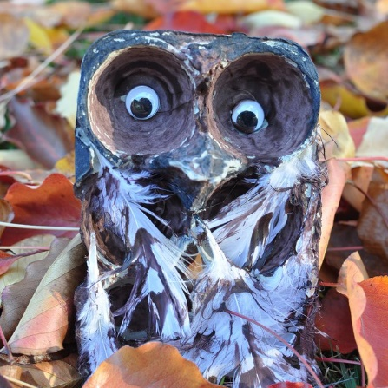
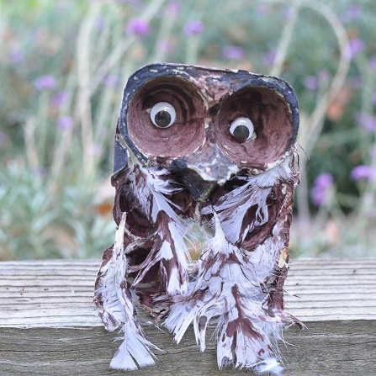
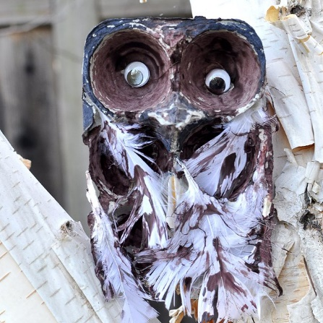
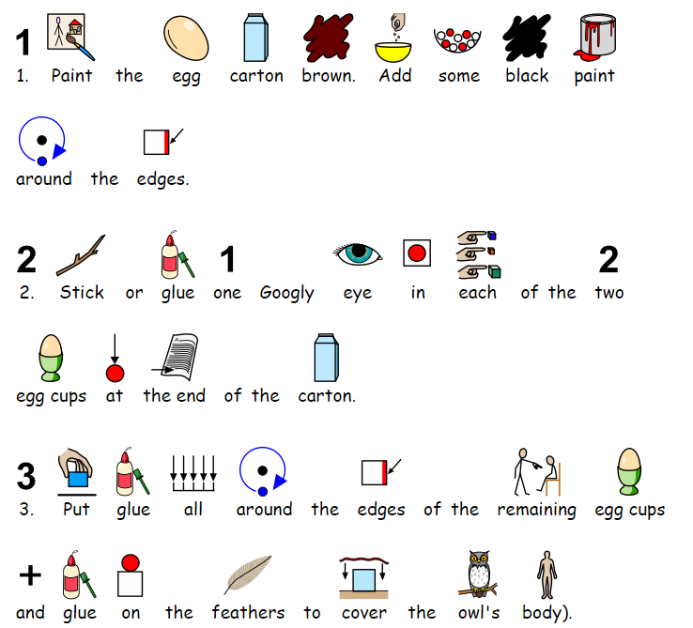

Slide 2
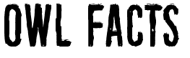
There are around 200 different owl species.
Owls are active at night (nocturnal).
A group of owls is called a parliament.
Most owls hunt insects, small mammals and other birds.
Some owl species hunt fish.
Owls have powerful talons (claws) which help them catch and kill prey.
Owls have large eyes and a flat face.
Owls can turn their heads as much as 270 degrees.
Owls are farsighted, meaning they can’t see things close to their eyes clearly.
Owls are very quiet in flight compared to other birds of prey.
The color of owl’s feathers helps them blend into their environment (camouflage).
Barn owls can be recognized by their heart shaped face.

Slide 3
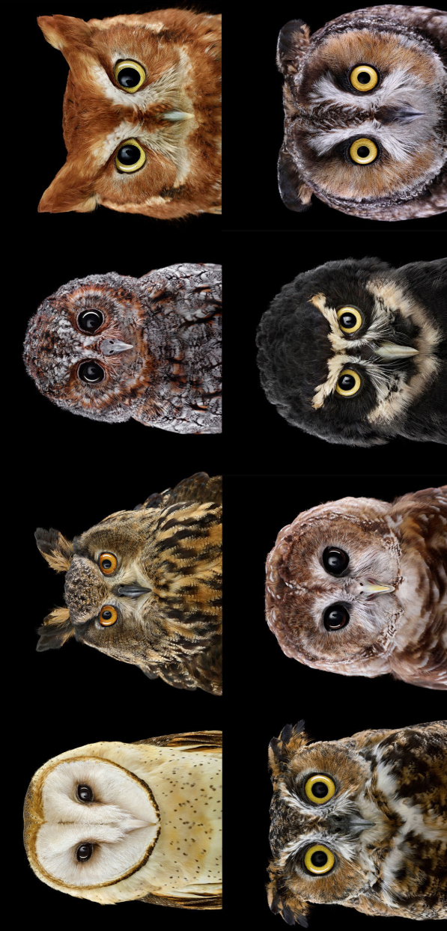

Slide 4
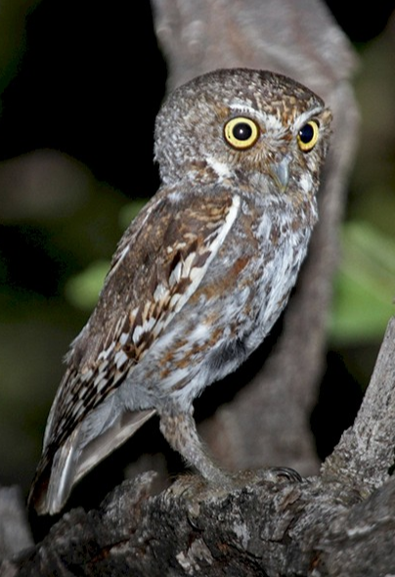

Slide 5
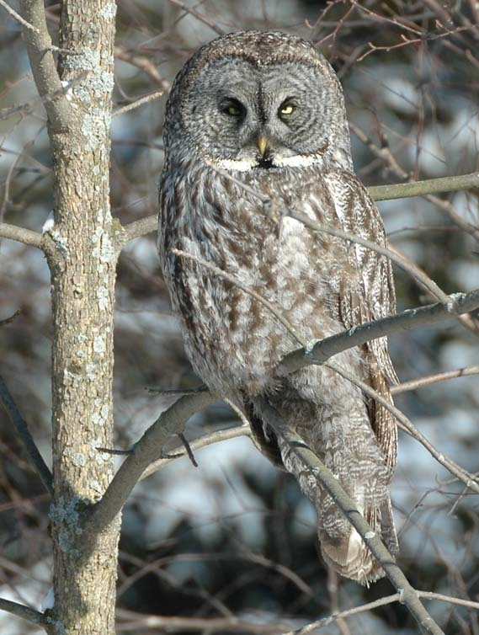

Slide 6

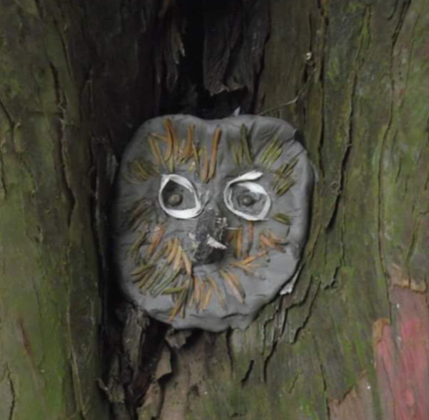


Slide 7



