Slide 1
Sensory Circuits
See separate information sheet for the purpose of sensory circuits. Follow through the powerpoint with your child, encouraging them to take part in each stage. The music links are on the bottom of each slide but feel free to use different music if you wish!
Included in the separate information sheet are other activities that you can try for each section. If you feel that there is something within those activities that is more suitable for your child then swap that for the activity mentioned in the powerpoint.

Slide 2
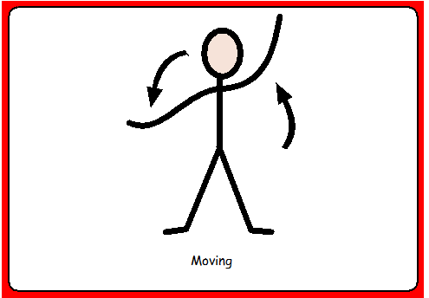
Alerting section
Encourage your child to move their body parts as independently as possible. This can be in any way they choose to begin with. Encourage them to stretch up high and then down to their toes. If appropriate, encourage your child to curl into a ball and then to stetch out their whole body.
Music: https://www.youtube.com/watch?v=fpD9kRyBn8o&list=PLwOuj-rO7Z3kSUC6yVhu0A82yqQEAn93X&index=2

Slide 3
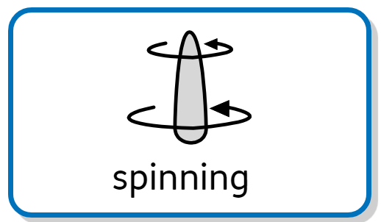

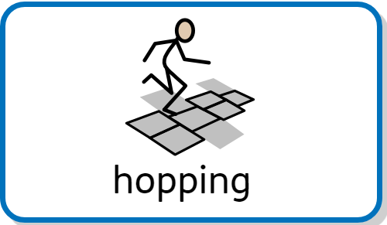

Alerting section
Depending on what is more appropriate for your own child, choose one of the movements below and encourage your child to make this movement throughout the song:
Jumping – this can be in any way that suits you child (using a trampoline or trampete is great too!)
Hopping
Skipping
Spinning
Music: https://www.youtube.com/watch?v=Z2xooz6844k&list=PLwOuj-rO7Z3kSUC6yVhu0A82yqQEAn93X&index=3

Slide 4
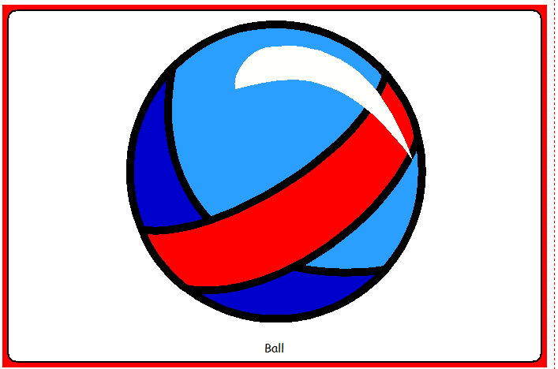
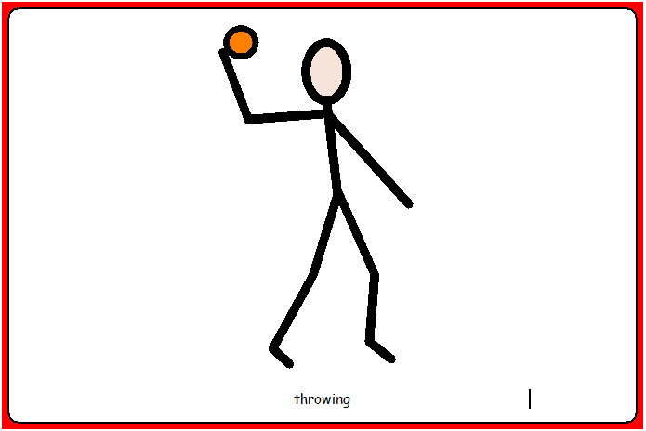
Organising section
To be supported / encouraged to throw or roll the balls.
If you have one, and appropriate, encourage your child to throw and catch, or to throw the ball into a target.
Music: https://www.youtube.com/watch?v=dUXk8Nc5qQ8

Slide 5
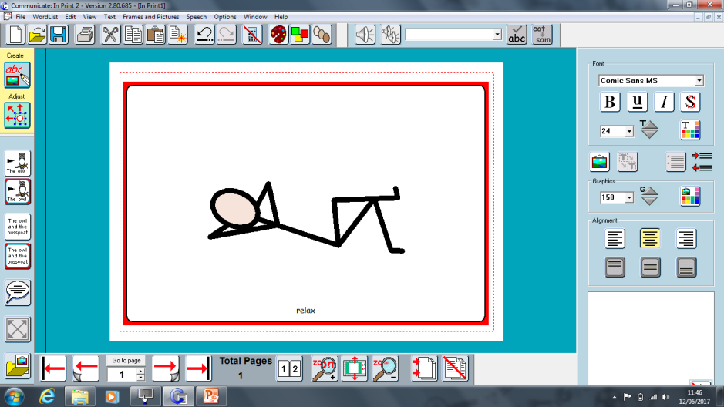
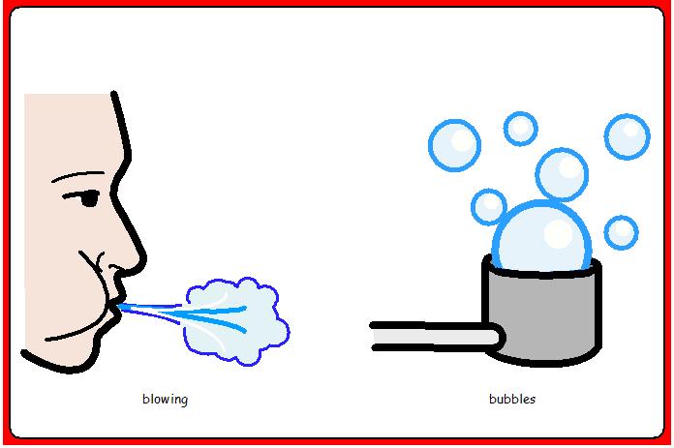
Relaxing section
Relax and listen to the music. You could blow bubbles or give a hand/foot massage. If your child likes deep pressure or vibrating resources such as massagers or cushions then this would be a great time for this.
Music: https://www.youtube.com/watch?v=gxxqdrrpgZc&t=3630s

