Slide 1
Sensory Circuits
See separate information sheet for the purpose of sensory circuits. Follow through the powerpoint with your child, encouraging them to take part in each stage. The music links are on the bottom of each slide but feel free to use different music if you wish!
Resources Needed:
pompoms / scarves / materials (or you could make home made pompoms with strands of tissue paper tied together)
balls
Bubbles

Slide 2
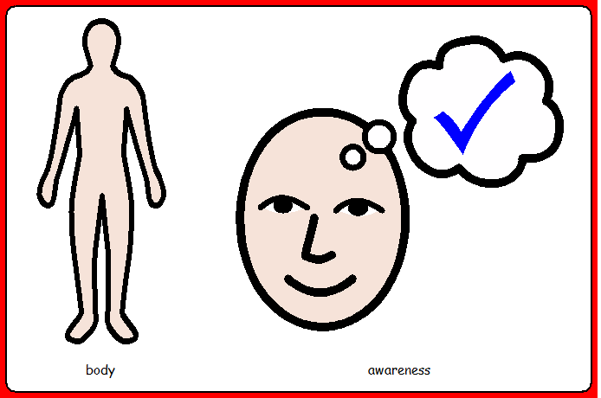
Action song:
Children to be supported to move the parts of their body along with the song.
Music: https://www.youtube.com/watch?v=oLaJ4jyKBUY

Slide 3
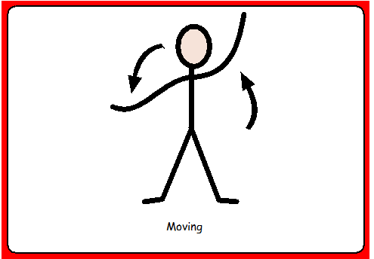
Support your child to move / encourage your child to independently move their arms, legs and bodies.
Music: https://www.youtube.com/watch?v=cZeM18fPbvI

Slide 4
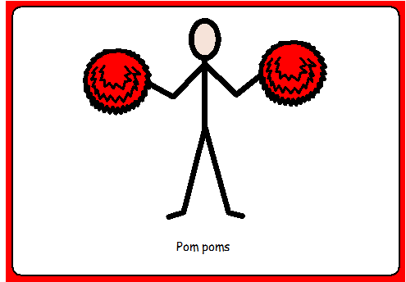
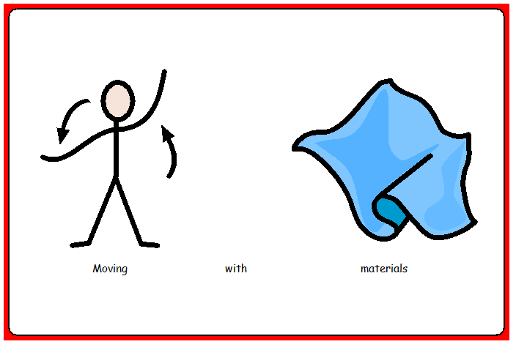
Children to be supported to move with the pom poms and scarves and to feel them on their body.
Alternatively you could use a variety of textured materials to move with or make pompoms using strips of tissue paper.
Music: https://www.youtube.com/watch?v=Z2xooz6844k&list=PLwOuj-rO7Z3kSUC6yVhu0A82yqQEAn93X&index=3

Slide 5
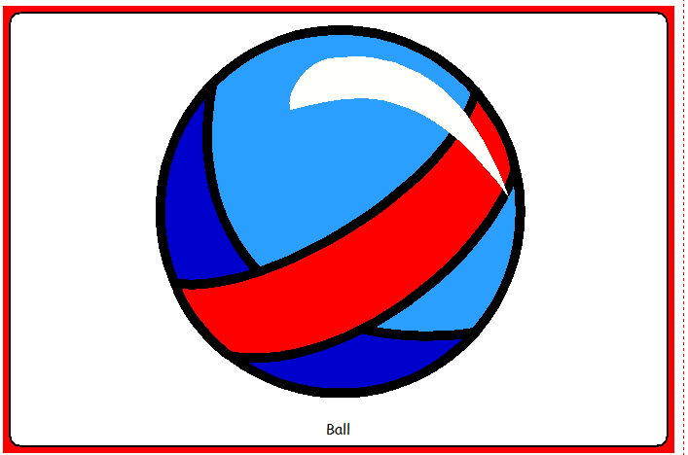
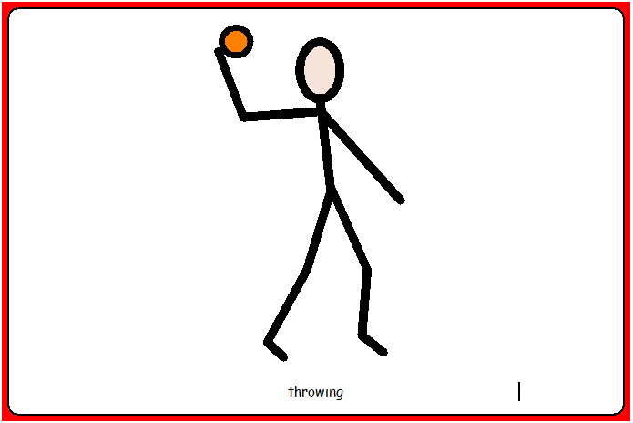
Children to be supported to explore the balls. To be supported / encouraged to throw or roll the balls.
If you have one, and appropriate, your child could also sit to bounce on an exercise ball.
Music: https://www.youtube.com/watch?v=dUXk8Nc5qQ8

Slide 6
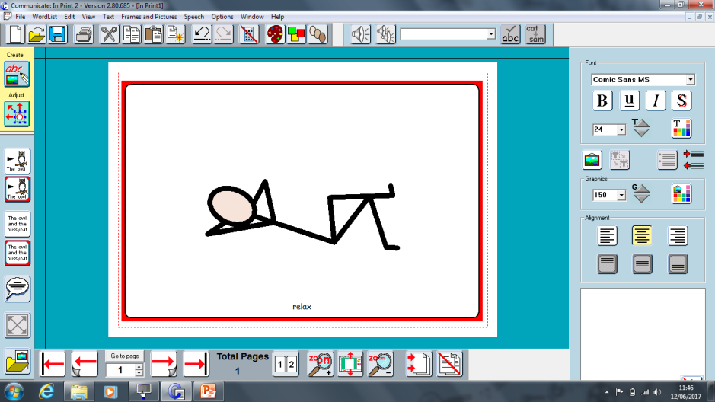
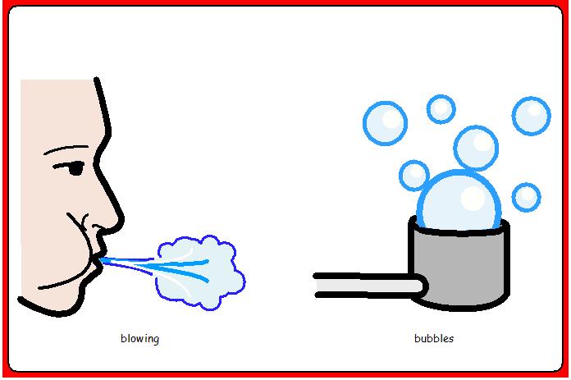
Relax and listen to the music. You could blow bubbles or give a hand/foot massage.
Music: https://www.youtube.com/watch?v=gxxqdrrpgZc&t=3630s

